Slide 1
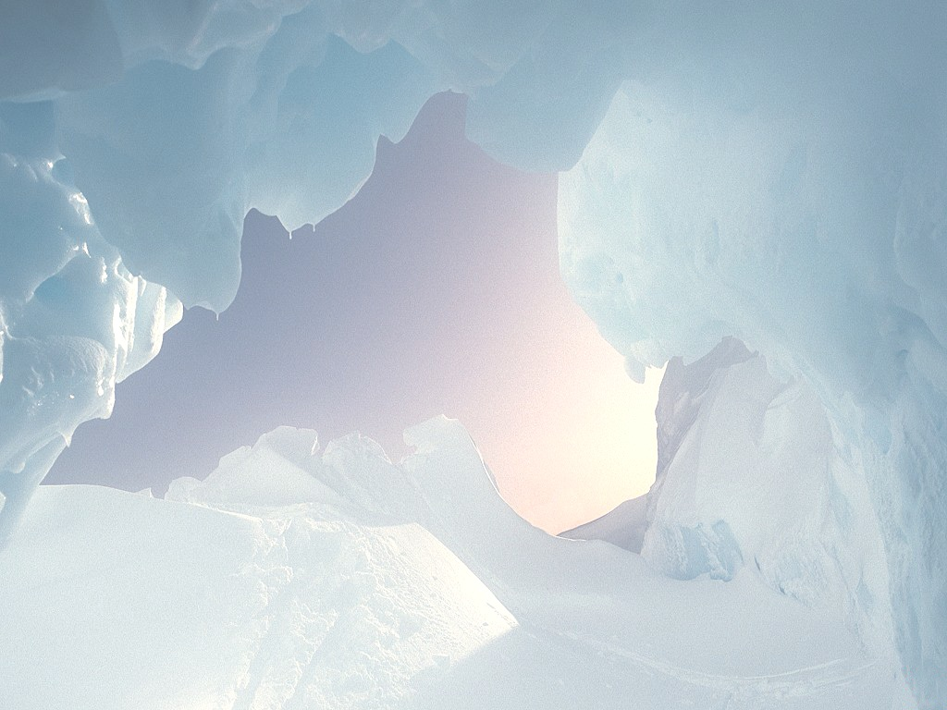
Holistic Ice Sheet Modeling: A First-Order Approach and Study
Shrae Ashley
Jarvis Christian College
&
Keila Vance
Jackson State University
Mentors:
Dr. Terry Hughes,
University of Maine, Climate Change Institute
&
Dr. Malcolm LeCompte,
Center of Excellence in Remote Sensing Education and Research,
Eliz. City State University.

Slide 2
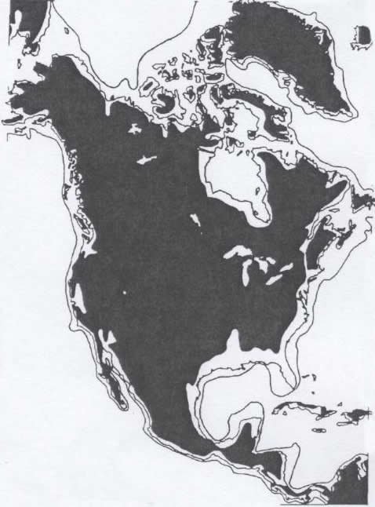
Introduction: Past, Present, and Future Shorelines
Past, present and future shorelines of Greenland, North & Central America are shown as polar ice sheets shrink from the last Glacial maximum to an ice-free Earth.

Slide 3
Research
A first-order ice sheet model was derived from simple geometrical consideration of the force balance
Model provides a first-order estimate of floating ice sheet thickness as it spreads across land, progressing from Sheet- to Stream- to Shelf-Flow
  Sheet-Flow: a grounded ice sheet with 100% of its weight lies on the bed
  Stream-Flow: a mass of ice, flowing toward the sea whose basal surface is partially afloat and partially grounded
  Shelf-Flow: a large floating area of ice
Ice Sheet thickness decreases from the grounded sheet to its thinnest where it is 100% afloat at the grounding line boundary
Free floating ice shelves continue to thin due to the force of gravity and difference in density between ice and water

Slide 4
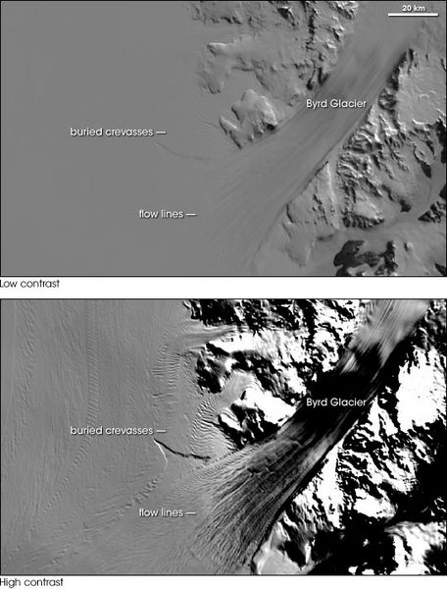
Byrd Glacier from Space
The most dynamic component of the cryosphere are the major ice streams.
Ice stream ablation is a major contributor to sea level rise
Understanding ice stream flow improves ability to predict of their contribution to sea level increase.
MODIS Imagery of Byrd Glacier, 11/20/03 and 2/29/04, http://earthobservatory.nasa.gov/
Byrd Glacier, one of the fastest
moving ice streams, accounts for a large fraction of the total drainage from the East Antarctic Ice Sheet to the Ross Ice Shelf

Slide 5
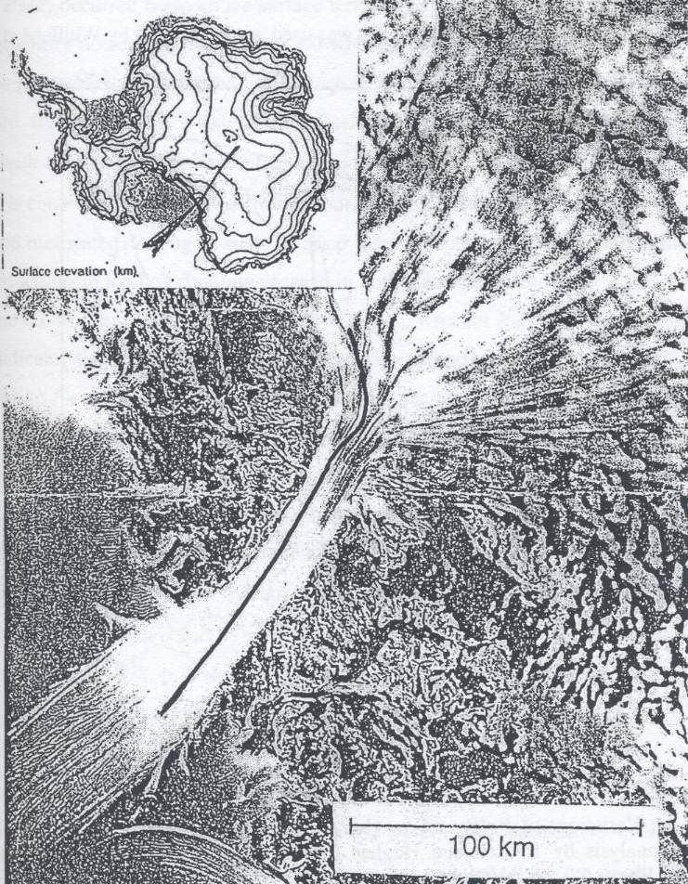
Byrd Glacier: Measured Thickness
RADAR measurements of the thickness of Byrd Glacier along the flightline
  Flight path shown as black line progressing up the fjord
The glacier is an ice sheet at the upper right progressing as an ice stream through its fjord flowing to the lower left.
What would the fjord look like without the glacier and the Ross Ice Shelf (lower left)?

Slide 6
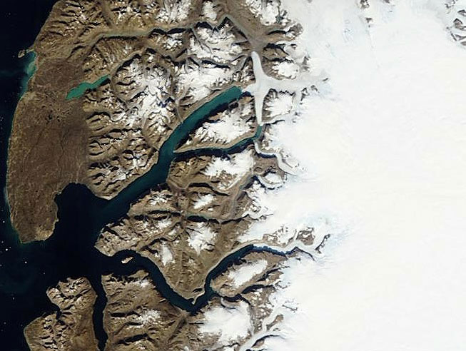
Greenland East Coast Ice Sheet, Ice Streams and Thawed Fjords (reversed)

Slide 7
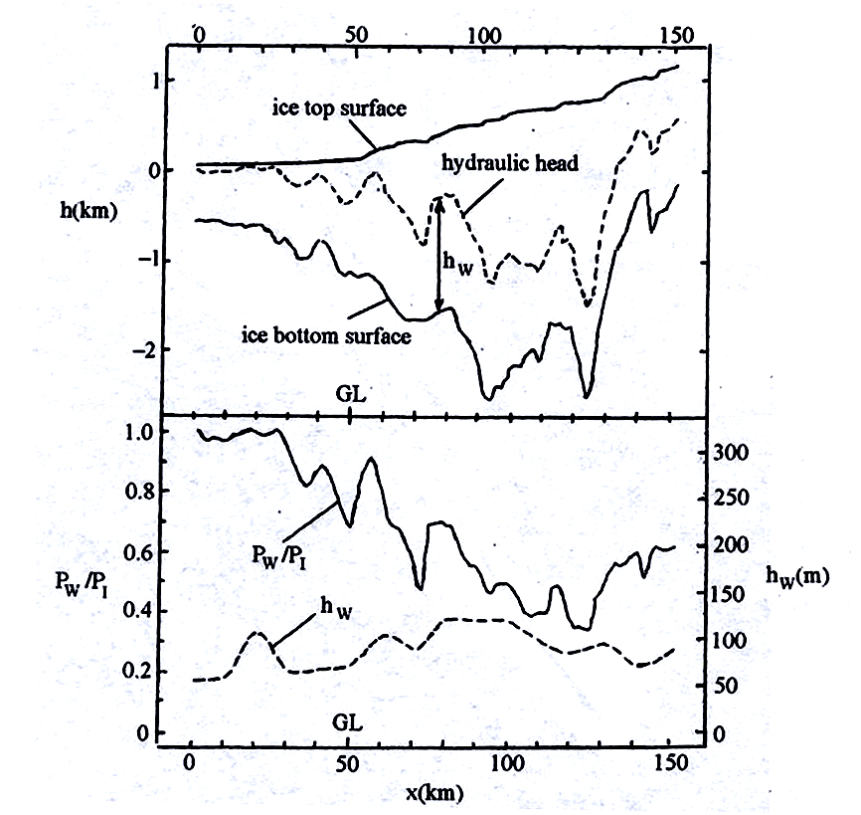
Byrd Glacier Data and Model Results
The top graph shows the results of the RADAR data providing ice sheet thickness.
The lower graph shows the results of a model interpretation of the data with regard to the ice stream’s basal water to basal ice pressure (P_{w}/P_{I}), which we call floating fraction Phi (Φ).

Slide 8
Hypothesis
An ice sheet proceeds from totally grounded sheet flow to partially floating stream flow to totally floating shelf flow based on the relative coupling of the ice to its bed, given by the floating fraction
Increases in sea level reduce the coupling and lead to faster stream flow and thinner streams
The first-order model captures the variability of bed coupling through the parameter “Φ” defined as the floating fraction of the ice stream
  Φ = 0 for totally grounded ice
  Φ = 1 for totally floating ice
  The derived first-order value for Φ = h_{o}/h_{I}
  h_{I} is the ice thickness at distance x from the grounding line
  h_{o} is the ice thickness at the grounding line, where x = 0

Slide 9
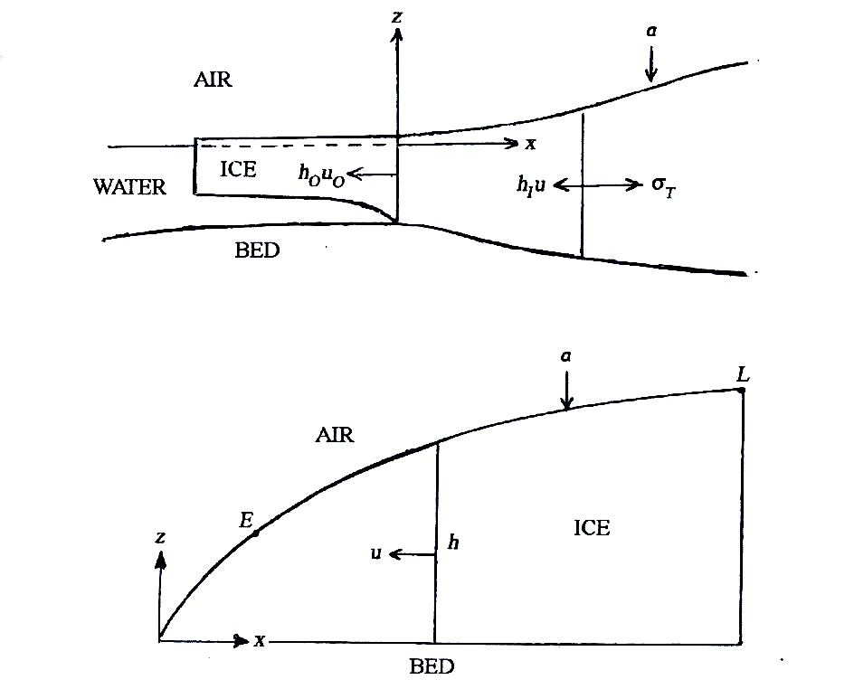
First-Order Model
The mass balance is shown for an ice-sheet flowband ending in water (top) and on land (bottom).
Ice entering from the right and top leaves at left.

Slide 10
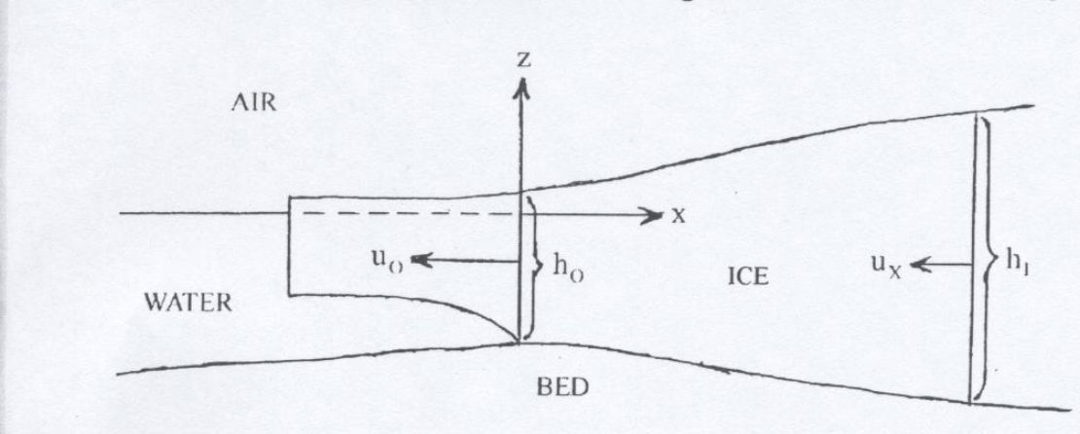
The Floating Fraction Φ
In our first-order model, floating fraction Φ is the ratio of ice thickness h_{o} at the grounding line to h_{I} at distance x in from the grounding line.
This ratio is obtained from a force balance in the x direction. Handouts giving this derivation are available upon request.

Slide 11
Procedure
Tabulate ice thickness (h_{I}) from airborne RADAR measurements of Byrd Glacier surface elevation and basal depth.
Calculate first-order, data-derived Phi (Φ) from h_{I} measurements and the ice thickness measured at the grounding line h_{o} : Φ = h_{o}/h_{I}
Compare first-order Φ variation profile with that derived from a higher order model, Φ = P_{W}/P_{I}
Compute simple functional forms of Φ variation and derive their associated first-order thickness (h_{I}) profiles.
Compare each calculated Φ with those derived from measurements of Byrd Glacier.

Slide 12
Floating Fraction Φ By Model
Blue is Φ from data (Φ = h_{o}/h_{I})
Pink is Φ from higher order model (Φ = P_{W}/P_{I})
Yellow is linear Φ (Φ = 0.8x/L + 0.2)
Purple is periodic Φ for quarter period: (Φ=cos²(π•x/(2•L))
Orange is periodic Φ for 3/8 of a period: [Φ = cos²(3•π•x/(4•L))]

Slide 13
Variation of Φ By Model
Blue curve is 1st Order Φ derived from RADAR ice thickness.
Pink shows Higher Order Model Phi (Φ =P_{w}/P_{I}) from RADAR data.
Green is the First Order Φ = h_{o}/h_{I} varying as cosine squared through 3/8 of a period

Slide 14
Ice Thickness By Model
Blue curve is ice measured thickness.
Pink shows ice thickness derived from the Higher Order Model Phi (Φ =P_{w}/P_{I})
Green is ice thickness derived from 1st Order Φ varying as Φ = cos²(3•π•x/(4•L)) for 3/8 of a period

Slide 15
Results
The floating fraction Φ initially decreases with distance from the grounding line.
Initial decrease in Φ is reflected in increasing ice thickness approaching the grounded ice sheet.
Increase in Φ at large x indicates uncoupling of the ice from the bed as East Antarctic ice converges on Byrd Glacier. This increases ice velocity, therefore basal friction, therefore basal melting, therefore floating fraction Φ.

Slide 16
References
Hughes, T.J. “Holistic Ice Sheet
ing: First-Order Approach” A CRESIS Publication,University of Maine, 2006
Hughes, T.J. and J. L. Fastook (1981). Byrd Glacier: 1978- 1979 field results. Antarctica Journal of the United States 16(5): 86-89.
Jezek, K. C., Ed. (1998) Early results from the first RADARSAT 1 Antarctica Mapping Mission. Byrd Polar Research Center Technical Report No. 98-02. Seattle, Byrd Polar Research Center, The Ohio State University, 22 pages.
Reusch, D. and T. J. Hughes (2003). Surfaces “waves” on Byrd Glacier. Antarctica Science 16(4) 547-555

Slide 17
Calculations
The excel spreadsheet shows:
  Phi (Φ) calculated by tabulating measured values of ice thickness h_{I} along the stream away from the grounding line where thickness is h_{o}
  Phi (Φ) derived from a higher order model
    Φ = P_{w}/P_{I}
  Simple functional forms showing Φ variation with distance from the grounding line and the derived ice thickness (h_{I}) profiles.

Slide 18
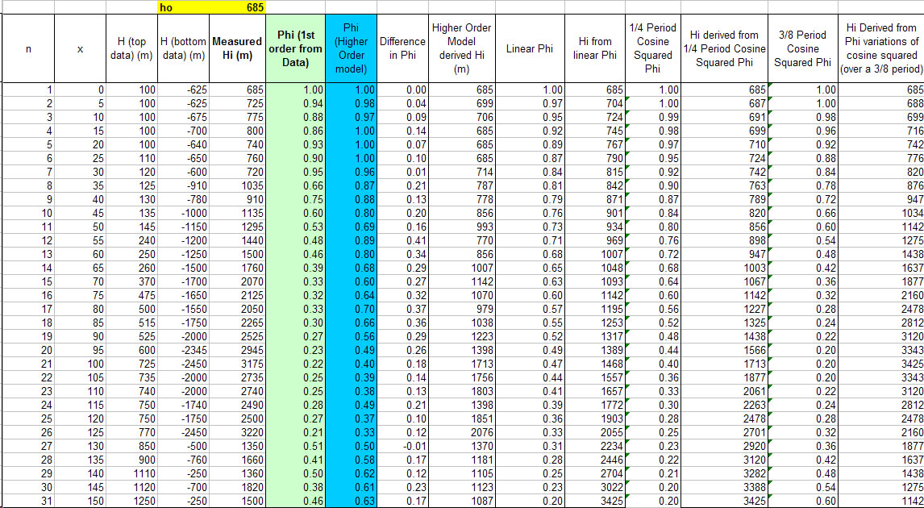
Calculations cont’d

