Slide 1

The Mass Balance Along a Flowband of Width w_{I}

Slide 2
Figure 1: Mass balance along an ice-sheet flowband

Slide 3
Mass balance Equation along x
(δh₁/δt)x = ax - (u_{x}h_{I} - u₀h₀) (1)

Slide 4
Mass balance at x
δh_{I}/δt = a - δ(u_{x}h_{I})/δx = a - u_{x}dh_{I}/dx - h_{I}du_{x}/dx (2)

Slide 5
Solving (2) for dh_{I}/dx
dh_{I}/dx = (a - δh_{I}/δt)/u_{x} - h_{I}(du_{x}/dx)/u_{x}
= (a - δh_{I}/δt)/u_{x} - h_{I}ε_{xx}/u_{x} (3)

Slide 6
Substituting for u_{x} from (1)
dh_{I}/dx = [h_{I}(a - δh_{I}/δt)]/[(a -δh_{I}/δt)x + u₀h₀]
-h_{I}²ε_{xx}/[(a - δh_{I}/δt)x + u₀h₀] (4)

Slide 7
Ignoring accumulation rate and thinning rate
dh_{I}/dx = - h_{I}²ε_{xx} / u₀h₀ (5)

Slide 8
Using the flow law
ε_{xx} = R(σ/_{xx}/A)^{n} = (σ _{T}/2A)^{n} (6)
where R = 1 and σ/_{xx} = σ_{T}/2 for tensile flow

Slide 9
Figure 2: A flowband profile

Slide 10
From Figure (2)
σ_{T} = (1/2)ρgh_{I}(1 - ρ_{Ι}/ρ_{w})(P_{w}/P_{I})²
= (1/2)ρ_{I}gh_{I}(1 - ρ_{Ι}/ρ_{w})φ² (7)

Slide 11
Substitute the flow law for ε_{xx} and Δh_{I}/Δx for dh_{I}/dx
dh_{I}/dx = - h_{I}²ε_{xx} / u₀h₀
Δh_{I}/Δx = -[(ρ_{Ι}g / 4A)(1-ρ_{I}/ρ_{w})]³(h_{I}⁵φ⁶/u₀h₀) (8)
where grounding line velocity u₀ is negative
Equation (8) is solved for φ for Byrd Glacier

Slide 12
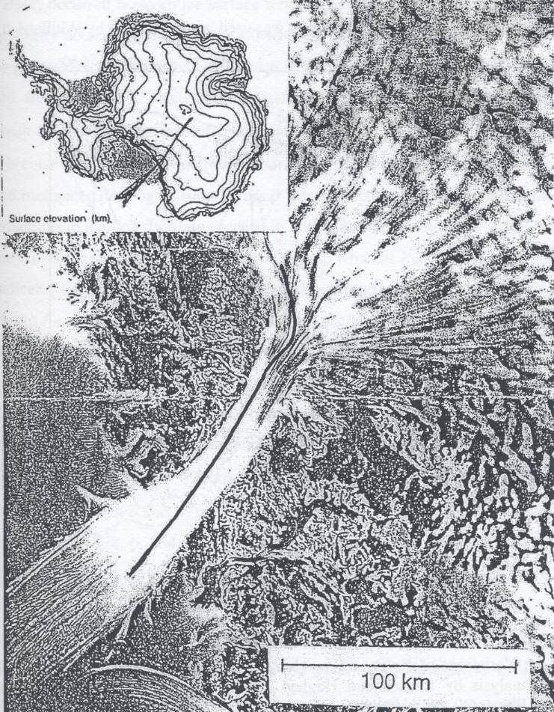
Figure 3: Byrd Glacier showing radio-echo flight line

Slide 13
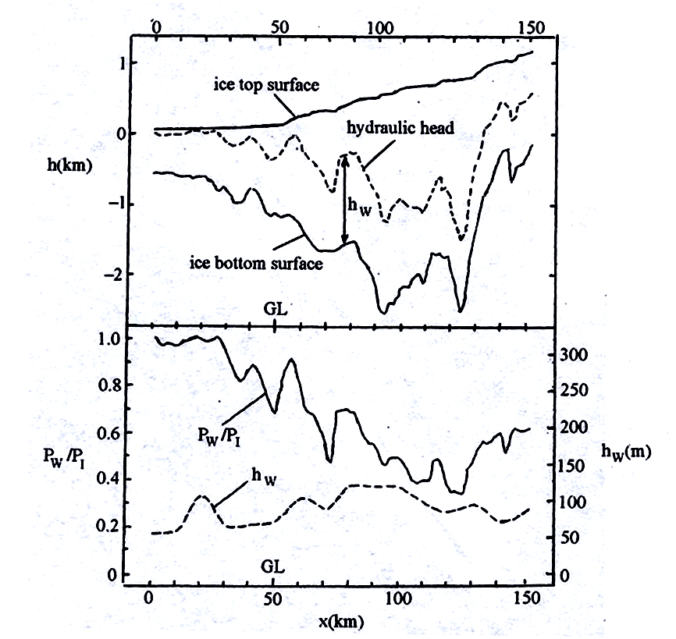
Figure 4: Results along flightline from Reusch and Hughes (2003)

Slide 14
Results from Equation (8)

Slide 15
Results from Vance and Ashley

Slide 16
Results for floating ice
The first two 5 km steps gave φ = 0 from
Equation (8) because Byrd Glacier was
afloat with a basal melting rate of 12 m/a
and Δh_{I}/Δx = 0. Then Equation (3) is:
dh_{I}/dx = (a - δh_{I}/δt)/u_{x} - h_{I}(du_{x}/dx)/u_{x}
= (a - δh_{I}/δt)/u_{x} - h_{I}ε_{xx}/u_{x}= 0 (9)

Slide 17
Equation (9) for floating ice
Solving Equation (9) for δh_{I}/δt gives:
δh_{I}/δt = a - h_{I}ε_{xx}= a + h_{I}ε_{zz} (10)
a = -12 m/a (Kenneally and Hughes, 2004)
h_{I} = 725 m (Reusch and Hughes, 2003)
ε_{xx} = (-120 m/a)/(50 km) (Brecher, 1982)
Equation (10) gives δh_{I}/δt = -10 m/a

