Slide 1
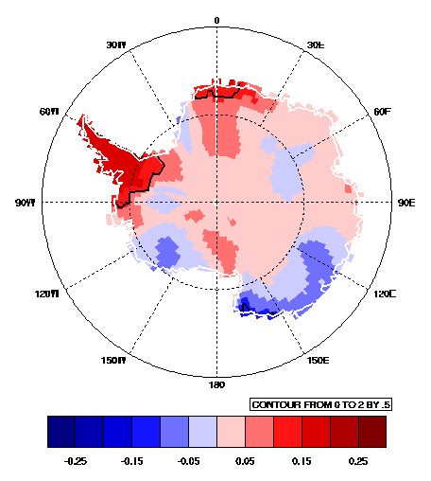

A high spatial resolution record of near-surface temperature over WAIS during the past 5 decades
Andrew J. Monaghan &
David H. Bromwich
Polar Meteorology Group
Byrd Polar Research Center
The Ohio State University
Columbus, Ohio
Research funded by NSF-OPP
Reconstructed Annual Antarctic Temperature Trends,
1960-2005 (K/decade; contours: p<0.05)

Slide 2
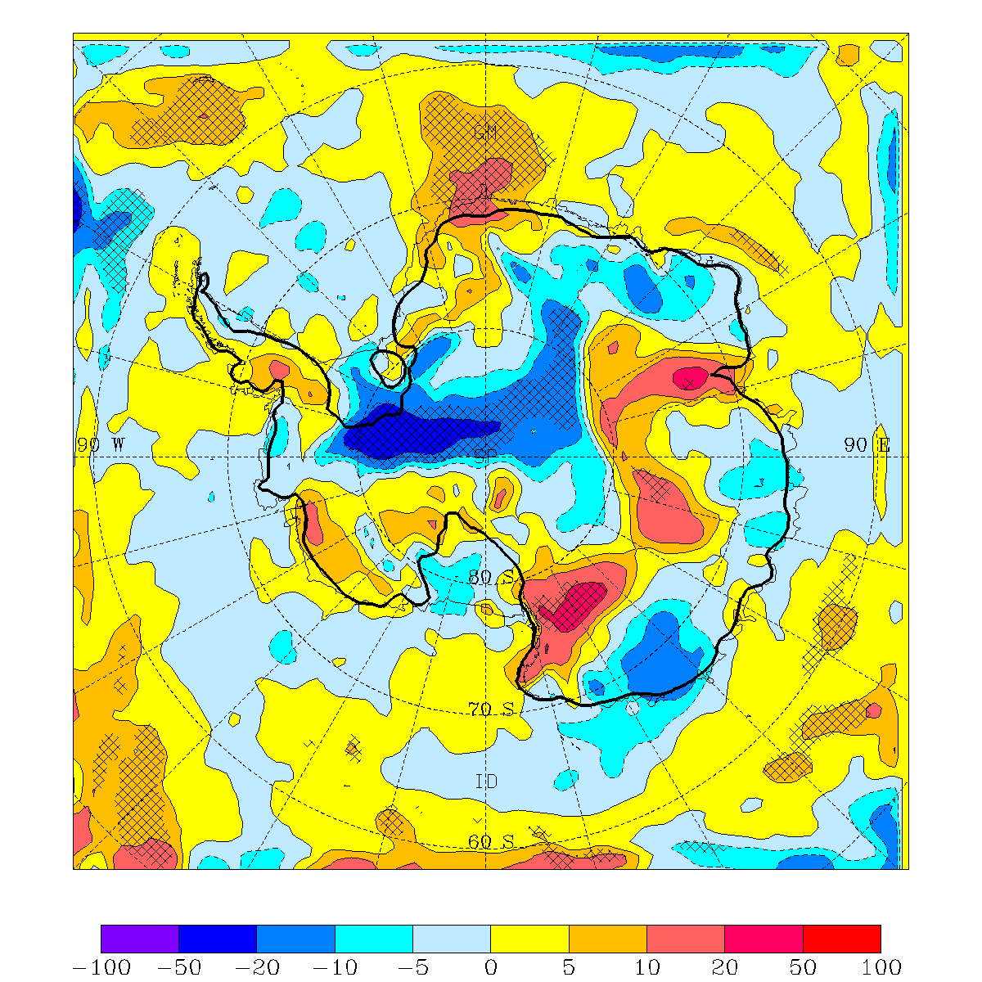
Motivation and Methodology (1)
There is a need to understand the decadal variability of snowfall and temperature over all of Antarctica in order to:
  put recent satellite-derived mass balance and temperature trends into perspective
  Understand Antarctica’s role in global sea level rise
  Provide a long-term record of snowfall and temperature for GCM assessment
Last year at WAIS we presented a record of Antarctic accumulation variability from several numerical models from 1985-2001.
  Result: No statistically significant change in snowfall since 1985.
  Problem: Model records are not reliable before ~1980. We need a longer record.
Snowfall trends, 1985-2001
(% decade⁻¹)
Monaghan et al. (PTRS-A, 2006)

Slide 3
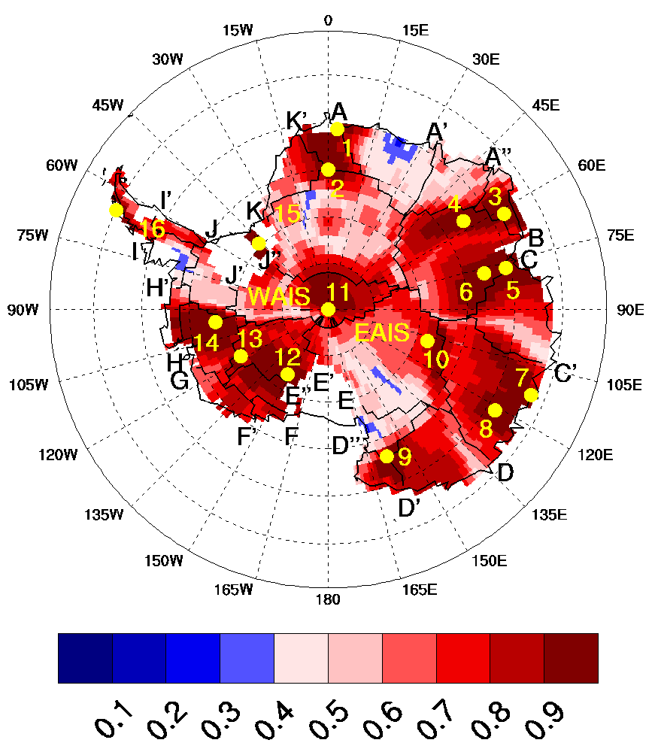
Motivation and Methodology (2)
Many new ice core accumulation records have emerged as a result of the International Transantarctic Scientific Expedition (ITASE).
By blending the ice core data with model records, we were able to reconstruct a robust snowfall record back to the IGY (results shown in next slide)
Spatial correlation of
annual snowfall variability at 16 ice core and/or human-observation locations (yellow dots) with long-term records.
(red colors: p<0.05)
Monaghan et al. (Science, 2006)

Slide 4
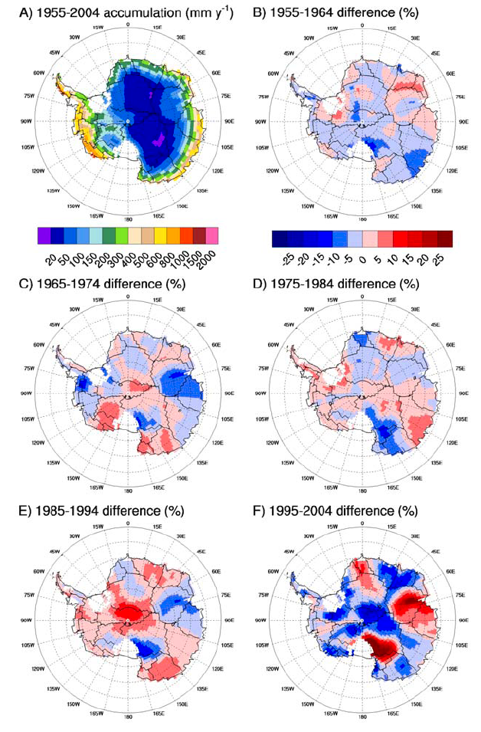
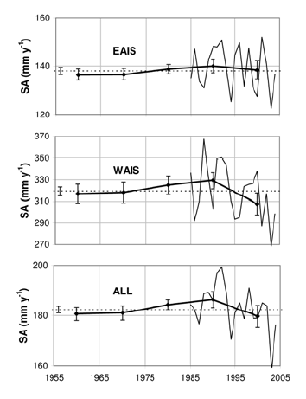
Antarctic Snowfall Trends since the IGY
Trends offsetting in space and time.
Considerable annual and decadal variability
No statistically-significant trend over the 50-year record
Monaghan et al. (Science, 2006)

Slide 5
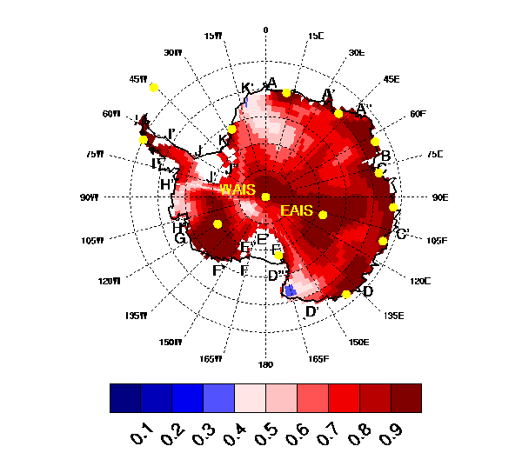
The Next Step:
Using the same methodology, here we reconstruct a temperature record back to 1960 using station data (from READER and NSIDC). The advantage of this technique is that it has spatial, in addition to temporal, resolution. Therefore, we can look at regional changes at monthly and annual scales.
Spatial correlation of
annual near-surface temperature variability at 15 Antarctic stations (yellow dots) with long-term records.
(red colors: p<0.05)

Slide 6
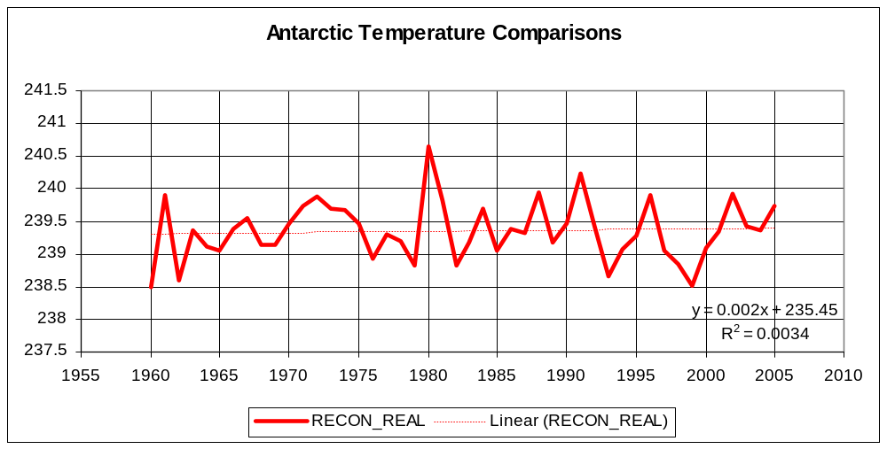
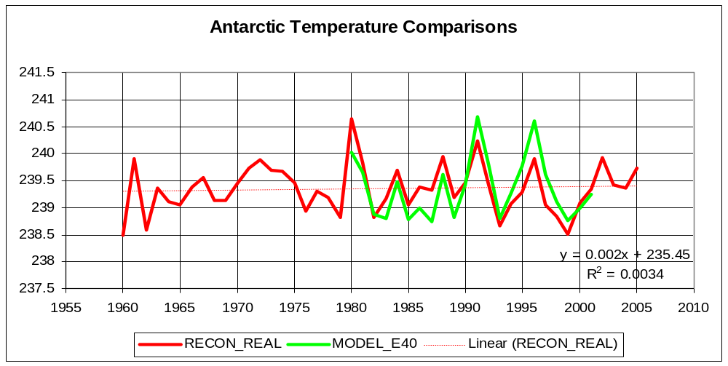
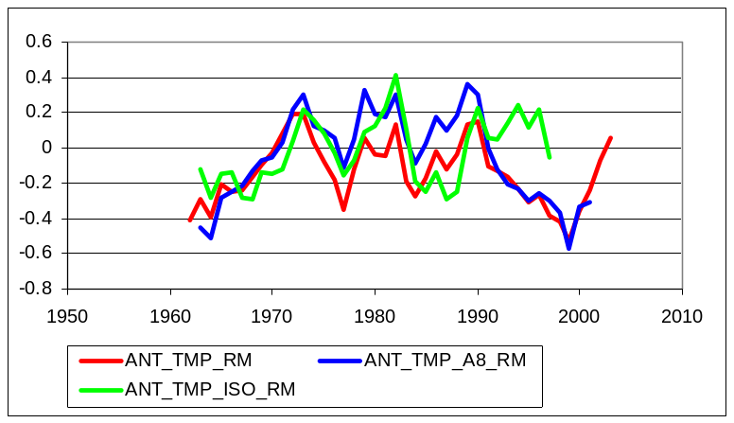
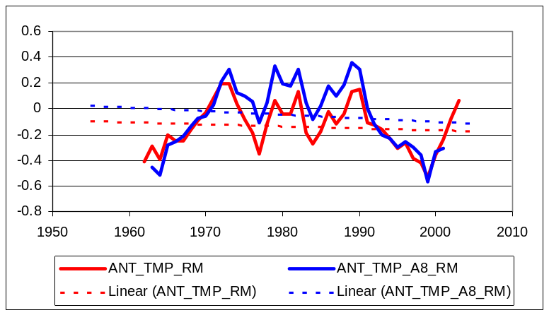
Antarctic Temperature Reconstruction:
Comparing Annual Time Series
Method Captures variability with good skill.
Model variability slightly large?
Our reconstruction closely matches that of Schneider et al. (GRL, 2006).

Slide 7
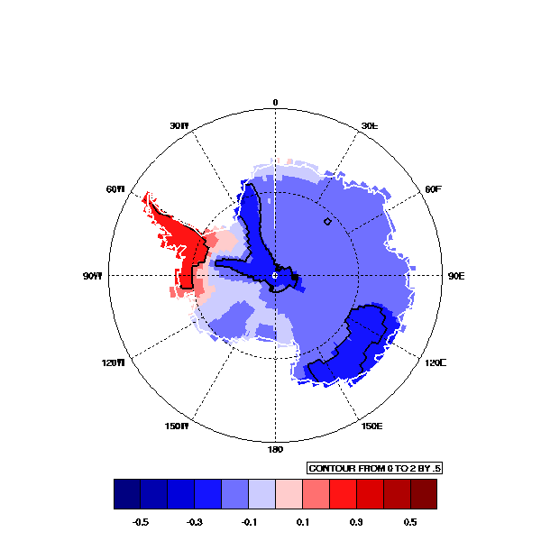
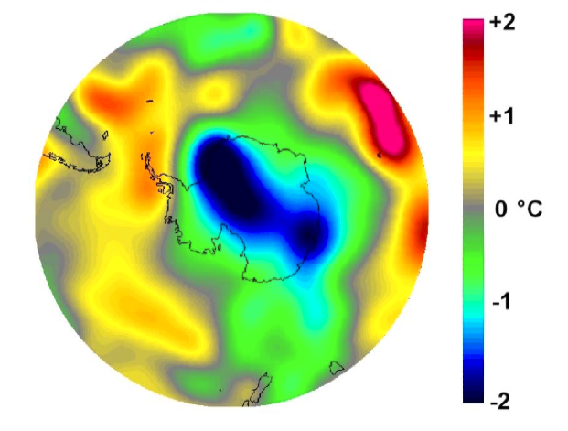
Antarctic Temperature Reconstruction:
Comparing Spatial Trends, 1969-2000
Chapman and Walsh (2005)
OUR METHOD (K/decade)
(contours: p<0.05)
KRIGED-Total Change (K)
From Station records
Trends match closely, but ours don’t have ‘kriged’ appearance
Note: We still have a ways to go in validating these temperature records. Thus, the subsequent results are preliminary.

Slide 8
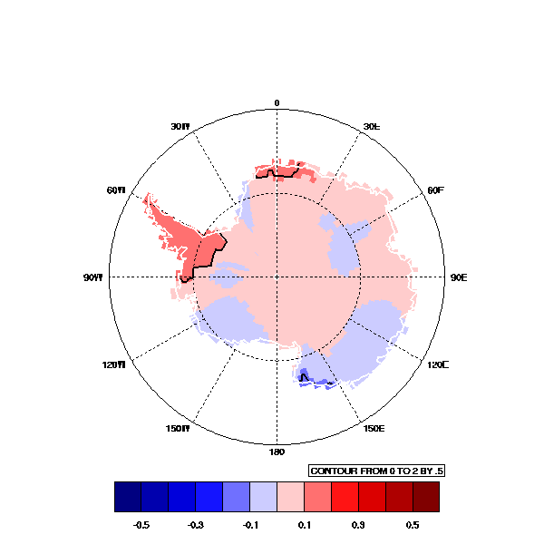
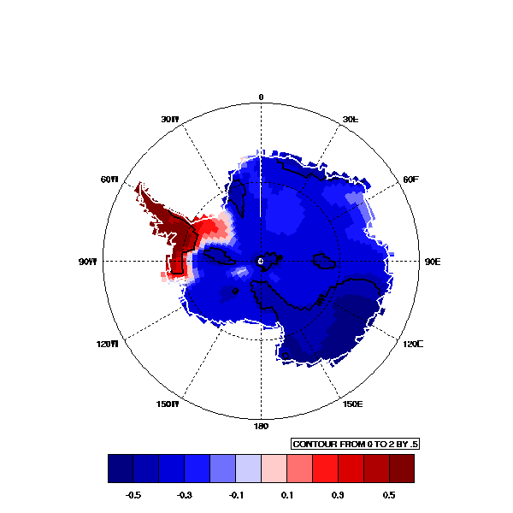
Antarctic Temperature Reconstruction:
Comparing Annual Trends (K/decade) over various periods (black contours: p<0.05)
1960-2005
1969-2000
1980-2001
Trends over continent are strongly dependent on time period.
Is recent change related to decadal variability?

Slide 9
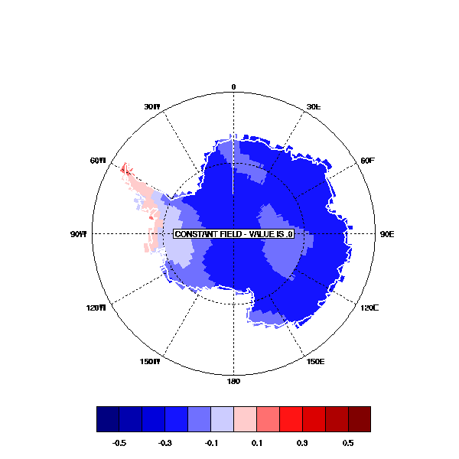
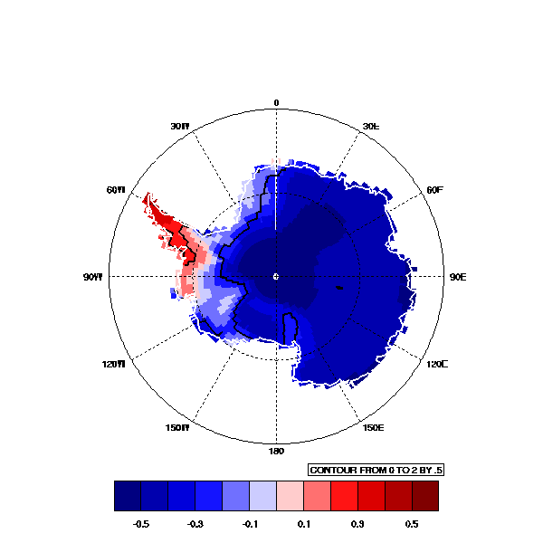
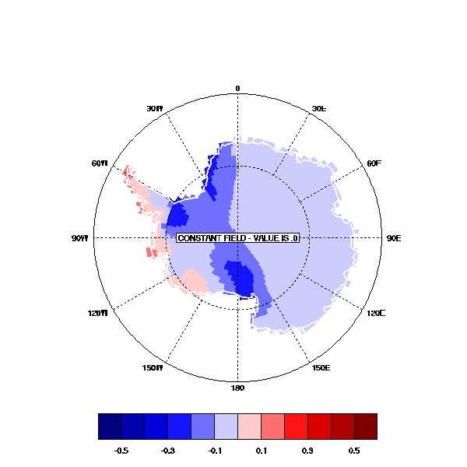
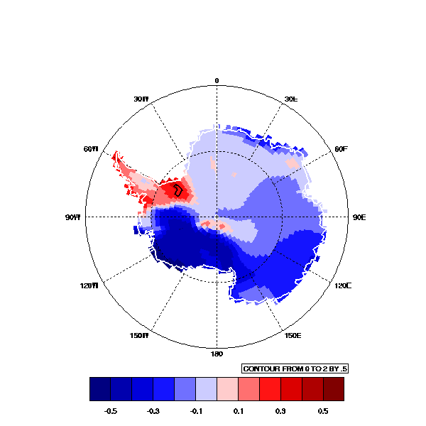
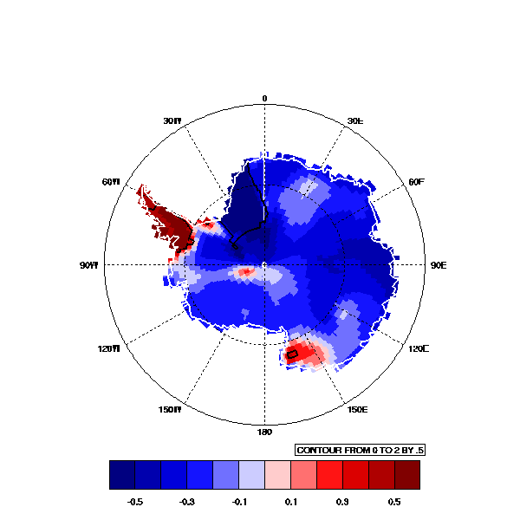
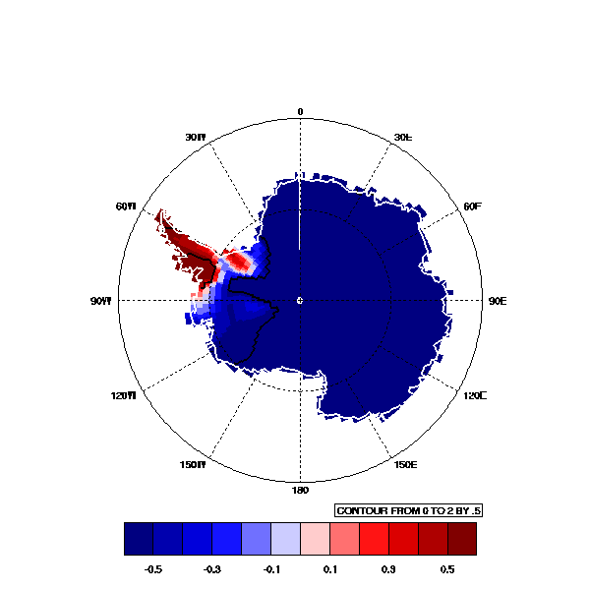
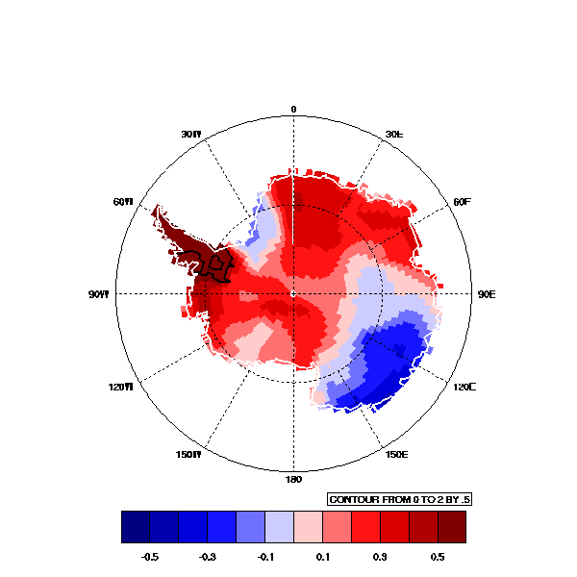
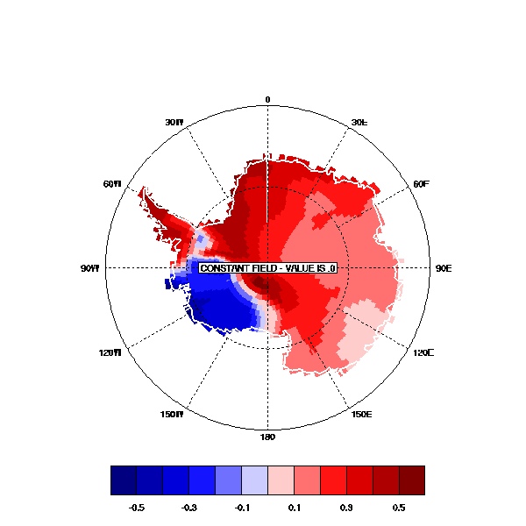
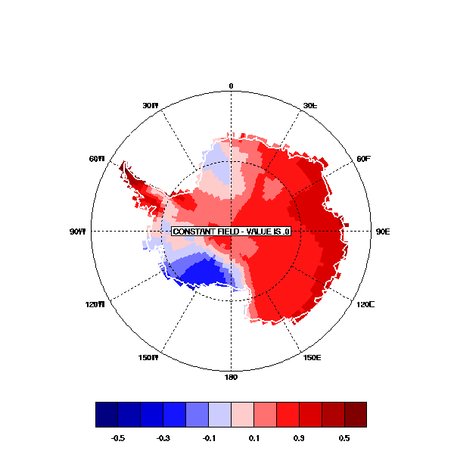
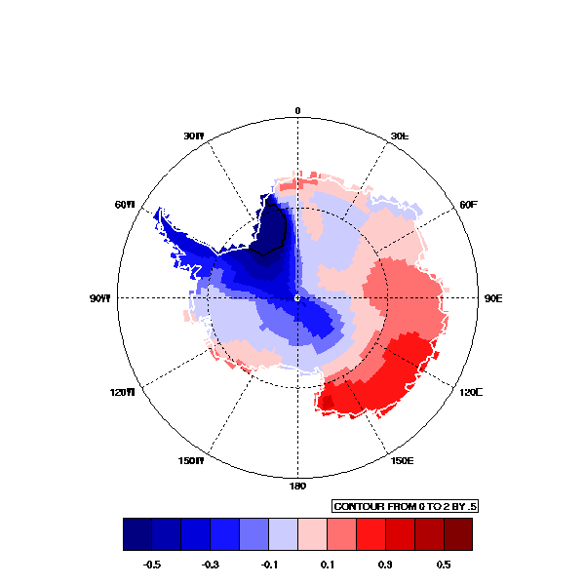
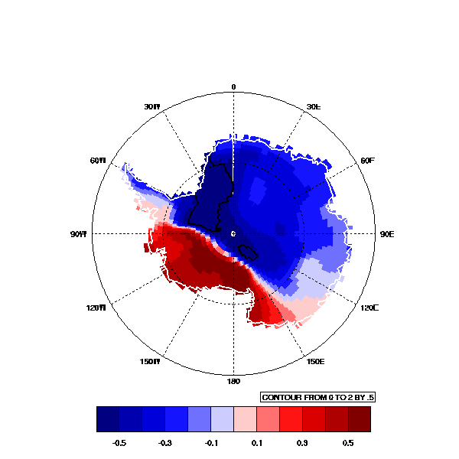
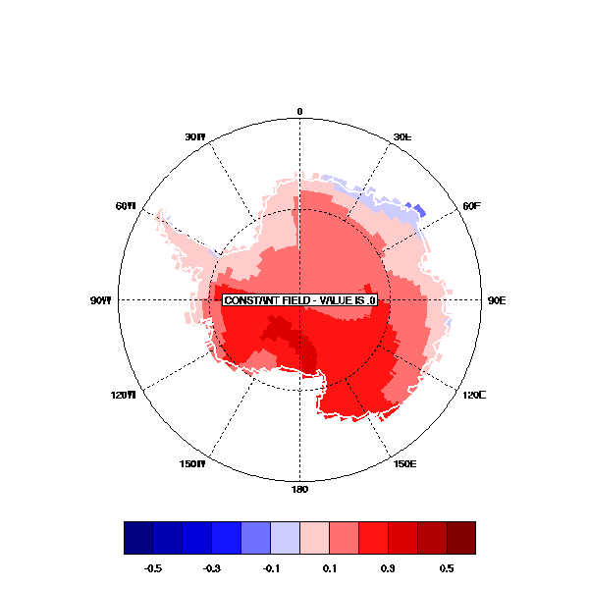
Antarctic Temperature Reconstruction:
Comparing monthly trends (K/decade)
1969-2000
DEC
JAN
FEB
MAR
APR
MAY
JUN
JUL
AUG
SEP
OCT
NOV
Summer, Autumn cooling related to strengthening of SAM
Winter surface warming consistent with tropospheric warming from Turner et al. (Science, 2006).

Slide 10
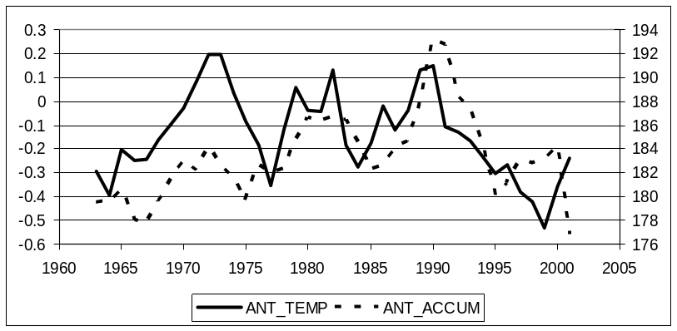
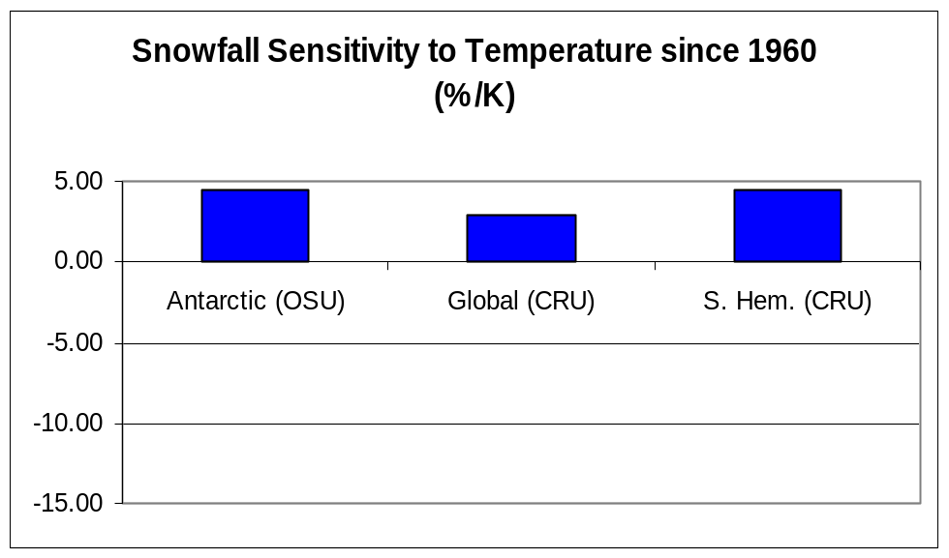
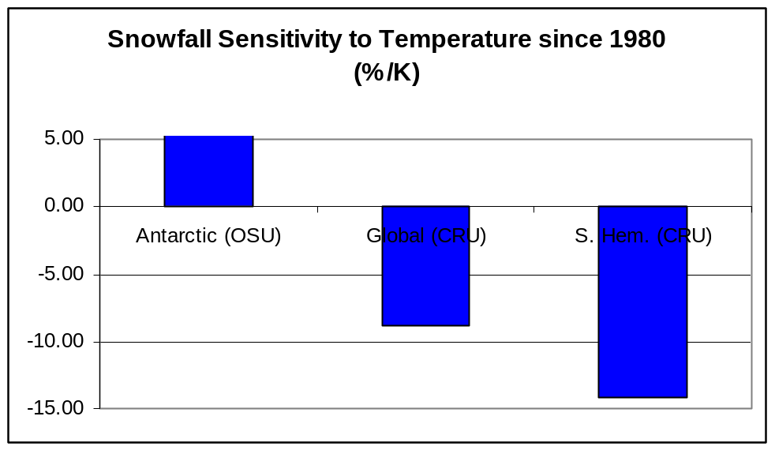
Sensitivity of Antarctic Annual Accumulation to Temperature
The extended snowfall and temperature records indicate an approximate 5%/K snowfall sensitivity to Antarctic temperature
This is consistent with AOGCM estimates from Huybrechts et al. (GPC, 2004)
Relationship is not robust for SH and global temps

Slide 11
Summary: Recent trends
Yearly and decadal snowfall and temperature variability is very large. It is critical to establish longer records from the extremely valuable satellite measurements of dH/dt, gravity fluctuations, temperature, and other parameters so that trends can be distinguished from the high background variability.
There have been no statistically significant trends in Antarctic snowfall or temperature (except the Peninsula) over the past 50-years. Sea level rise has not been offset by recently increased Antarctic snowfall, despite strong winter warming over Antarctica and year-round warming throughout the rest of the Southern Hemisphere.
These preliminary results suggest that the sensitivity of Antarctic snowfall to regional temperature changes is consistent with GCM estimates of ~5%/K. However, the linkage with the temperature behavior over Antarctica is complex and arises because of changes in the atmospheric circulation.
If Antarctic temperature changes become consistent with the rest of the globe in coming decades, as GCMs predict (due in part to the healing of the ozone hole), a rise in Antarctic snowfall is possible.
LOTS OF MODEL OUTPUT AVAILABLE: http://polarmet.mps.ohio-state.edu

