Slide 1
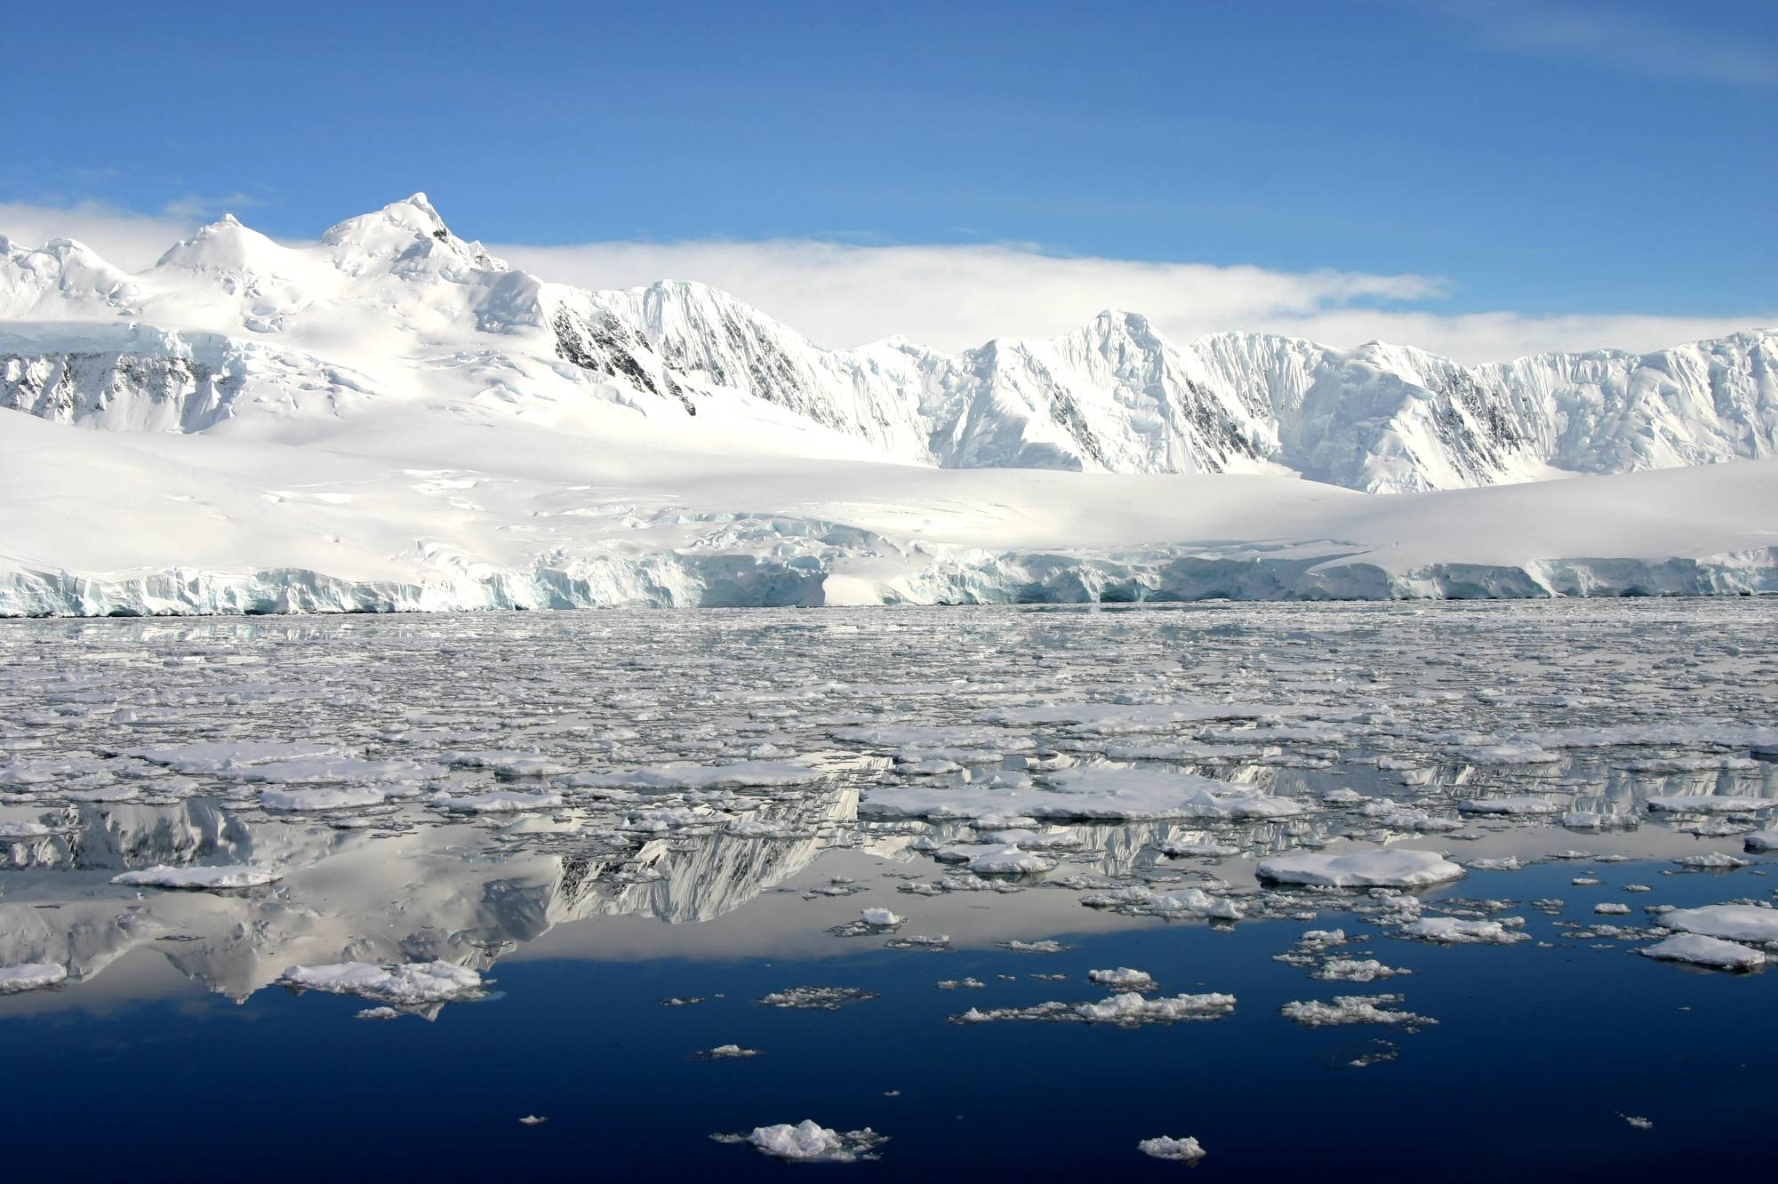

Advances in describing recent Antarctic climate variability
David H. Bromwich &
Andrew J. Monaghan
Polar Meteorology Group
Byrd Polar Research Center
The Ohio State University
Columbus, Ohio
Funded by NSF-OPP (Glaciology)
David H. Bromwich &
Andrew J. Monaghan
Polar Meteorology Group
Byrd Polar Research Center
The Ohio State University
Columbus, Ohio
Funded by NSF-OPP (Glaciology)
Credit: Zee Evans, NSF. The view from the Gerlache Strait between Anvers Island and the Antarctic Peninsula.

Slide 2
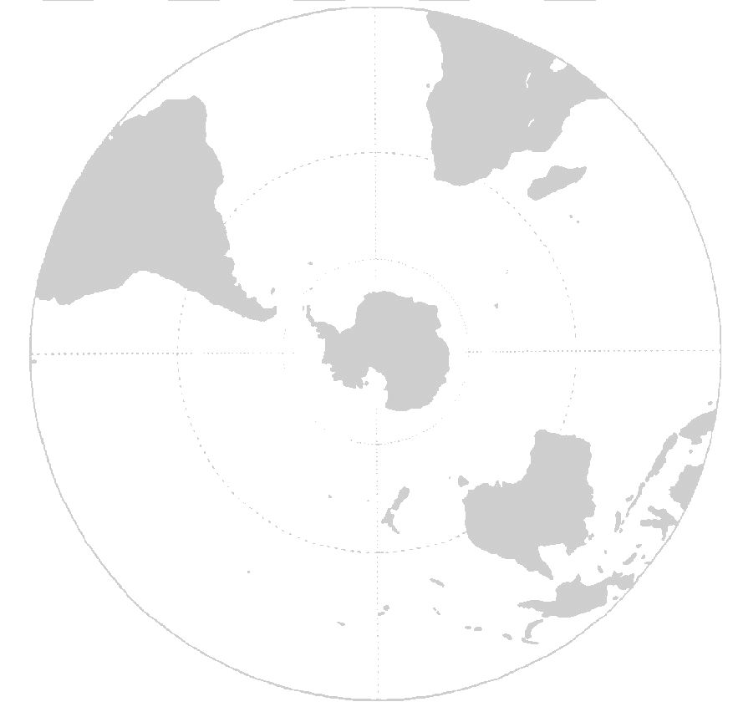
Background
The Polar Meteorology Group at Ohio State recently completed a 3-year project funded by NSF-OPP to better understand Antarctic surface mass balance. Accomplishments include:
  Simulating Antarctic snowfall variability (and climate) with a mesoscale atmospheric model (Polar MM5) from 1979-2002 (Monaghan et al. 2006a).
  Extending the record of Antarctic snowfall accumulation back to 1955 by blending atmospheric model fields with the ice core records from ITASE (Monaghan et al. 2006b).
  Extending the record of Antarctic near-surface temperature back to 1960, at the basin-scale, so that climate variability can be assessed in individual glacial drainages (Monaghan et al. 2007, accepted).
  Assessing the sensitivity of Antarctic snowfall to near-surface temperature fluctuations so that future changes in snowfall can be estimated and global climate model (GCM) projections can be assessed (Monaghan and Bromwich, submitted 2007; Bromwich et al. in preparation).
Here we present some recent results. The data generated during this project can be obtained through the Antarctic Master Directory, or by contacting us (bromwich.1@osu.edu).

Slide 3
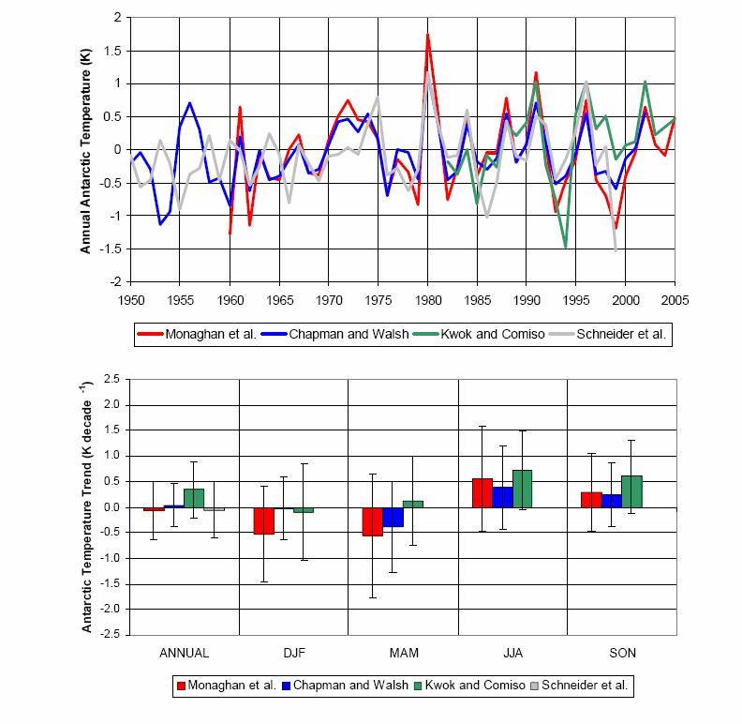
Antarctic Near-Surface Temperature Datasets
Time Series →
Trends →
(1982-2002)
(K decade⁻¹)
Monaghan and Bromwich
(BAMS, submitted)

Slide 4
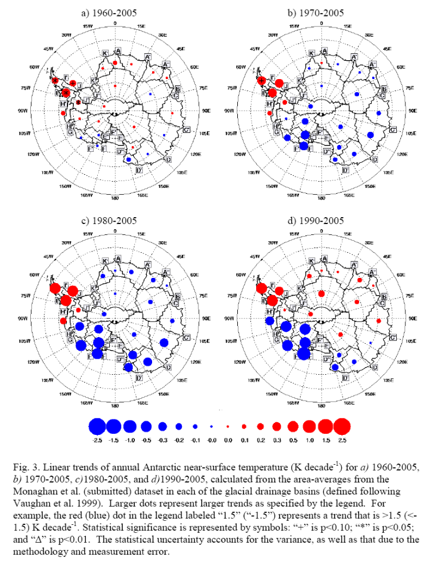
Antarctic Annual Near-Surface Temperature Trends
(K decade⁻¹)
From Monaghan et al. (2007, accepted)
1960-2005
1970-2005
Strength and sign of trends depends on period analyzed.
Statistical significance only over Peninsula for long periods
Independent validation (not shown) indicates that reconstruction is remarkably good over EAIS.
Over WAIS, there is less constraint. However, summer trends agree with satellite melt records (Picard and Fily 2007)
1980-2005
1990-2005
“+”: p<0.10
“*”: p<0.05
“∆”: p<0.01
Monaghan and Bromwich
(BAMS, submitted)

Slide 5
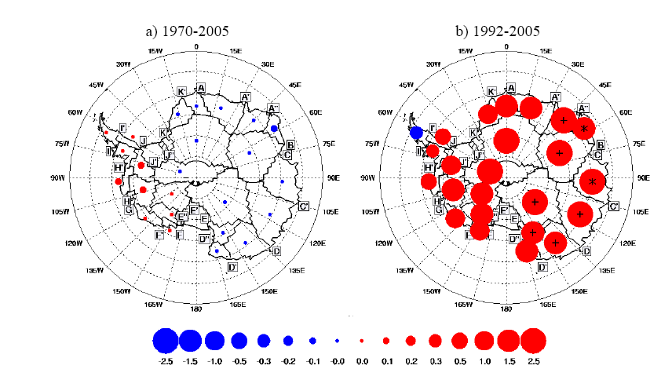
December Near-Surface Temperature Trends
(K decade⁻¹)
1970-2005
1992-2005
“+”: p<0.10
“*”: p<0.05
“∆”: p<0.01
Strong, widespread December (summer) warming starts in ~1992, consistent with leveling off of the Southern Annular Mode (SAM). It is still too early to determine whether this is a decadal fluctuation or related to anthropogenic change.
Monaghan and Bromwich
(BAMS, submitted)

Slide 6
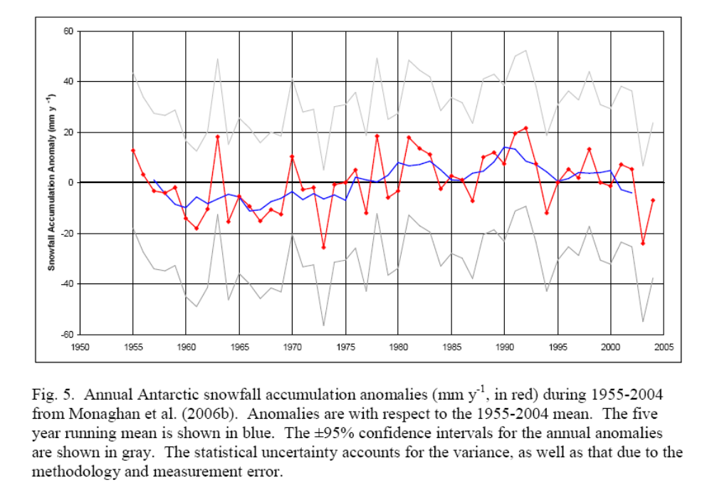
Antarctic Annual Snowfall Accumulation
(mm y⁻¹)
Updated for annual variance from Monaghan et al. (2006b)
Slow upward trend through the mid-1990s, but downward thereafter.
The 5-year running mean (blue) suggests that there may be a cyclic signal that oscillates at 50-y timescales (with approximately the same timing as the Pacific Decadal Oscillation (PDO)). Ekaykin et al. (2004) also noted a PDO signature in Vostok snow pits.
Monaghan and Bromwich
(BAMS, submitted)

Slide 7
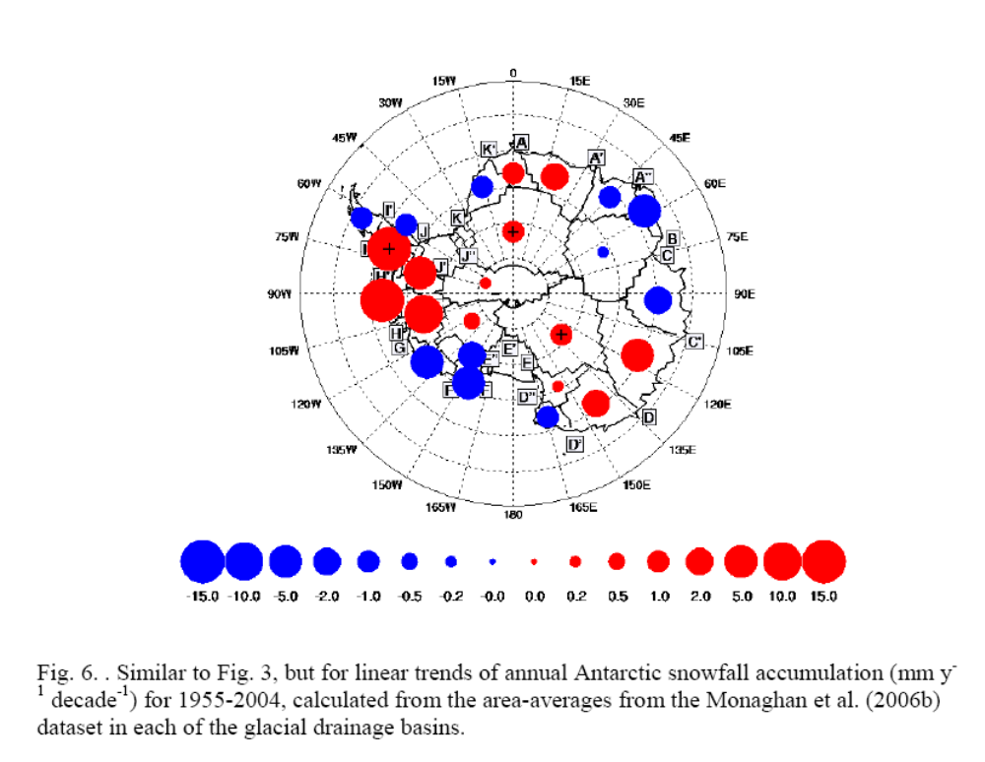
Antarctic Annual Snowfall Accumulation Trends
(mm y⁻¹ decade⁻¹)
1955-2004
Some weakly significant trends exist over the Peninsula (consistent with Turner et al. (2005)), and in the interior. Note that snowfall accumulation trends are sensitive to the time period analyzed.
Monaghan and Bromwich
(BAMS, submitted)

Slide 8
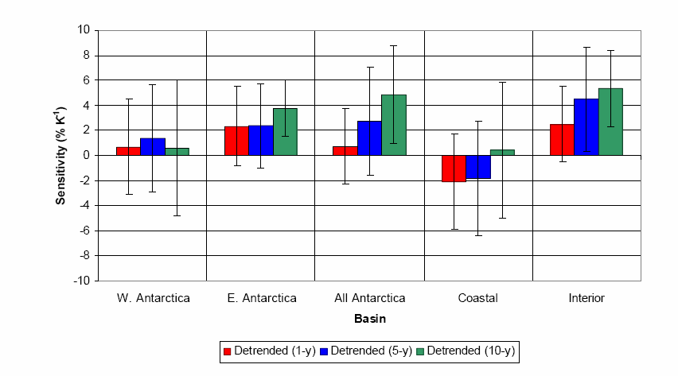
Sensitivity of Antarctic Annual Snowfall to near-surface temperature fluctuations (% K⁻¹) (1960-2004)
The sensitivity is dependent on region and time scale, but in all cases is positive.
Due to the greater influence of storms, the sensitivity in coastal regions and over WAIS is weaker than elsewhere.
Monaghan and Bromwich
(BAMS, submitted)

Slide 9
Summary
Extended records of Antarctic snowfall accumulation and near-surface temperature shed new light on recent climate variability in Antarctica. They confirm that yearly and decadal snowfall and temperature variability is very large. At the continental scale, trends for both have not been significant.
Summer warming over most of the continent since the early 1990s is consistent with a weakening of trends in the circumpolar westerlies (the “SAM”) during that season. The onset of the warming in 1992 coincides with the beginning of satellite records of dh/dt. It is uncertain whether the trends are part of cyclic variability or the first signs of anthropogenic warming.
The character of the snowfall accumulation record suggests that climate signals with multi-decadal periods may be exerting an important influence on snowfall fluctuations.
The observed sensitivity of Antarctic snowfall to near-surface temperature fluctuations is about 5% K⁻¹ at the continental scale for inter-decadal timescales. Thus if Antarctica warms by 3 K by the end of this century as GCMs project, snowfall may increase by about 15%, which is the equivalent of an additional uptake of 1 mm y⁻¹ sea level by 2100 (compared to 2000).
PROJECT DATA is cataloged in the Antarctic Master Directory, and can be obtained at: http://polarmet.mps.ohio-state.edu

Slide 10
Extra Slides

Slide 11
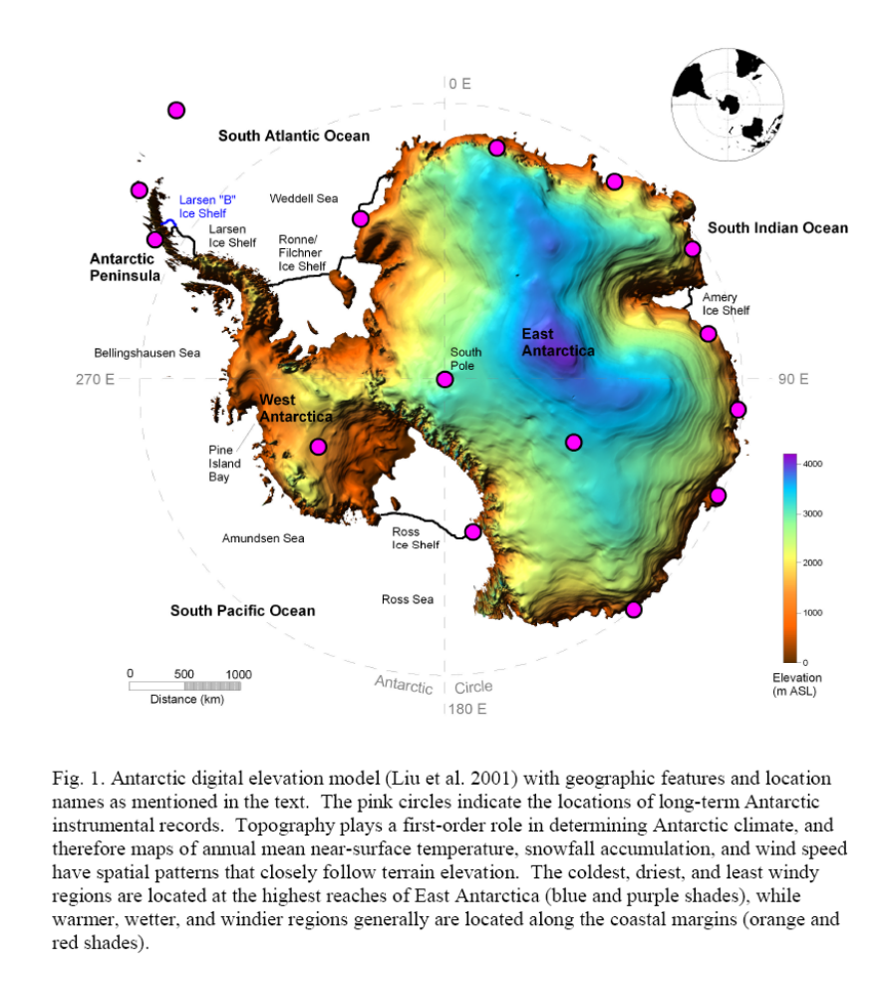
Stations used in the temperature reconstruction
Monaghan and Bromwich
(BAMS, submitted)

Slide 12
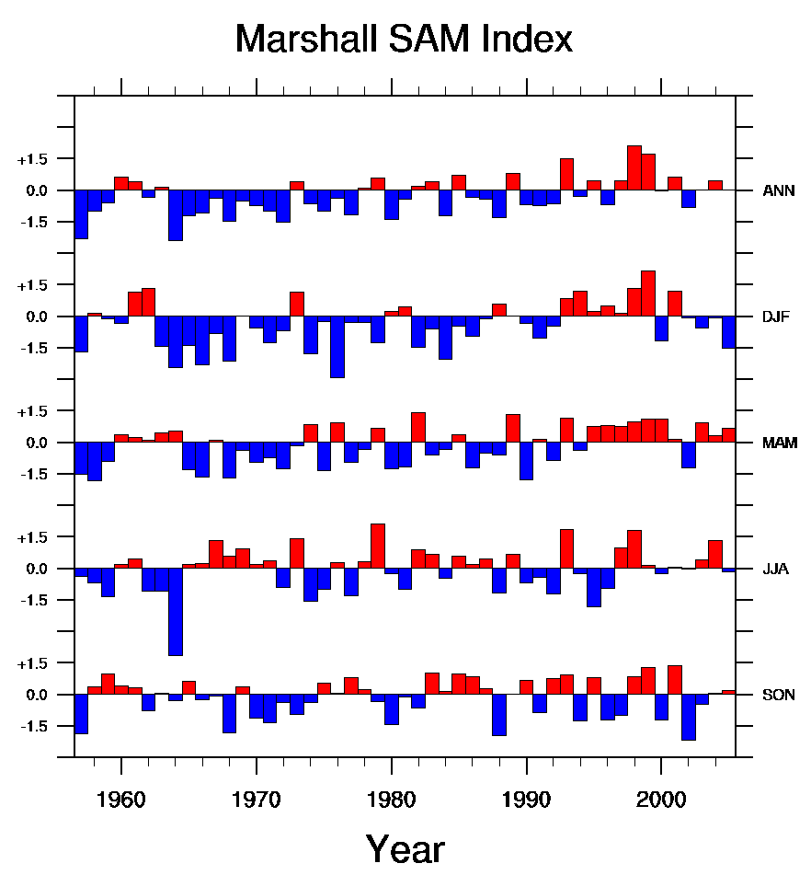
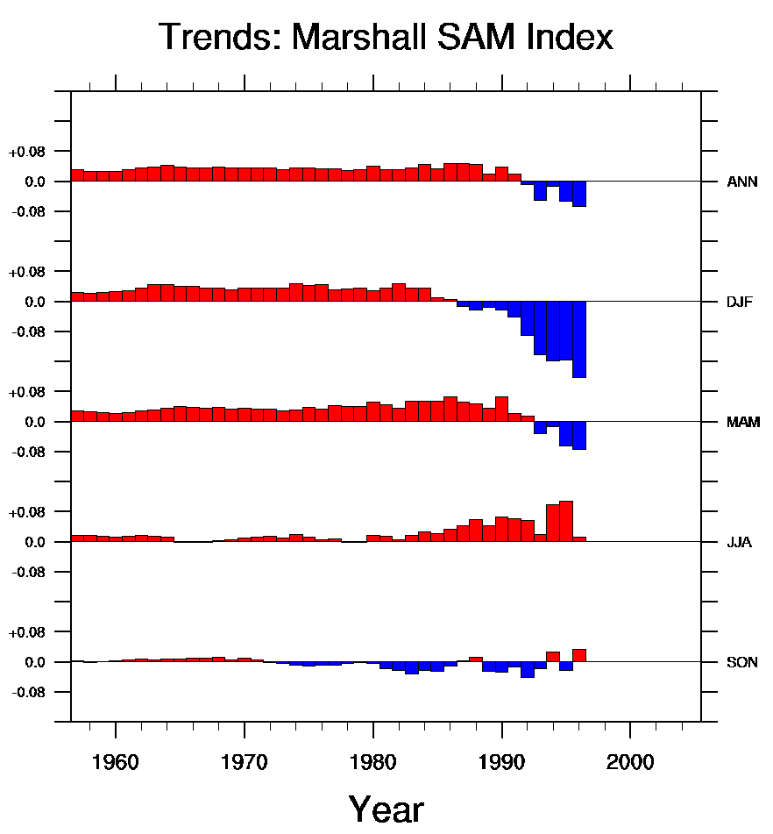
SAM variability and Trends
Annual
DJF
MAM
JJA
SON
SAM index, 1957-2005 “Running” SAM Trends through 2005
SAM trends have leveled off since the 1990s, despite increases in GHG concentrations and continued ozone depletion. Why?
Part 2: Understanding climate forcing mechanisms

Slide 13
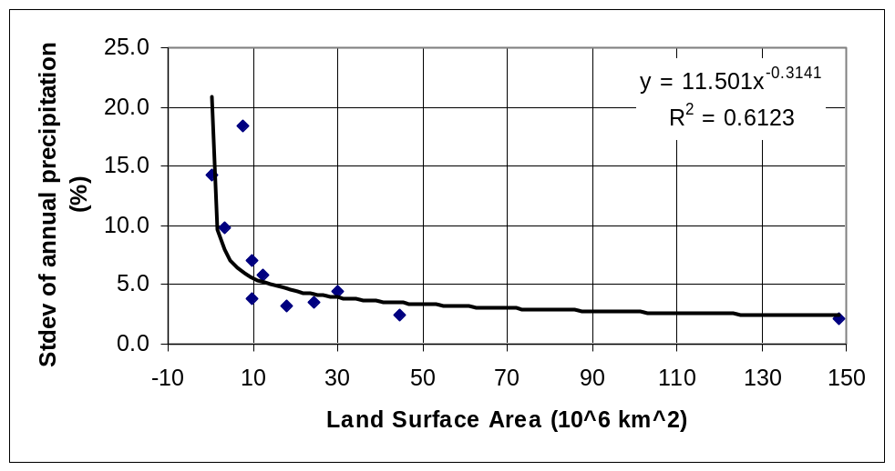
How does ERA-40 interannual Antarctic snowfall variability compare to other regions of the globe?
Table: Precipitation variability by Region
Region | land area | stdev | Source
 | (10^6 km^2) | (%)
GLOBE | 148.4 | 2.1 | CRU
ASIA | 44.6 | 2.5 | CRU
AFRICA | 30.1 | 4.4 | CRU
NAM | 24.3 | 3.6 | CRU
SAM | 17.8 | 3.3 | CRU
ANTARCTIC | 12.2 | 5.8 | OSU
EUROPE | 9.9 | 3.9 | CRU
AUSTRALIA | 7.7 | 18.5 | BOM
USTATES | 9.6 | 7.0 | NCDC
INDIA | 3.2 | 9.8 | JISAO
ENG/WALES | 0.2 | 14.2 | CRU
Antarctica
Antarctic snowfall variability compares well with other regions that have similar surface areas.

Slide 14
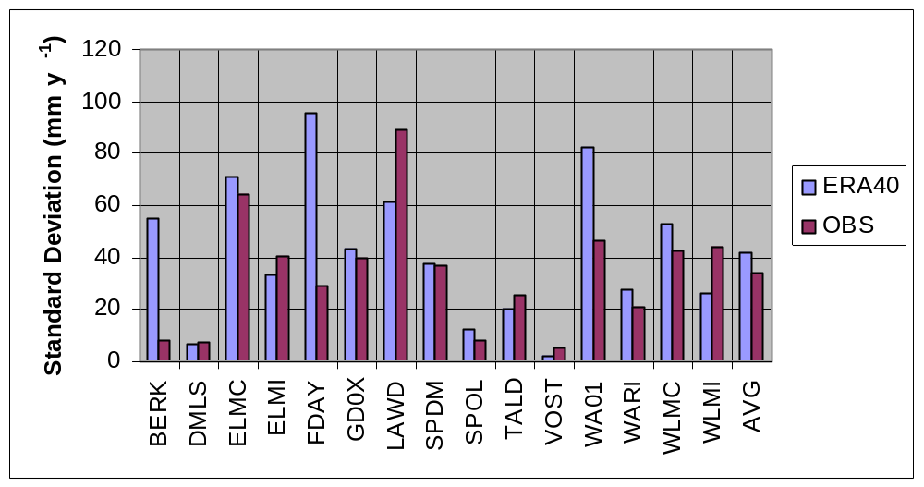
How does ERA-40 interannual Antarctic snowfall variability compare with ice core and snow stake records?
Modeled Antarctic snowfall variability compares well with observations considering the noise in many surface records. Overall, the snowfall variability is about 24% more variable than the station records

Slide 15
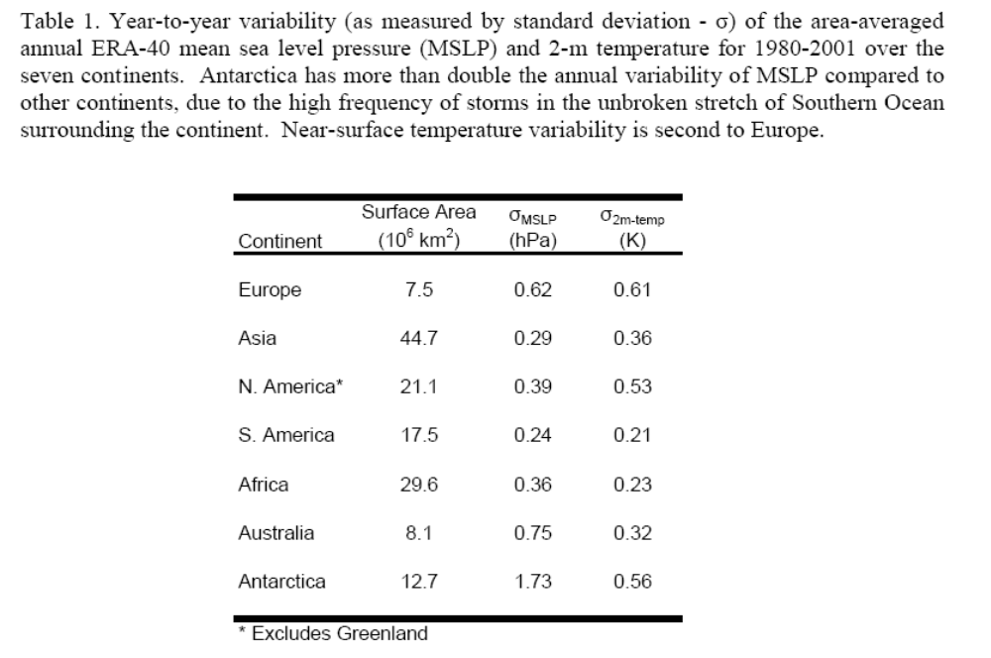
Comparison of annual variability over the continents
Monaghan and Bromwich
(BAMS, submitted)

Slide 16
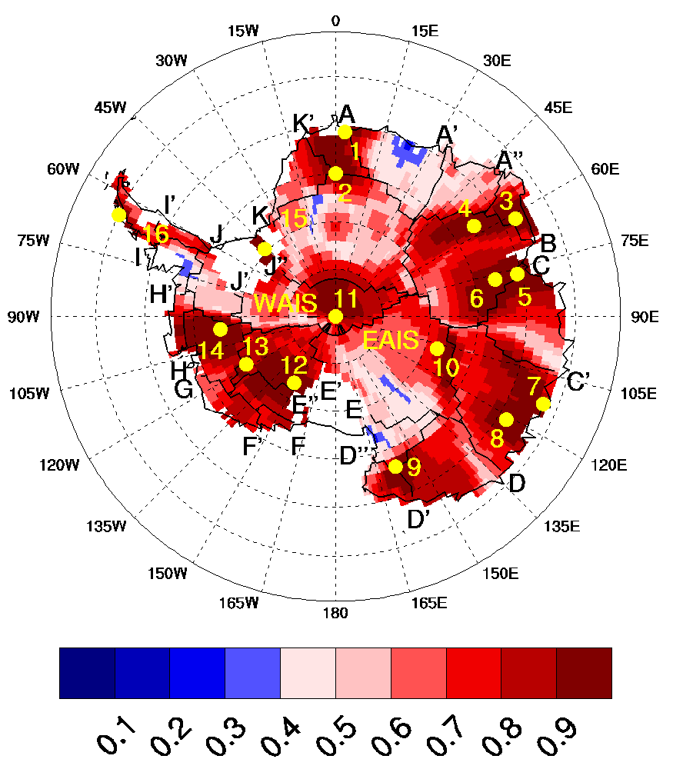
Snowfall Reconstruction
Many new ice core accumulation records have emerged as a result of the International Transantarctic Scientific Expedition (ITASE).
By blending the ice core data with model records, we were able to reconstruct a robust snowfall record back to the IGY (results shown in next slide)
Spatial correlation of
annual snowfall variability at 16 ice core and/or human-observation locations (yellow dots) with long-term records.
(red colors: p<0.05)
Monaghan et al. (Science, 2006)

Slide 17
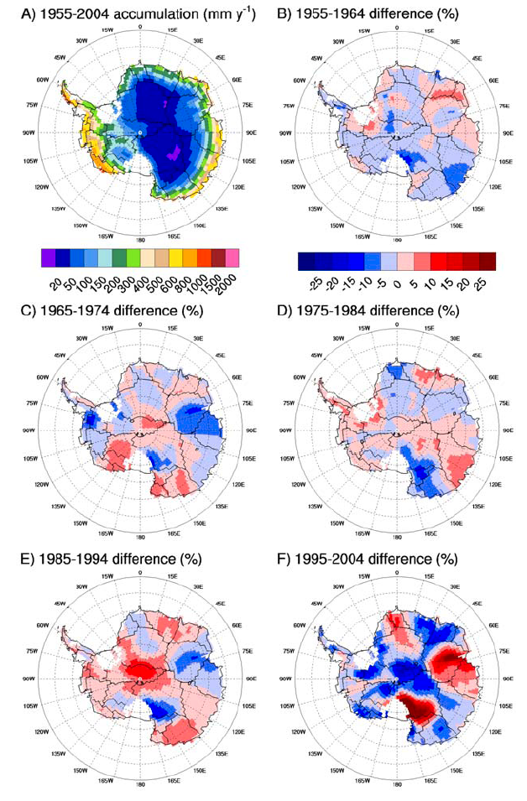
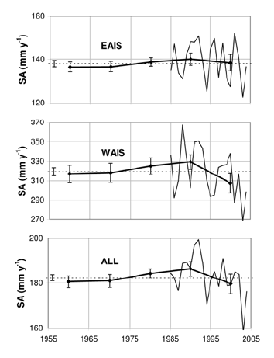
Antarctic Snowfall Trends since the IGY
Trends offsetting in space and time.
Considerable annual and decadal variability
No statistically-significant trend over the 50-year record
Monaghan et al. (Science, 2006)

Slide 18
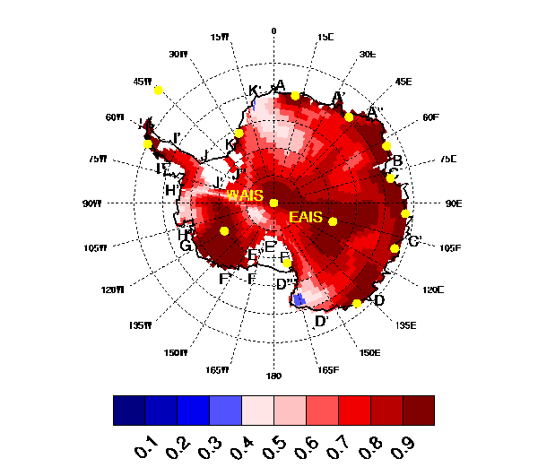
Near-surface temperature reconstruction
Using the same methodology, here we reconstruct a temperature record back to 1960 using station data (from READER and NSIDC). The advantage of this technique is that it has spatial, in addition to temporal, resolution. Therefore, we can look at regional changes at monthly and annual scales.
Spatial correlation of
annual near-surface temperature variability at 15 Antarctic stations (yellow dots) with long-term records.
(red colors: p<0.05)
Monaghan et al. (JGR, 2007, accepted)

Slide 19
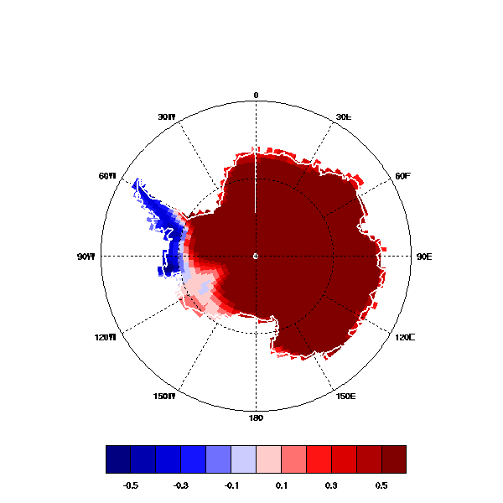
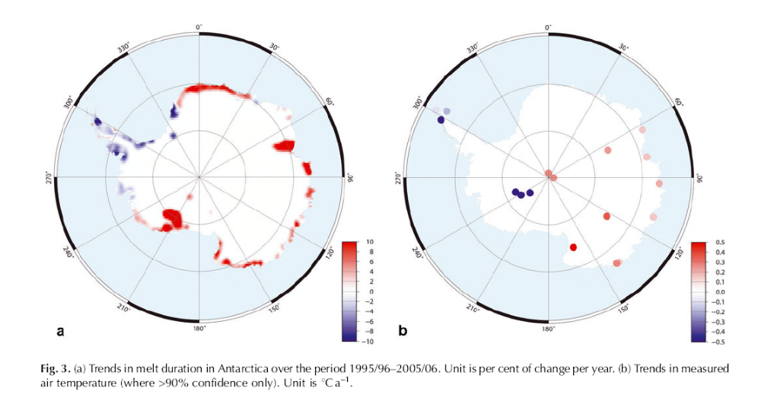
Satellite melt duration trends (1995/05-2005/06; % y⁻¹; Picard and Fily) vs DJF temperature trends (1992-2005; K decade⁻¹; Monaghan et al. 2007)

