Slide 1
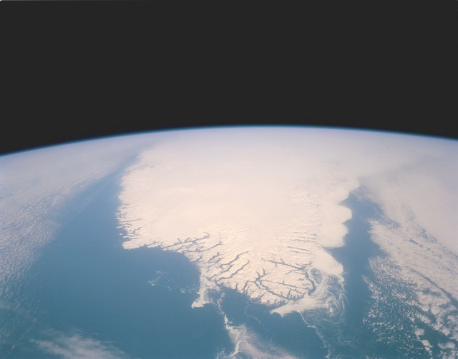
Ice Sheets in the Community Climate System Model
William H. Lipscomb
14th Annual WAIS Workshop, 8 September 2007

Slide 2
Acronyms
I work in the Climate, Ocean and Sea Ice Modeling (COSIM) group at Los Alamos National Laboratory (LANL).
COSIM has developed the ocean (POP) and sea ice (CICE) models used in the Community Climate System Model (CCSM) based at the National Center for Atmospheric Research (NCAR).
CCSM figured prominently in the Fourth Assessment Report (AR4) of the Intergovernmental Panel on Climate Change (IPCC).
Since 2006 I have been working on coupling the GLIMMER ice sheet model to CCSM.

Slide 3
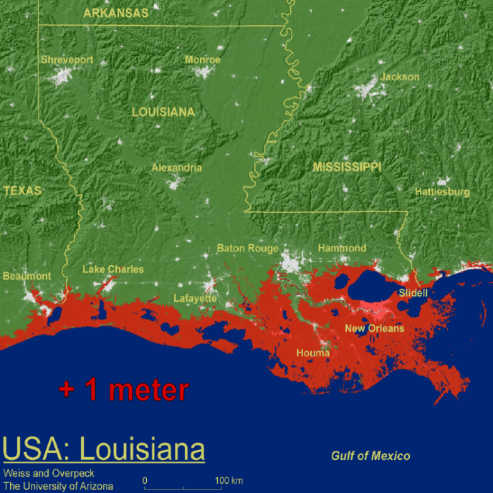
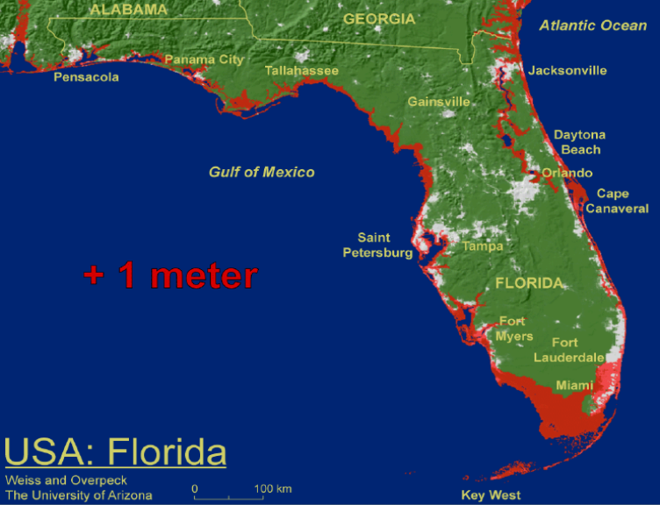
IPCC and sea level rise
Global sea level rose by ~31 cm/century, 1993-2003
  Thermal expansion: ~16 cm/century
  Glaciers and ice caps: ~ 8 cm/century
  Ice sheets: ~4 cm/century
Sea level will rise by ~18-59 cm in the 21st century, excluding “rapid dynamical changes in ice flow.”
Understanding of ice sheet dynamic effects “is too limited to assess their likelihood or provide a best estimate or an upper bound for sea level rise.”

Slide 4
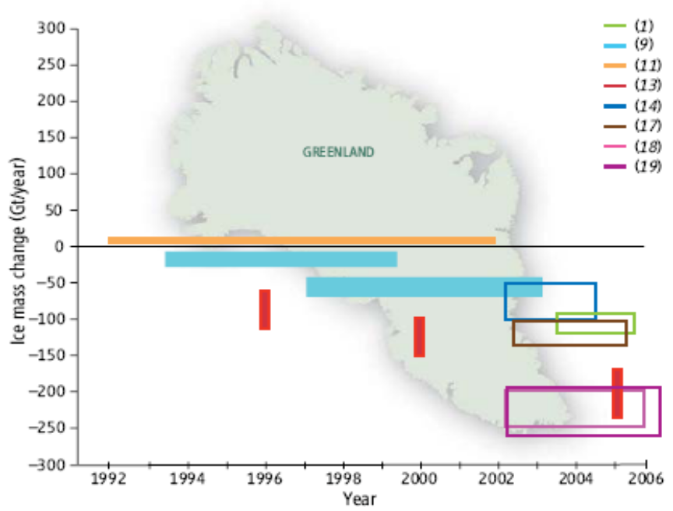
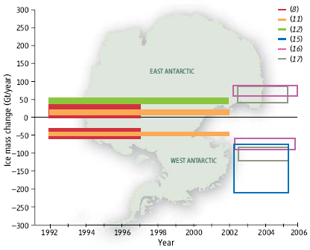
Ice sheet mass balance
Greenland
  Significant mass loss (~100-200 km³/yr) since late 1990s; increased discharge from large outlet glaciers
Antarctica
  Loss of ~50-100 km³/yr in West Antarctic; ice streams in Amundsen Sea embayment have accelerated and thinned
  Small mass gain (~0-50 km³/yr) in East Antarctica
Cazenave, 2006

Slide 5
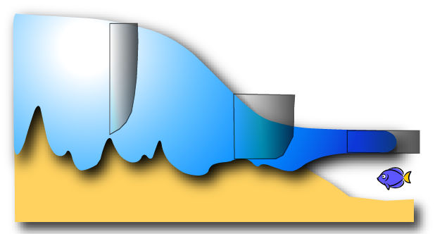
Current ice sheet models
Ice sheet: vertical shear stress
Ice stream, grounding line: mixture
Ice shelf: lateral & normal stress
U_{b}=0
U_{b} = U_{s}
0 < U_{b} < Us
Courtesy of Frank Pattyn
Models do well in cold interior where vertical shear stresses dominate (“shallow-ice approximation”).
There is a separate class of ice shelf models in which lateral/normal stresses dominate.
Models fail in small-scale transition regions (ice streams, outlet glaciers) where basal sliding occurs and all stresses are important.

Slide 6
Next-generation ice sheet models
Unified treatment of all stresses: vertical, lateral, and longitudinal (e.g., Pattyn 2003)
Higher resolution (~1-5 km) to resolve grounding lines, ice streams, and outlet glaciers
  Parallel codes
  Nested or adaptive grids
Improved basal physics (including subglacial hydrology, deformation of subglacial till)
Improved ice shelf physics (including calving laws, interactions with subshelf ocean circulation)

Slide 7
Coupling ice sheet models and GCMs
Until recently, most climate models have been run with static ice sheets. GCM output has been used for offline forcing of ice sheet models.
Why bother with coupling?
  As an ice sheet retreats, the local atmospheric and ocean circulation can change, modifying the rate of retreat.
  Atmospheric feedbacks may be significant only on century to millennial time scales, but ocean feedbacks involving ice shelves could be important on decadal time scales.

Slide 8
Coupling ice sheet models and GCMs
Degree day
Temperature
P - E
Interpolate to
ice sheet grid
Surface energy
balance
SW, LW,
T_{a}, q_{a}, |u|, P
GCM
Δx ~ 100 km
Δt ~ 1 hr
ISM
Δx ~ 10 km
Δt ~ 1 yr
Interpolate to
GCM grid
Ice sheet extent
Ice elevation
Runoff

Slide 9
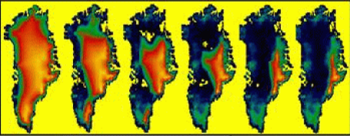
Coupled climate-ice sheet modeling
Ridley et al. (2005) coupled HadCM3 to a Greenland ice sheet model and ran for 3000 ice sheet years with 4 x CO₂. Most of the GIS melts.
Limitations: Shallow-ice approximation, positive-degree-day scheme, anomaly temperature forcing with prescribed mean.

Slide 10
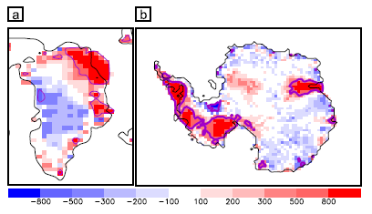
Coupled climate-ice sheet modeling
Vizcaino Trueba (2006) coupled Max Planck Institute earth system models to a model of the Greenland and Antarctic ice sheets (80 km, SIA)
  ESM1: T21, PDD
  ESM2: T31, surface energy-balance, no flux corrections
Modest melting rates and freshwater fluxes
Difference in elevation (m), model control v. ETOPO5

Slide 11
Our goal
To run fully coupled climate experiments using CCSM with an active, high-resolution, physically realistic ice sheet model—preferably before IPCC AR5 (~2013)
  Phase 1: Incorporate GLIMMER in CCSM with a surface energy-balance model.
  Phase 2: Develop a next-generation ice sheet model that can realistically simulate rapid changes in ice sheet flow.

Slide 12
CCSM version 3
Spectral or finite-volume atmosphere, ~1º or 2º
POP/CICE ocean and sea ice models, 1º displaced pole grid
Community Land Model (CLM), usually run on atmosphere grid
  Multiple landunits in each gridcell, multiple columns in each landunit
  Snow/energy-balance model is suitable for ice sheet surface mass balance
ATM
LND
CPL
ICE
OCN

Slide 13
CCSM version 4
The ice sheet surface mass balance will be computed in CLM for multiple elevation classes on the land grid, then interpolated to the finer ice sheet grid.
Ice sheet dynamics will be computed in a new component (GLC) on the fine grid.
GLC
(Dynamics)
ATM
LND
(Surface mass balance)
CPL
ICE
OCN

Slide 14
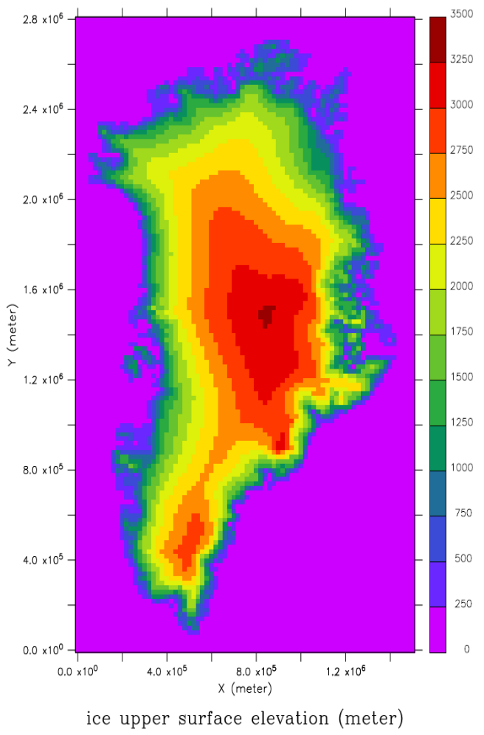
Progress to date
Added GLIMMER to CCSM
Created a 5th component, GLC, and added infrastructure for exchanging fields between GLC and the coupler
Modified the land model, CLM, so that it computes and passes to GLC the surface mass balance in each glacier column

Slide 15
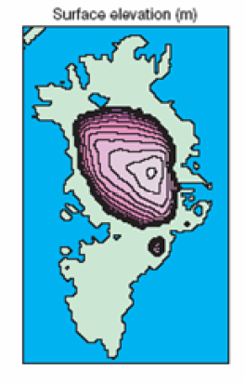
An ice sheet model in CCSM
Work remaining:
Allow multiple elevation classes in each land model grid cell; downscale to ice sheet grid.
Develop a parallel code using POP/CICE infrastructure.
Modify land/atmosphere/ocean boundaries on the fly.
Climate change experiments:
Begin with Greenland. IPCC climate-change experiments, Eemian interglacial.
Add Antarctica when a better ice sheet model is available.
Ice sheet grid cell
Land grid cell

Slide 16
Division of labor
I am funded by DOE to work fulltime on ice sheet model development for five years beginning in FY07. My focus will be on CCSM coupling and improved ice sheet dynamics (adapting techniques from POP/CICE).
We have secured funding for a LANL postdoc who will focus on ice sheet physics (subglacial hydrology, basal sliding) and science applications.
We hope to acquire additional support to work on ice shelf-ocean coupling, using a new ocean model (HYPOP) with a hybrid vertical coordinate.
We are collaborating with the U. Bristol group (Payne et al.) and the NSF Community Ice Sheet Model project (Hulbe, Johnson et al.).
We welcome other collaborations!

Slide 17
Summary
The rate of 21st century ice sheet melting and sea level rise is extremely uncertain and is now recognized as a high priority for coupled climate modeling.
We have coupled the GLIMMER ice sheet model to CCSM and will soon begin climate change experiments with an interactive Greenland ice sheet.
During the next several years we will devote substantial resources (~2-3 FTE) to improving the ice sheet model.
We hope to make a useful contribution to IPCC AR5, but time is limited; models must be frozen by ~2009-2010.

Slide 18
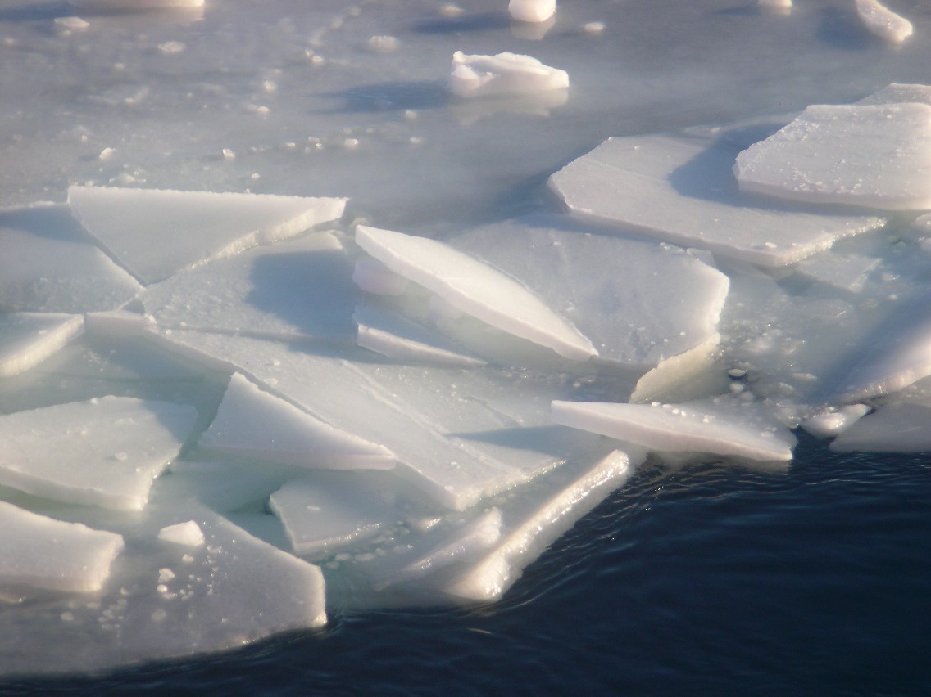
The End

Slide 19
Thermomechanical ice sheet models
Upper boundary
1. Air temperature
2. Snowfall minus melt
Ice flow
1. Gravity balanced locally
2. Glen’s flow law for horizontal velocity
3. Vertical velocity from flow divergence
z
Temperature
evolution
1. Diffusion
2. Advection
3. Dissipation
Thickness evolution
1. Horizontal flow divergence
2. Accumulation
T
Lower boundary
1. Slip velocity
2. Basal friction
3. Geothermal heat flux
Isostasy
1. Flexure in response to ice load
2. Mantle flow
Courtesy of Tony Payne

