Slide 1
Millennial versus orbital influences on ice marginal fluctuation: the southern signal
David Vacco
Richard Alley
David Pollard

Slide 2
Background
$$$ dating moraines to learn climate history
Mostly, use something like exposure-age mode or mean (or whatever seems sensible; for example, looking for youngest or oldest)
Given the investment, plenty of room for squeezing a bit more information out
Work by Patrick Applegate (poster) using age distributions for hypothesis-testing
Work here by Dave Vacco and Dave Pollard on use of number and volume as well as position and age of moraines

Slide 3
Glacier model description
Shallow ice approximation
Dynamic sub-glacial sediment driven by ice flux, water flux, and bulldozing (Pollard & Clark)
Valley glacier scale, L ~ 50 km
Sediment source erosion via bed quarrying

Slide 4
Quarrying by
u
τ
b
b
Sediment transport by water flux
Sediment deposition
Sediment transport by
Viscous deformation

Slide 5
Climate forcing description
Temperature history from ice core records
Scaled to assumed LGM-Modern amplitude
Temperature lapse rate with elevation
Ice surface budget using PDD
Snow rate a function of saturation vapor pressure (a function of temperature)

Slide 6
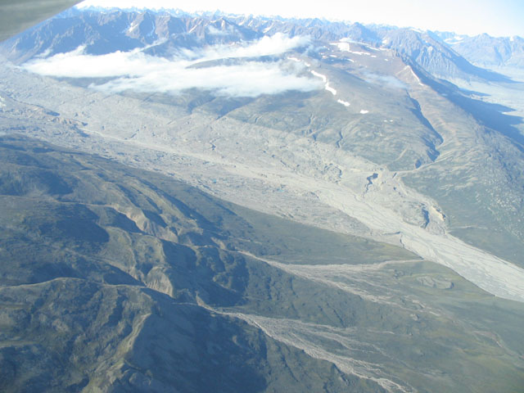

Slide 7
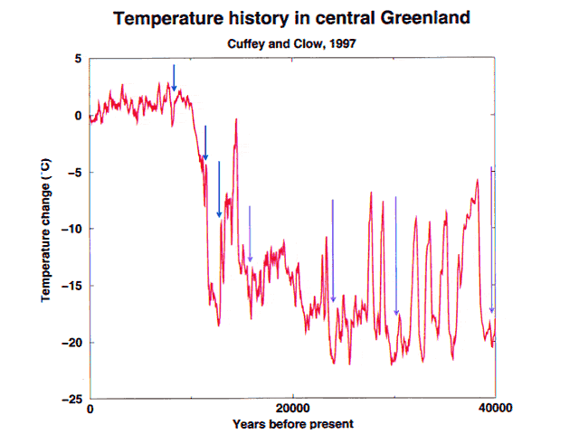
Moraines
(summer
temps.)
Today
LIA
YD
YD
Glacial max.
Ice-core mean
annual temps.

Slide 8
GISP2, low pass filter cut-off at 10,000 yrs
1
0.8
0.6
Fraction of warming,
LGM to modern
0.4
0.2
0
0
10
20
30
Time, kyr B.P.

Slide 9
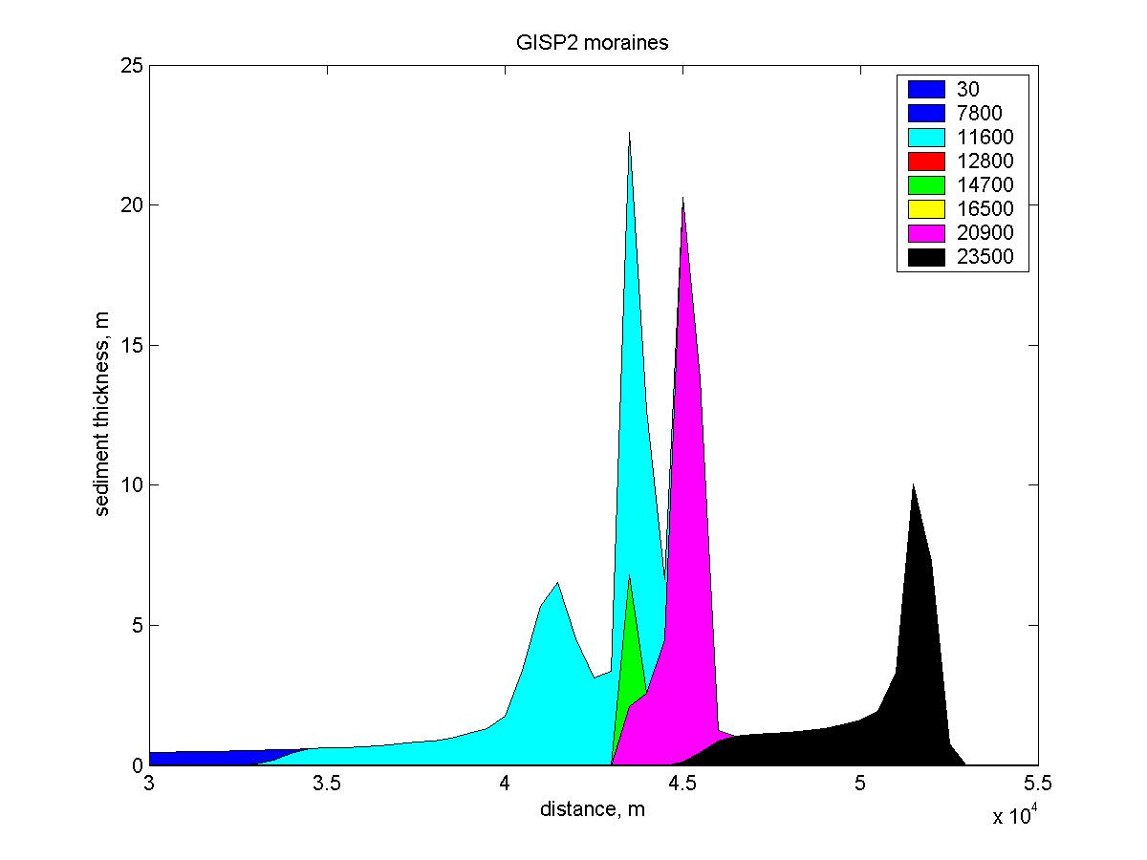
0.8
YD = 100 %
0.6
0.4
0.2
0
0
10
20
30
Time, kyrs B.P.

Slide 10
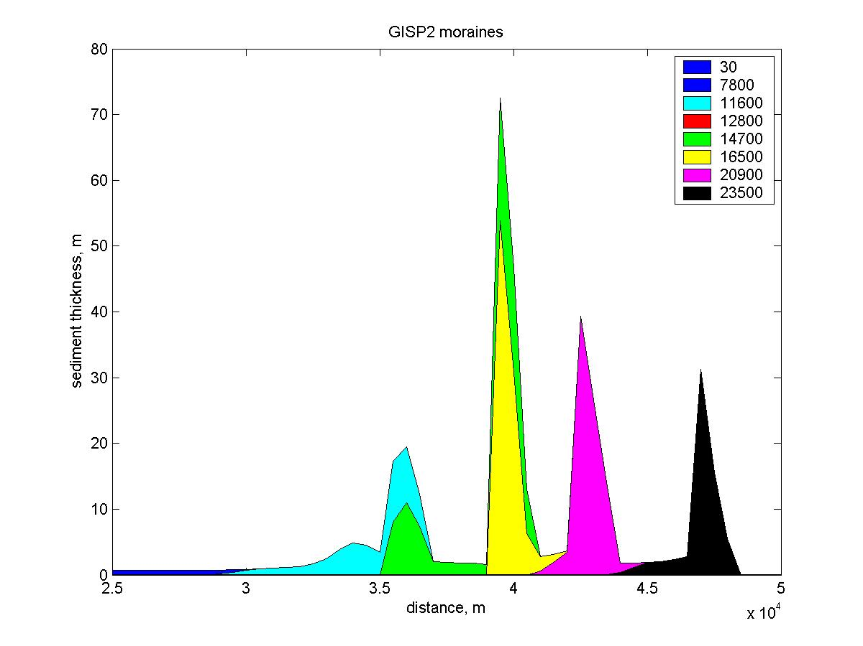
1.0
0.8
YD = 50%
0.6
0.4
0.2
0
10
20
30
Time, kyrs B.P.

Slide 11
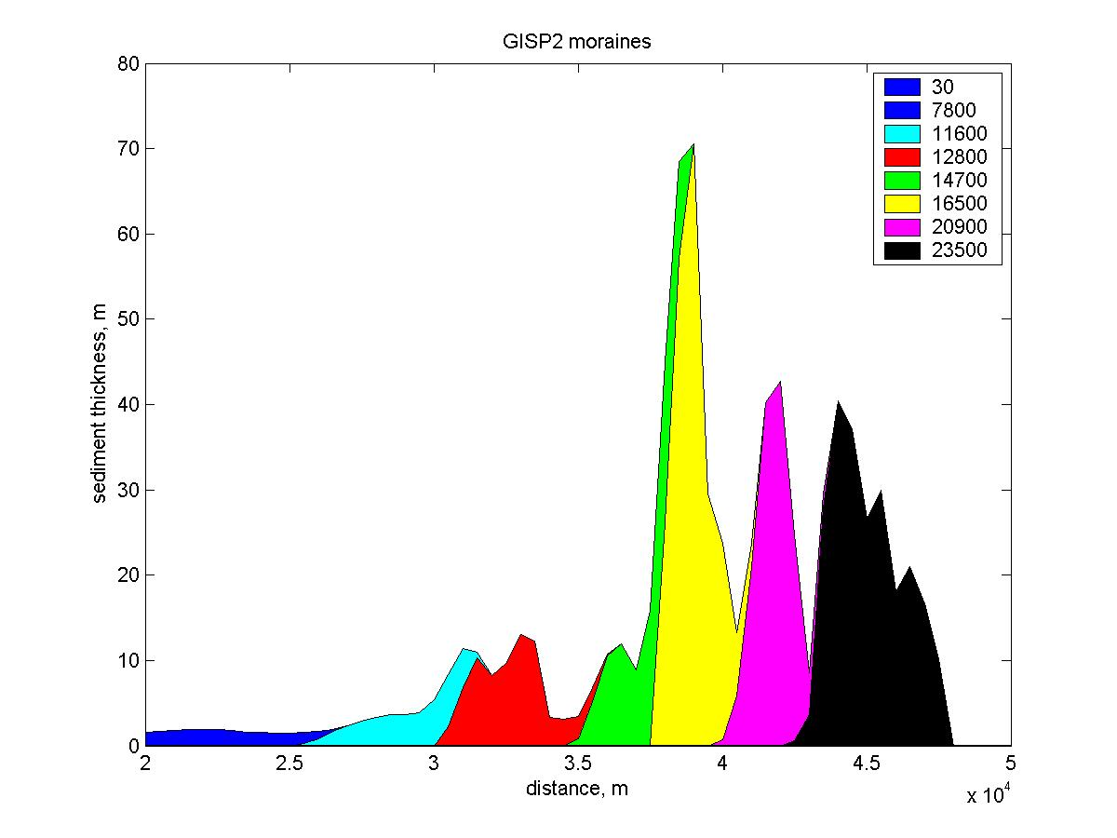
1.0
0.8
YD = 10 %
0.6
0.4
0.2
0
0
10
20
30
Time, kyrs B.P.

Slide 12
Byrd driven moraines

Slide 13
Separating the deglaciation signal from
the millennial scale signal, Byrd ice core
0.8
Byrd record
Low-pass filtered
10,000 yr cut-off
0.6
Fraction of warming,
LGM to modern
0.4
0.2
0
0
10
20
30
Time, kyr B.P.

Slide 14
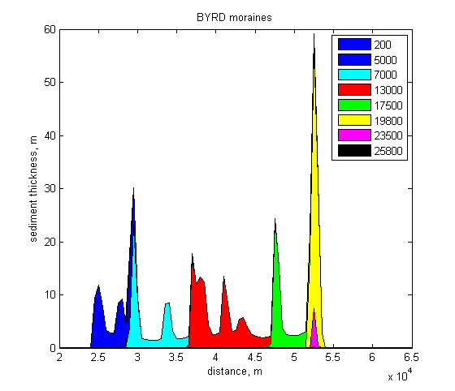
Millennial Scale = 100 %
0.8
0.6
0.4
0.2
0
10
0
20
30
Time, kyr B.P.

Slide 15
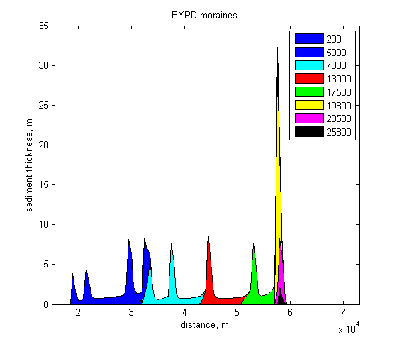
Millennial scale = 300 %
1.2
0.8
0.4
0
-0.2
0
10
20
30
Time, kyr B.P.

Slide 16
Dome C driven moraines

Slide 17
Separating the deglaciation signal from
the millennial scale signal, Dome C ice core
1
Dome C record
0.8
Low-pass filtered,
10,000 yr cut-off
0.6
Fraction of warming,
LGM to modern
0.4
0.2
0
0
10
20
30
Time, kyr B.P.

Slide 18
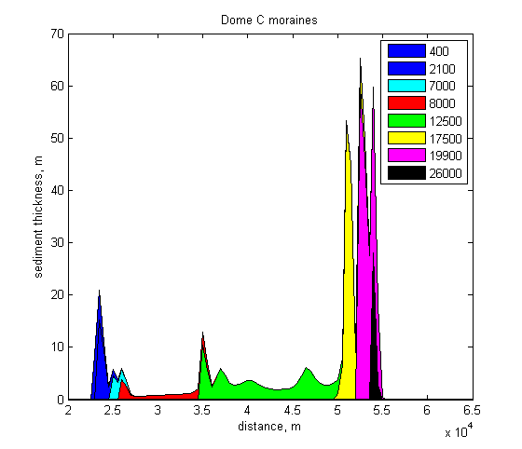
1
Millennial Scale = 100 %
0.8
0.6
0.4
0.2
0
0
10
20
30
Time, kyr B.P.

Slide 19
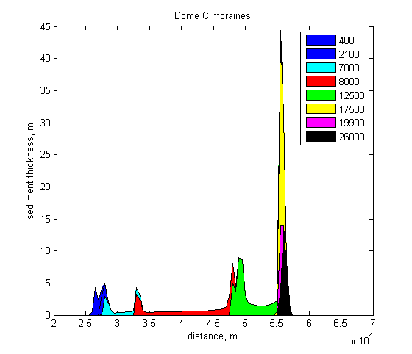
Millennial Scale = 300 %
1.2
0.8
0.4
0
-0.2
0
10
20
30
Time, kyr B.P.

Slide 20
Some thoughts
We need to use all moraine data--full distribution of boulder ages; position & volume & number--data too hard-won and expensive to waste.
Different hypotheses for climate control give different numbers, positions, and sizes of moraines (at least in model world)
Should be able to tell whether GISP2, Dome C or Byrd-type history, whether millennial-scale oscillations damped or amplified relative to orbital
Dave Vacco sends apologies; Patrick Applegate and Dave Pollard here and doing great things

Slide 21
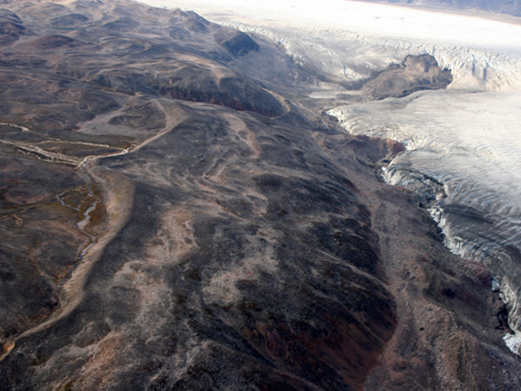

Slide 23
GISP2 driven moraines

Slide 24
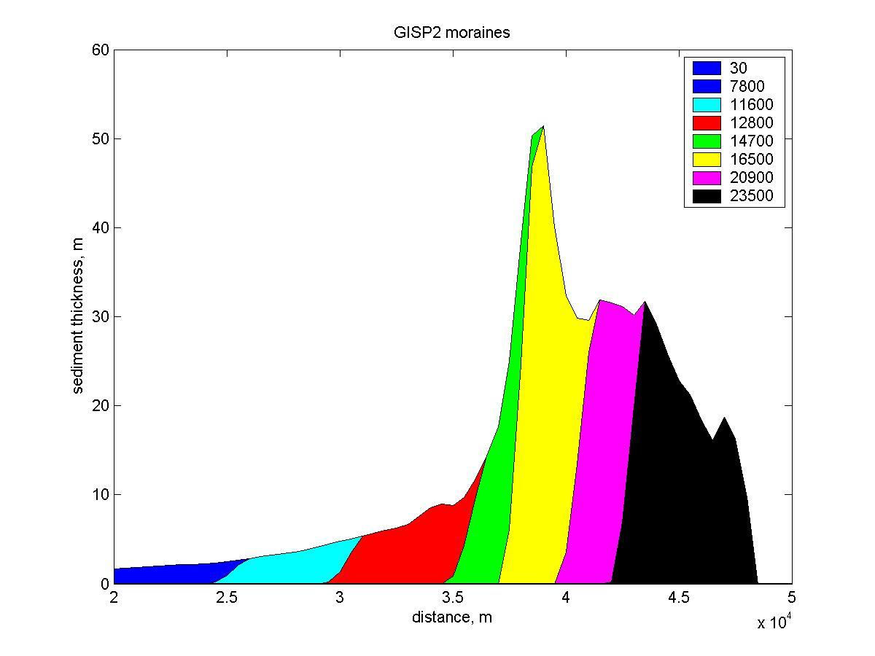
0.8
YD = 1 %
0.6
0.4
0.2
0
0
10
20
30
Time, kyrs B.P.

Slide 25
BULLDOZING
All sediment under the advance moved to the front

Slide 26
Did the WAIS region have an eventful deglaciation?
Mechanisms of climate change different on different time scales (millennial changes in deep-water circulation vs. slower orbital changes in seasonal sun)
Glaciers have different responses to the different forcings? (Denton et al., 2005)
First step: develop a “forward” model of moraine deposition--you supply a possible climate history, and we calculate the moraines it would produce
Leading to inversion?--you tell us how many, how big, how old moraines are, and we tell you climate history

Slide 27
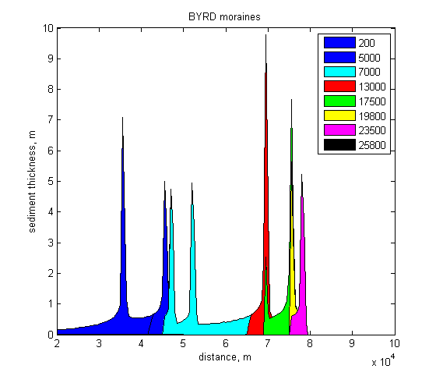
2
Millennial Scale = 1000 %
1
0
-1
0
10
20
30

Slide 28
Dome C, millennial strength at 100% and 300%
1.2
100%
300%
0.8
Fraction of warming,
LGM to modern
0.4
0
0
10
20
30
Time, kyr B.P.

Slide 29
Byrd ice core record, millennial 100% and 300%
1.2
100%
300%
0.8
Fraction of warming,
LGM to modern
0.4
0
0
10
20
30
Time, kyr B.P.

