Slide 1
WAIS Prediction:
Things We Need to Find Out
R.B. Alley, S. Anandakrishnan, R.T. Walker, B.R. Parizek, T.K. Dupont, and D.Pollard, Penn State now or in past
Thanks to NSF for $$--CReSIS, etc.
Thanks to lots of colleagues--esp. Mark Fahnestock & Ian Joughin extensive discussions
(Talks like this are a lot easier than doing real work. But, watch Science and elsewhere--we’re still getting some real work done.)

Slide 2
In case you’ve been in a coma…
Lots of exciting ice-sheet science coming out
Nearly every major project discovers something new
Which means that ice sheets are undersampled
Repeat that often, to many people, in many places: ICE SHEETS ARE UNDERSAMPLED
Surficial and subglacial lake drainages, ice quakes, ice-shelf collapses, tidal responses…
Back-of-the-envelope calculations (Rahmstorf, Hansen, Pfeffer, Meier, IPCC) and expert elicitations (Vaughan) are not converging well
So we really do need to sample the ice sheets…

Slide 3
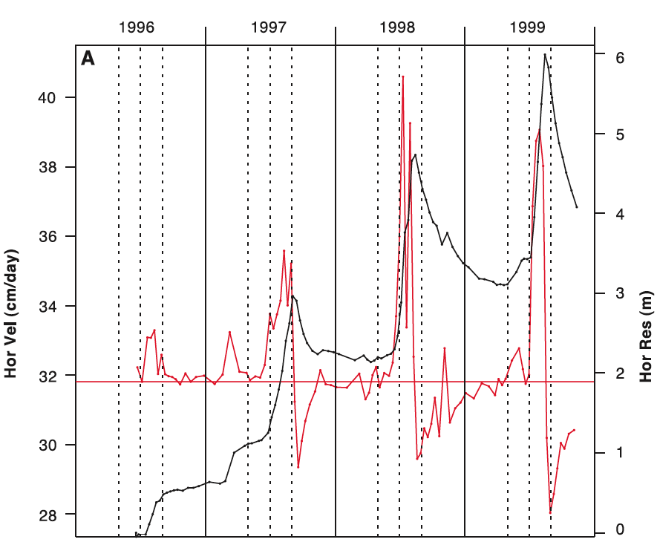
Much press for meltwater lube, but…
Winter slowdown almost as much as summer speed-up;
Observed extra motion attributed to meltwater input is ~1% of total motion;
Extra ~1 m/yr
Mean~115 m/yr
Zwally et al., 2002

Slide 4
Much press for meltwater lube, but…
Subsequent work shows effect is:
Real
Widespread
Maybe (or maybe not?) a bit larger than Zwally et al. found (10-20%?); but
Not large on the large outlet glaciers
So, important to include in quantitative models, but probably not world-changing
(Joughin et al., and van de Wal et al., both Science, 2008)

Slide 5
Meltwater drainage heat bigger issue
Up to ~2x effect if meltwater access to bed moves inland to thaw now-frozen bed (and >2x or >>2x if frozen regions potentially smooth and soft (Parizek & Alley, 2004)
Meltwater access by lake-driven fracture propagation--theory (Alley et al., 2005) and spectacular data (Das et al., 2008)
Don’t know yet where bed freeze-thaw boundary is (but Oswald and Gogineni, 2008 report technique), or whether sufficient tension to open crevasses above it
Not much persistent flow acceleration from Das et al. outbursts, but temporary effects large--contribute to fracture upglacier?

Slide 6
Subglacial lakes and drainages
Bugs? Sediments? Aliens? Surely interesting…
(With large uncertainties) doesn’t seem to be much effect of drainage events on ice flow
Understanding from jokulhlaups elsewhere is maybe some effect, but no large and sustained effects (e.g., Bjornsson, 2003)
Ice sheet with “dripping” lakes may be a tad bigger than one without--localization of lubrication in space and time tends to reduce total lubrication and thus gives slower ice flow.
(Note that both surficial and basal lake drainages may have big geomorphic impacts at the bed.)

Slide 7
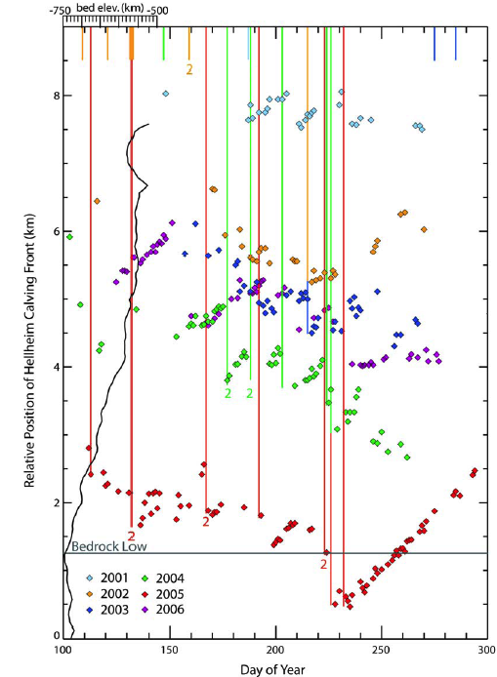
Big ice-quakes in Greenland occur at same time as big calving events--looks like quakes are the calving events (Victor Tsai’s talk this morning…). Big quakes on ice stream B very interesting (Sridhar, etc.), but so far apparently unique.
Joughin, Howat, Alley, Ekstrom, Fahnestock,
Moon, Nettles, Truffer, Tsai, JGR 2008

Slide 8
“Real deal” is end-load changes
Tides (Anandakrishnan et al., Bindschadler et al., etc.)--large effect of small forcing
Ice-shelf loss by basal melting or fracture-propagation fragmentation (MacAyeal et al., Scambos et al., etc.)
Even sea ice (Joughin et al., in press, shows Jakobshavn speed-up before spring melt when packed-in sea-ice clears)
Tides show that loss of big ice shelf would speed flow of tributaries
Jakobshavn, PIG, Larsen B show that loss of small ice shelf speeds flow of tributaries

Slide 9
Ocean and air science good…
I assume they’ll figure out changes in snowfall, surface temperature and meltwater generation, and sub-ice-shelf heat transport if they keep doing what they’re doing (and we support…)
But for ice-stream response, it makes a big difference whether the bed is linear-viscous (slight speed-up) or perfectly plastic (zoom…), or viscous becoming perfectly plastic when hit hard enough (Rathbun et al., 2008)
MacAyeal-Joughin type inversions from surface velocities can reveal how slippery bed is
Geophysics (especially seismics, also drilling and radar) reveals bed type, guides interpretation
But flow response to perturbation?????

Slide 10
Options?
Wait for ice sheet to fall apart, watch the evolution of stress and strain rate, determine “flow law” for bed, tell people what happened, predict behavior when the next ice age ends; or
Much better: get history of ice sheet, and tune parameters to match that history (Pollard, DeConto, ANDRILL, WAIS Divide, etc.)

Slide 11
Options?
Use the large stress perturbations associated with tides, earthquakes, lake drainages (from above and below), sea-ice loss, ice-shelf loss, or anything else to constrain inversions for slipperiness of bed as stress varies
Problem: all of these are fast enough that they require elastic as well as viscous modeling
Not a new idea (e.g., Anandakrishnan & Alley, 1997 found viscous behavior for tidal response)
But they were 1-d, and world isn’t…

Slide 12
So…
Be wary of balding, graying persons providing pious pronouncements
But, ice sheets remain undersampled--we have a lot of work to do;
Latent-heat transport in surface-meltwater penetration may be important;
End-load loss may be really important;
If we want to be doctors rather than undertakers, we need serious, high-time-resolution data and viscoelastic modeling of all the “events” we can find, as well as paleoclimatic data assimilation.

