Slide 1
Reaching for the Grail: Predicting Sea Level Contributions from Dynamic Ice Sheets for 2100 before 2100

Slide 2
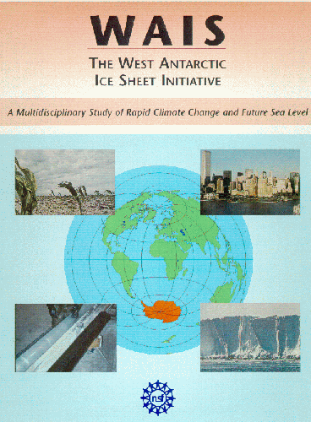
1990: How will the potentially unstable West Antarctic ice sheet affect future sea level?
1999: How will the unstable West Antarctic ice sheet affect future sea level?
2009:

Slide 3
IPCC Report Evolution
1990 – no mention of ice dynamics; time-scale thought too long for focus on 2100

Slide 4
IPCC Report Evolution
1990 – no mention of ice dynamics; time-scale thought too long for focus on 2100
1995 – West Antarctic collapse mentioned as high-risk/ low probability event

Slide 5
IPCC Report Evolution
1990 – no mention of ice dynamics; time-scale thought too long for focus on 2100
1995 – West Antarctic collapse mentioned as high-risk/ low probability event
2001 – feedback emphasizing importance of ice dynamics all but ignored

Slide 6
IPCC Report Evolution
1990 – no mention of ice dynamics; time-scale thought too long for focus on 2100
1995 – West Antarctic collapse mentioned as high-risk/ low probability event
2001 – feedback emphasizing importance of ice dynamics all but ignored
2007 – dramatic ice dynamics clearly identified as a limitation to prediction

Slide 7

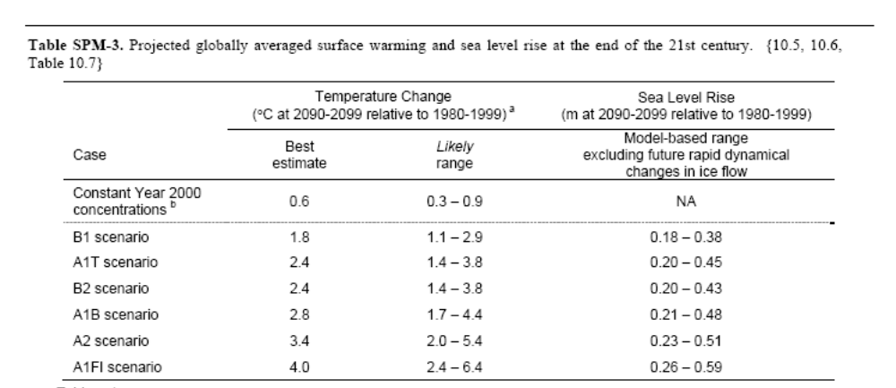
“…but..flow rates could increase or decrease in the future.”
“Larger values cannot be excluded…”
“…understanding of these effects is too limited to assess their likelihood or provide a best estimate or an upper bound for sea level rise.”

Slide 8
2008 LANL Workshop “Assessment Cluster”
Richard Alley
Jeremy Bassis
Ed Bueler
Robert Bindschadler
Mike Dinniman
Todd Dupont
Jim Fastook
Carl Gladish
Dan Goldberg
David Holland
Paul Holland
Christina Hulbe
Charles Jackson
Jesse Johnson
John Klinck
Bill Lipscomb
Doug MacAyeal
Byron Parizek
David Pollard
Steve Price
Christian Schoof
Olga Sergienko
Miren Vizcaino Trueba
Slawek Tulaczyk
Kees van der Veen
Ryan Walker
Participation is not closed

Slide 9
Goals
Provide quantitative estimates and uncertainties of land-ice contributions to sea level in time for next IPCC
Inform land ice model in CCSM

Slide 10
Approach
Define extreme scenarios
Run multiple models
Compare ensemble results
Refine scenarios based on results from other domains

Slide 11
Domains
Whole ice sheet
Ice-stream/ice-shelf
Ice-shelf/ocean

Slide 12
Whole Ice Sheet
Richard Alley
Jeremy Bassis
Ed Bueler (PISM)
Robert Bindschadler
Mike Dinniman
Todd Dupont
Jim Fastook
Carl Gladish
Dan Goldberg
David Holland
Paul Holland
Christina Hulbe (CCSM)
Charles Jackson
Jesse Johnson (CCSM)
John Klinck
Bill Lipscomb (CCSM)
Doug MacAyeal
Byron Parizek (2D only)
David Pollard
Steve Price (GLIMER)
Christian Schoof
Olga Sergienko (SYCOPOLIS)?
Miren Vizcaino Trueba
Slawek Tulaczyk
Kees van der Veen
Ryan Walker

Slide 13
Ice-Stream/Ice-Shelf
Richard Alley
Jeremy Bassis (inverse approach)
Ed Bueler
Robert Bindschadler
Mike Dinniman
Todd Dupont
Jim Fastook
Carl Gladish
Dan Goldberg
David Holland
Paul Holland
Christina Hulbe
Charles Jackson
Jesse Johnson
John Klinck
Bill Lipscomb
Doug MacAyeal
Byron Parizek
David Pollard
Steve Price
Christian Schoof
Olga Sergienko
Miren Vizcaino Trueba
Slawek Tulaczyk
Kees van der Veen
Ryan Walker

Slide 14
Ice-Shelf/Ocean
Richard Alley
Jeremy Bassis
Ed Bueler
Robert Bindschadler
Mike Dinniman (ROMS)
Todd Dupont
Jim Fastook
Carl Gladish
Dan Goldberg
David Holland
Paul Holland
Christina Hulbe
Charles Jackson
Jesse Johnson
John Klinck (ROMS)
Bill Lipscomb
Doug MacAyeal
Byron Parizek
David Pollard
Steve Price
Christian Schoof
Olga Sergienko
Miren Vizcaino Trueba
Slawek Tulaczyk
Kees van der Veen
Ryan Walker
Chris Little (?)

Slide 15
Preliminary Scenarios
(whole ice sheet domain)
Greenland
  Surface melt (via IPCC) directly into ocean
  Surface melt lubricates whole bed and stays
  Spatially variable basal lubrication
  Remove all ice below equilibrium line
Antarctica
  Remove all ice shelves
  Drain all subglacial lakes and lubricate bed
  Remove West Antarctica

Slide 16
Timetable
Mid- December 2008
  White papers defining scenarios for each domain
??
  Distribute input and forcing fields
  Rely on “data sets cluster”
??
  Compare results
  Draw conclusions
  More runs?
Mid-2010
  Write papers for publication by 2011 to satisfy IPCC-5 deadline

