Slide 1

Cyberinfrastructure Opportunities for Antarctic Research
Dan Lubin
Cyberinfrastructure Program Manager
NSF Office of Polar Programs
dlubin@nsf.gov
Overview of the NSF Office of Cyberinfrastructure
Specific Funding Opportunities
Preliminary Proposal Process

Slide 2
Cyberinfrastructure by Components
Learning & Work Force Needs & Opportunities
Virtual Organizations for Distributed Communities
High Performance Computing
Data Visualization & Interaction
Courtesy
Lucy Nowell, OCI

Slide 3
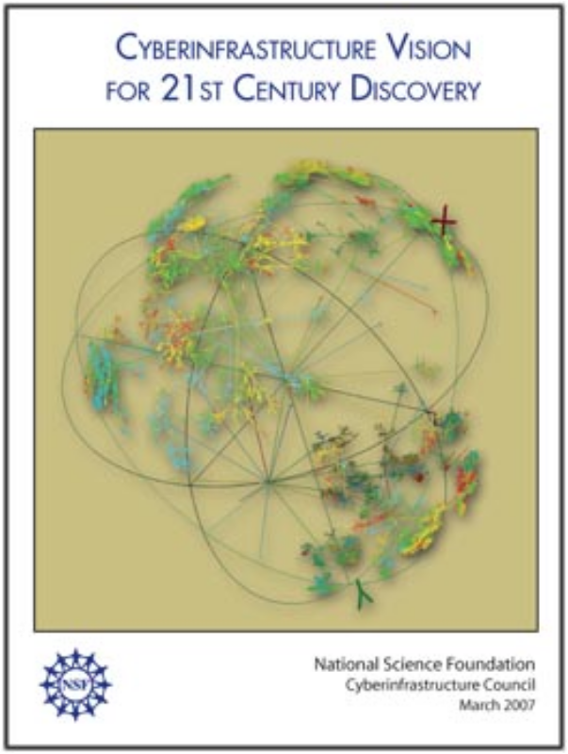

Required Reading!
Cyberinfrastructure Vision, March 2007
Available on NSF Office of Cyberinfrasturcture web site
www.nsf.gov/pubs/2007/nsf0728/index.jsp
High Performance Computing
Data, Data Analysis & Visualization
Virtual Organizations
Learning & Workforce Development

Slide 4

Cyberinfrastructure in Practice
Courtesy Dan Atkins, OCI Director
Transformative Application - to enhance discovery & learning
Provisioning -Creation, deployment and operation of advanced CI
provides shared and connecting CI
Borromean Ring: The three rings taken together are inseparable, but remove any one ring and the other two fall apart. See www.liv.ac.uk/~spmr02/rings/
catalyzes
Office of Cyberinfrastructure
R&D to enhance technical and social effectiveness of future CI environments
Notes:
Borromean Ring: The three rings taken together are inseparable, but remove any one ring and the other two fall apart. See www.liv.ac.uk/~spmr02/rings/.
Technologial determinism alone will not acheive the potential impact.

Slide 5
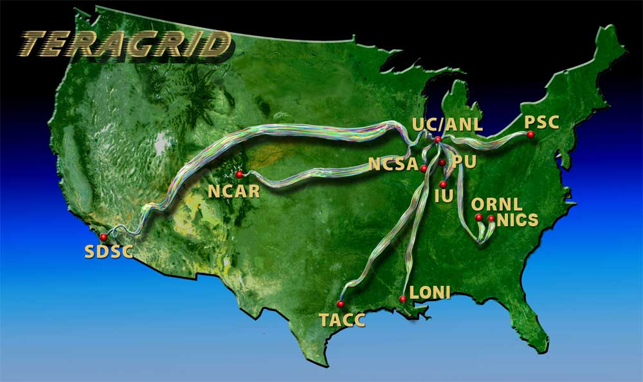
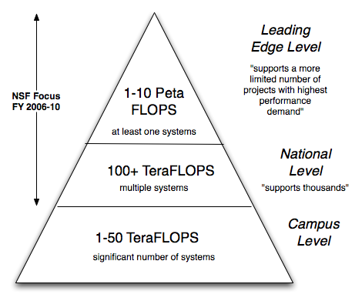
High Performance Computing
Track 1: One solicitation funded over 4 years: $200M acquisition + additional O&M cost.
Track 2: Four solicitations over 4 years: $30M/yr acquisition + additional O&M cost. First track 1 approved 8-07
TeraGrid
Large-scale operational CI for national open science community
  11 resource providers
  1 Grid Infrastructure Group (GIG)
Single unified allocation process
Comprehensive user support
  Advanced applications & software integration
  Science gateways
RS & Modeling: Don’t be afraid to check it out!

Slide 6
OCI Data Strategy
Mechanisms
Funded Programs
Policy Consideration
Partnerships
National Framework
DataNet
Partners
Digital Data Coordinating Group
Interagency Data Working Group
Activities
Culture Change
INTEROP
Exec-level Review of NSF Data Policies
Blue Ribbon task force on sustainable data repositories
Tools & Resources
STCI
NSF Data Policies & Registry Services
NSF-wide data working group
Opportunity Exploration
Federal Agencies, Academia, Library & Preservation Sector, Foundations & Non-profits, Commercial Sector, National Laboratories, International Agencies
Lucy Nowell, OCI

Slide 7



Virtual Organizations offer additional modes of interaction between People, Information, and Facilities
Time
Courtesy
Diana Rhoten, OCI
Same
(synchronous)
Different
(asynchronous)
ST-SP
P: Physical mtgs
I: Print-on-paper books, journals
F: Physical labs, studios, shops
DT-SP
P: Shared notebook
I: Library reserves
F: Time-shared physical labs, ...
Same
Geographic Place
ST-DP
P: AV conference
I: Web search
F: Online instruments
DT-DP
P: Email
I: Knowbots
F: Autonomous observatories
Different
P: people, I: information, F: facilities, instruments

Slide 8
Cyber-Enabled Discovery and Innovation
Preliminary Proposal Windows
  08 NOV 08 – 08 DEC 08 (Type I)
  09 NOV 08 – 09 DEC 08 (Type II)
Full Proposal Window (Invitation Only)
  20 APR 09 – 20 MAY 09
Multi-disciplinary research seeking contributions to more than one area of science or engineering, by innovation in, or innovative use of computational thinking
Computational thinking refers to computational…
  …Concepts
  …Methods
  …Models
  …Algorithms
  …Tools

Slide 9
CDI is Unique within NSF
five-year initiative
all directorates, programmatic offices involved
to create revolutionary science and engineering research outcomes
made possible by innovations and advances in computational thinking
emphasis on bold, multidisciplinary activities
radical, paradigm-changing science and engineering outcomes through computational thinking

Slide 10
CDI Philosophy
“Business as usual” need not apply
  “Projects that make straightforward use of existing computational concepts, methods, models, algorithms and tools to significantly advance only one discipline should be submitted to an appropriate program in that field instead of to CDI.”
No place for incremental research
Untraditional approaches and collaborations welcome
New on Transformative Research: to what extent does the proposed activity suggest and explore creative, original, or potentially transformative concepts?

Slide 11
Additional CDI Review Criteria
The proposal should define a bold multidisciplinary research agenda that, through computational thinking, promises paradigm-shifting outcomes in more than one field of science and engineering.
The proposal should provide a clear and compelling rationale that describes how innovations in, and/or innovative use of, computational thinking will lead to the desired project outcomes.
The proposal should draw on productive intellectual partnerships that capitalize upon knowledge and expertise synergies in multiple fields or sub-fields in science or engineering and/or in multiple types of organizations.
potential for extraordinary outcomes, such as,
  revolutionizing entire disciplines,
  creating entirely new fields, or
  disrupting accepted theories and perspectives
    … as a result of taking a fresh, multi-disciplinary approach.
  Special emphasis will be placed on proposals that promise to enhance competitiveness, innovation, or safety and security in the United States.

Slide 12
Three CDI Themes
CDI seeks transformative research in the following general themes, via innovations in, and/or innovative use of, computational thinking:
From Data to Knowledge: enhancing human cognition and generating new knowledge from a wealth of heterogeneous digital data;
Understanding Complexity in Natural, Built, and Social Systems: deriving fundamental insights on systems comprising multiple interacting elements; and
Building Virtual Organizations: enhancing discovery and innovation by bringing people and resources together across institutional, geographical and cultural boundaries.

Slide 13
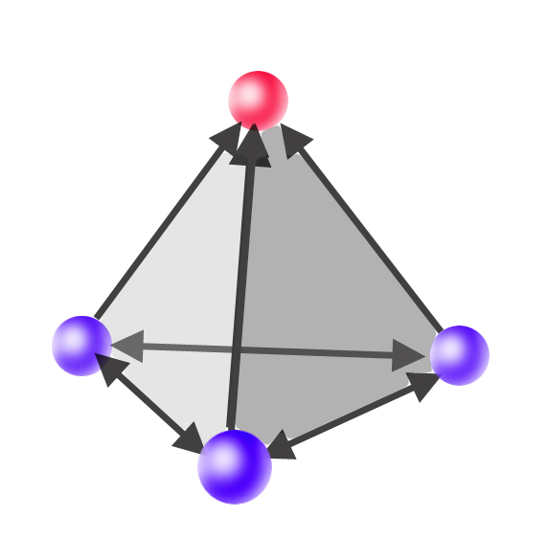
From Data to Knowledge
Efficient knowledge extraction accounting for uncertainties and noise, statistics
Modeling, data assimilation, inverse problems; validation;
Operations on data (algorithms for off-line and real-time applications)
Algorithms for analysis of large data sets,
dimension reduction
Human interaction with data
Knowledge
Theory
Simulation
Experiment
Notes:
From Data to Knowledge
Extracting useful information and deriving new knowledge from data efficiently, while accounting for the presence of uncertainty and dependency, leads to several sub-themes in which transformative ideas are needed:
Modeling
Operations on data
Algorithms
Human interaction with data

Slide 14

Understanding Complexity in Natural, Built, and Social Systems
Identifying general principles and laws that characterize complexity and capture the essence of complex systems -- Nonlinear couplings across multiple scales; emergent behavior
Attaining the breakthroughs, to overcome these
challenges, requires transformative ideas in
the following areas:
Simulation and Computational Experiments
Methods, Algorithms, and Tools
Design, control, operation and diagnostics
of engineered complex systems

Slide 15

Virtual Organizations (VOs)
Design, development, and assessment of VOs
Bringing domain needs together with algorithm development, systems operations, organizational studies, social computing, and interactive design
Flexible boundaries, memberships, and lifecycles, tailored to particular research problems, users and learner needs or tasks of any community, providing opportunities for:
Remote access
Collaboration
Education and training

Slide 16
DataNet: Sustainable Digital Data Preservation and Access Network
Preproposal by 13 NOV 08, Full proposal by 15 MAY 09
Lead Program Officer: Lucy Nowell
Challenge: How to develop the new methods, management structures and technologies to manage the diversity, size, and complexity of current and future data sets and data streams?
Answer: Create a set of exemplar national and global data research infrastructure organizations (dubbed DataNet Partners) that provide unique opportunities to communities of researchers to advance science and/or engineering research and learning.
The new types of organizations envisioned in this solicitation will integrate library and archival sciences, cyberinfrastructure, computer and information sciences, and domain science expertise.

Slide 17
INTEROP: Community-based Data Interoperability Networks
Full proposal target date: 23 JUL 09.
Lead Program Officer: Lucy Nowell
Goal: Foster the ability to re-purpose data – to use it in innovative ways and combinations not envisioned by those who created the data.
Interoperability: Ability of two or more systems or components to exchange information and to use the information that has been exchanged.
This program supports community efforts to provide for broad interoperability through the development of mechanisms such as robust data and metadata conventions, ontologies, and taxonomies.
Support is provided for Data Interoperability Networks that will be responsible for consensus-building activities and for providing the expertise necessary to turn the consensus into technical standards with associated implementation tools and resources.

Slide 18
Success with CDI Preliminary Proposals and NSF Preliminary Proposals in General
Write your preliminary proposal to succeed in Interdisciplinary Panel Review.
  Even if mail review will also be used.
Convince the reader that your topic is important beyond your research community.
  Don’t “hype” or “oversell”; don’t load proposal with buzzwords.
  Do craft ~2-4 sentences at a Scientific American readership level.
State your objectives in language common to all scientists.
  Example: What is known, What is not known, How your project will make a transformative impact on the unknown.
  Example: Statement of Hypothesis and strategy for testing (real hypothesis, not a baloney hypothesis!).
Include a complete business plan.
  Who is doing what, and for what support. Explain all CVs, letters of support included.
  Do not drop names.
  Explain clearly how the computational thinking will be done! No “token” computer scientist!
Broader Impacts must be well thought out and credible, not boilerplate!

Slide 19
Cyberinfrastructure and OPP
OCI will very likely set the standard for future OPP investments in data management and interoperability, cyber-enabled collaboration, and other requirements for computational resources.
Most of the OCI solicitations lend themselves very well to polar concerns. Do consider submitting proposals!
There has already been good interest in OCI proposal submission by polar researchers in 07-08. Can we keep it up next year?
Polar Researchers: I’m on your side! (dlubin@nsf.gov, 703-292-7416)

