Slide 1
Possible Mechanisms for Glacial Earthquakes
Victor C. Tsai¹, James R. Rice^{1,2}, Mark Fahnestock³
1. Dept. of Earth and Planetary Sciences, Harvard U.
2. School of Eng. and Applied Sciences, Harvard U.
3. Inst. for the Study of Earth, Oceans, and Space, UNH
WAIS Workshop, October 10th, 2008
based on Tsai, Rice, Fahnestock, JGR-ES, 2008

Slide 2
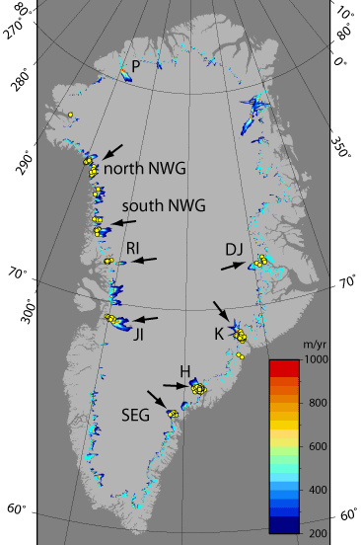
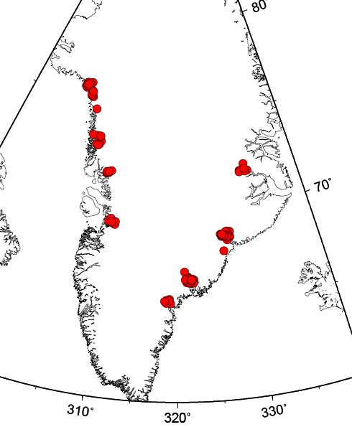
What are Glacial Earthquakes?
Ekström et al., 2003
Ekström et al., 2006
Tsai and Ekström, 2007
M_{S} ~ 4.6 – 5.1
A ~ 0.1-2.0 x 10¹⁴ kg m
Lack high freq. radiation
At large, fast-flowing outlet glaciers
Forces ~horizontal, perpendicular to calving front
Seasonality: more events in summer months
1993-2004 Events
Bamber et al., 2001
Notes:
Vast majority of the events discovered are in glaciated regions, primarily Greenland
Events in 1993-2005, mention period band

Slide 3
Some Additional Observations
Large calving front retreats when glacial earthquakes occur!
  I. Joughin, et al. and V.C. Tsai, JGR, 2008
Lack of surface displacements in GPS obs.
  M. Nettles, et al., AGU, 2007 (in review, 2008)
Large calving events observed with long-period seismic energy
  J. Amundson, et al., in review, 2008

Slide 4
Possible Models?
“Sliding” “Calving”
(Glacier acceleration) (Iceberg acceleration)
Both can produce amplitudes and timescales
See poster for details!
Recent observations suggest no sliding
Tsai, Rice and Fahnestock, JGR, 2008

Slide 5
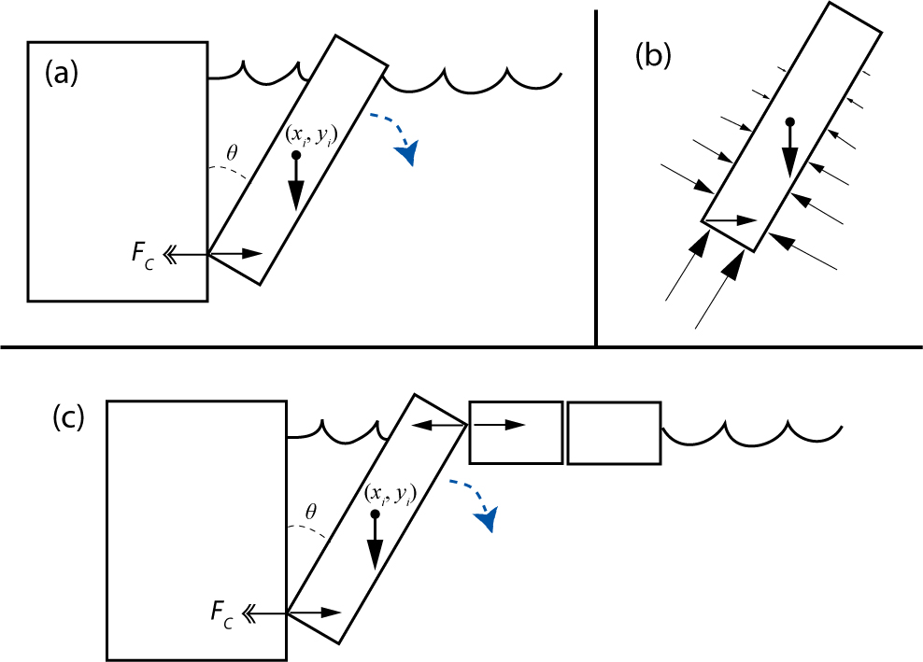
Models of Calving Acceleration
Iceberg melange

Slide 6
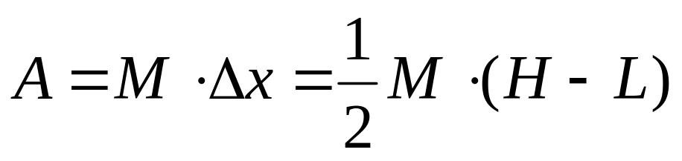
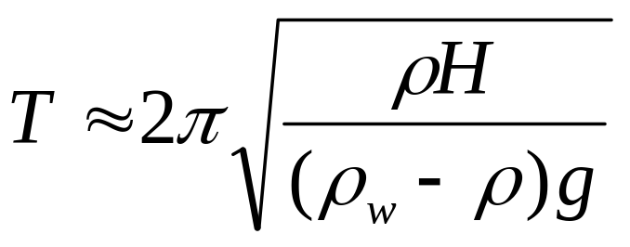
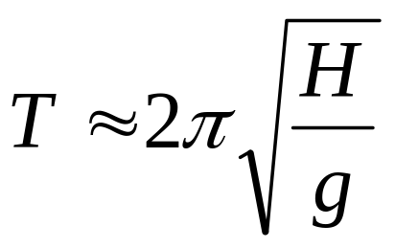
Scaling Analysis for Tipping
Tipping Amplitude:
Tipping Timescale:
  Inverted Pendulum
Bobbing timescale:

Slide 7
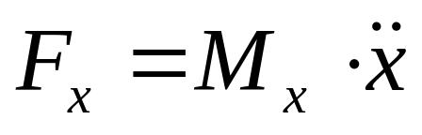
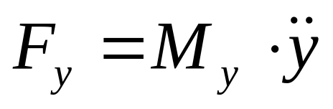
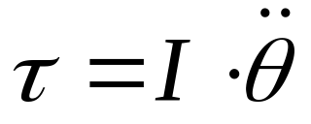
Numerical Solution
Newtonian system of ODEs:
, ,
F includes hydrostatic pressure
Includes added mass effects
Ignores Bernoulli, (surface) waves, boundaries
Try a range of reasonable parameters…

Slide 8
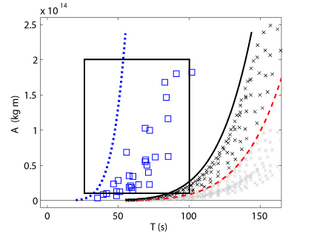
Amplitude/Timescale for Calving
Scaling for bobbing
Tipping w/out melange
Melange model
Range of obs
Scaling for tipping

Slide 9
Comparison of Model Results with Glacial Earthquake Observations
Amplitudes and timescales agree
Force approximately horizontal, perpendicular to calving front
At all large outlet glaciers without thick sea ice
Seasonal variations are similar to calving variations
Reason for amplitude variations unclear
Need better understanding of calving controls

Slide 10
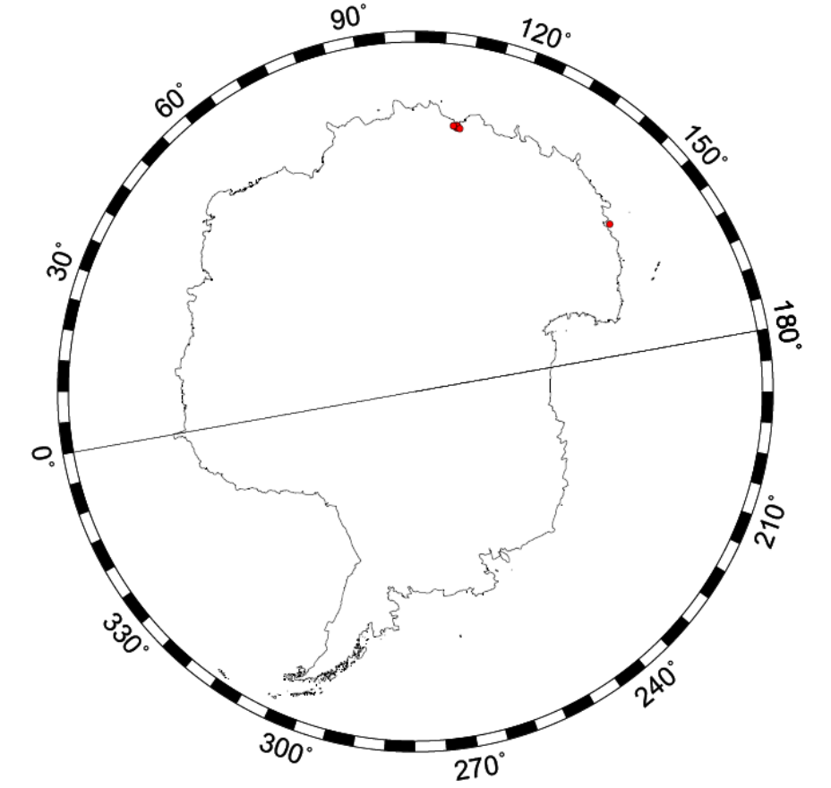
What about Antarctica?
Totten Glacier
There are events in (East) Antarctica but none of this type in West Antarctica
Calving from ice shelf, not from grounded ice Poor seismic coupling
Calving style different
0
1
East
West

