Slide 1
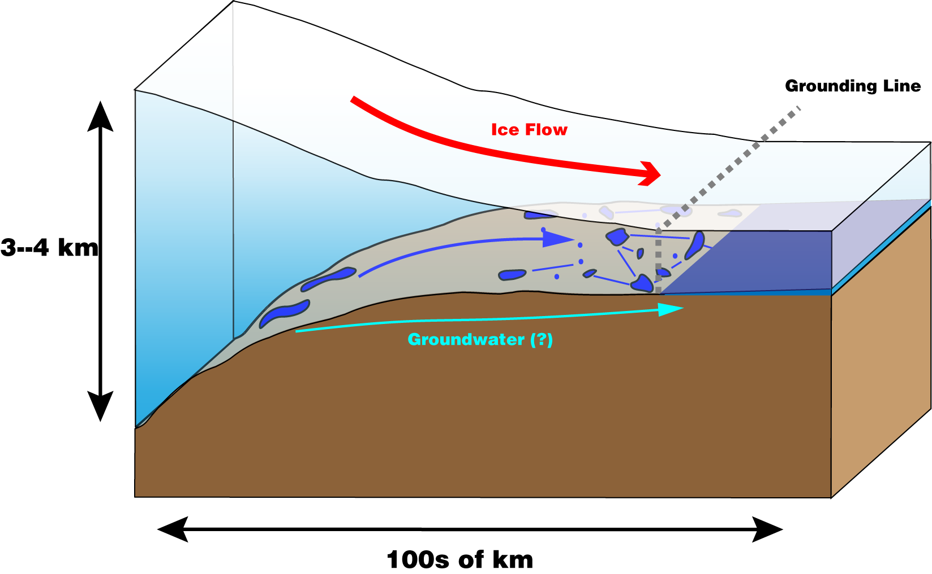
Stability and drainage of subglacial water systems
Timothy Creyts
Univ. California, Berkeley
Christian Schoof
U. British Columbia

Slide 2
Motivation
  What are dynamic effects of the lakes?
    They modulate water flow
      Storage elements in the water system
    They modulate ice flow
      Bed slip is linked to water pressure
      Sliding over hard beds is controlled by effective pressure
      Sliding over soft beds is also controlled by effective pressure
    Drainage morphology and structure determine effective pressure

Slide 3
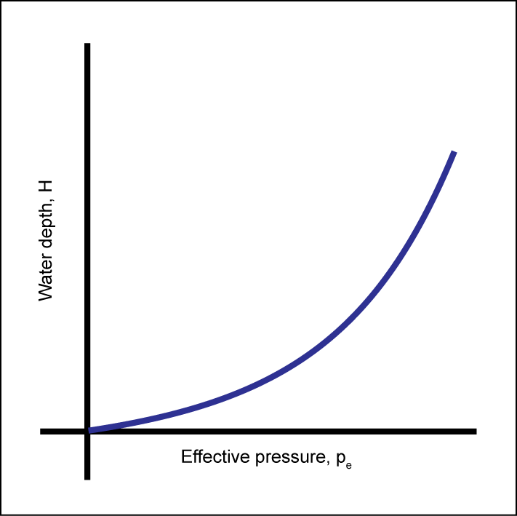
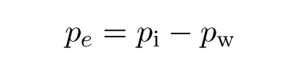
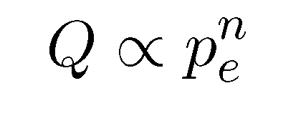
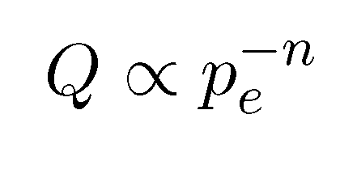
Effects of subglacial hydrology
Fast types: Water discharge increases with effective pressure
Decrease lubrication: channelize and concentrate water flow
Slow types: water discharge decreases with increasing effective pressure
Increase lubrication: distribute water over the bed

Slide 4
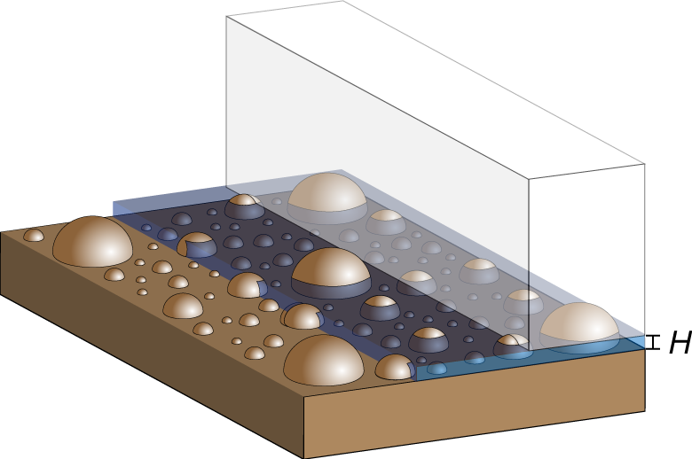
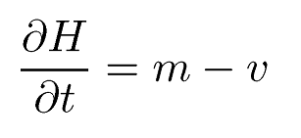
Water flow through sheets: mass balance
Use an idealized geometry for drainage
  Flow width much broader than deep
  Assume roughness of hemispherical protrusions on a bed
Simple geometry and mass balance
Melt rate of the ice roof
Closure rate of ice into the water

Slide 5
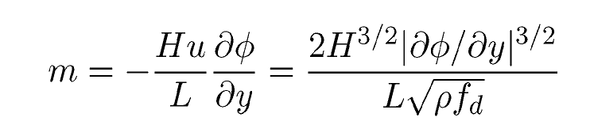
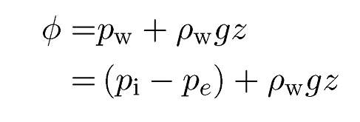
Mass balance: Melt rate
Mass balance equation
Use steady state momentum and heat balances
  Heat is generated via viscous dissipation and overlying ice is at the melting point
Analytic form:
Substitute Darcy-Weisbach shear stress relationship
Where the hydraulic potential is
Use values of H and ∂φ/∂y to compute m

Slide 6
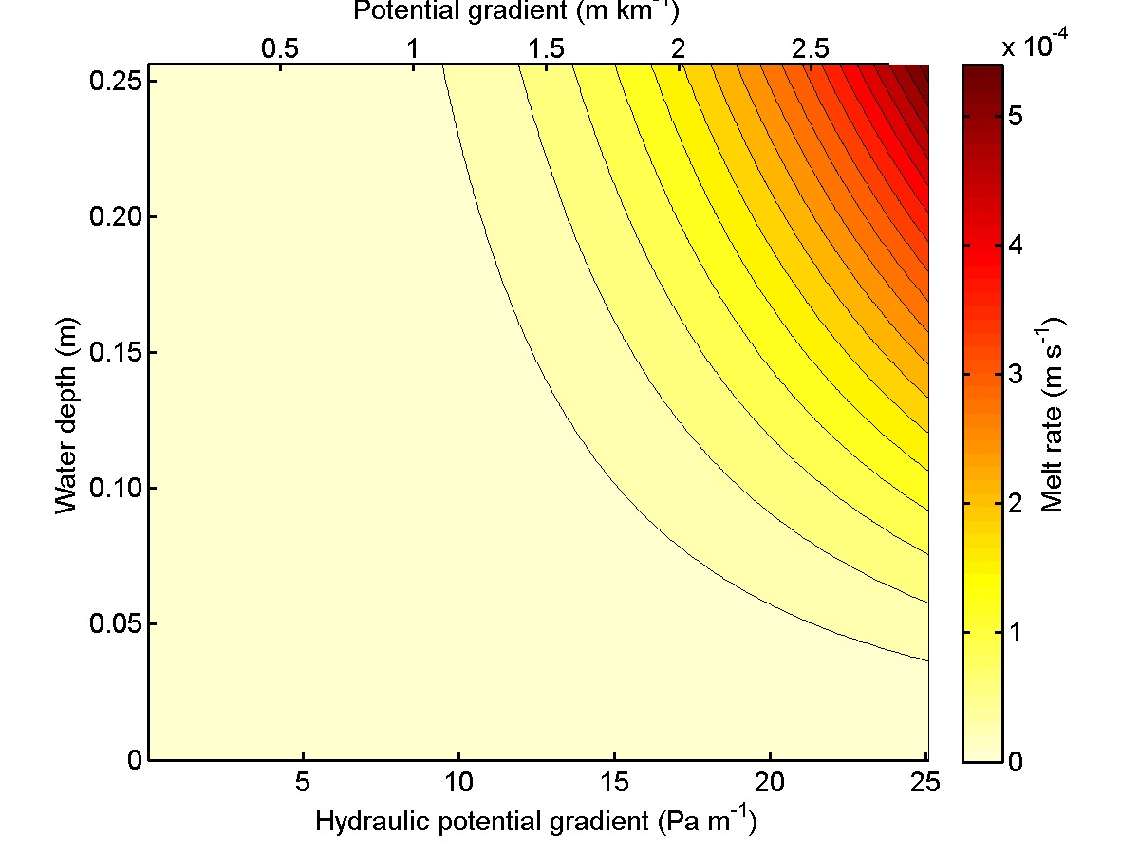
Mass balance: Melt rate
Analytic solution in two dimensions
Smooth
in H
Smooth in ∂φ/∂y

Slide 7
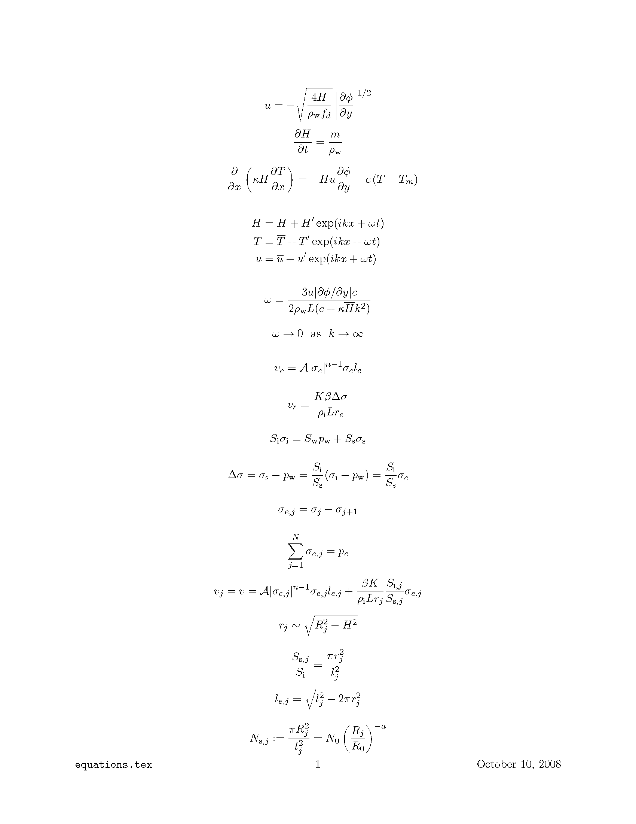
Mass balance: Closure rate
Regelation closure rate and creep closure rate sum to the total closure rate
Velocity is constant across all grain sizes
Bed properties from the sediment distribution (assumed fractal) (grain spacing, effective grain radius, areas of ice and sediment)
Need to calculate stresses
Creep Regelation
(Nye, 1953; Nye, 1967; Weertman 1964)

Slide 8
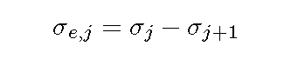
Mass balance: Closure rate
Stress recursion
Define a incremental effective stress between two protrusion sizes j and j+1
The sum of these incremental effective pressures must equal the total effective pressure
Solve for stresses and velocity simultaneously

Slide 9
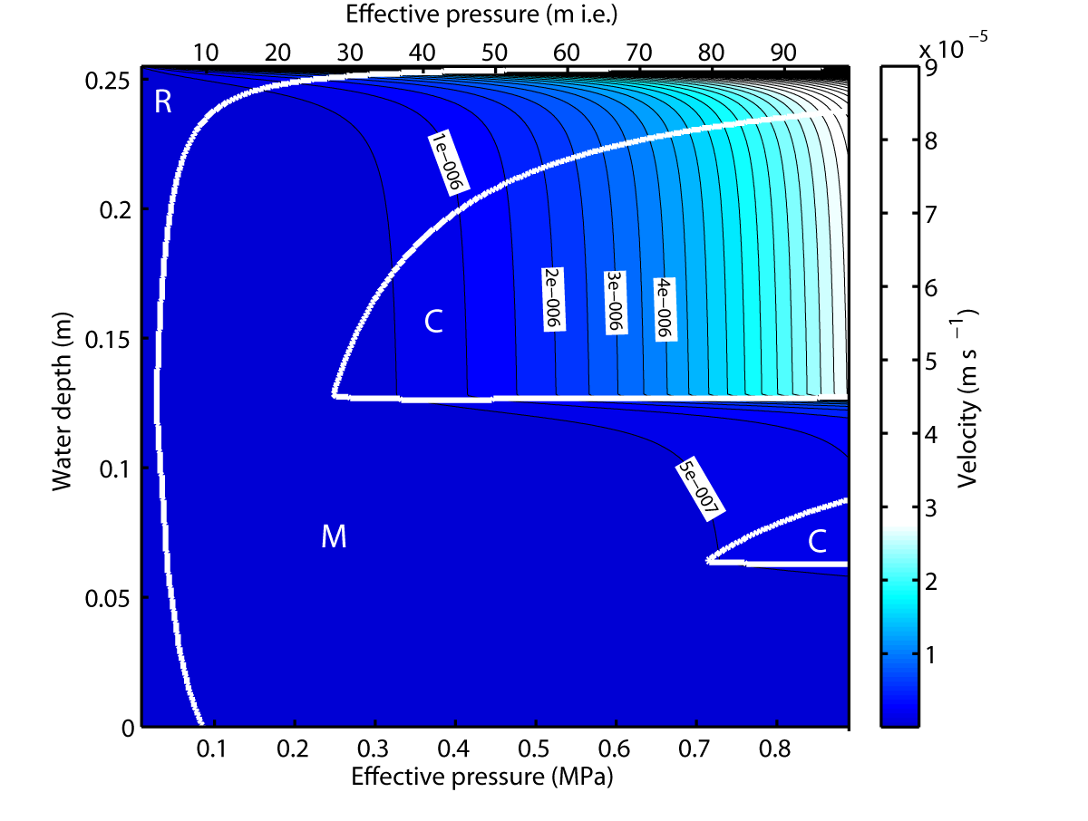
Mass balance: Closure rate
  Clay to Boulders spaced logarithmically (along the Φ-scale)
  Each occupies the same areal fraction of the bed
R1: largest grain size
Not
Smooth
in H
R2: next largest grain size
R3: third largest grain size
Smooth in pe

Slide 10
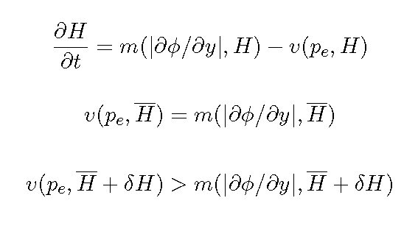
Stability of the water system
Stability criterion:
  For any infinitesimal increase in water depth, the closure rate must be greater than the melt rate for stability
Multiple solutions
  Intersect the melt rate curve and the closure rate curve

Slide 11
Stability of the water system
Intersect the melt rate curve and the closure rate curve
These two sections are on the next slide

Slide 12
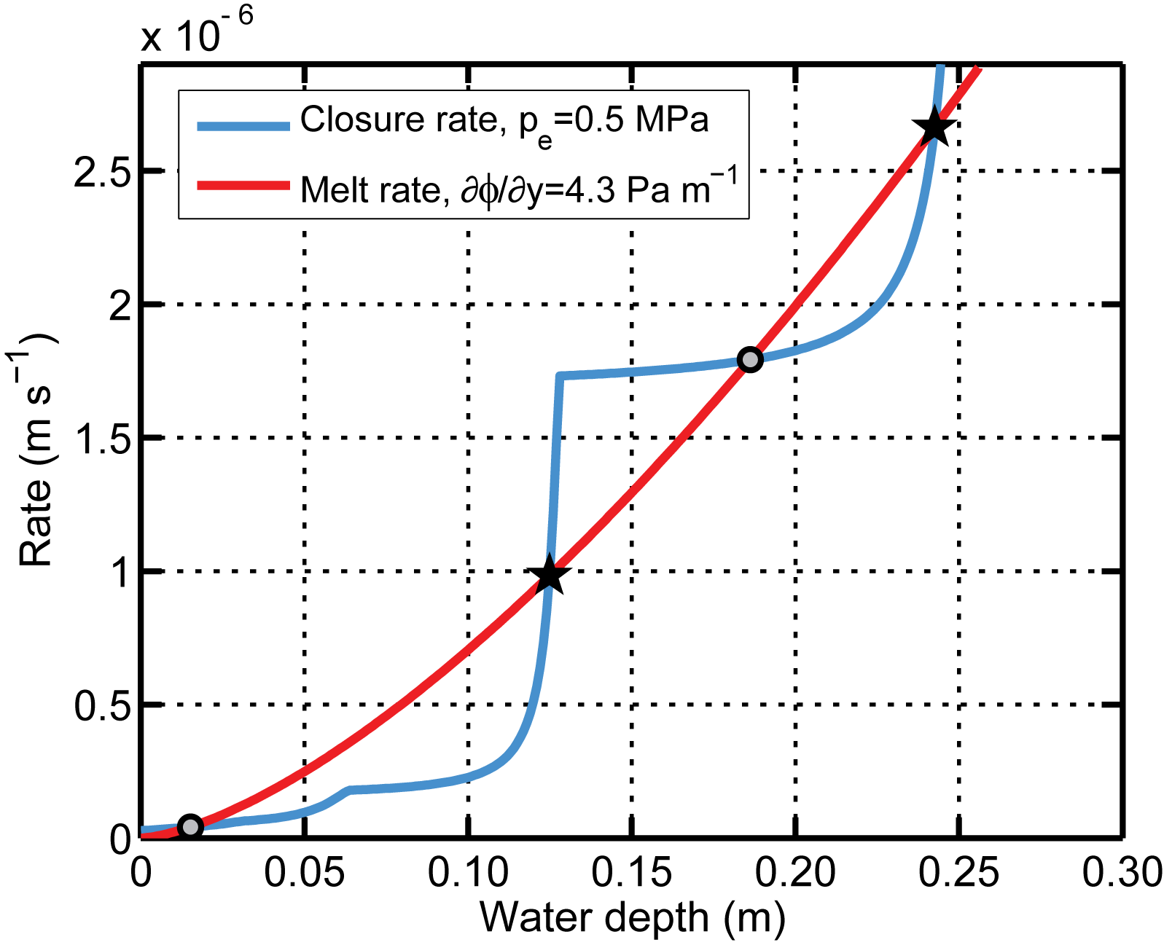
Stability of the water system
Where closure rate and melt rate intersect, there is a steady state solution for water depth
Circles are unstable solutions
Stars are stable solutions
Can do this for all of the closure and melt rate combinations

Slide 13
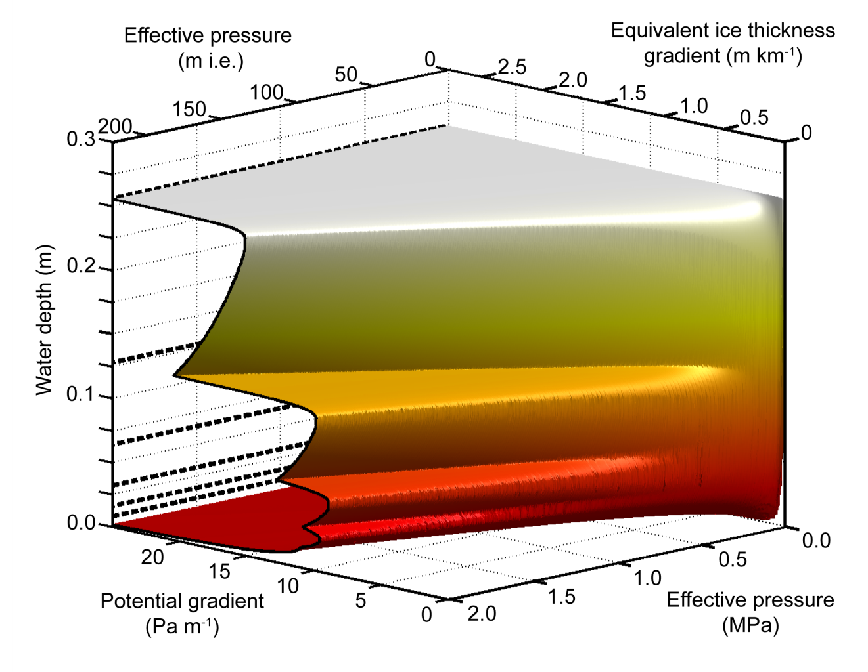
Stability of the water system
Steady state solutions: all intersections
‘Flat’ plateaux (Illuminated parts) are stable
Greyed (upward sloping) areas are unstable
Crenulated appearance means that there are unstable “jumps” between stable water depth solutions
R1
R2
R3
R4
Slices in the next slide

Slide 14
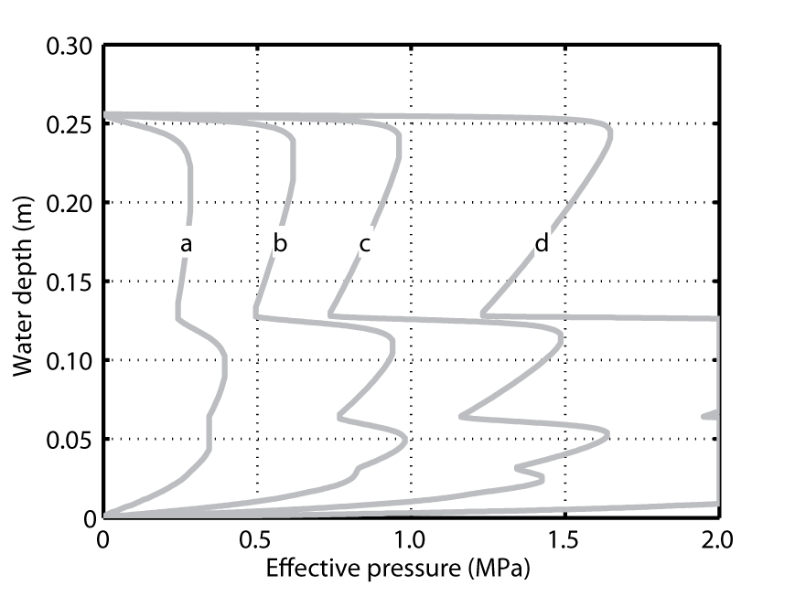
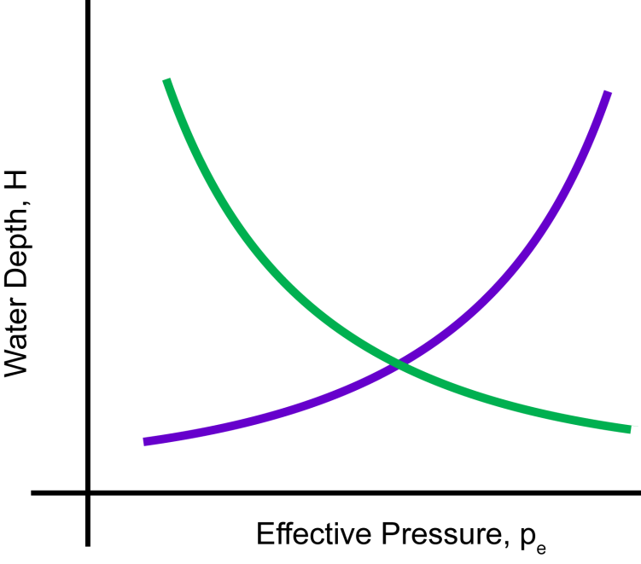
Stability of the water system
Fast
Slow
2.5 Pa/m
5.0 Pa/m
7.5 Pa/m
12.5 Pa/m
Positive sloping (unstable) = “channelizing” drainage
Negative sloping (stable) = “distributing” drainage

Slide 15
Conclusions: Details
Stability is the result of
  A smooth melt rate
  A non-smooth closure rate
Steady state drainage can be both stable and unstable
Caveats
  Knowledge of sub-grid roughness is important
  Grain distribution is largely unknown

Slide 16
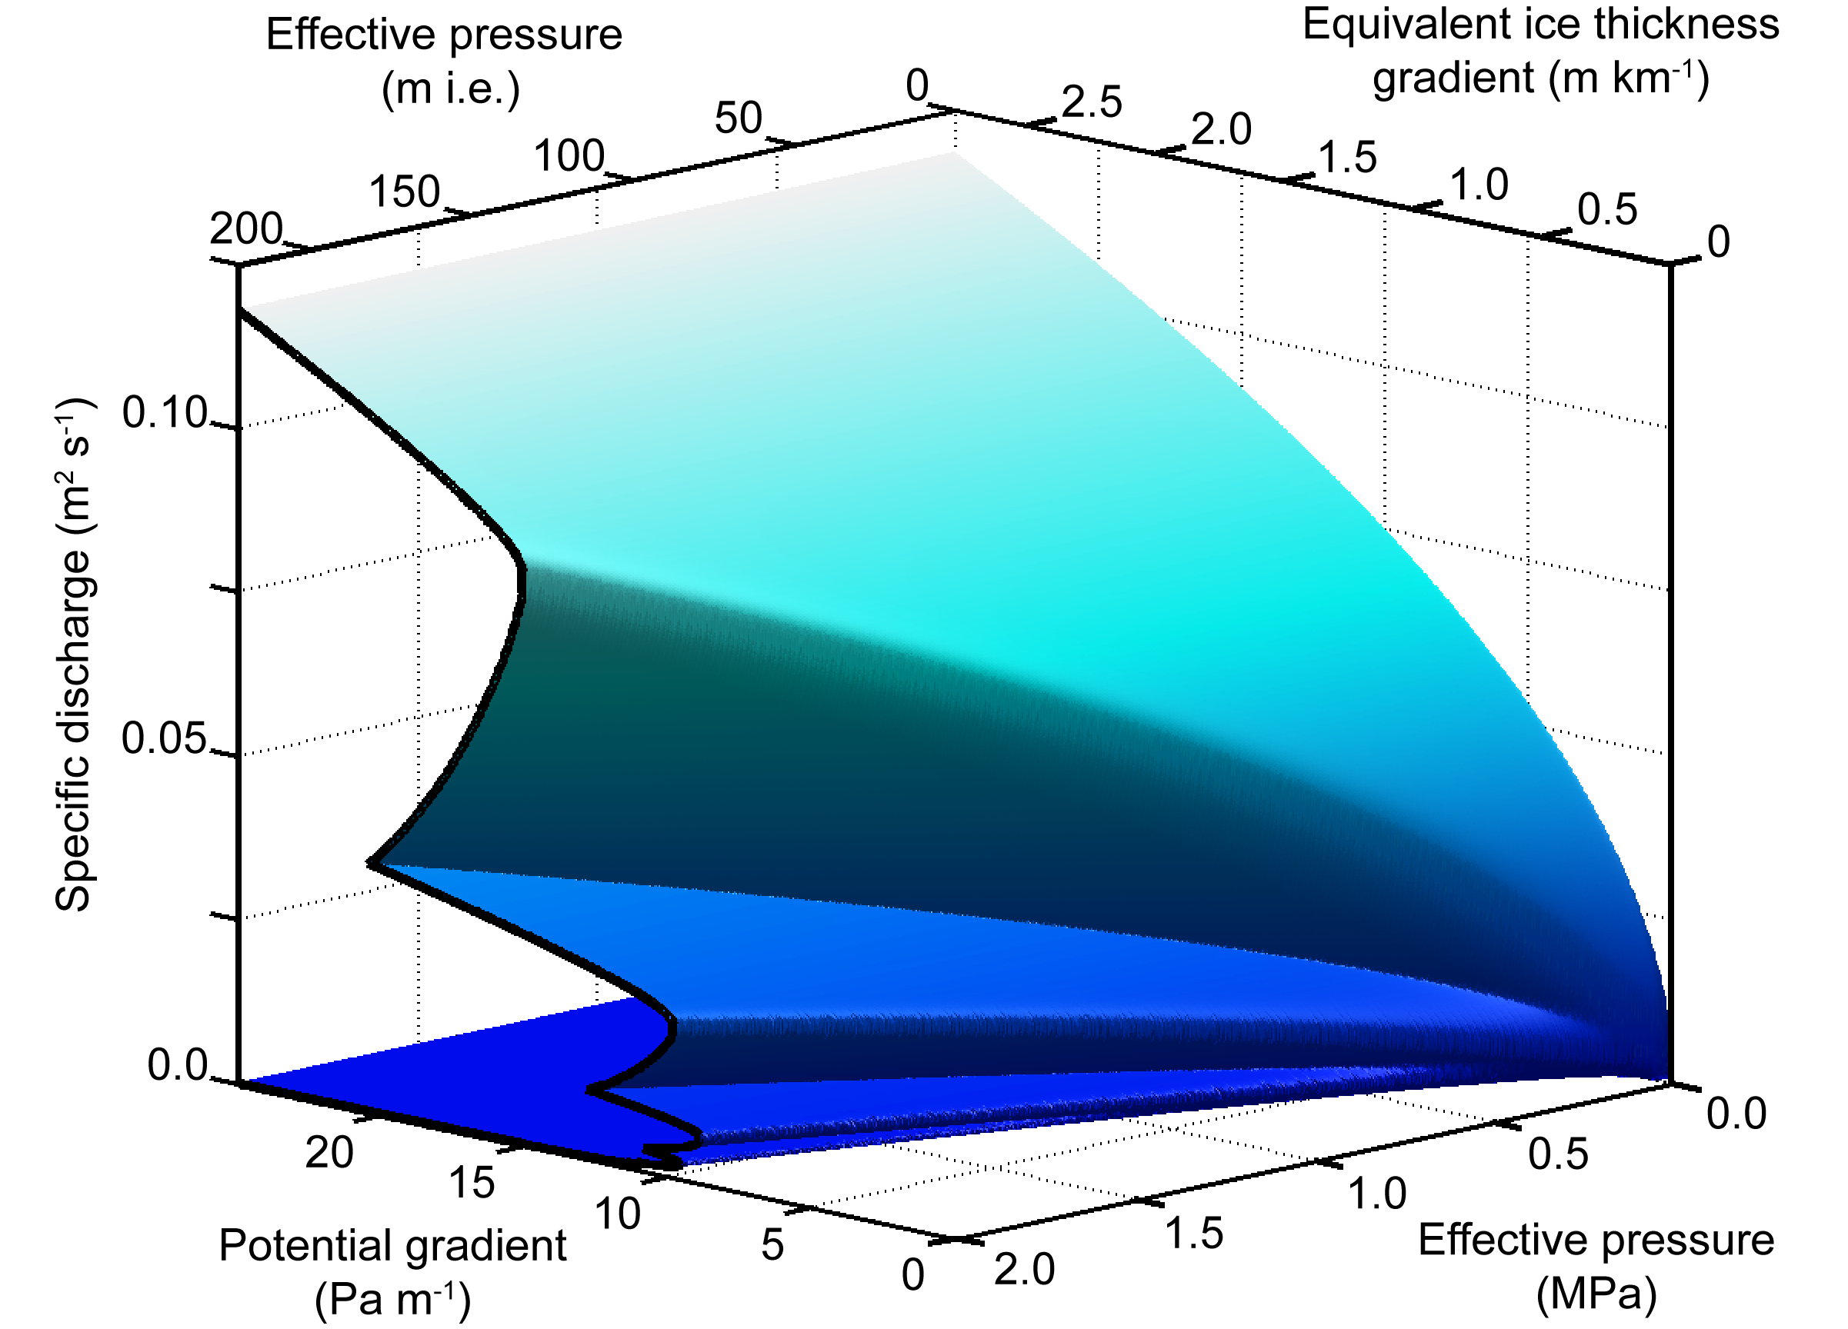

Conclusions: Discharge
Steady state water discharge: Q=Hu,
3D Solution, but now solve for water discharge
Relationship between discharge and potential gradient is the hydraulic conductivity.
“Crenulated” hydraulic conductivity

Slide 17
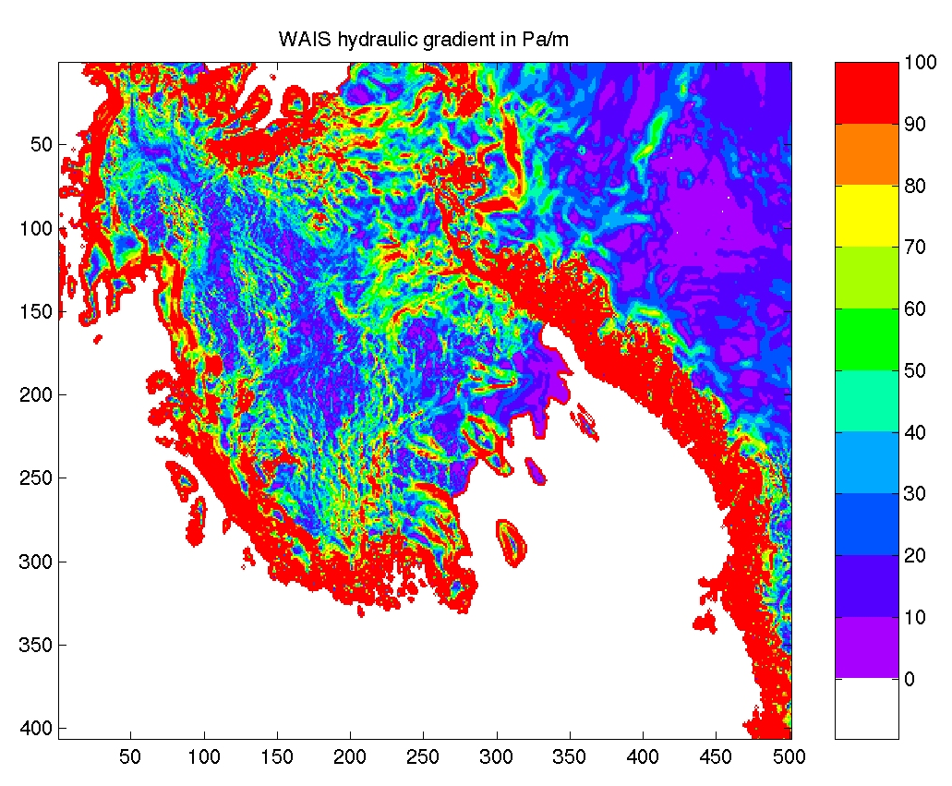
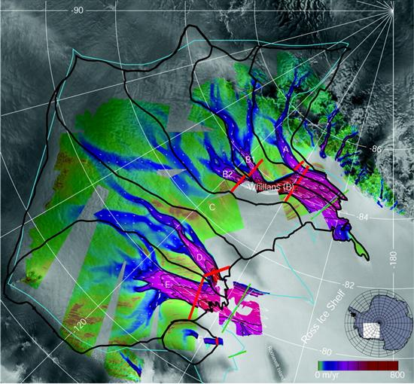
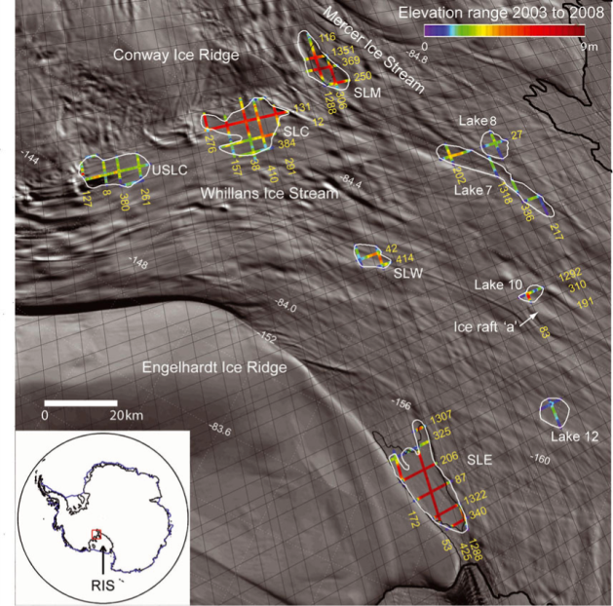
Conclusions: Big Picture
Blue/Purple areas are where this phenomenon likely occurs
Mercer (A), Whillans (B), and MacAyeal (E) Ice streams show this behavior and correspond to the theory presented here
Fricker and Scambos, 2009
Joughin et al, 1999

Slide 18
Summary
  A simple, steady state model of water drainage indicates:
    Water systems can have stable and unstable water discharge
    Low potential gradients driving water flow likely mean “distributed” and “channelized” systems are possible
    Multiple steady states explain discharge behavior under low gradient ice sheets
      Coincident with areas of observed lake filling and draining

Slide 19
Thanks!
Funding through: NSF OPP Postdoctoral Fellowship, NSF M&G program, NSERC, and Univ. British Columbia
Thanks to: R. Alley, H. Bjornsson, G. Clarke, J. Walder, and P. Creyts
T. T. Creyts and C. G. Schoof. In press. Drainage through subglacial water sheets, J. Geophys. Res., doi:10.1029/2008JF001215

Slide 20
End
To exit slide show, press Esc

