Slide 1
Chapter Four
效用Utility

Slide 2
What Do We Do in This Chapter?
We create a mathematical measure of preference in order to advance our analysis.

Slide 3
Preferences偏好——回顾上一章
x y: x is preferred strictly to y.
x ∼ y: x and y are equally preferred.
x y: x is preferred at least as much as is y.
❐

~

Slide 4
Preferences
Completeness(完全性): For any two bundles x and y it is always possible to state either that
x y
or that
y x.

~

~

Slide 5
Preferences
Reflexivity（反身性）: Any bundle x is always at least as preferred as itself; i.e.
x x.

~

Slide 6
Preferences
Transitivity（传递性）: If
x is at least as preferred as y, and
y is at least as preferred as z, then
x is at least as preferred as z; i.e.
x y and y z x z.



~
~
~

Slide 7
效用函数Utility Functions
A preference relation that is complete, reflexive, transitive and continuous can be represented by a continuous utility function.
Continuity（连续性） means that small changes to a consumption bundle cause only small changes to the preference level.

Slide 8
效用函数Utility Functions
A utility function U(x) represents a preference relation if and only if:
x’ x” U(x’) > U(x”)
x’ x” U(x’) < U(x”)
x’ ∼ x” U(x’) = U(x”).

~
❐
❐

Slide 9
效用函数Utility Functions
Utility is an ordinal序数 (i.e. ordering) concept.
E.g. if U(x) = 6 and U(y) = 2 then bundle x is strictly preferred to bundle y. But x is not preferred three times as much as y.

Slide 10
Utility Functions and Indifference Curve
Consider the bundles (4,1), (2,3) and (2,2).
Suppose (2,3) (4,1) ∼ (2,2).
Assign to these bundles any numbers that preserve the preference ordering;
e.g. U(2,3) = 6 > U(4,1) = U(2,2) = 4.
Call these numbers utility levels.
❐

Slide 11
Utility Functions and Indifference Curve
An indifference curve contains equally preferred bundles.
Equal preference ⇒ same utility level.
Therefore, all bundles in an indifference curve have the same utility level.

Slide 12
Utility Functions and Indifference Curve
So the bundles (4,1) and (2,2) are in the indiff. curve with utility level U ≡ 4
But the bundle (2,3) is in the indiff. curve with utility level U ≡ 6.
On an indifference curve diagram, this preference information looks as follows:

Slide 13
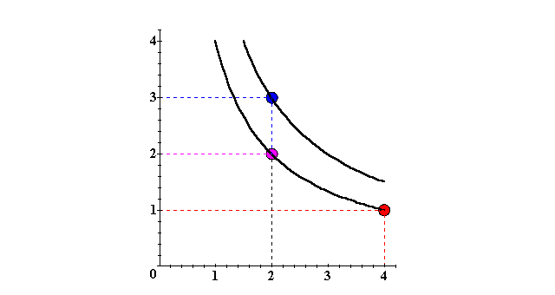
Utility Functions and Indifference Curve
x₂
(2,3) (2,2) ∼ (4,1)
❐
U ≡ 6
U ≡ 4
x₁

Slide 14
Utility Functions and Indifference Curve
Another way to visualize this same information is to plot the utility level on a vertical axis.

Slide 15
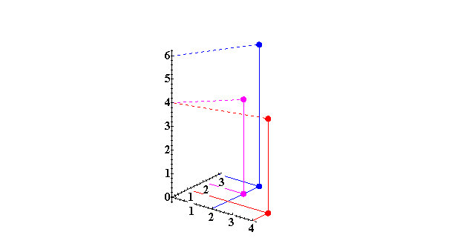
Utility Functions and Indifference Curve
3D plot of consumption & utility levels for 3 bundles
Utility
U(2,3) = 6
U(2,2) = 4
U(4,1) = 4
x₂
x₁

Slide 16
Utility Functions and Indifference Curve
This 3 Dimensions visualization of preferences can be made more informative by adding into it the two indifference curves.

Slide 17
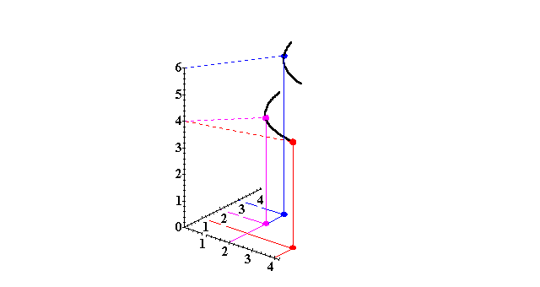
Utility Functions and Indifference Curve
Utility
U ≡ 6
U ≡ 4
x₂
Higher indifference
curves contain
more preferred
bundles.
x₁

Slide 18
Utility Functions and Indifference Curve
Comparing more bundles will create a larger collection of all indifference curves and a better description of the consumer’s preferences.

Slide 19
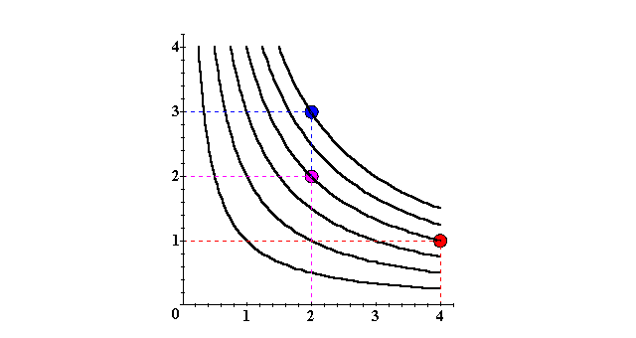
Utility Functions and Indifference Curve
x₂
U ≡ 6
U ≡ 4
U ≡ 2
x₁

Slide 20
Utility Functions and Indifference Curve
As before, this can be visualized in 3D by plotting each indifference curve at the height of its utility index.

Slide 21
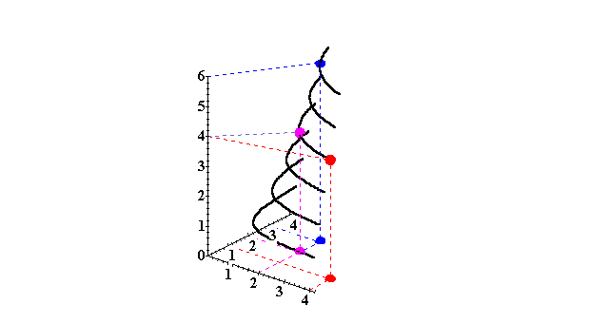
Utility Functions and Indifference Curve
Utility
U ≡ 6
U ≡ 5
U ≡ 4
x₂
U ≡ 3
U ≡ 2
U ≡ 1
x₁

Slide 22
Utility Functions and Indifference Curve
更多的无差异曲线和连续的偏好
Comparing all possible consumption bundles gives the complete collection of the consumer’s indifference curves, each with its assigned utility level.
This complete collection of indifference curves completely represents the consumer’s preferences.
Look at the following animations:

Slide 23
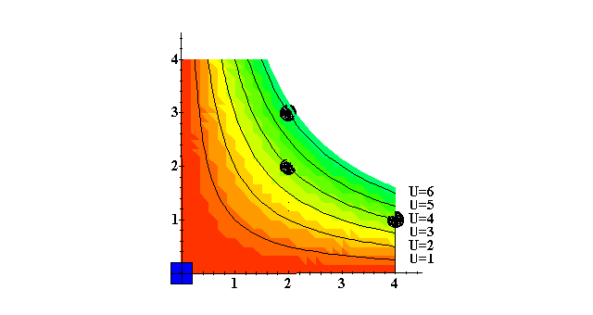
Utility Functions and Indifference Curve
x₂
x₁

Slide 24
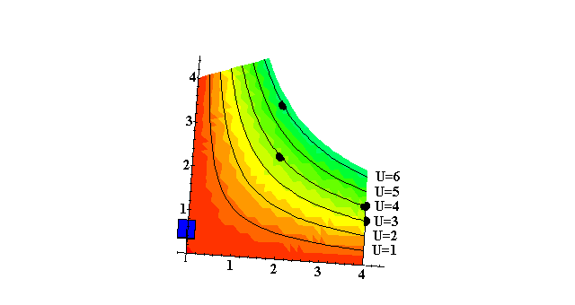
Utility Functions and Indifference Curve
x₂
x₁

Slide 25
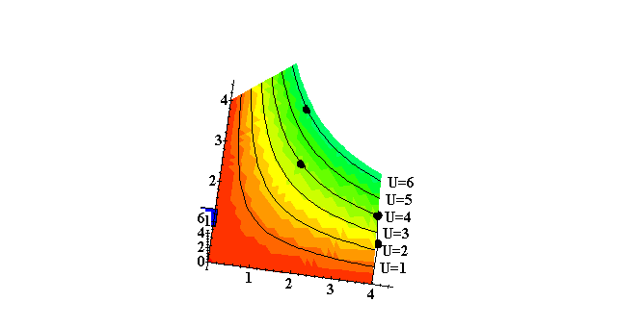
Utility Functions and Indifference Curve
x₂
x₁

Slide 26
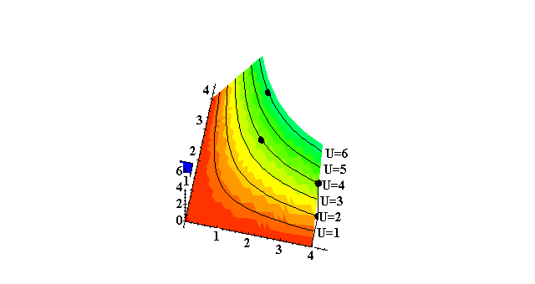
Utility Functions and Indifference Curve
x₂
x₁

Slide 27
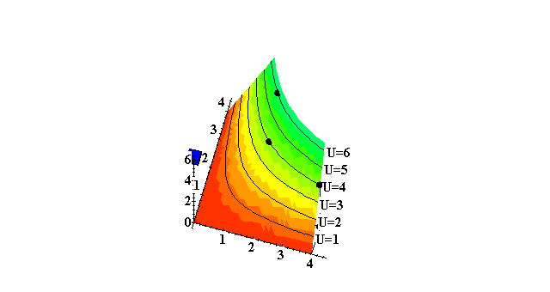
Utility Functions and Indifference Curve
x₂
x₁

Slide 28

Utility Functions and Indifference Curve
x₂
x₁

Slide 29
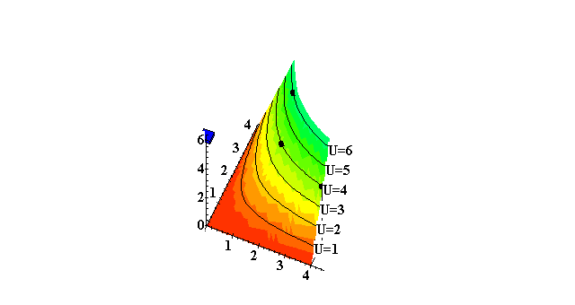
Utility Functions and Indifference Curve
x₁

Slide 30
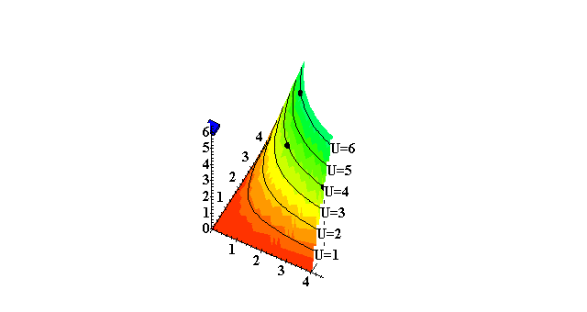
Utility Functions and Indifference Curve
x₁

Slide 31
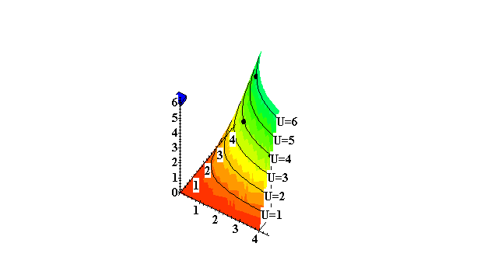
Utility Functions and Indifference Curve
x₁

Slide 32
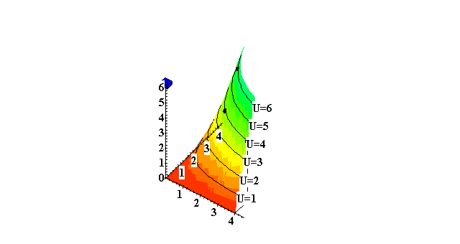
Utility Functions and Indifference Curve
x₁

Slide 33
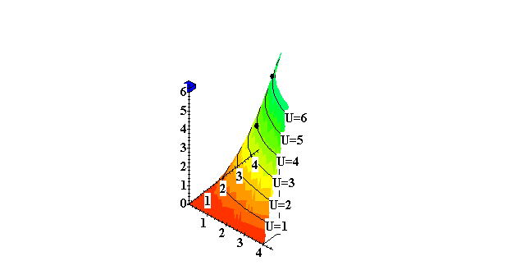
Utility Functions and Indifference Curve
x₁

Slide 34
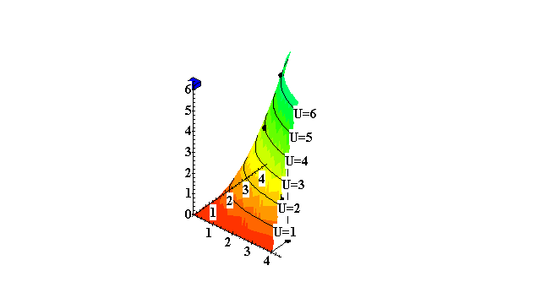
Utility Functions and Indifference Curve
x₁

Slide 35
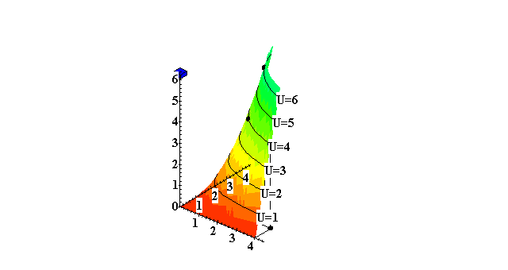
Utility Functions and Indifference Curve
x₁

Slide 36
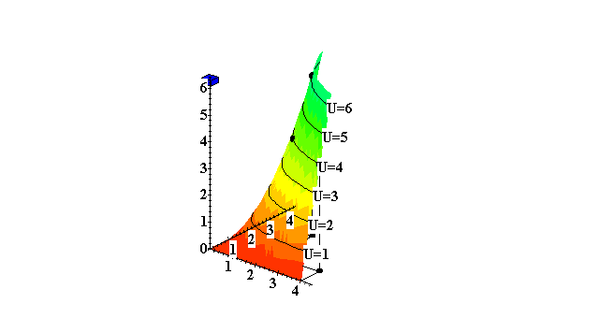
Utility Functions and Indifference Curve
x₁

Slide 37
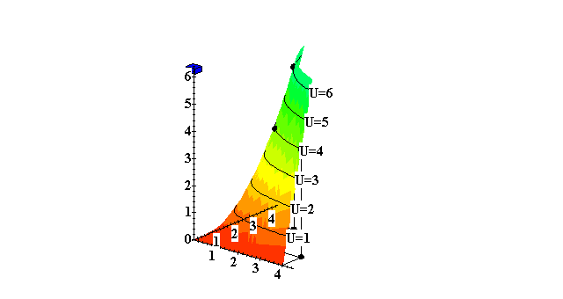
Utility Functions and Indifference Curve
x₁

Slide 38
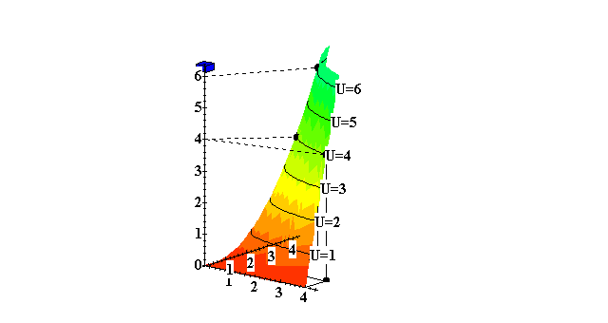

Utility Functions and Indifference Curve
x₁

Slide 39
Utility Functions and Indifference Curve
The collection of all indifference curves for a given preference relation is an indifference map（映射、镜像）.
An indifference map is equivalent to a utility function效用函数.

Slide 40
Utility Functions
There is no unique utility function representation of a preference relation.一个偏好关系可以对应多个效用函数
Suppose U(x₁,x₂) = x₁x₂ represents a preference relation.
Again consider the bundles (4,1),
(2,3) and (2,2).

Slide 41
Utility Functions
U(x₁,x₂) = x₁x₂, so
U(2,3) = 6 > U(4,1) = U(2,2) = 4;
that is, (2,3) (4,1) ∼ (2,2).
❐

Slide 42
Utility Functions
❐
U(x₁,x₂) = x₁x₂ (2,3) (4,1) ∼ (2,2).
Define V = U².

Slide 43
Utility Functions
❐
U(x₁,x₂) = x₁x₂ (2,3) (4,1) ∼ (2,2).
Define V = U².
Then V(x₁,x₂) = x₁²x₂² and
V(2,3) = 36 > V(4,1) = V(2,2) = 16
so again
(2,3) (4,1) ∼ (2,2).
V preserves the same order as U and so represents the same preferences.
❐

Slide 44
Utility Functions
❐
U(x₁,x₂) = x₁x₂ (2,3) (4,1) ∼ (2,2).
Define W = 2U + 10.

Slide 45
Utility Functions
❐
U(x₁,x₂) = x₁x₂ (2,3) (4,1) ∼ (2,2).
Define W = 2U + 10.
Then W(x₁,x₂) = 2x₁x₂+10 so
W(2,3) = 22 > W(4,1) = W(2,2) = 18. Again,
(2,3) (4,1) ∼ (2,2).
W preserves the same order as U and V and so represents the same preferences.
❐

Slide 46
Utility Functions
If
  U is a utility function that represents a preference relation and
  f is a strictly increasing function严格递增的函数,
then V = f(U) is also a utility function
representing . V is a composite function.

~

~

Slide 47
好商品、坏商品、中性商品
A good 好商品is a commodity unit which increases utility (gives a more preferred bundle).
A bad 坏商品is a commodity unit which decreases utility (gives a less preferred bundle).
A neutral中性商品 is a commodity unit which does not change utility (gives an equally preferred bundle).

Slide 48
好商品、坏商品、中性商品
Utility
Utility
function
Units of
water are
goods
Units of
water are
bads
x’
Water
Around x’ units, a little extra water is a neutral.

Slide 49
Utility Functions and Indifference Curve
A Reminder：几种特殊的偏好
Perfect substitute, perfect complements, well-behaved preference。
What are their utility functions？

Slide 50
Perfect Substitute
What are the utility functions？

Slide 51
Utility Functions and Indifference Curve
Instead of U(x₁,x₂) = x₁x₂ consider
V(x₁,x₂) = x₁ + x₂.
What do the indifference curves for this “perfect substitution” utility function look like?

Slide 52
Indifference Curve of Perfect Substitute
x₂
x₁ + x₂ = 5
13
x₁ + x₂ = 9
9
x₁ + x₂ = 13
5
V(x₁,x₂) = x₁ + x₂.
5
9
13
x₁

Slide 53
Indifference Curve of Perfect Substitute
x₂
x₁ + x₂ = 5
13
x₁ + x₂ = 9
9
x₁ + x₂ = 13
5
V(x₁,x₂) = x₁ + x₂.
5
9
13
x₁
All are linear（直线） and parallel（平行）.

Slide 54
Perfect Complement
What are the utility functions？

Slide 55
Utility Functions and Indifference Curves
Instead of U(x₁,x₂) = x₁x₂ or
V(x₁,x₂) = x₁ + x₂, consider
W(x₁,x₂) = min{x₁,x₂}.
What do the indifference curves for this “perfect complementarity” utility function look like?

Slide 56
Indifference Curve of Perfect Complement
x₂
45º
W(x₁,x₂) = min{x₁,x₂}
8
min{x₁,x₂} = 8
5
min{x₁,x₂} = 5
3
min{x₁,x₂} = 3
3
5
8
x₁

Slide 57
Indifference Curve of Perfect Complement
x₂
45º
W(x₁,x₂) = min{x₁,x₂}
8
min{x₁,x₂} = 8
5
min{x₁,x₂} = 5
3
min{x₁,x₂} = 3
3
5
8
x₁
All are right-angled with vertices（顶点） on a ray from the origin（原点）.

Slide 58
The necessities of life
What are the utility functions？

Slide 59
Indifference Curve of the Necessities of Life
A utility function of the form
U(x₁,x₂) = f(x₁) + x₂
is linear in just x₂ and is called quasi-linear拟线性.
E.g. U(x₁,x₂) = 2x₁^{1/2} + x₂.

Slide 60
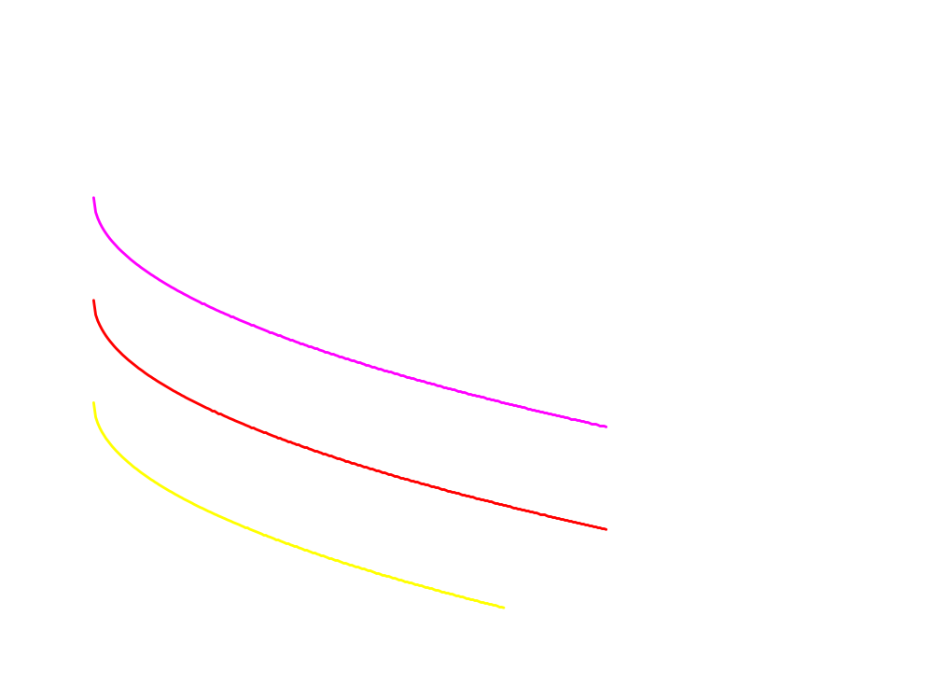
Quasi-linear（拟线性） Indifference Curves
x₂
Each curve is a vertically shifted copy of the others.
拟线性：效用函数关于是线性的x₂=k+v（x₁）
x₁

Slide 61
Well-behaved Preference
What are the utility functions？

Slide 62
Indifference Curve of Well-behaved Preference
Any utility function of the form
U(x₁,x₂) = x₁ª x₂^{b}
with a > 0 and b > 0 is called a Cobb-Douglas utility function柯布·道格拉斯效用函数.
E.g. U(x₁,x₂) = x₁^{1/2} x₂^{1/2} (a = b = 1/2)
V(x₁,x₂) = x₁ x₂³ (a = 1, b = 3)

Slide 63
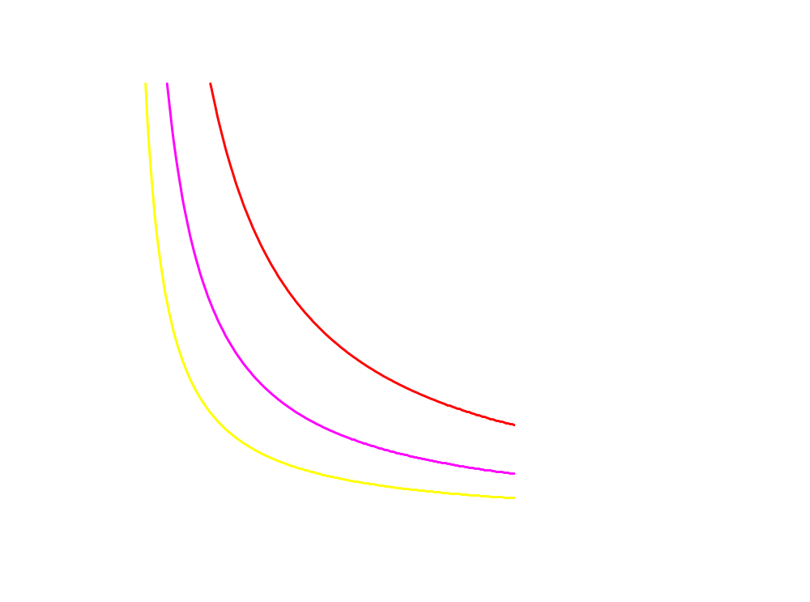
Indifference Curve of Cobb-Douglas utility function
x₂
All curves are hyperbolic双曲线, asymptoting 渐进线的to, but never touching any axis.
Well-Behaved Preferences（良态偏好）
x₁

Slide 64
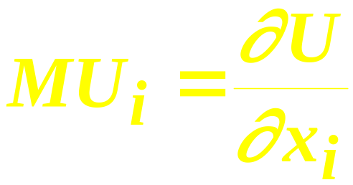
Marginal Utilities
边际意味着增量Marginal means “incremental”.
The marginal utility of commodity i is the rate-of-change of total utility as the quantity of commodity i consumed changes; i.e.

Slide 65
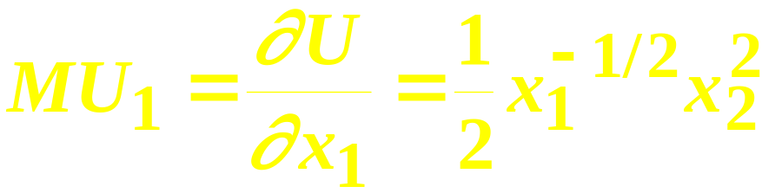
Marginal Utilities
E.g. if U(x₁,x₂) = x₁^{1/2} x₂² then

Slide 66
Marginal Utilities
E.g. if U(x₁,x₂) = x₁^{1/2} x₂² then

Slide 67
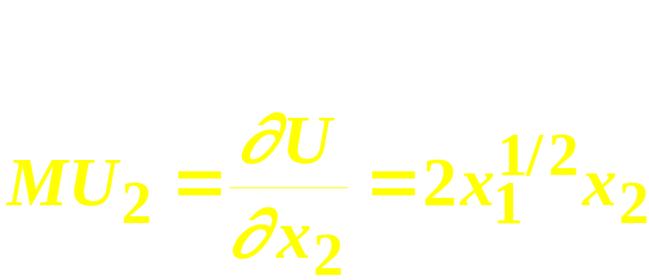
Marginal Utilities
E.g. if U(x₁,x₂) = x₁^{1/2} x₂² then

Slide 68
Marginal Utilities
E.g. if U(x₁,x₂) = x₁^{1/2} x₂² then

Slide 69
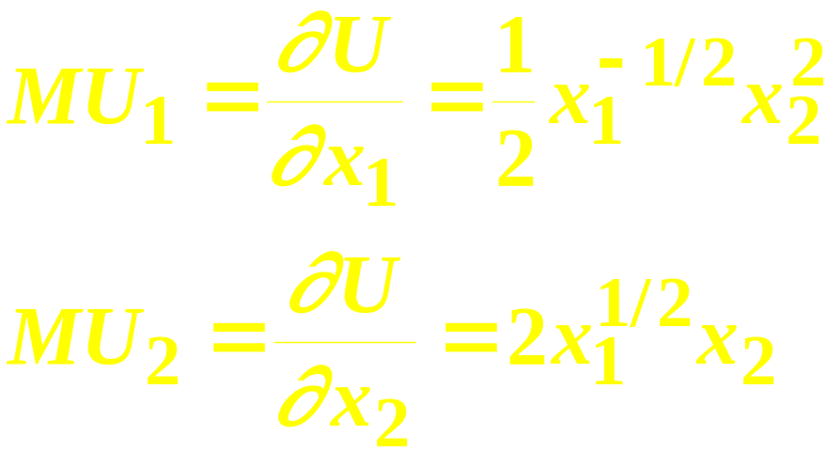
Marginal Utilities
So, if U(x₁,x₂) = x₁^{1/2} x₂² then

Slide 70
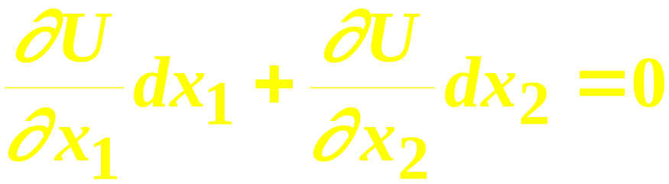
Marginal Utilities and MRS
The general equation for an indifference curve is
U(x₁,x₂) ≡ k, a constant.
Totally differentiating this identity gives

Slide 71
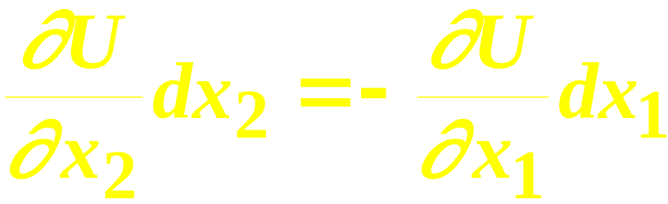
Marginal Utilities and MRS
rearranged is

Slide 72

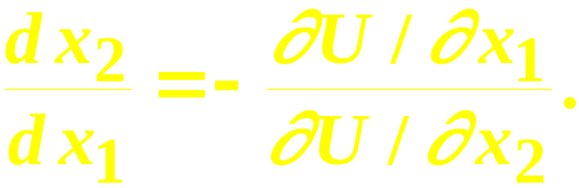
Marginal Utilities and MRS
And
rearranged is
This is the MRS.

Slide 73
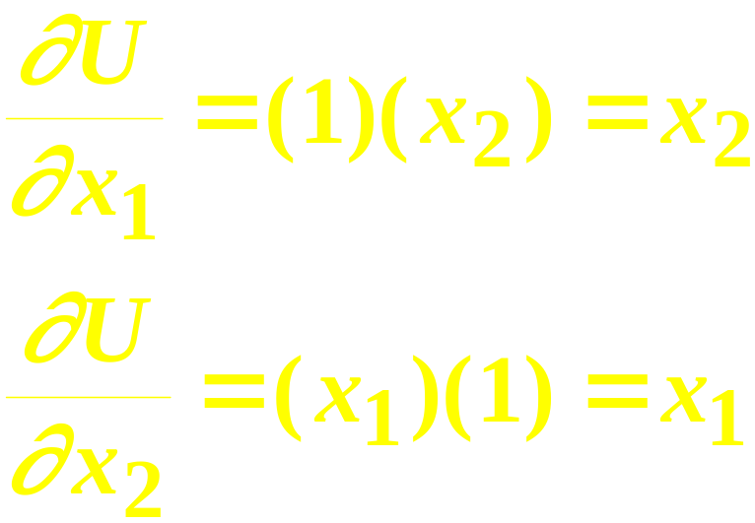
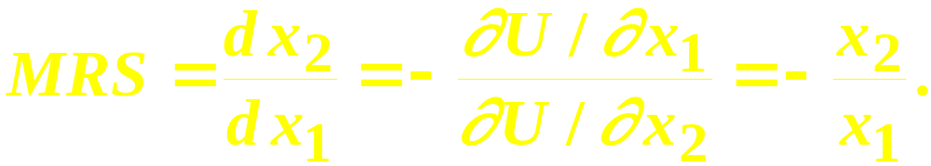
Marginal Utilities and MRS：an example
Suppose U(x₁,x₂) = x₁x₂. Then
so

Slide 74
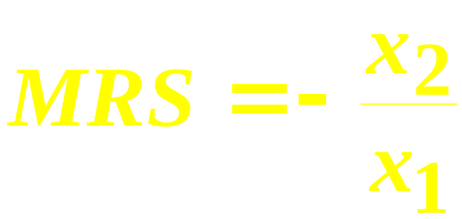
Marginal Utilities and MRS：an example
U(x₁,x₂) = x₁x₂;
x₂
8
MRS(1,8) = - 8/1 = -8
MRS(6,6) = - 6/6 = -1.
6
U = 36
U = 8
1
6
x₁

Slide 75
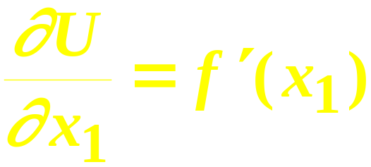
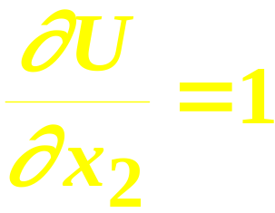
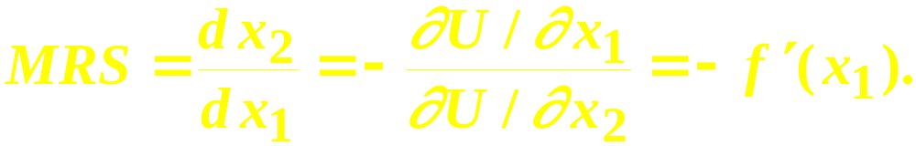
Marg. Rates-of-Substitution for Quasi-linear Utility Functions
A quasi-linear utility function is of the form U(x₁,x₂) = f(x₁) + x₂.
so

Slide 76
Marg. Rates-of-Substitution for Quasi-linear Utility Functions
′
MRS = - f (x₁) does not depend upon x₂ so the slope of indifference curves for a quasi-linear utility function is constant along any line for which x₁ is constant. What does that make the indifference map for a quasi-linear utility function look like?

Slide 77
Marg. Rates-of-Substitution for Quasi-linear Utility Functions
x₂
MRS =
- f(x₁’)
Each curve is a vertically shifted copy of the others.
MRS = -f(x₁”)
MRS is a constant
along any line for which x₁ is
constant.
x₁’
x₁”
x₁

Slide 78
Monotonic Transformations & Marginal Rates -of-Substitution边际替代率和单调变换
Applying a monotonic transformation to a utility function representing a preference relation simply creates another utility function representing the same preference relation. 单调变换的效用函数代表相同的偏好
What happens to marginal rates-of-substitution when a monotonic transformation is applied?边际替代率如何变化呢？

Slide 79
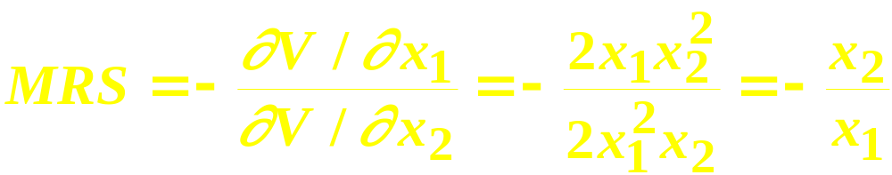
Monotonic Transformations & Marginal Rates -of-Substitution边际替代率和单调变换
For U(x₁,x₂) = x₁x₂ the MRS = - x₂/x₁.
Create V = U²; i.e. V(x₁,x₂) = x₁²x₂². What is the MRS for V?
which is the same as the MRS for U.

Slide 80
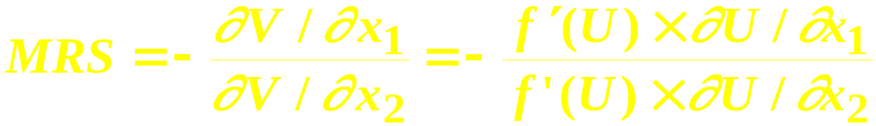
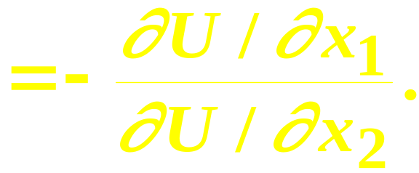
Monotonic Transformations & Marginal Rates -of-Substitution边际替代率和单调变换
More generally, if V = f(U) where f is a strictly increasing function, then
So MRS is unchanged by a positive
monotonic transformation.

