Slide 1
Chapter 5
选择

Slide 2
Economic Rationality经济理性
The principal behavioral postulate is that a decisionmaker chooses its most preferred alternative from those available to it.
The available choices constitute the choice set.
How is the most preferred bundle in the choice set located?

Slide 3
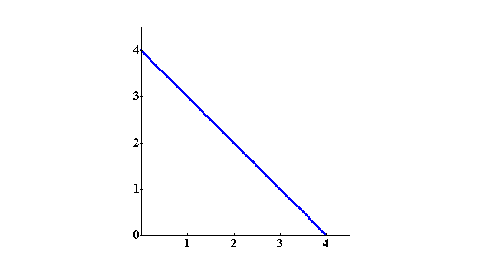
Rational Constrained Choice约束下的理性选择
x₂
x₁

Slide 4
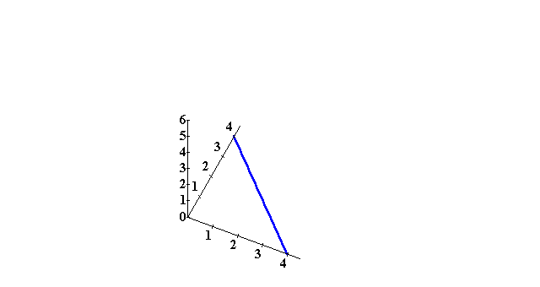
Rational Constrained Choice
Utility
x₂
x₁

Slide 5
Rational Constrained Choice
Utility
x₂
x₁

Slide 6
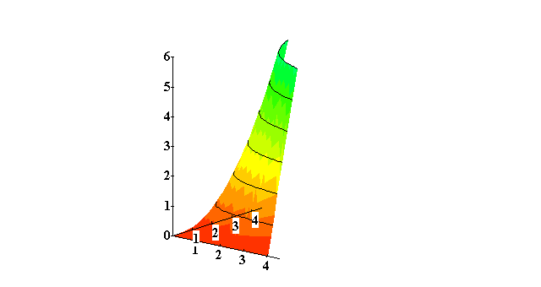
Rational Constrained Choice
Utility
x₂
x₁

Slide 7
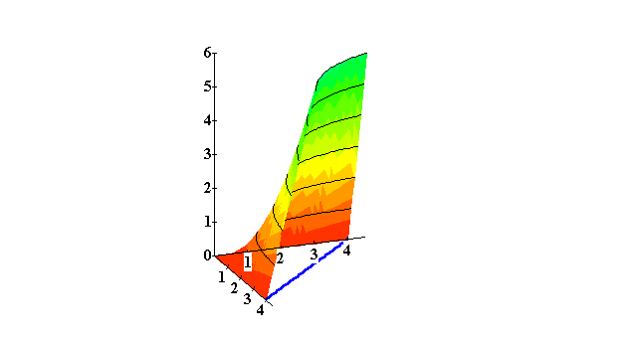
Rational Constrained Choice
Utility
x₂
x₁

Slide 8
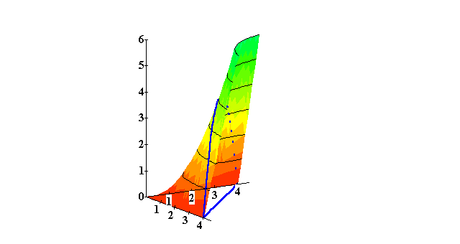
Rational Constrained Choice
Utility
x₂
x₁

Slide 9
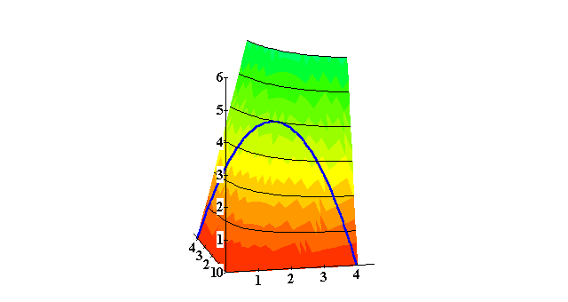
Rational Constrained Choice
Utility
x₂
x₁

Slide 10
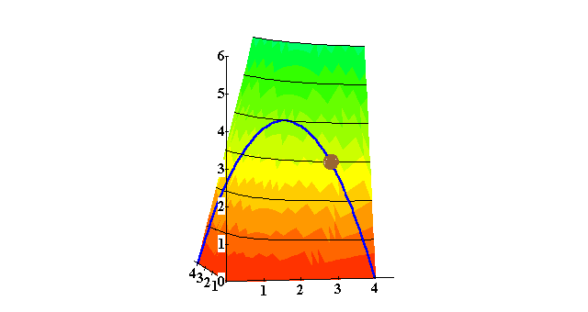
Rational Constrained Choice
Utility
x₂
x₁

Slide 11
Rational Constrained Choice
Utility
Affordable, but not the most preferred affordable bundle.
x₂
x₁

Slide 12

Rational Constrained Choice
Utility
The most preferred
of the affordable
bundles.
Affordable, but not the most preferred affordable bundle.
x₂
x₁

Slide 13
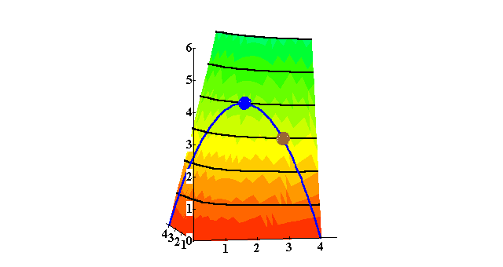
Rational Constrained Choice
Utility
x₂
x₁

Slide 14
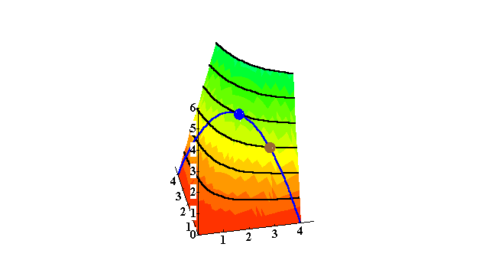
Rational Constrained Choice
Utility
x₂
x₁

Slide 15
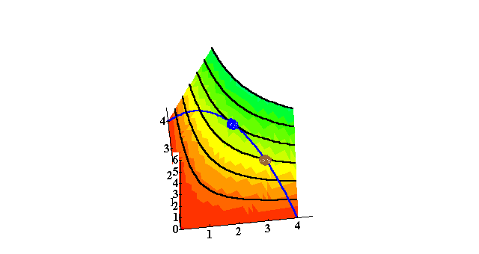
Rational Constrained Choice
x₂
Utility
x₁

Slide 16
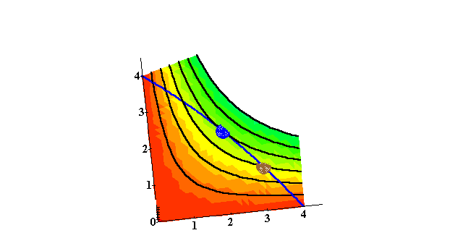
Rational Constrained Choice
x₂
Utility
x₁

Slide 17
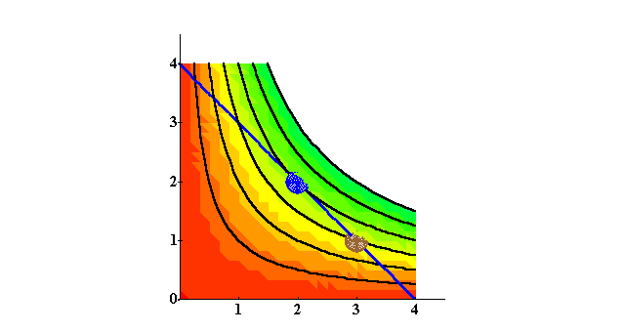
Rational Constrained Choice
x₂
The point of tangency is
the optimal choice
x₁

Slide 18
Rational Constrained Choice
x₂
Affordable
bundles
x₁

Slide 19
Rational Constrained Choice
x₂
Affordable
bundles
x₁

Slide 20
Rational Constrained Choice
x₂
More preferred
bundles
Affordable
bundles
x₁

Slide 21
Rational Constrained Choice
x₂
More preferred
bundles
Affordable
bundles
x₁

Slide 22
Rational Constrained Choice
x₂
x₂*
x₁*
x₁

Slide 23
Rational Constrained Choice
x₂
(x₁*,x₂*) is the most
preferred affordable
bundle.
It is also an equilibrium
Point.
x₂*
x₁*
x₁

Slide 24
Rational Constrained Choice
The most preferred affordable bundle is called the consumer’s ORDINARY DEMAND 一般性需求at the given prices and budget.
Ordinary demands will be denoted by
x₁*(p₁,p₂,m) and x₂*(p₁,p₂,m).

Slide 25
Rational Constrained Choice
When x₁* > 0 and x₂* > 0 the demanded bundle is INTERIOR(内点解).
If buying (x₁*,x₂*) costs $m then the budget is exhausted.

Slide 26
Rational Constrained Choice
x₂
(x₁*,x₂*) is interior.
(x₁*,x₂*) exhausts the
budget.
x₂*
x₁*
x₁

Slide 27
Rational Constrained Choice
x₂
(x₁*,x₂*) is interior.
(a) (x₁*,x₂*) exhausts the
budget; p₁x₁* + p₂x₂* = m.
x₂*
x₁*
x₁

Slide 28
Rational Constrained Choice
x₂
(x₁*,x₂*) is interior .
(b) The slope of the indiff.
curve at (x₁*,x₂*) equals
the slope of the budget
constraint.
x₂*
x₁*
x₁

Slide 29
Rational Constrained Choice
(x₁*,x₂*) satisfies two conditions:
(a) the budget is exhausted;
p₁x₁* + p₂x₂* = m
(b) the slope of the budget constraint, -p₁/p₂, and the slope of the indifference curve containing (x₁*,x₂*) are equal at (x₁*,x₂*).

Slide 30
Computing Ordinary Demands
How can this information be used to locate (x₁*,x₂*) for given p₁, p₂ and m?

Slide 31

Computing Ordinary Demands- a Cobb-Douglas Example.
Suppose that the consumer has Cobb-Douglas preferences.

Slide 32
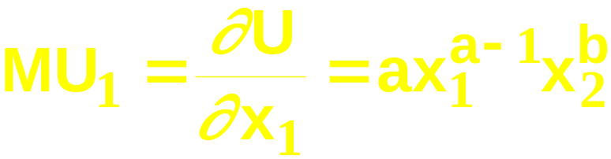
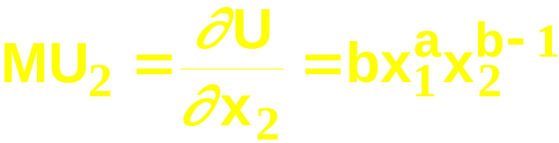
Computing Ordinary Demands- a Cobb-Douglas Example.
Suppose that the consumer has Cobb-Douglas preferences.
Then

Slide 33
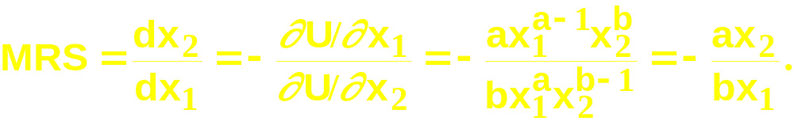
Computing Ordinary Demands- a Cobb-Douglas Example.
So the MRS is

Slide 34
计算一般性需求- a Cobb-Douglas Example.
So the MRS is
At (x₁*,x₂*), MRS = -p₁/p₂ so

Slide 35
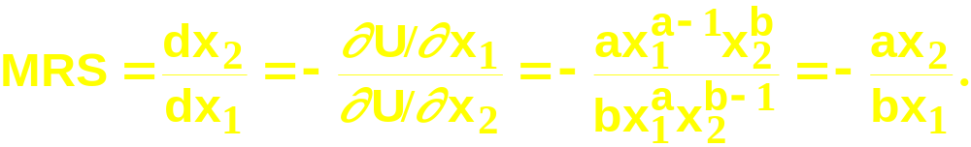
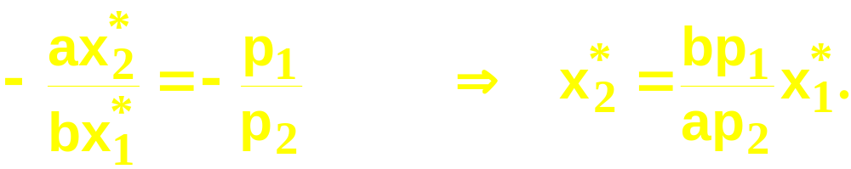
计算一般性需求- a Cobb-Douglas Example.
So the MRS is
At (x₁*,x₂*), MRS = -p₁/p₂ so
(A)

Slide 36

计算一般性需求- a Cobb-Douglas Example.
(x₁*,x₂*) also exhausts the budget so
(B)

Slide 37
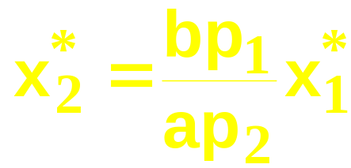

计算一般性需求- a Cobb-Douglas Example.
So now we know that
(A)
(B)

Slide 38
计算一般性需求- a Cobb-Douglas Example.
So now we know that
(A)
Substitute
(B)

Slide 39
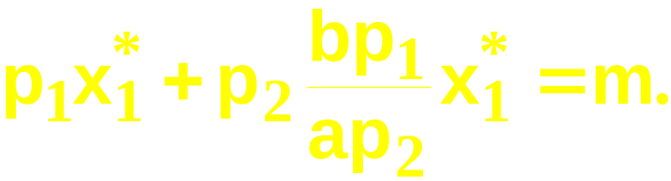
计算一般性需求- a Cobb-Douglas Example.
So now we know that
(A)
Substitute
(B)
and get
This simplifies to ….

Slide 40
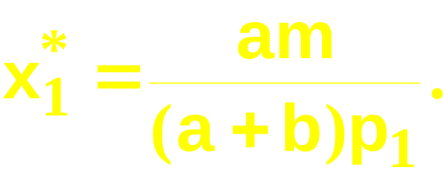
计算一般性需求- a Cobb-Douglas Example.

Slide 41
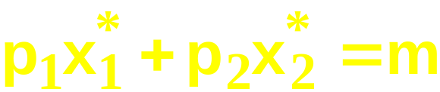
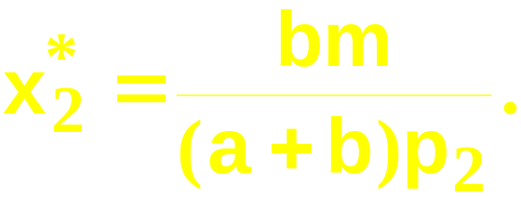
计算一般性需求- a Cobb-Douglas Example.
Substituting for x₁* in
then gives

Slide 42
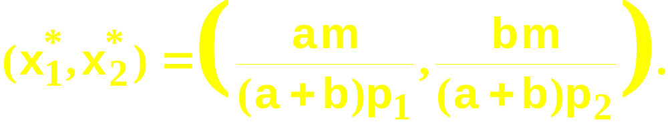
计算一般性需求- a Cobb-Douglas Example.
So we have discovered that the most
preferred affordable bundle for a consumer with Cobb-Douglas preferences
is

Slide 43

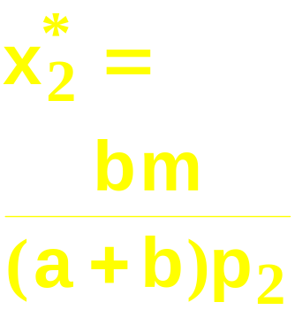
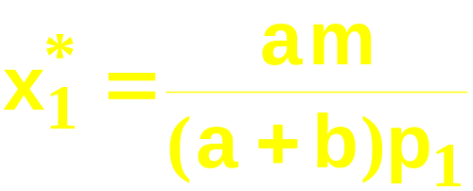
计算一般性需求- a Cobb-Douglas Example.
x₂
x₁

Slide 44
Rational Constrained Choice约束下的理性选择
When x₁* > 0 and x₂* > 0
and (x₁*,x₂*) exhausts the budget,
and indifference curves have no
‘kinks’扭折, the ordinary demands are obtained by solving:
(a) p₁x₁* + p₂x₂* = y
(b) the slopes of the budget constraint, -p₁/p₂, and of the indifference curve containing (x₁*,x₂*) are equal at (x₁*,x₂*).

Slide 45
Rational Constrained Choice约束下的理性选择
But what if x₁* = 0?
Or if x₂* = 0?
If either x₁* = 0 or x₂* = 0 then the ordinary demand (x₁*,x₂*) is at a corner solution（角点解） to the problem of maximizing utility subject to a budget constraint.

Slide 46
Examples of Corner Solutions—the Perfect Substitutes Case完美替代
x₂
MRS = -1
x₁

Slide 47
Examples of Corner Solutions—the Perfect Substitutes Case
x₂
MRS = -1
Slope = -p₁/p₂ with p₁ > p₂.
x₁

Slide 48
Examples of Corner Solutions -- the Perfect Substitutes Case
x₂
MRS = -1
Slope = -p₁/p₂ with p₁ > p₂.
x₁

Slide 49
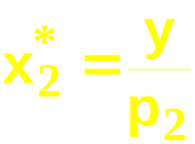
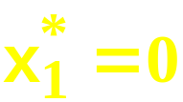
Examples of Corner Solutions -- the Perfect Substitutes Case
x₂
MRS = -1
Slope = -p₁/p₂ with p₁ > p₂.
x₁

Slide 50
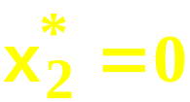
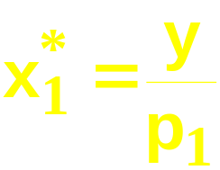
Examples of Corner Solutions -- the Perfect Substitutes Case
x₂
MRS = -1
Slope = -p₁/p₂ with p₁ < p₂.
x₁

Slide 51
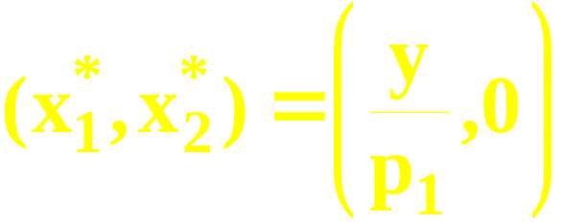
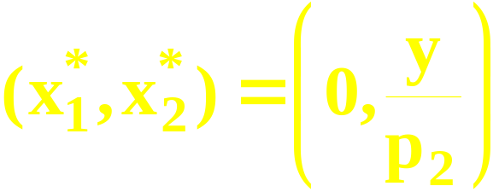
Examples of Corner Solutions -- the Perfect Substitutes Case
So when U(x₁,x₂) = x₁ + x₂, the most
preferred affordable bundle is (x₁*,x₂*)
where
if p₁ < p₂
and
if p₁ > p₂.

Slide 52


Examples of Corner Solutions -- the Perfect Substitutes Case
x₂
MRS = -1
Slope = -p₁/p₂ with p₁ = p₂.
x₁

Slide 53

Examples of Corner Solutions -- the Perfect Substitutes Case
x₂
All the bundles in the
constraint are equally the
most preferred affordable
when p₁ = p₂.
x₁

Slide 54
角点解的例子—the Non-Convex Preferences Case非凸偏好的情形
x₂
Better
x₁

Slide 55
Examples of Corner Solutions -- the Non-Convex Preferences Case
x₂
x₁

Slide 56
Examples of Corner Solutions -- the Non-Convex Preferences Case
x₂
Which is the most preferred
affordable bundle?
x₁

Slide 57
Examples of Corner Solutions -- the Non-Convex Preferences Case
x₂
The most preferred
affordable bundle
x₁

Slide 58
Examples of Corner Solutions -- the Non-Convex Preferences Case
Notice that the “tangency solution”
is not the most preferred affordable
bundle.
x₂
The most preferred
affordable bundle
x₁

Slide 59
Examples of ‘Kinky’ Solutions扭折解-- the Perfect Complements Case
x₂
U(x₁,x₂) = min{ax₁,x₂}
x₂ = ax₁
x₁

Slide 60
Examples of ‘Kinky’ Solutions扭折解-- the Perfect Complements Case
x₂
U(x₁,x₂) = min{ax₁,x₂}
x₂ = ax₁
MRS = 0
x₁

Slide 61
Examples of ‘Kinky’ Solutions扭折解-- the Perfect Complements Case
x₂
U(x₁,x₂) = min{ax₁,x₂}
MRS = -
∞
x₂ = ax₁
MRS = 0
x₁

Slide 62
Examples of ‘Kinky’ Solutions扭折解-- the Perfect Complements Case
x₂
U(x₁,x₂) = min{ax₁,x₂}
MRS = -
∞
MRS is undefined
x₂ = ax₁
MRS = 0
x₁

Slide 63
Examples of ‘Kinky’ Solutions扭折解-- the Perfect Complements Case
x₂
U(x₁,x₂) = min{ax₁,x₂}
x₂ = ax₁
x₁

Slide 64
Examples of ‘Kinky’ Solutions扭折解-- the Perfect Complements Case
x₂
U(x₁,x₂) = min{ax₁,x₂}
Which is the most
preferred affordable bundle?
x₂ = ax₁
x₁

Slide 65
Examples of ‘Kinky’ Solutions扭折解-- the Perfect Complements Case
x₂
U(x₁,x₂) = min{ax₁,x₂}
The most preferred
affordable bundle
x₂ = ax₁
x₁

Slide 66
Examples of ‘Kinky’ Solutions扭折解-- the Perfect Complements Case
x₂
U(x₁,x₂) = min{ax₁,x₂}
x₂ = ax₁
x₂*
x₁*
x₁

Slide 67
Examples of ‘Kinky’ Solutions扭折解-- the Perfect Complements Case
x₂
U(x₁,x₂) = min{ax₁,x₂}
(a) p₁x₁* + p₂x₂* = m
x₂ = ax₁
x₂*
x₁*
x₁

Slide 68
Examples of ‘Kinky’ Solutions扭折解-- the Perfect Complements Case
x₂
U(x₁,x₂) = min{ax₁,x₂}
(a) p₁x₁* + p₂x₂* = m
(b) x₂* = ax₁*
x₂ = ax₁
x₂*
x₁*
x₁

Slide 69
Examples of ‘Kinky’ Solutions扭折解-- the Perfect Complements Case
(a) p₁x₁* + p₂x₂* = m; (b) x₂* = ax₁*.

Slide 70
Examples of ‘Kinky’ Solutions扭折解-- the Perfect Complements Case
(a) p₁x₁* + p₂x₂* = m; (b) x₂* = ax₁*.
Substitution from (b) for x₂* in (a) gives p₁x₁* + p₂ax₁* = m

Slide 71
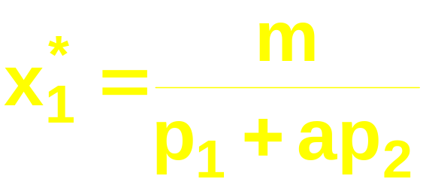
Examples of ‘Kinky’ Solutions扭折解-- the Perfect Complements Case
(a) p₁x₁* + p₂x₂* = m; (b) x₂* = ax₁*.
Substitution from (b) for x₂* in (a) gives p₁x₁* + p₂ax₁* = m
which gives

Slide 72
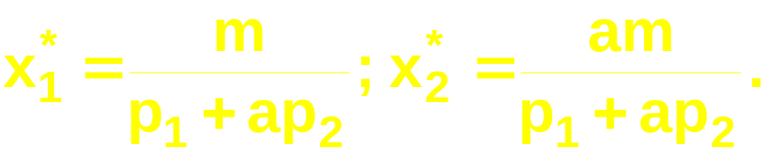
Examples of ‘Kinky’ Solutions扭折解-- the Perfect Complements Case
(a) p₁x₁* + p₂x₂* = m; (b) x₂* = ax₁*.
Substitution from (b) for x₂* in (a) gives p₁x₁* + p₂ax₁* = m
which gives

Slide 73
Examples of ‘Kinky’ Solutions扭折解-- the Perfect Complements Case
(a) p₁x₁* + p₂x₂* = m; (b) x₂* = ax₁*.
Substitution from (b) for x₂* in (a) gives p₁x₁* + p₂ax₁* = m
which gives
A bundle of 1 commodity 1 unit and
a commodity 2 units costs p₁ + ap₂;
m/(p₁ + ap₂) such bundles are affordable.

Slide 74
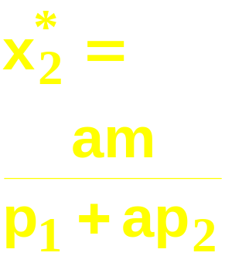
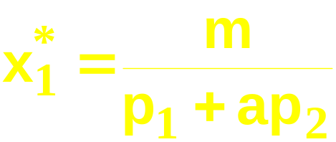
Examples of ‘Kinky’ Solutions扭折解-- the Perfect Complements Case
x₂
U(x₁,x₂) = min{ax₁,x₂}
x₂ = ax₁
x₁

Slide 75
Choosing Taxes
For the same amount of tax revenue, is it better to raise it via a quantity tax or an income tax?

Slide 76
Choosing Taxes
The original budget constraint : p₁x₁ + p₂x₂ = m
The budget constraint with quantity tax: (p₁ + t)x₁ + p₂x₂ = m
The budget constraint with the optimal choice: (p₁+ t)x₁*+p₂x₂*= m
The tax revenue：R * = tx₁*
所得税下的预算约束： p₁x₁ + p₂x₂ = m-R *=m- tx₁*

Slide 77
Choosing Taxes
The budget constraint with income tax:
p₁x₁ + p₂x₂ = m-R *=m- tx₁*

