Slide 1
Chapter Six
Demand

Slide 2
Properties of Demand Functions需求函数的性质
比较静态分析Comparative statics analysis of ordinary demand functions -- the study of how ordinary demands x₁*(p₁,p₂,y) and x₂*(p₁,p₂,y) change as prices p₁, p₂ and income y change.

Slide 3
Own-Price Changes
自身价格变化
How does x₁*(p₁,p₂,y) change as p₁ changes, holding p₂ and y constant?
Suppose only p₁ increases, from p₁’ to p₁’’ and then to p₁’’’.

Slide 4
Own-Price Changes
Fixed p₂ and y.
x₂
p₁x₁ + p₂x₂ = y
p₁ = p₁’
x₁

Slide 5
Own-Price Changes
Fixed p₂ and y.
x₂
p₁x₁ + p₂x₂ = y
p₁ = p₁’
p₁= p₁’’
x₁

Slide 6
Own-Price Changes
Fixed p₂ and y.
x₂
p₁x₁ + p₂x₂ = y
p₁ = p₁’
p₁=
p₁’’’
p₁= p₁’’
x₁

Slide 7
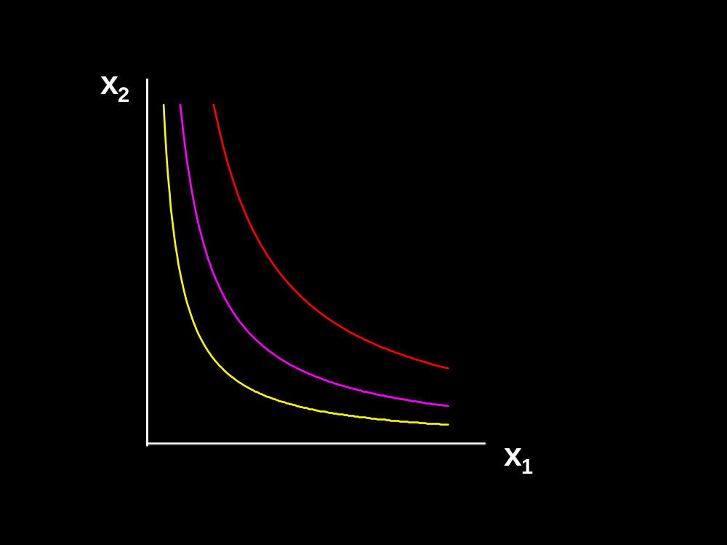
Own-Price Changes
Fixed p₂ and y.
p₁ = p₁’

Slide 8
Own-Price Changes
Fixed p₂ and y.
p₁ = p₁’
x₁*(p₁’)

Slide 9
p₁
自身价格变化
Fixed p₂ and y.
p₁ = p₁’
p₁’
x₁*(p₁’)
x₁*
x₁*(p₁’)

Slide 10
p₁
自身价格变化
Fixed p₂ and y.
p₁ = p₁’’
p₁’
x₁*(p₁’)
x₁*
x₁*(p₁’)

Slide 11
p₁
自身价格变化
Fixed p₂ and y.
p₁ = p₁’’
p₁’
x₁*(p₁’)
x₁*
x₁*(p₁’)
x₁*(p₁’’)

Slide 12
p₁
自身价格变化
Fixed p₂ and y.
p₁’’
p₁’
x₁*(p₁’)
x₁*
x₁*(p₁’’)
x₁*(p₁’)
x₁*(p₁’’)

Slide 13
p₁
自身价格变化
Fixed p₂ and y.
p₁ = p₁’’’
p₁’’
p₁’
x₁*(p₁’)
x₁*
x₁*(p₁’’)
x₁*(p₁’)
x₁*(p₁’’)

Slide 14
p₁
自身价格变化
Fixed p₂ and y.
p₁ = p₁’’’
p₁’’
p₁’
x₁*(p₁’)
x₁*
x₁*(p₁’’)
x₁*(p₁’’’)
x₁*(p₁’)
x₁*(p₁’’)

Slide 15
p₁
自身价格变化
Fixed p₂ and y.
p₁’’’
p₁’’
p₁’
x₁*(p₁’’’)
x₁*(p₁’)
x₁*
x₁*(p₁’’)
x₁*(p₁’’’)
x₁*(p₁’)
x₁*(p₁’’)

Slide 16
p₁
自身价格变化
Ordinary
demand curve
for commodity 1
Fixed p₂ and y.
p₁’’’
p₁’’
p₁’
x₁*(p₁’’’)
x₁*(p₁’)
x₁*
x₁*(p₁’’)
x₁*(p₁’’’)
x₁*(p₁’)
x₁*(p₁’’)

Slide 17
p₁
自身价格变化
Ordinary
demand curve
for commodity 1
Fixed p₂ and y.
p₁’’’
p₁’’
p₁’
x₁*(p₁’’’)
x₁*(p₁’)
x₁*
x₁*(p₁’’)
x₁*(p₁’’’)
x₁*(p₁’)
x₁*(p₁’’)

Slide 18
p₁
自身价格变化
Ordinary
demand curve
for commodity 1
Fixed p₂ and y.
p₁’’’
p₁ price
offer curve价格提供曲线
p₁’’
p₁’
x₁*(p₁’’’)
x₁*(p₁’)
x₁*
x₁*(p₁’’)
x₁*(p₁’’’)
x₁*(p₁’)
x₁*(p₁’’)

Slide 19
Own-Price Changes
The curve containing all the utility-maximizing bundles traced out as p₁ changes, with p₂ and y constant, is the p₁- price offer curve价格提供曲线.
The plot of the x₁-coordinate of the p₁- price offer curve against p₁ is the ordinary demand curve for commodity 1.

Slide 20
Own-Price Changes
What does a p₁ price-offer curve look like for Cobb-Douglas preferences?

Slide 21

Own-Price Changes
What does a p₁ price-offer curve look like for Cobb-Douglas preferences?
Take
Then the ordinary demand functions for commodities 1 and 2 are

Slide 22
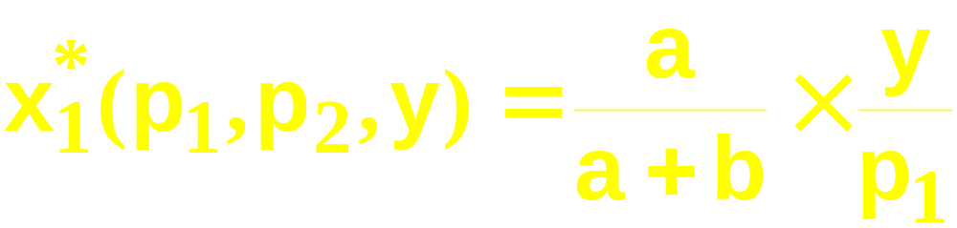
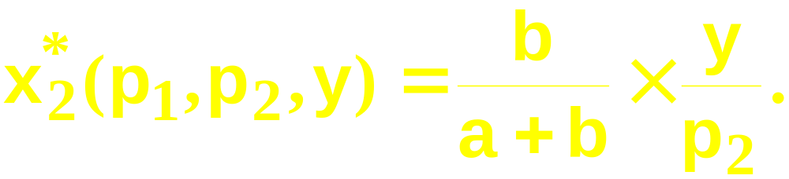
Own-Price Changes
and
Notice that x₂* does not vary with p₁ so the
p₁ price offer curve is

Slide 23
Own-Price Changes
and
Notice that x₂* does not vary with p₁ so the
p₁ price offer curve is flat

Slide 24
Own-Price Changes
and
Notice that x₂* does not vary with p₁ so the
p₁ price offer curve is flat and the ordinary
demand curve for commodity 1 is a

Slide 25
Own-Price Changes
and
Notice that x₂* does not vary with p₁ so the
p₁ price offer curve is flat and the ordinary
demand curve for commodity 1 is a
rectangular hyperbola（直角双曲线）.

Slide 26
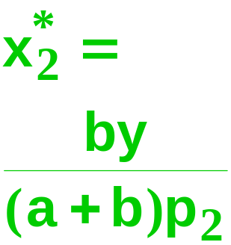
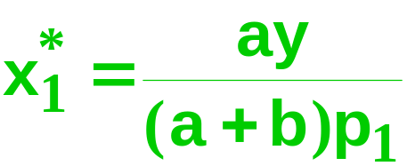
自身价格变化
Fixed p₂ and y.
x₁*(p₁’’’)
x₁*(p₁’)
x₁*(p₁’’)

Slide 27
p₁
自身价格变化
Ordinary
demand curve
for commodity 1
is
Fixed p₂ and y.
x₁*
x₁*(p₁’’’)
x₁*(p₁’)
x₁*(p₁’’)

Slide 28
Own-Price Changes
What does a p₁ price-offer curve look like for a perfect-complements utility function?

Slide 29

Own-Price Changes
What does a p₁ price-offer curve look like for a perfect-complements utility function?
Then the ordinary demand functions
for commodities 1 and 2 are

Slide 30
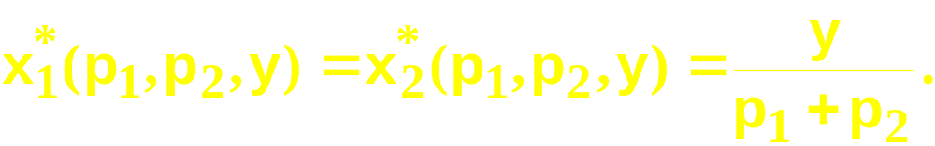
Own-Price Changes

Slide 31
Own-Price Changes
With p₂ and y fixed, higher p₁ causes
smaller x₁* and x₂*.

Slide 32
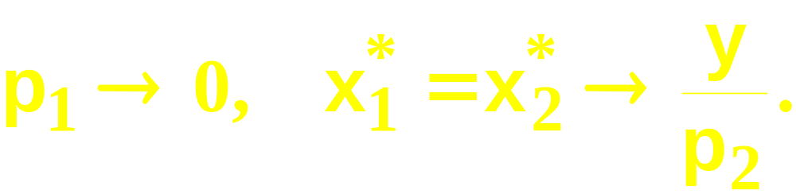
Own-Price Changes
With p₂ and y fixed, higher p₁ causes
smaller x₁* and x₂*.
As

Slide 33
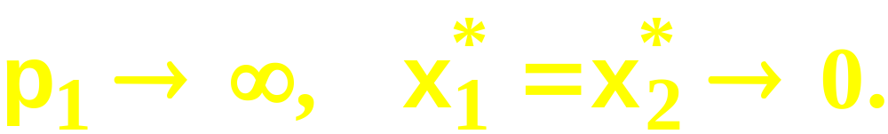
Own-Price Changes
With p₂ and y fixed, higher p₁ causes
smaller x₁* and x₂*.
As
As

Slide 34
Own-Price Changes
Fixed p₂ and y.
x₂
x₁

Slide 35
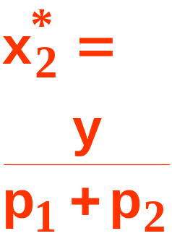
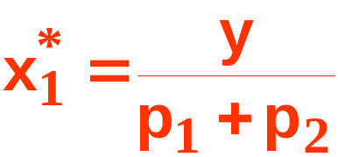
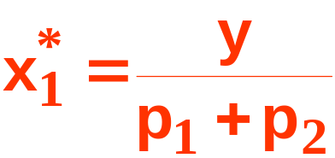
p₁
Own-Price Changes
Fixed p₂ and y.
x₂
p₁ = p₁’
y/p₂
p₁’
’
x₁*
’
x₁
’

Slide 36
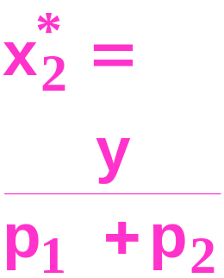
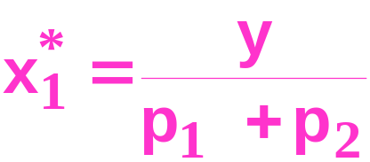
p₁
Own-Price Changes
Fixed p₂ and y.
x₂
p₁ = p₁’’
y/p₂
p₁’’
p₁’
x₁*
’’
’’
x₁
’’

Slide 37
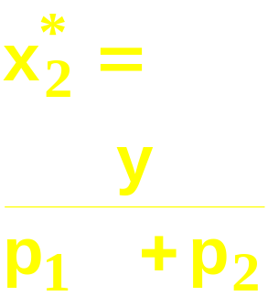
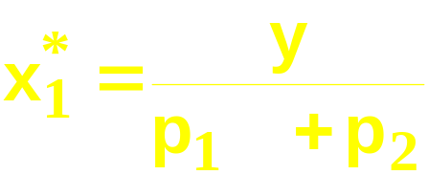
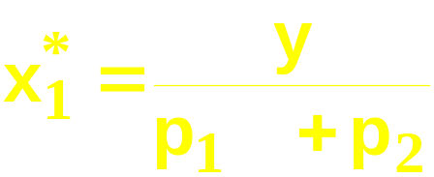
Own-Price Changes
p₁
Fixed p₂ and y.
p₁’’’
x₂
p₁ = p₁’’’
y/p₂
p₁’’
p₁’
x₁*
’’’
’’’
x₁
’’’

Slide 38
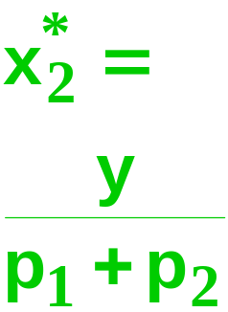

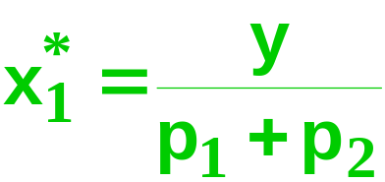
Own-Price Changes
p₁
Ordinary
demand curve
for commodity 1
is
Fixed p₂ and y.
p₁’’’
x₂
y/p₂
p₁’’
p₁’
x₁*
x₁

Slide 39

Own-Price Changes
What does a p₁ price-offer curve look like for a perfect-substitutes utility function?
Then the ordinary demand functions
for commodities 1 and 2 are

Slide 40
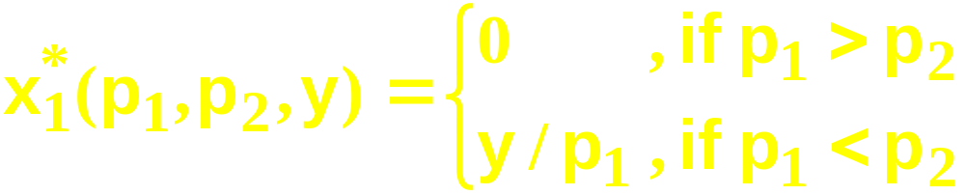
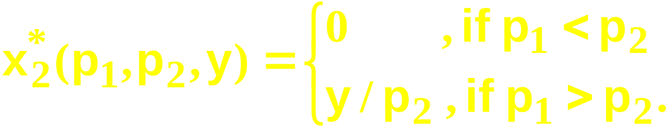
Own-Price Changes
and

Slide 41
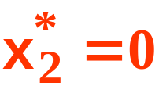
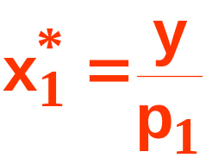
Own-Price Changes
Fixed p₂ and y.
Fixed p₂ and y.
x₂
p₁ = p₁’ < p₂
x₁
’

Slide 42
Own-Price Changes
p₁
Fixed p₂ and y.
Fixed p₂ and y.
x₂
p₁ = p₁’ < p₂
p₁’
x₁*
’
x₁
’

Slide 43
p₁
Own-Price Changes
Fixed p₂ and y.
Fixed p₂ and y.
x₂
p₁ = p₁’’ = p₂
p₁’
x₁*
x₁

Slide 44
p₁
Own-Price Changes
Fixed p₂ and y.
Fixed p₂ and y.
x₂
p₁ = p₁’’ = p₂
p₁’
x₁*
x₁

Slide 45
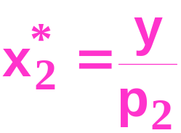

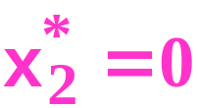

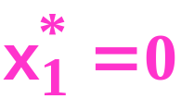
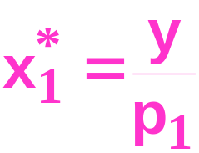
p₁
Own-Price Changes
Fixed p₂ and y.
Fixed p₂ and y.
x₂
p₁ = p₁’’ = p₂
p₁’
x₁*
x₁
’’

Slide 46
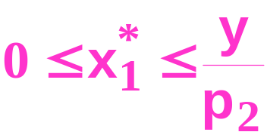
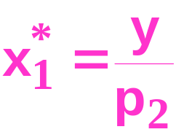
p₁
Own-Price Changes
Fixed p₂ and y.
Fixed p₂ and y.
x₂
p₁ = p₁’’ = p₂
p₂ = p₁’’
p₁’
x₁*
x₁

Slide 47
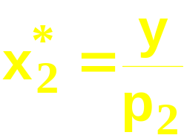
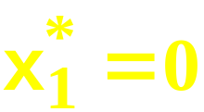
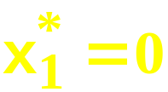
p₁
Own-Price Changes
Fixed p₂ and y.
Fixed p₂ and y.
p₁’’’
x₂
p₂ = p₁’’
p₁’
x₁*
x₁

Slide 48

p₁
Own-Price Changes
Ordinary
demand curve
for commodity 1
Fixed p₂ and y.
Fixed p₂ and y.
p₁’’’
x₂
p₂ = p₁’’
p₁ price
offer
curve
p₁’
x₁*
x₁

Slide 49
Own-Price Changes
Usually we ask “Given the price for commodity 1 what is the quantity demanded of commodity 1?”
But we could also ask the inverse question “At what price for commodity 1 would a given quantity of commodity 1 be demanded?”

Slide 50
Own-Price Changes
p₁
Given p₁’, what quantity is
demanded of commodity 1?
p₁’
x₁*

Slide 51
Own-Price Changes
p₁
Given p₁’, what quantity is
demanded of commodity 1?
Answer: x₁’ units.
p₁’
x₁’
x₁*

Slide 52
Own-Price Changes
p₁
Given p₁’, what quantity is
demanded of commodity 1?
Answer: x₁’ units.
The inverse question is:
Given x₁’ units are
demanded, what is the
price of
commodity 1?
x₁’
x₁*

Slide 53
Own-Price Changes
p₁
Given p₁’, what quantity is
demanded of commodity 1?
Answer: x₁’ units.
The inverse question is:
Given x₁’ units are
demanded, what is the
price of
commodity 1?
Answer: p₁’
p₁’
x₁’
x₁*

Slide 54
Own-Price Changes
Taking quantity demanded as given and then asking what must be price describes the inverse demand function （反需求函数）of a commodity.

Slide 55
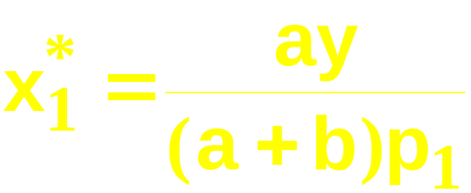
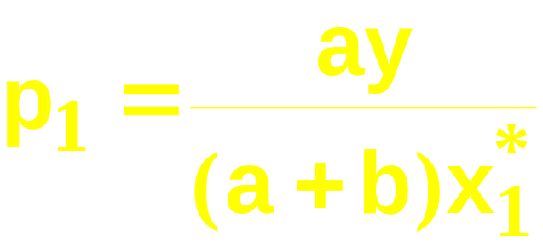
Own-Price Changes
A Cobb-Douglas example:
is the ordinary demand function and
is the inverse demand function.

Slide 56
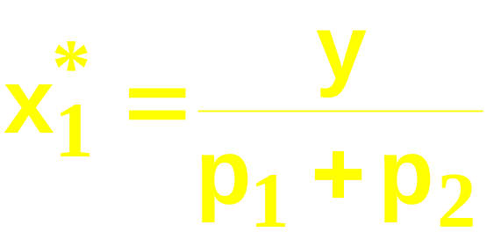
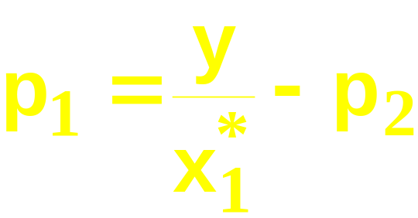
Own-Price Changes
A perfect-complements example:
is the ordinary demand function and
is the inverse demand function.

Slide 57
Income Changes收入变化
How does the value of x₁*(p₁,p₂,y) change as y changes, holding both p₁ and p₂ constant?

Slide 58
Income Changes
Fixed p₁ and p₂.
y’ < y’’ < y’’’

Slide 59
Income Changes
Fixed p₁ and p₂.
y’ < y’’ < y’’’

Slide 60
Income Changes
Fixed p₁ and p₂.
y’ < y’’ < y’’’
x₂’’’
x₂’’
x₂’
x₁’
x₁’’’
x₁’’

Slide 61
Income Changes
Fixed p₁ and p₂.
y’ < y’’ < y’’’
Income
offer curve
x₂’’’
x₂’’
x₂’
x₁’
x₁’’’
x₁’’

Slide 62
Income Changes
A plot of quantity demanded against income is called an Engel curve恩格尔曲线：对一个商品需求量和收入的变化之间的关系.

Slide 63
Income Changes收入变化
Fixed p₁ and p₂.
y’ < y’’ < y’’’
Income
offer curve
x₂’’’
x₂’’
x₂’
x₁’
x₁’’’
x₁’’

Slide 64
Income Changes收入变化
Fixed p₁ and p₂.
y’ < y’’ < y’’’
Income
offer curve
y
x₂’’’
y’’’
x₂’’
y’’
x₂’
y’
x₁’
x₁’’’
x₁’
x₁’’’
x₁*
x₁’’
x₁’’

Slide 65
Income Changes收入变化
Fixed p₁ and p₂.
y’ < y’’ < y’’’
Income
offer curve
y
x₂’’’
y’’’
x₂’’
Engel
curve;
good 1
y’’
x₂’
y’
x₁’
x₁’’’
x₁’
x₁’’’
x₁*
x₁’’
x₁’’

Slide 66
Income Changes收入变化
y
Fixed p₁ and p₂.
y’’’
y’’
y’ < y’’ < y’’’
y’
Income
offer curve
x₂’
x₂’’’
x₂*
x₂’’
x₂’’’
x₂’’
x₂’
x₁’
x₁’’’
x₁’’

Slide 67
Income Changes收入变化
y
Engel
curve;
good 2
Fixed p₁ and p₂.
y’’’
y’’
y’ < y’’ < y’’’
y’
Income
offer curve
x₂’
x₂’’’
x₂*
x₂’’
x₂’’’
x₂’’
x₂’
x₁’
x₁’’’
x₁’’

Slide 68
Income Changes收入变化
y
Engel
curve;
good 2
Fixed p₁ and p₂.
y’’’
y’’
y’ < y’’ < y’’’
y’
Income offer curve 收入供给曲线
y
x₂’
x₂’’’
x₂*
x₂’’
x₂’’’
y’’’
x₂’’
Engel
curve;
good 1
y’’
x₂’
y’
x₁’
x₁’’’
x₁’
x₁’’’
x₁*
x₁’’
x₁’’

Slide 69
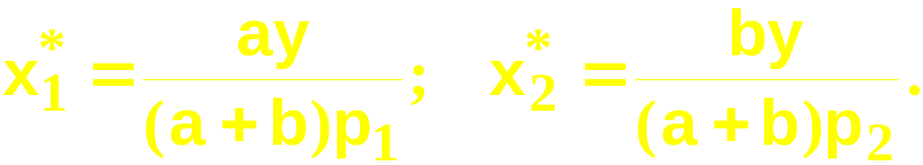
Income Changes and Cobb-Douglas Preferences
An example of computing the equations of Engel curves; the Cobb-Douglas case.
The ordinary demand equations are

Slide 70
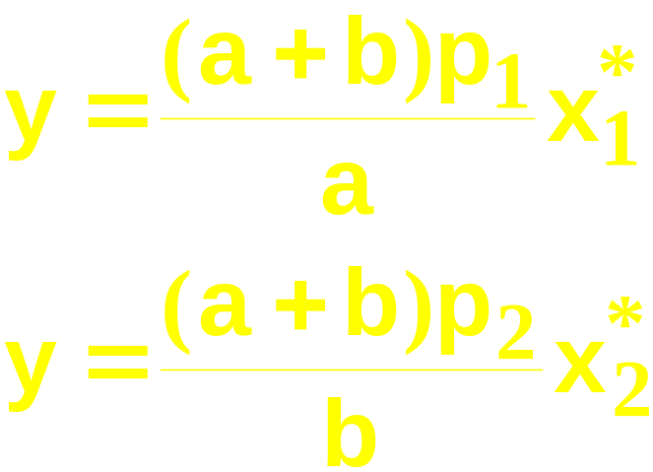
Income Changes and Cobb-Douglas Preferences
Rearranged to isolate y, these are:
Engel curve for good 1
Engel curve for good 2

Slide 71
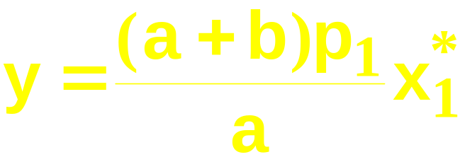
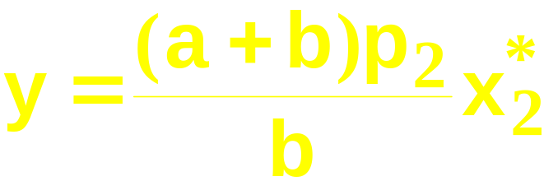
Income Changes and Cobb-Douglas Preferences
y
Engel curve
for good 1
x₁*
y
Engel curve
for good 2
x₂*

Slide 72
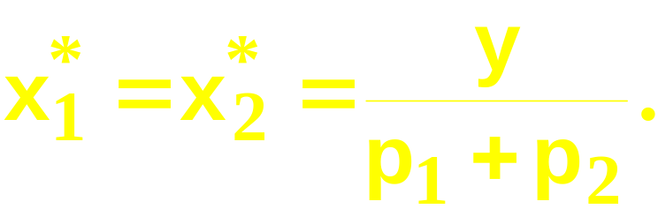
Income Changes and Perfectly-Complementary Preferences
Another example of computing the equations of Engel curves; the perfectly-complementary case.
The ordinary demand equations are

Slide 73
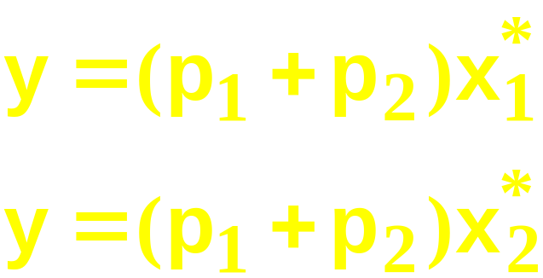
Income Changes and Perfectly-Complementary Preferences
Rearranged to isolate y, these are:
Engel curve for good 1
Engel curve for good 2

Slide 74
Income Changes
Fixed p₁ and p₂.
x₂
x₁

Slide 75
Income Changes
Fixed p₁ and p₂.
x₂
y’ < y’’ < y’’’
x₁

Slide 76
Income Changes
Fixed p₁ and p₂.
x₂
y’ < y’’ < y’’’
x₁

Slide 77
Income Changes
Fixed p₁ and p₂.
x₂
y’ < y’’ < y’’’
x₂’’’
x₂’’
x₂’
x₁’
x₁’’’
x₁
x₁’’

Slide 78
Income Changes
Fixed p₁ and p₂.
x₂
y’ < y’’ < y’’’
y
x₂’’’
y’’’
x₂’’
Engel
curve;
good 1
y’’
x₂’
y’
x₁’
x₁’’’
x₁’
x₁’’’
x₁*
x₁
x₁’’
x₁’’

Slide 79
Income Changes
y
Engel
curve;
good 2
Fixed p₁ and p₂.
y’’’
x₂
y’’
y’ < y’’ < y’’’
y’
x₂’
x₂’’’
x₂*
x₂’’
x₂’’’
x₂’’
x₂’
x₁’
x₁’’’
x₁
x₁’’

Slide 80
Income Changes
y
Engel
curve;
good 2
Fixed p₁ and p₂.
y’’’
x₂
y’’
y’ < y’’ < y’’’
y’
y
x₂’
x₂’’’
x₂*
x₂’’
x₂’’’
y’’’
x₂’’
Engel
curve;
good 1
y’’
x₂’
y’
x₁’
x₁’’’
x₁’
x₁’’’
x₁*
x₁
x₁’’
x₁’’

Slide 81
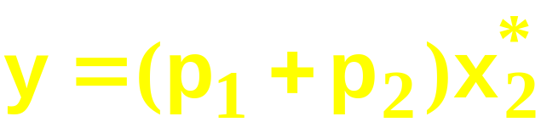
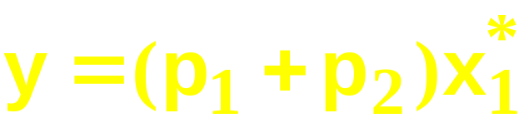
Income Changes
y
Engel
curve;
good 2
Fixed p₁ and p₂.
y’’’
y’’
y’
y
x₂’
x₂’’’
x₂*
x₂’’
y’’’
Engel
curve;
good 1
y’’
y’
x₁’
x₁’’’
x₁*
x₁’’

Slide 82

Income Changes and Perfectly-Substitutable Preferences
Another example of computing the equations of Engel curves; the perfectly-substitution case.
The ordinary demand equations are

Slide 83
Income Changes and Perfectly-Substitutable Preferences

Slide 84
Income Changes and Perfectly-Substitutable Preferences
Suppose p₁ < p₂. Then

Slide 85
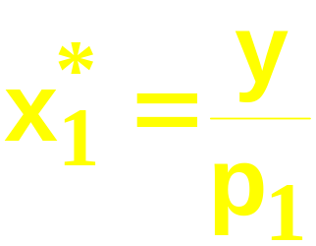
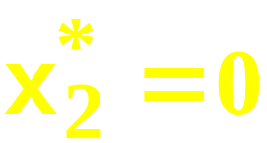
Income Changes and Perfectly-Substitutable Preferences
Suppose p₁ < p₂. Then
and

Slide 86
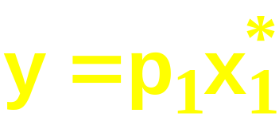
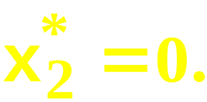
Income Changes and Perfectly-Substitutable Preferences
Suppose p₁ < p₂. Then
and
and

Slide 87
Income Changes and Perfectly-Substitutable Preferences
y
y
x₁*
0
x₂*
Engel curve
for good 1
Engel curve
for good 2

Slide 88
Income Changes
In every example so far the Engel curves have all been straight lines?
Q: Is this true in general?
A: No. Engel curves are straight lines if the consumer’s preferences are homothetic（位似偏好或相似偏好）.

Slide 89
Homotheticity
A consumer’s preferences are homothetic if and only if
for every k > 0.
That is, the consumer’s MRS is the same anywhere on a straight line drawn from the origin.
❐
⇔
❐
(x₁,x₂) (y₁,y₂) (kx₁,kx₂) (ky₁,ky₂)

Slide 90


Income Effects -- A Nonhomothetic Example
Quasilinear preferences（拟线性偏好） are not homothetic.
For example,

Slide 91
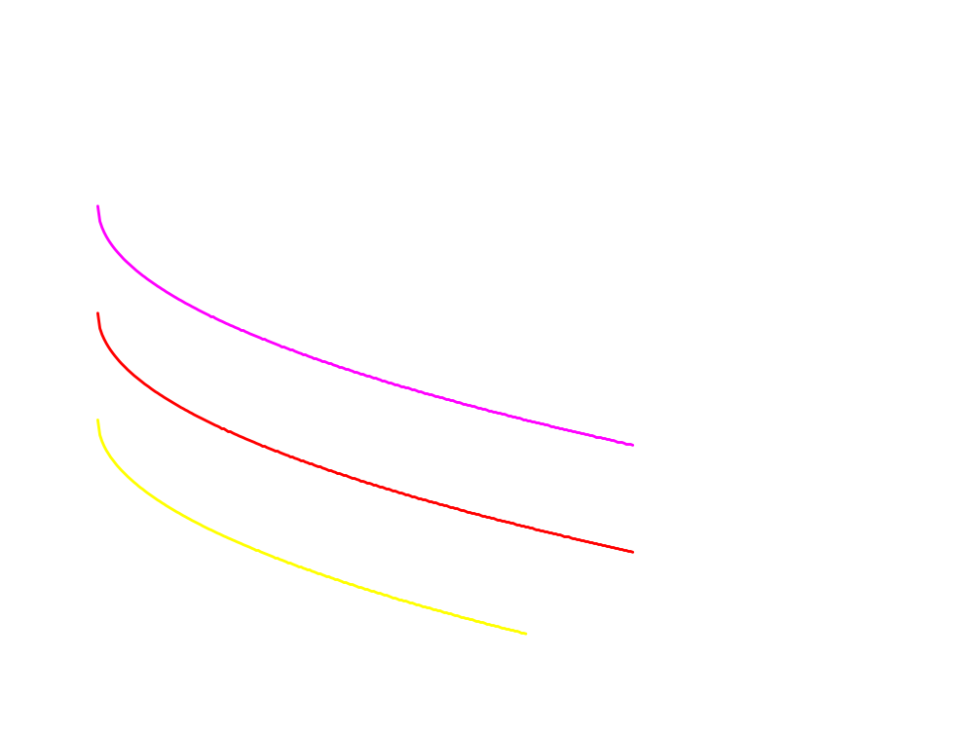
Quasi-linear Indifference Curves拟线性偏好
x₂
Each curve is a vertically shifted copy of the others.
Each curve intersects
both axes.
x₁

Slide 92

Income Changes; Quasilinear Utility
x₂
x₁
~
x₁

Slide 93
Income Changes; Quasilinear Utility
x₂
y
Engel
curve
for
good 1
~
x₁*
x₁
x₁
~
x₁

Slide 94
Income Changes; Quasilinear Utility
y
Engel
curve
for
good 2
x₂
x₂*
x₁
~
x₁

Slide 95
Income Changes; Quasilinear Utility
y
Engel
curve
for
good 2
x₂
x₂*
y
Engel
curve
for
good 1
~
x₁*
x₁
x₁
~
x₁

Slide 96
Income Effects
A good for which quantity demanded rises with income is called normal正常商品.
Therefore a normal good’s Engel curve is positively sloped.

Slide 97
Income Effects
A good for which quantity demanded falls as income increases is called income inferior（劣等品、抵挡品）.
Therefore an income inferior good’s Engel curve is negatively sloped.

Slide 98
Income Changes; Goods
1 & 2 Normal
y
Engel
curve;
good 2
y’’’
y’’
y’
Income
offer curve
y
x₂’
x₂’’’
x₂*
x₂’’
x₂’’’
y’’’
x₂’’
Engel
curve;
good 1
y’’
x₂’
y’
x₁’
x₁’’’
x₁’
x₁’’’
x₁*
x₁’’
x₁’’

Slide 99
收入变化： Good 2 Is Normal, Good 1 Becomes Income Inferior
x₂
x₁

Slide 100
Income Changes ： Good 2 Is Normal, Good 1 Becomes Income Inferior
x₂
x₁

Slide 101
Income Changes; Good 2 Is Normal, Good 1 Becomes Income Inferior
x₂
x₁

Slide 102
Income Changes; Good 2 Is Normal, Good 1 Becomes Income Inferior
x₂
x₁

Slide 103
Income Changes; Good 2 Is Normal, Good 1 Becomes Income Inferior
x₂
x₁

Slide 104
Income Changes; Good 2 Is Normal, Good 1 Becomes Income Inferior
x₂
Income
offer curve
x₁

Slide 105
Income Changes; Good 2 Is Normal, Good 1 Becomes Income Inferior
x₂
y
Engel curve
for good 1
x₁
x₁*

Slide 106
Income Changes; Good 2 Is Normal, Good 1 Becomes Income Inferior
y
x₂
Engel curve
for good 2
x₂*
y
Engel curve
for good 1
x₁
x₁*

Slide 107
Ordinary Goods
A good is called ordinary（普通商品） if the quantity demanded of it always increases as its own price decreases.

Slide 108
Ordinary Goods
Fixed p₂ and y.
x₂
x₁

Slide 109
Ordinary Goods
Fixed p₂ and y.
x₂
p₁ price
offer
curve
x₁

Slide 110
Ordinary Goods
Fixed p₂ and y.
Downward-sloping
demand curve
x₂
p₁
p₁ price
offer
curve
⇔
Good 1 is
ordinary
x₁*
x₁

Slide 111
Giffen Goods吉芬商品
If, for some values of its own price, the quantity demanded of a good rises as its own-price increases then the good is called Giffen（吉芬商品）.

Slide 112
Giffen Goods吉芬商品
Fixed p₂ and y.
x₂
x₁

Slide 113
Giffen Goods吉芬商品
Fixed p₂ and y.
x₂
p₁ price offer
curve
x₁

Slide 114
Giffen Goods吉芬商品
Fixed p₂ and y.
Demand curve has
a positively
sloped part
x₂
p₁
p₁ price offer
curve
⇔
Good 1 is
Giffen
x₁*
x₁

Slide 115
交叉价格效应Cross-Price Effects
If an increase in p₂
  increases demand for commodity 1 then commodity 1 is a gross substitute （总替代关系）for commodity 2.
  reduces demand for commodity 1 then commodity 1 is a gross complement（总互补关系） for commodity 2.

Slide 116
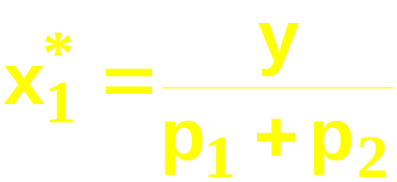
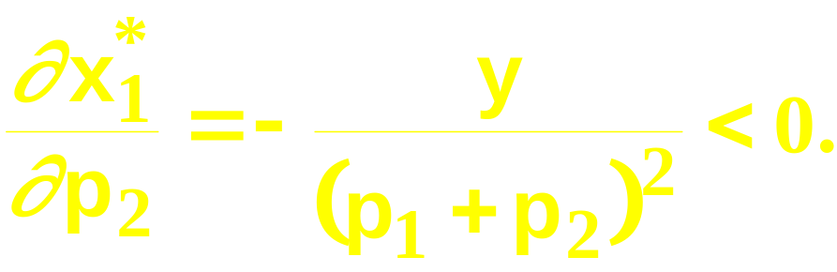
交叉价格效应
A perfect-complements example:
so
Therefore commodity 2 is a gross
complement for commodity 1.

Slide 117
交叉价格效应
p₁
Increase the price of
good 2 from p₂’ to p₂’’
and
p₁’’’
p₁’’
p₁’
x₁*
’

Slide 118
交叉价格效应
p₁
Increase the price of
good 2 from p₂’ to p₂’’
and the demand curve
for good 1 shifts inwards
-- good 2 is a
complement for good 1.
p₁’’’
p₁’’
p₁’
x₁*
’’

Slide 119

交叉价格效应
A Cobb- Douglas example:
so

Slide 120

交叉价格效应
A Cobb- Douglas example:
so
Therefore commodity 1 is neither a gross
complement nor a gross substitute for
commodity 2.

