Slide 1
Chapter Nine
Buying and Selling
购买和销售

Slide 2
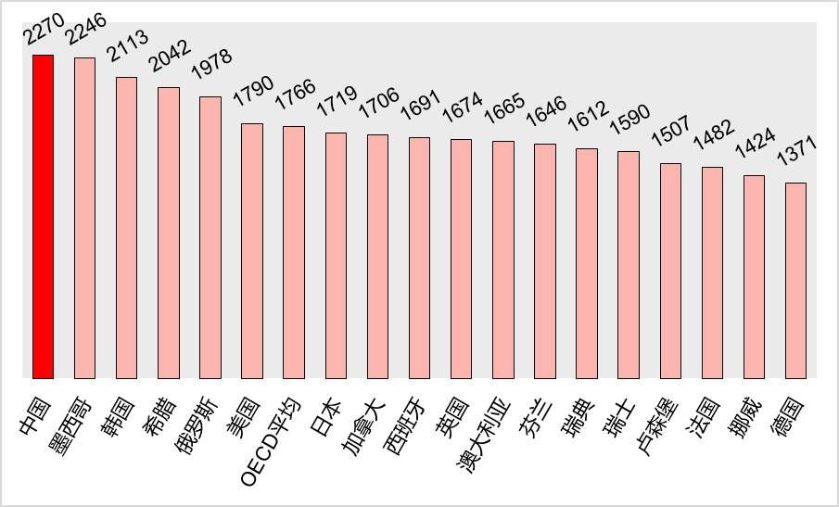
Work Hours in 2017

Slide 3
Buying and Selling购买和销售
We expand our basic consumer choice framework to include the possibility that consumers can sell something to generate income.
What will be bought? What will be sold?
Who will be a buyer? Who will be a seller?

Slide 4
Buying and Selling购买和销售
And how are incomes generated?
How does the value of income depend upon commodity prices?
How can we put all this together to explain better how price changes affect demands?

Slide 5

Endowments禀赋
The list of resource units with which a consumer starts is his endowment.
A consumer’s endowment will be denoted by the vector (omega).

Slide 6

Endowments
E.g.
states that the consumer is endowed with 10 units of good 1 and 2 units of good 2.

Slide 7
Endowments
E.g.
states that the consumer is endowed with 10 units of good 1 and 2 units of good 2.
What is the endowment’s value?
For which consumption bundles may it be exchanged?

Slide 8
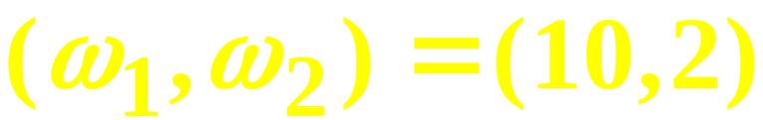
Endowments
p₁=2 and p₂=3 so the value of the endowment is
Q: For which consumption bundles may the endowment be exchanged?
A: For any bundle costing no more than the endowment’s value.

Slide 9
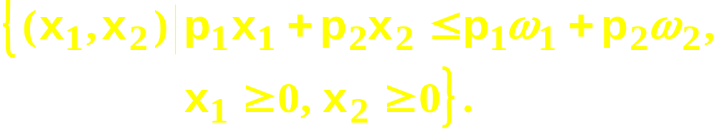
Budget Constraints Revisited
So, given p₁ and p₂, the budget constraint for a consumer with an endowment is
The budget set is

Slide 10

Budget Constraints Revisited
x₂
ω₂
ω₁
x₁

Slide 11
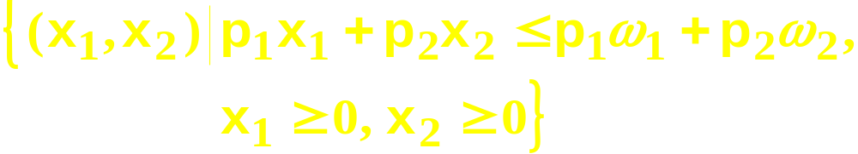
Budget Constraints Revisited
x₂
ω₂
Budget set
ω₁
x₁

Slide 12
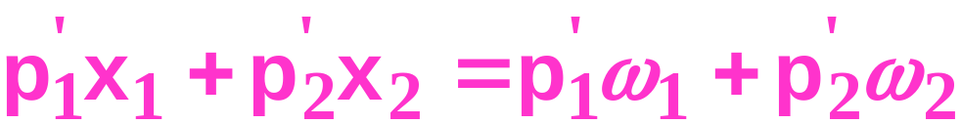
Budget Constraints Revisited
x₂
ω₂
ω₁
x₁

Slide 13
Budget Constraints Revisited
x₂
ω₂
Budget set
ω₁
x₁

Slide 14
Budget Constraints Revisited
The endowment point is always on
the budget constraint.
x₂
ω₂
ω₁
x₁

Slide 15
Budget Constraints Revisited
The endowment point禀赋点 is always on the budget constraint.
x₂
So price changes pivot（旋转） the constraint about the endowment point.
ω₂
ω₁
x₁

Slide 16

Budget Constraints Revisited
The constraint
is
That is, the sum of the values of a consumer’s net demands is zero.

Slide 17
Net Demands净需求
Suppose and p₁=2, p₂=3. Then the constraint is
If the consumer gross demands (x₁*,x₂*) = (7,4), then 3 units of good 1 exchange for 2 units of good 2. Net demands are
x₁*- ω₁ = 7-10 = -3 and
x₂*- ω₂ = 4 - 2 = +2.

Slide 18
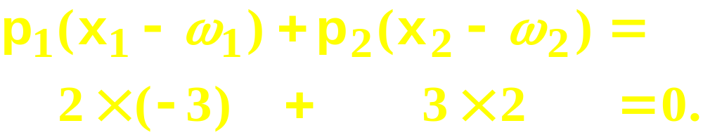
Net Demands净需求
p₁=2, p₂=3, x₁*-ω₁ = -3 and x₂*-ω₂ = +2 so
The purchase of 2 extra good 2 units at
$3 each is funded by giving up 3 good 1
units at $2 each.

Slide 19
Net Demands
x₂
At prices (p₁,p₂) the consumer
sells units of good 1 to acquire
more units of good 2.
x₂*
ω₂
x₁*
ω₁
x₁

Slide 20
Net Demands
x₂
At prices (p₁’,p₂’) the consumer
sells units of good 2 to acquire
more of good 1.
ω₂
x₂*
ω₁
x₁*
x₁

Slide 21
Net Demands
x₂
At prices (p₁”,p₂”) the consumer
consumes her endowment; net
demands are all zero.
x₂*=ω₂
x₁*=ω₁
x₁

Slide 22
Net Demands
x₂
Price-offer curve contains all the
utility-maximizing gross demands
for which the endowment can be
exchanged.
ω₂
ω₁
x₁

Slide 23
Net Demands
x₂
Price-offer curve
Sell good 1, buy good 2
ω₂
ω₁
x₁

Slide 24
Net Demands
x₂
Price-offer curve
Buy good 1, sell good 2
ω₂
ω₁
x₁

Slide 25
Labor Supply劳动供给
A worker is endowed with $m of non-labor income非劳动收入 and R hours of time which can be used for labor or leisure休闲. ω = (R, m).
Consumption good’s price is p_{c}.
w is the wage rate.
⎯
⎯

Slide 26


Labor Supply
The worker’s budget constraint is
where C, R denote gross demands for the consumption good and for leisure. That is
⎯
⎯
{
{
expenditure
endowment
value

Slide 27
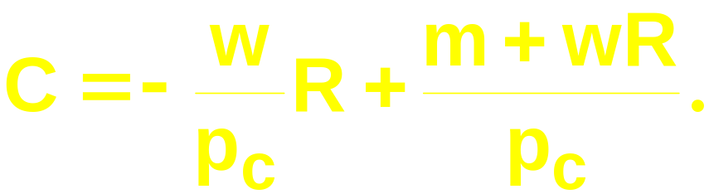
Labor Supply
⎯
rearranges to
⎯

Slide 28
Labor Supply
($)
C
m
endowment
⎯
R
R

Slide 29
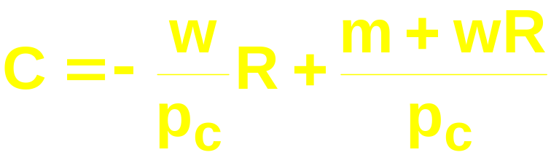
Labor Supply
C
⎯
m
endowment
⎯
R
R

Slide 30
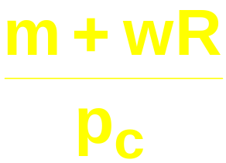
Labor Supply
C
⎯
⎯
m
endowment
⎯
R
R

Slide 31
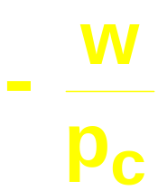
Labor Supply
C
⎯
⎯
slope = , the ‘real wage rate’
w：the nominal wage
rate
m
endowment
⎯
R
R

Slide 32
Labor Supply
C
⎯
⎯
C*
m
endowment
⎯
R
R*
R
leisure
demanded
labor
supplied

Slide 33
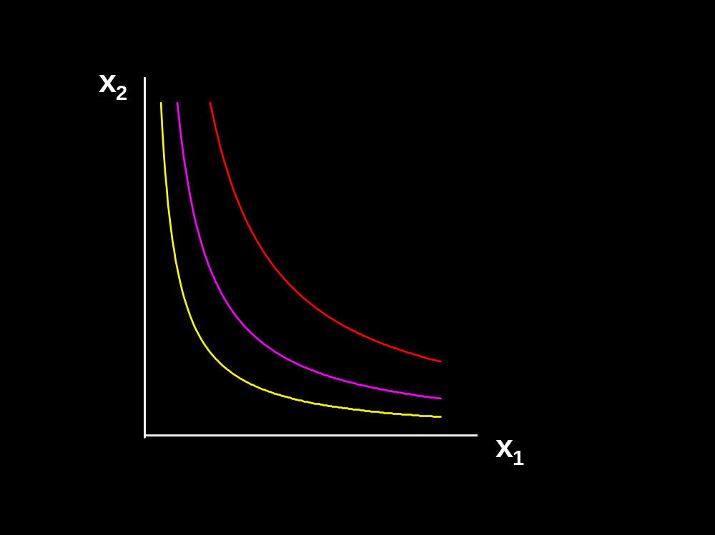
Comparative statics analysis of labor supply劳动供给的比较静态分析
wage
supply curve
of labor
c
labor
R

Slide 34
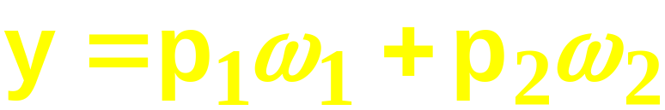
Slutsky’s Equation Revisited
修正的斯勒茨基方程
Slutsky: changes to demands caused by a price change are the sum of
  a pure substitution effect, and
  an income effect.
This assumed that income y did not change as prices changed. But
does change with price. How does this modify Slutsky’s equation?

Slide 35
Slutsky’s Equation Revisited
修正的斯勒茨基方程
A change in p₁ or p₂ changes
so there will be
an additional income effect, called the endowment income effect.
Slutsky’s decomposition will thus have three components
  a pure substitution effect
  an (ordinary) income effect, and
  an endowment income effect.

Slide 36
Slutsky’s Equation Revisited
修正的斯勒茨基方程
x₂
Initial prices are (p₁’,p₂’).
x₂’
ω₂
x₁’
ω₁
x₁

Slide 37
Slutsky’s Equation Revisited
x₂
Initial prices are (p₁’,p₂’).
Final prices are (p₁”,p₂”).
x₂’
ω₂
x₂”
x₁’
ω₁
x₁”
x₁

Slide 38
Slutsky’s Equation Revisited
x₂
Initial prices are (p₁’,p₂’).
Final prices are (p₁”,p₂”).
How is the change in demand
from (x₁’,x₂’) to (x₁”,x₂”) explained?
x₂’
ω₂
x₂”
x₁’
ω₁
x₁”
x₁

Slide 39
Slutsky’s Equation Revisited
x₂
Initial prices are (p₁’,p₂’).
x₂’
ω₂
x₁’
ω₁
x₁

Slide 40
Slutsky’s Equation Revisited
x₂
Initial prices are (p₁’,p₂’).
Final prices are (p₁”,p₂’).
x₂’
ω₂
x₂”
x₁’
ω₁
x₁”
x₁

Slide 41
Slutsky’s Equation Revisited
x₂
⇒
Pure substitution effect
ω₂
ω₁
x₁

Slide 42
Slutsky’s Equation Revisited
x₂
⇒
Pure substitution effect
ω₂
ω₁
x₁

Slide 43
Slutsky’s Equation Revisited
x₂
⇒
Pure substitution effect
⇒
Ordinary income effect
ω₂
ω₁
x₁

Slide 44
Slutsky’s Equation Revisited
x₂
⇒
Pure substitution effect
⇒
Ordinary income effect
ω₂
ω₁
x₁

Slide 45
Slutsky’s Equation Revisited
x₂
⇒
Pure substitution effect
⇒
Ordinary income effect
⇒
Endowment income effect
ω₂
ω₁
x₁

Slide 46
Slutsky’s Equation Revisited
x₂
⇒
Pure substitution effect
⇒
Ordinary income effect
⇒
Endowment income effect
ω₂
ω₁
x₁

Slide 47
Slutsky’s Equation Revisited
Overall change in demand caused by a
change in price is the sum of:
(i) a pure substitution effect
(ii) an ordinary income effect
(iii) an endowment income effect

Slide 48
Calculation of the substitution effect: a example
A farmer’s demand function for milk
Assume his production of milk is 40 quart, the price of milk is 3$ per quart.
When the price falls to $2, what is the substitution effect, the ordinary income effect and the endowment income effect?

