Slide 1
Chapter Fifteen
Market Demand
市场需求

Slide 2

From Individual to Market Demand Functions从个人需求到市场需求
Think of an economy containing n consumers, denoted by i = 1, … ,n.
Consumer i’s ordinary demand function for commodity j is

Slide 3
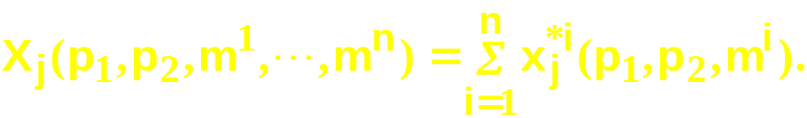
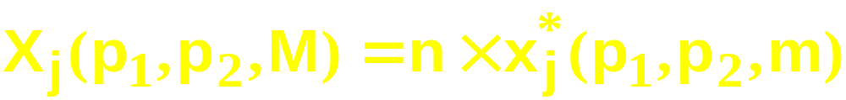
From Individual to Market Demand Functions从个人需求到市场需求
When all consumers are price-takers, the market demand function for commodity j is
If all consumers are identical then
where M = nm.

Slide 4
From Individual to Market Demand Functions从个人需求到市场需求
The market demand curve is the “horizontal sum” of the individual consumers’ demand curves.
E.g. suppose there are only two consumers; i = A,B.

Slide 5
From Individual to Market Demand Functions从个人需求到市场需求
p₁
p₁
p₁’
p₁’
p₁”
p₁”
20
15

Slide 6
From Individual to Market Demand Functions从个人需求到市场需求
p₁
p₁
p₁’
p₁’
p₁”
p₁”
20
15
p₁
p₁’

Slide 7
From Individual to Market Demand Functions从个人需求到市场需求
p₁
p₁
p₁’
p₁’
p₁”
p₁”
20
15
p₁
p₁’
p₁”

Slide 8
From Individual to Market Demand Functions从个人需求到市场需求
p₁
p₁
p₁’
p₁’
p₁”
p₁”
20
15
p₁
p₁’
The “horizontal sum”
of the demand curves
of individuals A and B.
p₁”
35

Slide 9
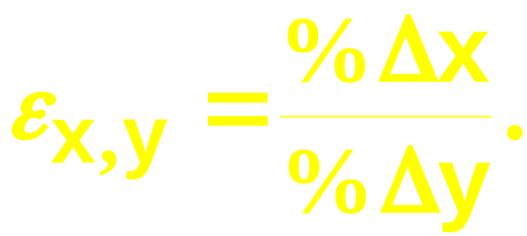
Elasticities弹性
Elasticity measures the “sensitivity” of one variable with respect to another.
The elasticity of variable X with respect to variable Y is

Slide 10
Economic Applications of Elasticity
弹性的经济应用
Economists use elasticities to measure the sensitivity of
  quantity demanded of commodity i with respect to the price of commodity i (own-price elasticity of demand)需求的自身价格弹性
  demand for commodity i with respect to the price of commodity j (cross-price elasticity of demand). 需求的交叉价格弹性

Slide 11
Economic Applications of Elasticity
弹性的经济应用
  demand for commodity i with respect to income (income elasticity of demand)需求的收入弹性
  quantity supplied of commodity i with respect to the price of commodity i (own-price elasticity of supply)供给的自身价格弹性

Slide 12
Economic Applications of Elasticity
弹性的经济应用
  quantity supplied of commodity i with respect to the wage rate (elasticity of supply with respect to the price of labor)
  and many, many others.

Slide 13
Own-Price Elasticity of Demand
需求的自身价格弹性
Q: Why not use a demand curve’s slope to measure the sensitivity of quantity demanded to a change in a commodity’s own price?

Slide 14
Own-Price Elasticity of Demand
需求的自身价格弹性
p₁
p₁
slope
= - 2
slope
= - 0.2
10
10
5
X₁*
50
X₁*
In which case is the quantity demanded
X₁* more sensitive to changes to p₁?

Slide 15
Own-Price Elasticity of Demand
需求的自身价格弹性
p₁
p₁
slope
= - 2
slope
= - 0.2
10
10
5
X₁*
50
X₁*
In which case is the quantity demanded
X₁* more sensitive to changes to p₁?

Slide 16
Own-Price Elasticity of Demand
10-packs
Single Units
p₁
p₁
slope
= - 2
slope
= - 0.2
10
10
5
X₁*
50
X₁*
In which case is the quantity demanded
X₁* more sensitive to changes to p₁?

Slide 17
Own-Price Elasticity of Demand
10-packs
Single Units
p₁
p₁
slope
= - 2
slope
= - 0.2
10
10
5
X₁*
50
X₁*
In which case is the quantity demanded
X₁* more sensitive to changes to p₁?
It is the same in both cases.

Slide 18
Own-Price Elasticity of Demand
Q: Why not just use the slope of a demand curve to measure the sensitivity of quantity demanded to a change in a commodity’s own price?
A: Because the value of sensitivity then depends upon the (arbitrary) units of measurement used for quantity demanded.

Slide 19
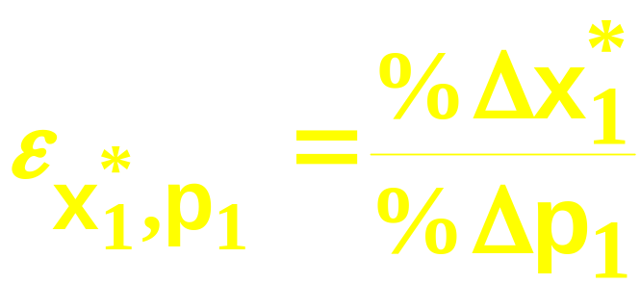
Own-Price Elasticity of Demand
is a ratio of percentages and so has no
units of measurement.
Hence own-price elasticity of demand is a sensitivity measure that is independent of units of measurement.

Slide 20
Arc and Point Elasticities
弧弹性和点弹性
An “average” own-price elasticity of demand for commodity i over an interval of values for p_{i}价格区间is an arc-elasticity弧弹性, usually computed by a mid-point formula.
Elasticity computed for a single value of p_{i} is a point elasticity点弹性.

Slide 21
Arc Own-Price Elasticity
自身价格的弧弹性
What is the “average” own-price
elasticity of demand for prices
in an interval centered on p_{i}’?
p_{i}
p_{i}’+h
p_{i}’
p_{i}’-h
X_{i}*

Slide 22
Arc Own-Price Elasticity
自身价格的弧弹性
What is the “average” own-price
elasticity of demand for prices
in an interval centered on p_{i}’?
p_{i}
p_{i}’+h
p_{i}’
p_{i}’-h
X_{i}*

Slide 23
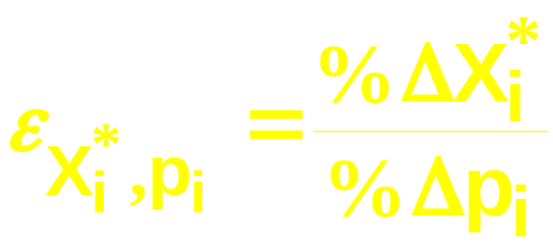
Arc Own-Price Elasticity
自身价格的弧弹性
What is the “average” own-price
elasticity of demand for prices
in an interval centered on p_{i}’?
p_{i}
p_{i}’+h
p_{i}’
p_{i}’-h
X_{i}*

Slide 24
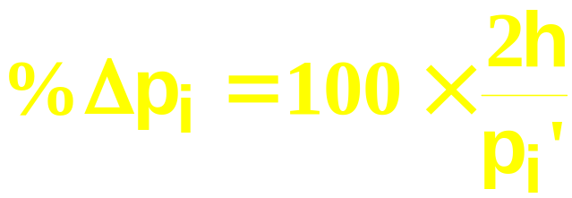
Arc Own-Price Elasticity
自身价格的弧弹性
What is the “average” own-price
elasticity of demand for prices
in an interval centered on p_{i}’?
p_{i}
p_{i}’+h
p_{i}’
p_{i}’-h
X_{i}*

Slide 25
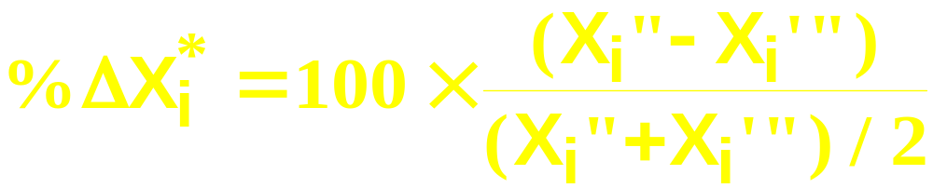
Arc Own-Price Elasticity
自身价格的弧弹性
What is the “average” own-price
elasticity of demand for prices
in an interval centered on p_{i}’?
p_{i}
p_{i}’+h
p_{i}’
p_{i}’-h
X_{i}*

Slide 26
Arc Own-Price Elasticity
自身价格的弧弹性

Slide 27
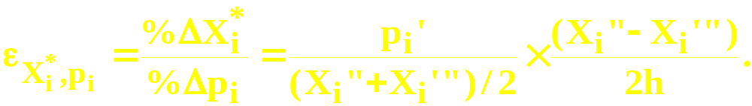
Arc Own-Price Elasticity
自身价格的弧弹性
So
is the arc own-price elasticity of demand
需求的自身价格弧弹性.

Slide 28
Point Own-Price Elasticity
自身价格的点弹性
What is the own-price elasticity
of demand in a very small interval
of prices centered on p_{i}’?
p_{i}
p_{i}’+h
p_{i}’
p_{i}’-h
X_{i}*

Slide 29
Point Own-Price Elasticity
What is the own-price elasticity
of demand in a very small interval
of prices centered on p_{i}’?
p_{i}
p_{i}’+h
As h → 0,
p_{i}’
p_{i}’-h
X_{i}*

Slide 30
Point Own-Price Elasticity
What is the own-price elasticity
of demand in a very small interval
of prices centered on p_{i}’?
p_{i}
p_{i}’+h
As h → 0,
p_{i}’
p_{i}’-h
X_{i}*

Slide 31
Point Own-Price Elasticity
What is the own-price elasticity
of demand in a very small interval
of prices centered on p_{i}’?
p_{i}
p_{i}’+h
As h → 0,
p_{i}’
p_{i}’-h
X_{i}*

Slide 32
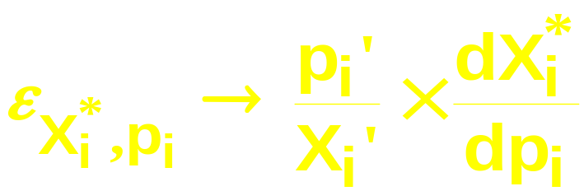
Point Own-Price Elasticity
What is the own-price elasticity
of demand in a very small interval
of prices centered on p_{i}’?
p_{i}
As h → 0,
p_{i}’
X_{i}*

Slide 33
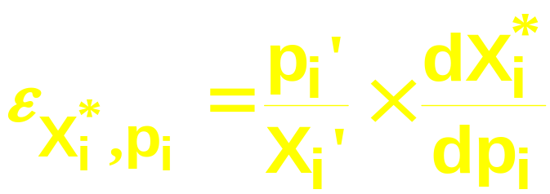
Point Own-Price Elasticity
What is the own-price elasticity
of demand in a very small interval
of prices centered on p_{i}’?
p_{i}
p_{i}’
is the elasticity at the
point
X_{i}*

Slide 34
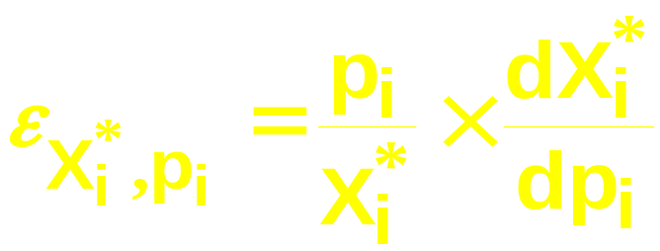
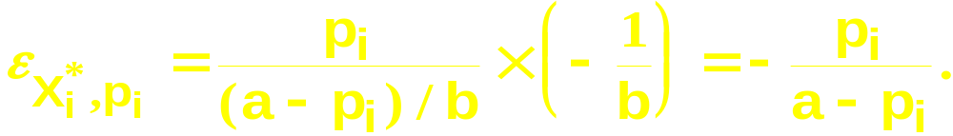
Point Own-Price Elasticity
E.g. Suppose p_{i} = a - bX_{i}.
Then X_{i} = (a-p_{i})/b and
Therefore,

Slide 35
Point Own-Price Elasticity
p_{i}
p_{i} = a - bX_{i}*
a
a/b
X_{i}*

Slide 36
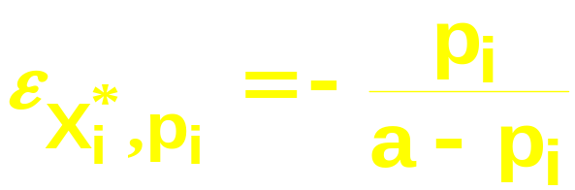
Point Own-Price Elasticity
p_{i}
p_{i} = a - bX_{i}*
a
a/b
X_{i}*

Slide 37

Point Own-Price Elasticity
p_{i}
p_{i} = a - bX_{i}*
a
a/b
X_{i}*

Slide 38

Point Own-Price Elasticity
p_{i}
p_{i} = a - bX_{i}*
a
a/b
X_{i}*

Slide 39
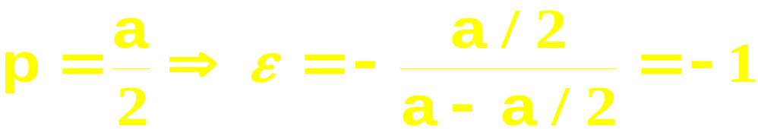
Point Own-Price Elasticity
p_{i}
p_{i} = a - bX_{i}*
a
a/b
X_{i}*

Slide 40

Point Own-Price Elasticity
p_{i}
p_{i} = a - bX_{i}*
a
a/2
a/2b
a/b
X_{i}*

Slide 41
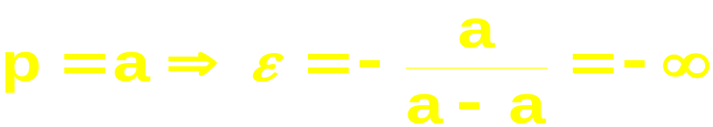
Point Own-Price Elasticity
p_{i}
p_{i} = a - bX_{i}*
a
a/2
a/2b
a/b
X_{i}*

Slide 42

Point Own-Price Elasticity
p_{i}
p_{i} = a - bX_{i}*
a
a/2
a/2b
a/b
X_{i}*

Slide 43
Point Own-Price Elasticity
p_{i}
p_{i} = a - bX_{i}*
a
own-price elastic
a/2
own-price inelastic
a/2b
a/b
X_{i}*

Slide 44
Point Own-Price Elasticity
p_{i}
p_{i} = a - bX_{i}*
a
own-price elastic
a/2
(own-price unit elastic)
own-price inelastic
a/2b
a/b
X_{i}*

Slide 45
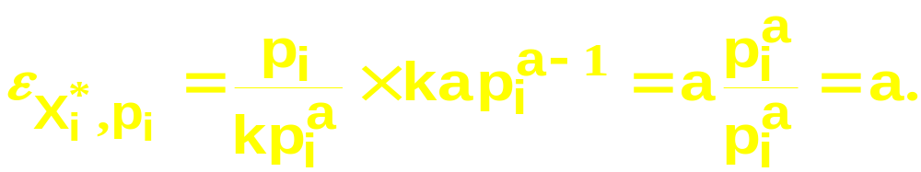
Point Own-Price Elasticity
E.g.
Then
so

Slide 46
Point Own-Price Elasticity
p_{i}
everywhere along
the demand curve.
X_{i}*

Slide 47
Revenue and Own-Price Elasticity of Demand需求的点弹性与销售收入
If raising a commodity’s price causes little decrease in quantity demanded, then sellers’ revenues rise.
Hence own-price inelastic 缺乏弹性的demand causes sellers’ revenues to rise as price rises.

Slide 48
Revenue and Own-Price Elasticity of Demand
If raising a commodity’s price causes a large decrease in quantity demanded, then sellers’ revenues fall.
Hence own-price elastic 富有弹性的demand causes sellers’ revenues to fall as price rises.

Slide 49
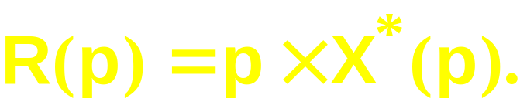
Revenue and Own-Price Elasticity of Demand
Sellers’ revenue is

Slide 50
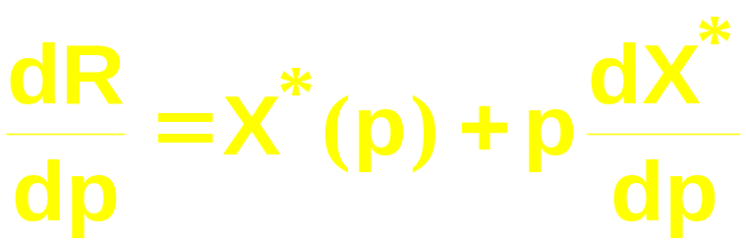
Revenue and Own-Price Elasticity of Demand
Sellers’ revenue is
So

Slide 51
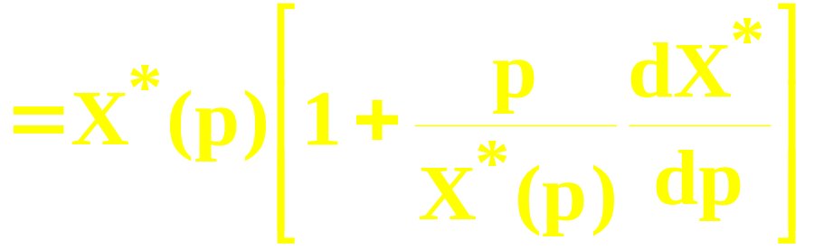
Revenue and Own-Price Elasticity of Demand
Sellers’ revenue is
So

Slide 52
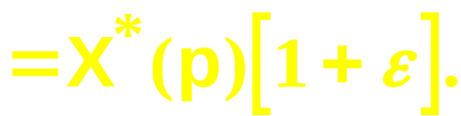
Revenue and Own-Price Elasticity of Demand
Sellers’ revenue is
So

Slide 53
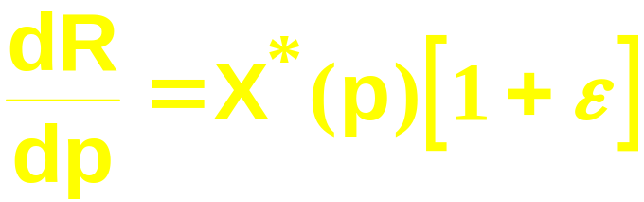
Revenue and Own-Price Elasticity of Demand

Slide 54
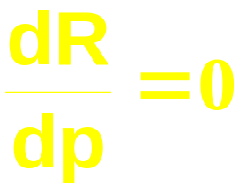

Revenue and Own-Price Elasticity of Demand
so if
then
and a change to price does not alter
sellers’ revenue.

Slide 55
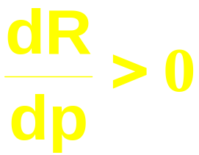

Revenue and Own-Price Elasticity of Demand
but if
then
and a price increase raises sellers’
revenue.

Slide 56
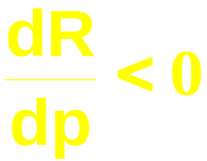

Revenue and Own-Price Elasticity of Demand
And if
then
and a price increase reduces sellers’
revenue.

Slide 57
Revenue and Own-Price Elasticity of Demand
In summary:
Own-price inelastic demand;
price rise causes rise in sellers’ revenue.
Own-price unit elastic demand;
price rise causes no change in sellers’
revenue.
Own-price elastic demand;
price rise causes fall in sellers’ revenue.

Slide 58
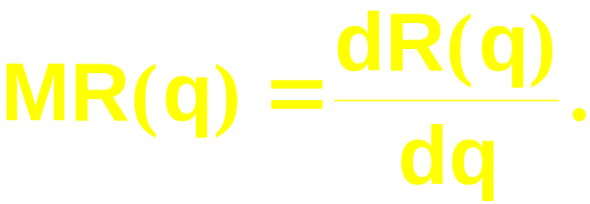
Marginal Revenue and Own-Price Elasticity of Demand需求弹性与边际收入
A seller’s marginal revenue is the rate at which revenue changes with the number of units sold by the seller.

Slide 59

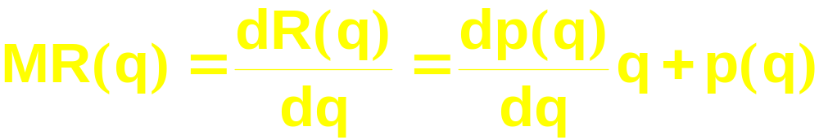
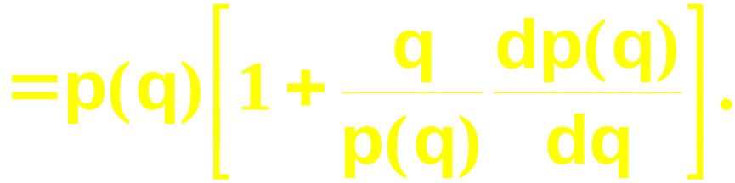
Marginal Revenue and Own-Price Elasticity of Demand
p(q) denotes the seller’s inverse demand function; i.e. the price at which the seller can sell q units. Then
so

Slide 60
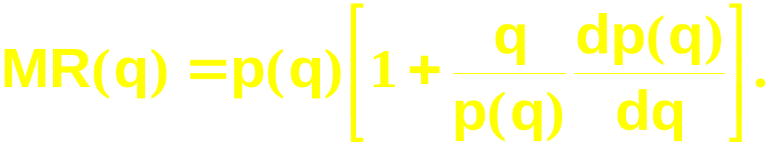
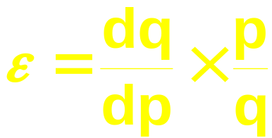
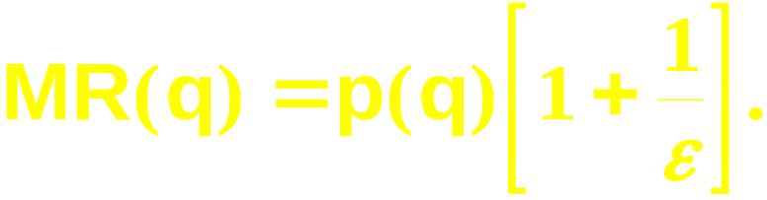
Marginal Revenue and Own-Price Elasticity of Demand需求弹性与边际收入
and
so

Slide 61
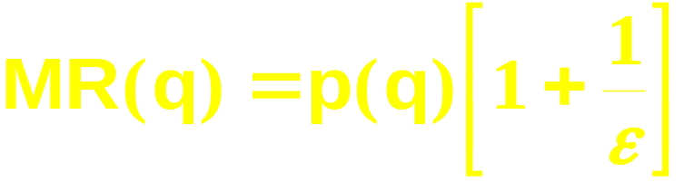
Marginal Revenue and Own-Price Elasticity of Demand
says that the rate
at which a seller’s revenue changes
with the number of units it sells
depends on the sensitivity of quantity
demanded to price; i.e., upon the
of the own-price elasticity of demand.

Slide 62
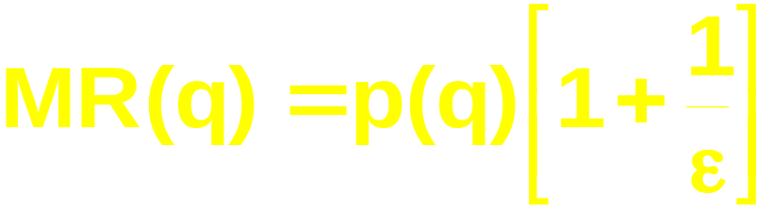






Marginal Revenue and Own-Price Elasticity of Demand
If
then
If
then
If
then

Slide 63



Marginal Revenue and Own-Price Elasticity of Demand
If
Selling one
more unit does not change the seller’s
revenue.
then
If
Selling one
more unit reduces the seller’s revenue.
then
If
then
Selling one
more unit raises the seller’s revenue.

Slide 64


Marginal Revenue and Own-Price Elasticity of Demand
An example with linear inverse demand.
Then
and

Slide 65


Marginal Revenue and Own-Price Elasticity of Demand
p
a
a/2b
a/b
q

Slide 66
Marginal Revenue and Own-Price Elasticity of Demand
p
a
$
a/2b
a/b
q
R(q)
q
a/2b
a/b

Slide 67
Income elasticity收入弹性
Income elasticity is used to describe how the quantity demanded to a change in income:

Slide 68
Income elasticity
A normal good: Income elasticity is positive.
A inferior good: Income elasticity is negative.
A luxury good: Income elasticity is greater than 1.

Slide 69
Income elasticity
As a general rule of thumb, income elasticity tend to cluster around 1.

