Slide 1
Chapter Eighteen
Technology技术

Slide 2
Technologies技术
A technology is a process by which inputs are converted to an output.
E.g. labor, a computer, a projector, electricity, and software are being combined to produce this lecture.

Slide 3
Technologies技术
Usually several technologies will produce the same product -- a blackboard and chalk can be used instead of a computer and a projector.
Which technology is “best”?
How do we compare technologies?

Slide 4
Input Bundles投入要素束
x_{i} denotes the amount used of input i; i.e. the level of input i.
An input bundle is a vector of the input levels; (x₁, x₂, … , x_{n}).
E.g. (x₁, x₂, x₃) = (6, 0, 9⋅3).

Slide 5
Production Functions生产函数
y denotes the output level.
The technology’s production function states the maximum amount of output possible最大可能产量 from an input bundle.

Slide 6
Production Functions生产函数
One input, one output
Output Level
y = f(x) is the
production
function.
y’
y’ = f(x’) is the maximal output level obtainable from x’ input units.
x’
x
Input Level

Slide 7
Production Sets生产集合
A production plan is an input bundle and an output level; (x₁, … , x_{n}, y).
A production plan is feasible if
The collection of all feasible production plans is the production set or technology set.

Slide 8
Production Sets生产集合
One input, one output
Output Level
y = f(x) is the
production
function.
y’
y’ = f(x’) is the maximal output level obtainable from x’ input units.
y”
y” = f(x’) is an output level that is feasible from x’ input units.
x’
x
Input Level

Slide 9
Production Sets生产集合
The production set is

Slide 10
Production Sets生产集合
One input, one output
Output Level
y’
The technology set
y”
x’
x
Input Level

Slide 11
Production Sets生产集合
One input, one output
Output Level
Technically efficient plans
y’
The technology set
Technically inefficient plans
y”
x’
x
Input Level

Slide 12
Technologies with Multiple Inputs 多投入要素技术
What does a technology look like when there is more than one input?
The two input case: Input levels are x₁ and x₂. Output level is y.
Suppose the production function is

Slide 13
Technologies with Multiple Inputs 多要素投入技术
E.g. the maximal output level possible from the input bundle (x₁, x₂) = (1, 8) is
And the maximal output level possible from (x₁,x₂) = (8,8) is

Slide 14
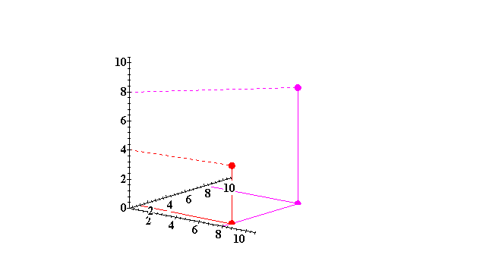
Technologies with Multiple Inputs 多要素投入技术
Output, y
x₂
(8,8)
(8,1)
x₁

Slide 15
Technologies with Multiple Inputs 多要素投入技术
The y output unit isoquant 等产量线is the set of all input bundles that yield at most the same output level y.

Slide 16
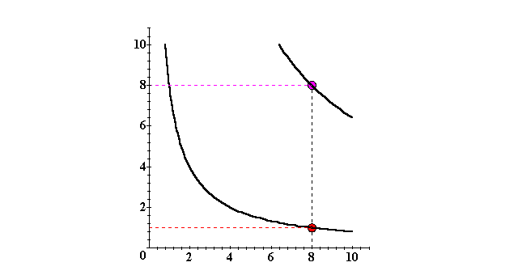
Isoquants with Two Variable Inputs 二个可变投入变量的等产量线
x₂
y ≡ 8
y ≡ 4
x₁

Slide 17
Isoquants with Two Variable Inputs 二个可变投入变量的等产量线
Isoquants can be graphed by adding an output level axis and displaying each isoquant at the height of the isoquant’s output level.

Slide 18
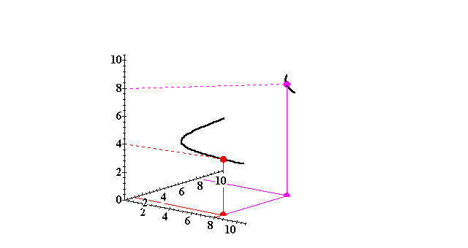
Isoquants with Two Variable Inputs 二个可变投入变量的等产量线
Output, y
y ≡ 8
x₂
y ≡ 4
x₁

Slide 19
Isoquants with Two Variable Inputs 二个可变投入变量的等产量线
More isoquants tell us more about the technology.

Slide 20
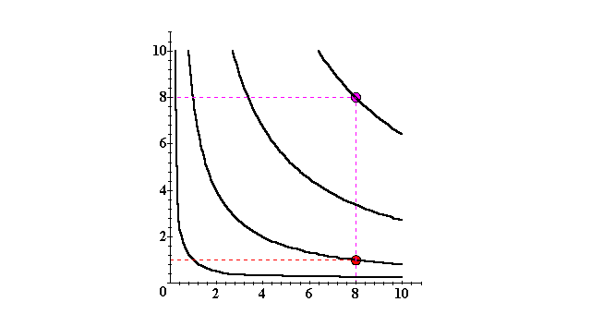
Isoquants with Two Variable Inputs
x₂
y ≡ 8
y ≡ 6
y ≡ 4
y ≡ 2
x₁

Slide 21
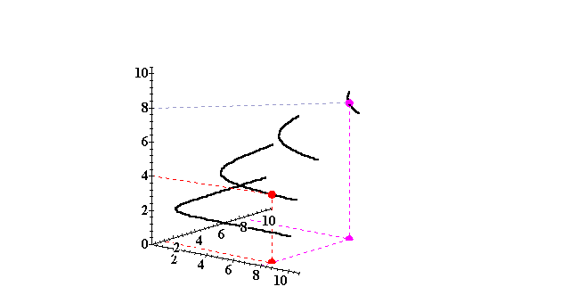
Isoquants with Two Variable Inputs
Output, y
y ≡ 8
y ≡ 6
x₂
y ≡ 4
y ≡ 2
x₁

Slide 22
Technologies with Multiple Inputs 多要素投入技术
The complete collection of isoquants is the isoquant map.
The isoquant map is equivalent to the production function -- each is the other.
E.g.

Slide 23
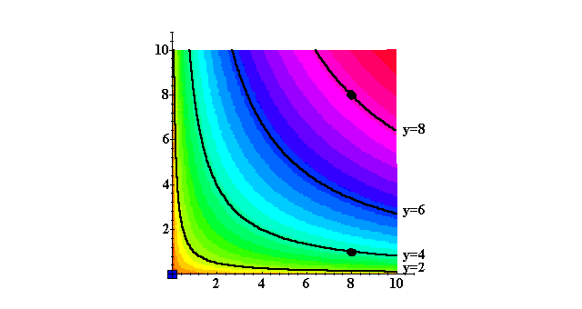
Technologies with Multiple Inputs
x₂
y
x₁

Slide 24
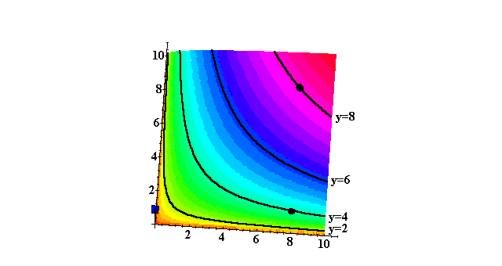
Technologies with Multiple Inputs
x₂
y
x₁

Slide 25
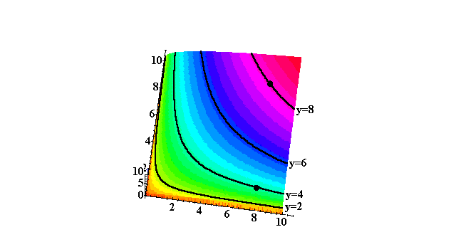
Technologies with Multiple Inputs
x₂
y
x₁

Slide 26
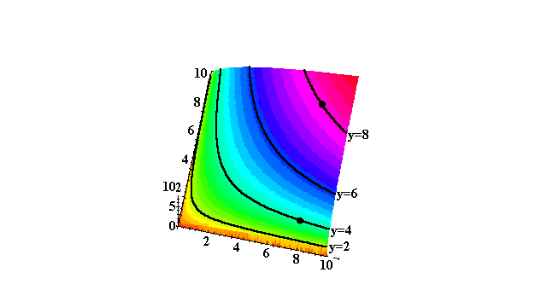
Technologies with Multiple Inputs
x₂
y
x₁

Slide 27
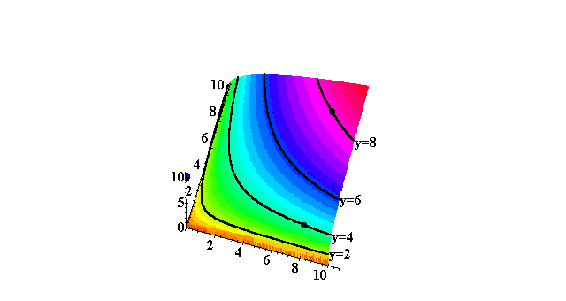
Technologies with Multiple Inputs
x₂
y
x₁

Slide 28
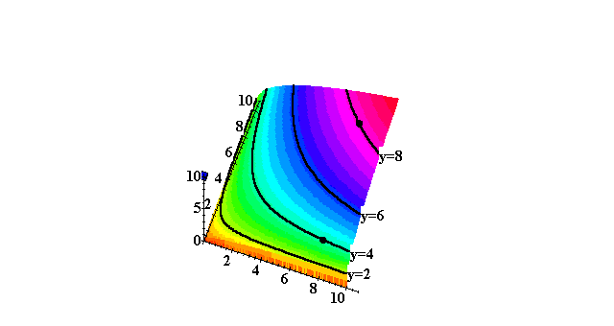
Technologies with Multiple Inputs
x₂
y
x₁

Slide 29
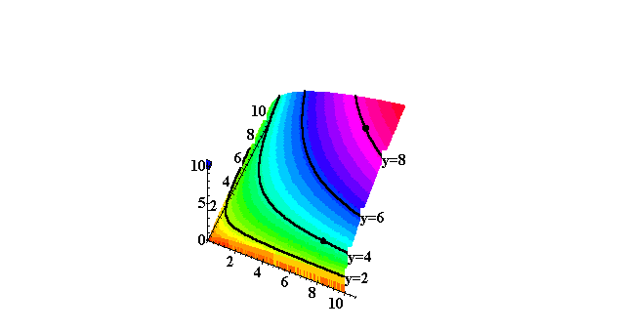
Technologies with Multiple Inputs
y
x₁

Slide 30
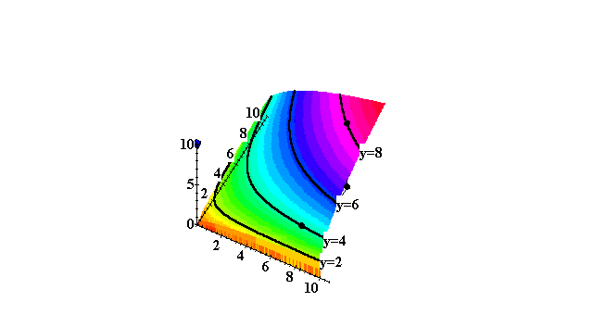
Technologies with Multiple Inputs
y
x₁

Slide 31
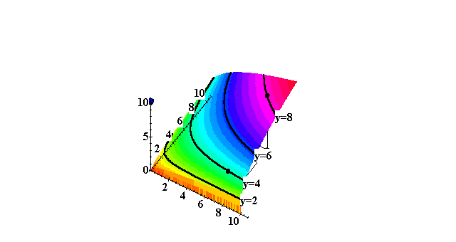
Technologies with Multiple Inputs
y
x₁

Slide 32
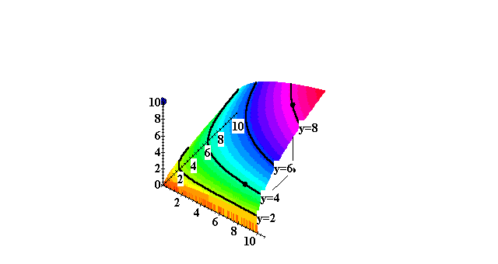
Technologies with Multiple Inputs
y
x₁

Slide 33
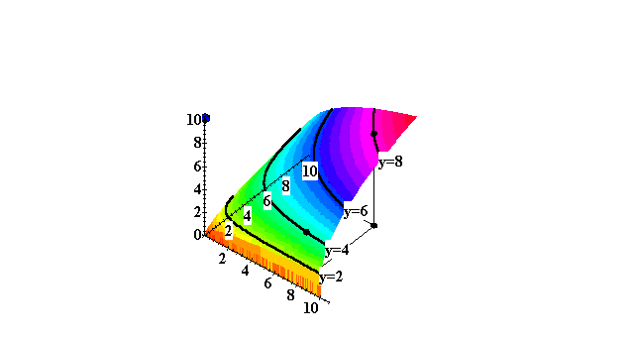
Technologies with Multiple Inputs
y
x₁

Slide 34
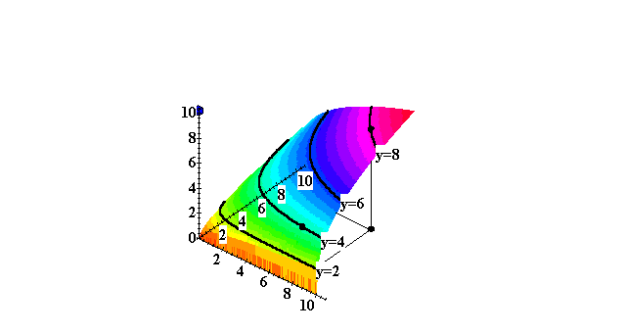
Technologies with Multiple Inputs
y
x₁

Slide 35
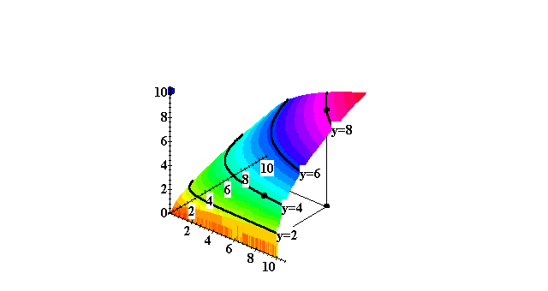
Technologies with Multiple Inputs
y
x₁

Slide 36
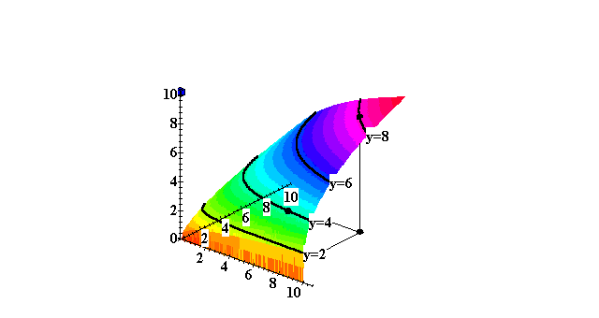
Technologies with Multiple Inputs
y
x₁

Slide 37

Technologies with Multiple Inputs
y
x₁

Slide 38
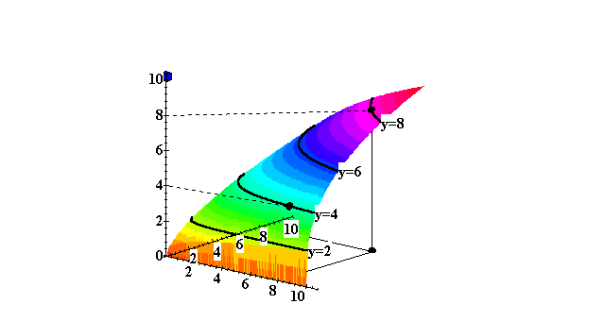
Technologies with Multiple Inputs
y
x₁

Slide 39
Cobb-Douglas Technologies 柯布道格拉斯技术
A Cobb-Douglas production function is of the form
E.g. with

Slide 40
Cobb-Douglas Technologies 柯布道格拉斯技术
x₂
All isoquants are hyperbolic双曲线,asymptoting渐近线to, but never touching any axis.
x₁

Slide 41
Cobb-Douglas Technologies 柯布道格拉斯技术
x₂
All isoquants are hyperbolic双曲线,asymptoting渐近线to, but never touching any axis.
x₁

Slide 42
Cobb-Douglas Technologies 柯布道格拉斯技术
x₂
All isoquants are hyperbolic双曲线,asymptoting渐近线to, but never touching any axis.
x₁

Slide 43
Cobb-Douglas Technologies 柯布道格拉斯技术
x₂
All isoquants are hyperbolic双曲线,asymptoting渐近线to, but never touching any axis.
>
x₁

Slide 44
Fixed-Proportions Technologies 固定投入比例技术
A fixed-proportions production function is of the form
E.g. with

Slide 45
Fixed-Proportions Technologies 固定投入比例技术
x₂
x₁ = 2x₂
7
min{x₁,2x₂} = 14
4
min{x₁,2x₂} = 8
2
min{x₁,2x₂} = 4
4
8
14
x₁

Slide 46
Perfect-Substitutes Technologies 完全替代投入要素技术
A perfect-substitutes production function is of the form
E.g. with

Slide 47
Perfect-Substitution Technologies 完全替代投入要素技术
x₂
x₁ + 3x₂ = 18
x₁ + 3x₂ = 36
x₁ + 3x₂ = 48
8
6
All are linear and parallel
3
9
18
24
x₁

Slide 48
Marginal (Physical) Products 边际产出
The marginal product of input i is the rate-of-change of the output level as the level of input i changes, holding all other input levels fixed.
That is,

Slide 49
Marginal (Physical) Products 边际产出
E.g. if
then the marginal product of input 1 is

Slide 50
Marginal (Physical) Products 边际产出
E.g. if
then the marginal product of input 1 is

Slide 51
Marginal (Physical) Products 边际产出
E.g. if
then the marginal product of input 1 is
and the marginal product of input 2 is

Slide 52
Marginal (Physical) Products 边际产出
E.g. if
then the marginal product of input 1 is
and the marginal product of input 2 is

Slide 53
Marginal (Physical) Products 边际产出
Typically the marginal product of one
input depends upon the amount used of other inputs一种投入要素的边际产出取决于另一种要素的投入数量. E.g. if
then,
if x₂ = 8,
and if x₂ = 27 then

Slide 54
Marginal (Physical) Products 边际产出
The marginal product of input i is diminishing要素的边际产出递减 if it becomes smaller as the level of input i increases. That is, if

Slide 55
Marginal (Physical) Products 边际产出
E.g. if
then
and

Slide 56
Marginal (Physical) Products 边际产出
E.g. if
then
and
so

Slide 57
Marginal (Physical) Products 边际产出
E.g. if
then
and
so
and

Slide 58
Marginal (Physical) Products 边际产出
E.g. if
then
and
so
and
Both marginal products are diminishing递减.

Slide 59
Returns-to-Scale规模报酬
Marginal products describe the change in output level as a single input level changes.
Returns-to-scale describes how the output level changes as all input levels change in direct proportion 同比例变化(e.g. all input levels doubled, or halved).

Slide 60
Returns-to-Scale规模报酬
If, for any input bundle (x₁,…,x_{n}),
then the technology described by the production function f exhibits constant returns-to-scale规模报酬不变. E.g. (k = 2) doubling all input levels doubles the output level.

Slide 61
Returns-to-Scale规模报酬
One input, one output
Output Level
y = f(x)
2y’
Constant returns-to-scale
y’
x’
2x’
x
Input Level

Slide 62
Returns-to-Scale规模报酬
If, for any input bundle (x₁,…,x_{n}),
then the technology exhibits diminishing returns-to-scale规模报酬递减. E.g. (k = 2) doubling all input levels less than doubles the output level.

Slide 63
Returns-to-Scale规模报酬
One input, one output
Output Level
2f(x’)
y = f(x)
f(2x’)
Decreasing returns-to-scale
f(x’)
x’
2x’
x
Input Level

Slide 64
Returns-to-Scale规模报酬
If, for any input bundle (x₁,…,x_{n}),
then the technology exhibits increasing returns-to-scale规模报酬递增. E.g. (k = 2) doubling all input levels more than doubles the output level.

Slide 65
Returns-to-Scale规模报酬
One input, one output
Output Level
Increasing returns-to-scale
y = f(x)
f(2x’)
2f(x’)
f(x’)
x’
2x’
x
Input Level

Slide 66
Returns-to-Scale规模报酬
A single technology can ‘locally’ exhibit different returns-to-scale.

Slide 67
Returns-to-Scale规模报酬
One input, one output
Output Level
y = f(x)
Increasing returns-to-scale
Decreasing returns-to-scale
x
Input Level

Slide 68
Examples of Returns-to-Scale
The perfect-substitutes 完全替代production function is
Expand all input levels proportionately by k. The output level becomes

Slide 69
Examples of Returns-to-Scale
The perfect-substitutes 完全替代production function is
Expand all input levels proportionately by k. The output level becomes

Slide 70
Examples of Returns-to-Scale
The perfect-substitutes完全替代 production function is
Expand all input levels proportionately by k. The output level becomes
The perfect-substitutes production function exhibits constant returns-to-scale规模报酬不变.

Slide 71
Examples of Returns-to-Scale
The perfect-complements完全互补 production function is
Expand all input levels proportionately by k. The output level becomes

Slide 72
Examples of Returns-to-Scale
The perfect-complements完全互补 production function is
Expand all input levels proportionately by k. The output level becomes

Slide 73
Examples of Returns-to-Scale
The perfect-complements 完全互补production function is
Expand all input levels proportionately by k. The output level becomes
The perfect-complements production function exhibits constant returns-to-scale.规模报酬不变

Slide 74
Examples of Returns-to-Scale
The Cobb-Douglas production function is
Expand all input levels proportionately by k. The output level becomes

Slide 75
Examples of Returns-to-Scale
The Cobb-Douglas production function is
Expand all input levels proportionately by k. The output level becomes

Slide 76
Examples of Returns-to-Scale
The Cobb-Douglas production function is
Expand all input levels proportionately by k. The output level becomes

Slide 77
Examples of Returns-to-Scale
The Cobb-Douglas production function is
Expand all input levels proportionately by k. The output level becomes

Slide 78
Examples of Returns-to-Scale
The Cobb-Douglas production function is
The Cobb-Douglas technology’s returns- to-scale is constant if a₁+ … + a_{n} = 1

Slide 79
Examples of Returns-to-Scale
The Cobb-Douglas production function is
The Cobb-Douglas technology’s returns- to-scale is constant if a₁+ … + a_{n} = 1 increasing if a₁+ … + a_{n} > 1

Slide 80
Examples of Returns-to-Scale
The Cobb-Douglas production function is
The Cobb-Douglas technology’s returns- to-scale is constant if a₁+ … + a_{n} = 1 increasing if a₁+ … + a_{n} > 1 decreasing if a₁+ … + a_{n} < 1.

Slide 81
Returns-to-Scale
Q: Can a technology exhibit increasing returns-to-scale even though all of its marginal products are diminishing?

Slide 82
Returns-to-Scale
Q: Can a technology exhibit increasing returns-to-scale even if all of its marginal products are diminishing?
A: Yes.
E.g.

Slide 83
Returns-to-Scale
so this technology exhibits increasing returns-to-scale.

Slide 84
Returns-to-Scale
so this technology exhibits increasing returns-to-scale.
But
diminishes as x₁
increases

Slide 85
Returns-to-Scale
so this technology exhibits increasing returns-to-scale.
But
diminishes as x₁
increases and
diminishes as x₁
increases.

Slide 86
Returns-to-Scale
So a technology can exhibit increasing returns-to-scale even if all of its marginal products are diminishing. Why?

Slide 87
Returns-to-Scale
A marginal product is the rate-of-change of output as one input level increases, holding all other input levels fixed.
Marginal product diminishes because the other input levels are fixed, so the increasing input’s units have each less and less of other inputs with which to work.

Slide 88
Returns-to-Scale
When all input levels are increased proportionately, there need be no diminution of marginal products since each input will always have the same amount of other inputs with which to work. Input productivities need not fall and so returns-to-scale can be constant or increasing.

Slide 89
Technical Rate-of-Substitution （边际)技术替代率
At what rate can a firm substitute one input for another without changing its output level?

Slide 90
Technical Rate-of-Substitution （边际)技术替代率
x₂
y≡100
x₁

Slide 91
Technical Rate-of-Substitution （边际)技术替代率
The slope is the rate at which input 2 must be given up as input 1’s level is increased so as not to change the output level. The slope of an isoquant 等产量线的斜率is its technical rate-of-substitution.
x₂
y≡100
x₁

Slide 92
Technical Rate-of-Substitution （边际)技术替代率
How is a technical rate-of-substitution computed?

Slide 93
Technical Rate-of-Substitution （边际)技术替代率
How is a technical rate-of-substitution computed?
The production function is
A small change (dx₁, dx₂) in the input bundle causes a change to the output level of

Slide 94
Technical Rate-of-Substitution （边际)技术替代率
But dy = 0 since there is to be no change to the output level, so the changes dx₁ and dx₂ to the input levels must satisfy

Slide 95
Technical Rate-of-Substitution （边际)技术替代率
rearranges to
so

Slide 96
Technical Rate-of-Substitution （边际)技术替代率
is the rate at which input 2 must be given up as input 1 increases so as to keep the output level constant. It is the slope of the isoquant.

Slide 97
Technical Rate-of-Substitution; A Cobb-Douglas Example
so
and
The technical rate-of-substitution is

Slide 98
Technical Rate-of-Substitution; A Cobb-Douglas Example
x₂
x₁

Slide 99
Technical Rate-of-Substitution; A Cobb-Douglas Example
x₂
8
4
x₁

Slide 100
Technical Rate-of-Substitution; A Cobb-Douglas Example
x₂
6
12
x₁

Slide 101
Well-Behaved Technologies良态技术
A well-behaved technology is
Monotonic单调性, and
Convex凸性.

Slide 102
Well-Behaved Technologies – Monotonicity单调性
Monotonicity: More of any input generates more output.
y
y
monotonic
not monotonic
x
x

Slide 103
Well-Behaved Technologies – Convexity凸性
Convexity: If the input bundles x’ and x” both provide y units of output then the mixture tx’ + (1-t)x” provides at least y units of output, for any 0 < t < 1.

Slide 104
Well-Behaved Technologies – Convexity凸性
x₂
y≡100
x₁

Slide 105
Well-Behaved Technologies – Convexity凸性
x₂
y≡100
x₁

Slide 106
Well-Behaved Technologies – Convexity凸性
x₂
y≡120
y≡100
x₁

Slide 107
Well-Behaved Technologies – Convexity凸性
x₂
Convexity implies that the TRS increases (becomes less negative) as x₁ increases.
x₁

Slide 108
Well-Behaved Technologies
higher output
x₂
y≡200
y≡50
y≡100
x₁

Slide 109
The Long-Run and the Short-Runs 长期和短期
The long-run is the circumstance in which a firm is unrestricted in its choice of all input levels.
There are many possible short-runs.
A short-run is a circumstance in which a firm is restricted in some way in its choice of at least one input level.

Slide 110
The Long-Run and the Short-Runs 长期和短期
Examples of restrictions that place a firm into a short-run:
temporarily being unable to install, or remove, machinery
being required by law to meet affirmative action quotas
having to meet domestic content regulations.

Slide 111
The Long-Run and the Short-Runs 长期和短期
A useful way to think of the long-run is that the firm can choose as it pleases in which short-run circumstance to be.

Slide 112
The Long-Run and the Short-Runs 长期和短期
What do short-run restrictions imply for a firm’s technology?
Suppose the short-run restriction is fixing the level of input 2.
Input 2 is thus a fixed input in the short-run. Input 1 remains variable.

Slide 113
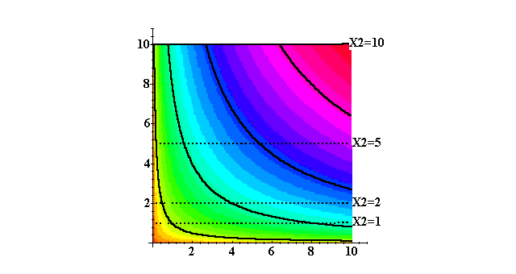
The Long-Run and the Short-Runs
x₂
y
x₁

Slide 114
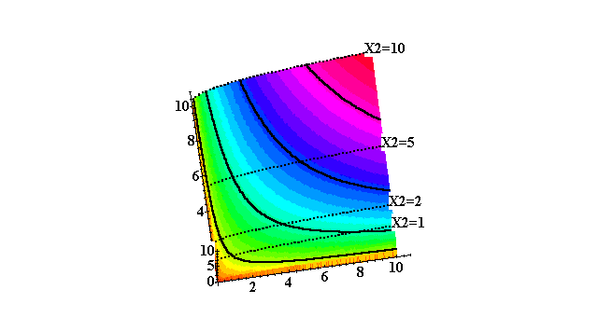
The Long-Run and the Short-Runs
x₂
y
x₁

Slide 115
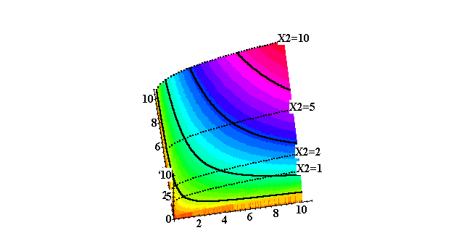
The Long-Run and the Short-Runs
x₂
y
x₁

Slide 116
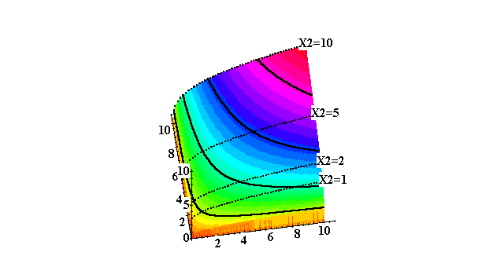
The Long-Run and the Short-Runs
x₂
y
x₁

Slide 117
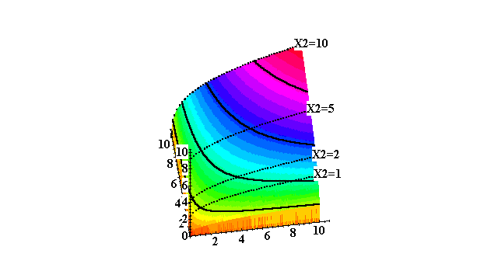
The Long-Run and the Short-Runs
x₂
y
x₁

Slide 118
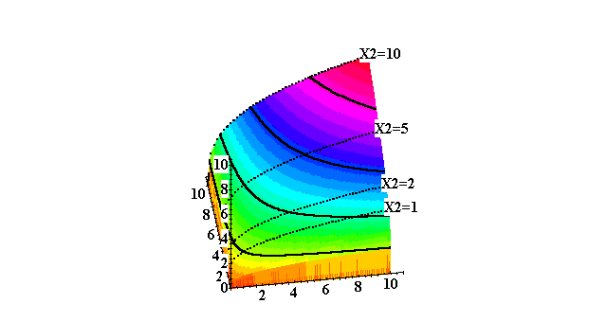
The Long-Run and the Short-Runs
x₂
y
x₁

Slide 119
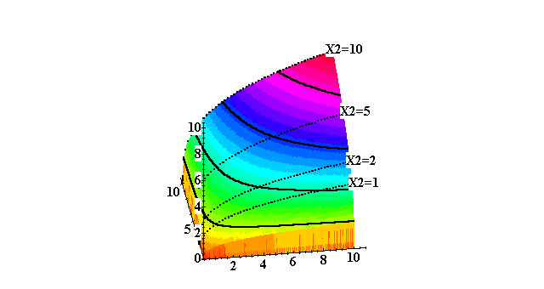
The Long-Run and the Short-Runs
x₂
y
x₁

Slide 120
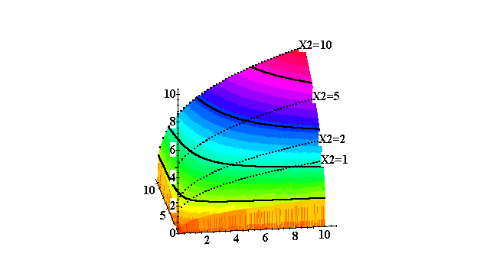
The Long-Run and the Short-Runs
y
x₂
x₁

Slide 121
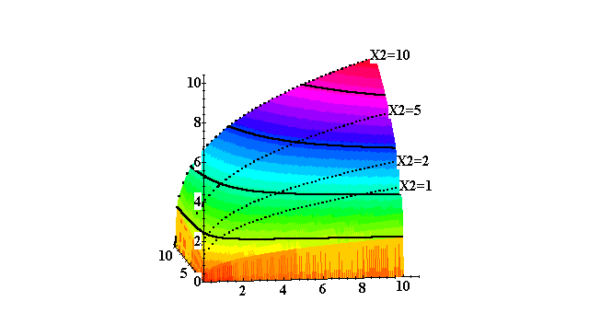
The Long-Run and the Short-Runs
y
x₂
x₁

Slide 122
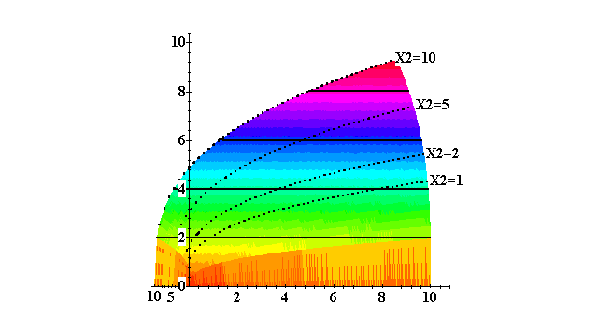
The Long-Run and the Short-Runs
y
x₂
x₁

Slide 123
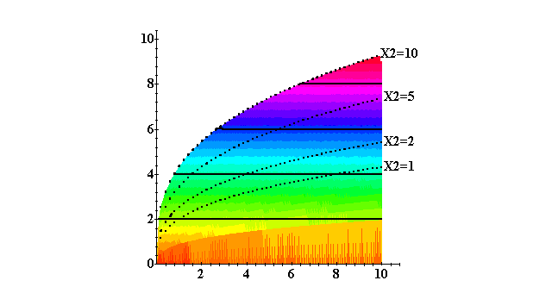
The Long-Run and the Short-Runs
y
x₁

Slide 124
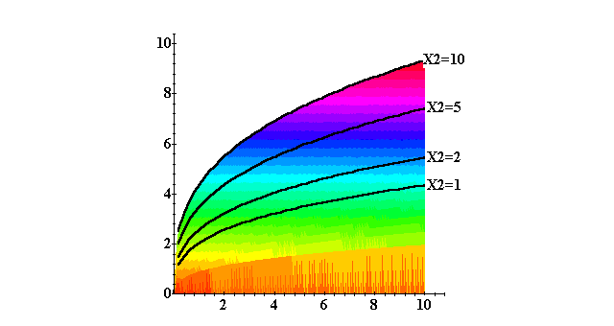
The Long-Run and the Short-Runs
y
x₁

Slide 125
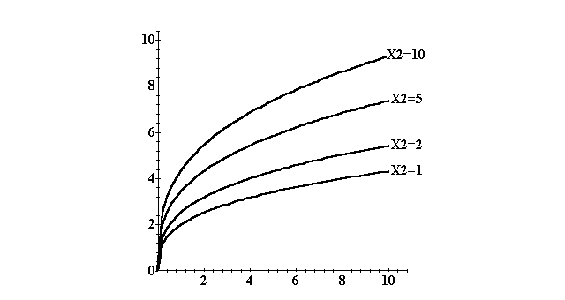
The Long-Run and the Short-Runs
y
x₁
Four short-run production functions.

Slide 126
The Long-Run and the Short-Runs 长期和短期
is the long-run production function (both x₁ and x₂ are variable).
The short-run production function when x₂ ≡ 1 is
The short-run production function when x₂ ≡ 10 is

Slide 127
The Long-Run and the Short-Runs
y
x₁
Four short-run production functions.

