Slide 1
Chapter Twenty-One
Cost Curves
成本曲线

Slide 2
Types of Cost Curves成本曲线的类型
A total cost curve总成本曲线 is the graph of a firm’s total cost function.
A variable cost curve可变成本曲线 is the graph of a firm’s variable cost function.
An average total cost curve平均成本曲线 is the graph of a firm’s average total cost function.

Slide 3
Types of Cost Curves
An average variable cost curve平均成本曲线 is the graph of a firm’s average variable cost function.
An average fixed cost curve平均固定成本曲线 is the graph of a firm’s average fixed cost function.
A marginal cost curve边际成本曲线 is the graph of a firm’s marginal cost function.

Slide 4
Types of Cost Curves
How are these cost curves related to each other?
How are a firm’s long-run and short-run cost curves related?

Slide 5
Fixed, Variable & Total Cost Functions 固定、可变和总成本函数
F is the total cost to a firm of its short-run fixed inputs. F, the firm’s fixed cost固定成本, does not vary with the firm’s output level.
c_{v}(y) is the total cost to a firm of its variable inputs when producing y output units. c_{v}(y) is the firm’s variable cost可变成本 function.
c_{v}(y) depends upon the levels of the fixed inputs.

Slide 6
Fixed, Variable & Total Cost Functions
c(y) is the total cost of all inputs, fixed and variable, when producing y output units. c(y) is the firm’s total cost function总成本函数;

Slide 7
$
F
y

Slide 8
$
c_{v}(y)
y

Slide 9
$
c_{v}(y)
F
y

Slide 10
$
c(y)
c_{v}(y)
F
F
y

Slide 11
Av. Fixed, Av. Variable & Av. Total Cost Curves平均固定、平均可变和平均总成本
The firm’s total cost function is For y > 0, the firm’s average total cost function is

Slide 12
Av. Fixed, Av. Variable & Av. Total Cost Curves平均固定、平均可变和平均总成本
What does an average fixed cost curve look like?
AFC(y) is a rectangular hyperbola直角双曲线 so its graph looks like ...

Slide 13
$/output unit
AFC(y) → 0 as y → ∞
AFC(y)
0
y

Slide 14
Av. Fixed, Av. Variable & Av. Total Cost Curves
In a short-run with a fixed amount of at least one input, the Law of Diminishing (Marginal) Returns must apply, causing the firm’s average variable cost of production to increase eventually.边际报酬递减导致平均可变成本最终增加

Slide 15
$/output unit
AVC(y)
0
y

Slide 16
$/output unit
AVC(y)
AFC(y)
0
y

Slide 17
Av. Fixed, Av. Variable & Av. Total Cost Curves
And ATC(y) = AFC(y) + AVC(y)

Slide 18
$/output unit
ATC(y) = AFC(y) + AVC(y)
ATC(y)
AVC(y)
AFC(y)
0
y

Slide 19
$/output unit
AFC(y) = ATC(y) - AVC(y)
ATC(y)
AFC
AVC(y)
AFC(y)
0
y

Slide 20
Since AFC(y) → 0 as y → ∞, ATC(y) → AVC(y) as y → ∞.
$/output unit
ATC(y)
AFC
AVC(y)
AFC(y)
0
y

Slide 21
Since AFC(y) → 0 as y → ∞, ATC(y) → AVC(y) as y → ∞.
$/output unit
And since short-run AVC(y) must eventually increase, ATC(y) must
eventually increase in a short-run.
ATC(y)
AVC(y)
AFC(y)
0
y

Slide 22
Marginal Cost Function边际成本函数
Marginal cost is the rate-of-change of variable production cost as the output level changes边际成本是可变成本关于产量的函数. That is,

Slide 23
Marginal Cost Function边际成本函数
The firm’s total cost function is and the fixed cost F does not change with the output level y, so
MC is the slope of both the variable cost and the total cost functions.

Slide 24
Marginal and Variable Cost Functions 边际成本和可变成本函数
Since MC(y) is the derivative of c_{v}(y), c_{v}(y) must be the integral of MC(y). That is,

Slide 25
Marginal and Variable Cost Functions
$/output unit
MC(y)
Area is the variable cost of making y’ units
0
y

Slide 26
Marginal & Average Cost Functions
How is marginal cost related to average variable cost?

Slide 27
Marginal & Average Cost Functions
Since

Slide 28
Marginal & Average Cost Functions
Since
Therefore,
as

Slide 29
Marginal & Average Cost Functions
Since
Therefore,
as
as

Slide 30
Marginal & Average Cost Functions
as

Slide 31
$/output unit
MC(y)
AVC(y)
y

Slide 32
$/output unit
MC(y)
AVC(y)
y

Slide 33
$/output unit
MC(y)
AVC(y)
y

Slide 34
$/output unit
MC(y)
AVC(y)
y

Slide 35
$/output unit
The short-run MC curve intersects the short-run AVC curve from below at the AVC curve’s
minimum.
MC(y)
AVC(y)
y

Slide 36
Marginal & Average Cost Functions
Similarly, since

Slide 37
Marginal & Average Cost Functions
Similarly, since
Therefore,
as

Slide 38
Marginal & Average Cost Functions
Similarly, since
Therefore,
as
as

Slide 39
$/output unit
as
MC(y)
ATC(y)
y

Slide 40
Marginal & Average Cost Functions
The short-run MC curve intersects the short-run AVC curve from below at the AVC curve’s minimum短期边际成本曲线穿过短期平均可变成本曲线最低点.
And, similarly, the short-run MC curve intersects the short-run ATC curve from below at the ATC curve’s minimum短期边际成本曲线穿过短期平均总成本曲线最低点.

Slide 41
$/output unit
MC(y)
ATC(y)
AVC(y)
y

Slide 42
Short-Run & Long-Run Total Cost Curves
A firm has a different short-run total cost curve for each possible short-run circumstance短期成本曲线因固定成本的不同而不同.
Suppose the firm can be in one of just three short-runs; x₂ = x₂′ or x₂ = x₂′′ x₂′ < x₂′′ < x₂′′′. or x₂ = x₂′′′.

Slide 43
$
c_{s}(y;x₂′)
F′ = w₂x₂′
F′
0
y

Slide 44
$
c_{s}(y;x₂′)
F′ = w₂x₂′
F′′ = w₂x₂′′
c_{s}(y;x₂′′)
F′′
F′
0
y

Slide 45
$
c_{s}(y;x₂′)
F′ = w₂x₂′
F′′ = w₂x₂′′
A larger amount of the fixed input increases the firm’s fixed cost.
c_{s}(y;x₂′′)
F′′
F′
0
y

Slide 46
$
c_{s}(y;x₂′)
F′ = w₂x₂′
F′′ = w₂x₂′′
A larger amount of the fixed input increases the firm’s fixed cost.
c_{s}(y;x₂′′)
Why does a larger amount of the fixed input reduce the slope of the firm’s total cost curve?
F′′
F′
0
y

Slide 47
Short-Run & Long-Run Total Cost Curves短期和长期总成本曲线
MP₁ is the marginal physical productivity
of the variable input 1, so one extra unit of
input 1 gives MP₁ extra output units.
Therefore, the extra amount of input 1
needed for 1 extra output unit is

Slide 48
Short-Run & Long-Run Total Cost Curves
MP₁ is the marginal physical productivity
of the variable input 1, so one extra unit of
input 1 gives MP₁ extra output units.
Therefore, the extra amount of input 1
needed for 1 extra output unit is
units of input 1.

Slide 49
Short-Run & Long-Run Total Cost Curves
MP₁ is the marginal physical productivity
of the variable input 1, so one extra unit of
input 1 gives MP₁ extra output units.
Therefore, the extra amount of input 1
needed for 1 extra output unit is
units of input 1每1单位边际产出的投入.
Each unit of input 1 costs w₁, so the firm’s
extra cost from producing one extra unit
of output is

Slide 50
Short-Run & Long-Run Total Cost Curves
MP₁ is the marginal physical productivity
of the variable input 1, so one extra unit of
input 1 gives MP₁ extra output units.
Therefore, the extra amount of input 1
needed for 1 extra output unit is
units of input 1.
Each unit of input 1 costs w₁, so the firm’s
extra cost from producing one extra unit
of output is每1单位边际产出的成本是

Slide 51
Short-Run & Long-Run Total Cost Curves
is the slope of the firm’s total cost curve.

Slide 52
Short-Run & Long-Run Total Cost Curves短期和长期总成本曲线
is the slope of the firm’s total cost curve.
If input 2 is a complement to input 1 then MP₁ is higher for higher x₂.如果要素2与要素1互补会提高要素1的边际产出
Hence, MC is lower for higher x₂.
That is, a short-run total cost curve starts higher and has a lower slope if x₂ is larger.

Slide 53
$
c_{s}(y;x₂′)
F′ = w₂x₂′
F′′ = w₂x₂′′
F′′′ = w₂x₂′′′
c_{s}(y;x₂′′)
c_{s}(y;x₂′′′)
F′′′
F′′
F′
0
y

Slide 54
Short-Run & Long-Run Total Cost Curves短期和长期总成本曲线
The firm has three short-run total cost curves.
In the long-run the firm is free to choose amongst these three since it is free to select x₂ equal to any of x₂′, x₂′′, or x₂′′′.
How does the firm make this choice?

Slide 55
$
For 0 ≤ y ≤ y′, choose x₂ = ?
c_{s}(y;x₂′)
c_{s}(y;x₂′′)
c_{s}(y;x₂′′′)
F′′′
F′′
F′
0
y′
y′′
y

Slide 56
$
For 0 ≤ y ≤ y′, choose x₂ = x₂′.
c_{s}(y;x₂′)
c_{s}(y;x₂′′)
c_{s}(y;x₂′′′)
F′′′
F′′
F′
0
y′
y′′
y

Slide 57
$
For 0 ≤ y ≤ y′, choose x₂ = x₂′.
c_{s}(y;x₂′)
For y′ ≤ y ≤ y′′, choose x₂ = ?
c_{s}(y;x₂′′)
c_{s}(y;x₂′′′)
F′′′
F′′
F′
0
y′
y′′
y

Slide 58
$
For 0 ≤ y ≤ y′, choose x₂ = x₂′.
c_{s}(y;x₂′)
For y′ ≤ y ≤ y′′, choose x₂ = x₂′′.
c_{s}(y;x₂′′)
c_{s}(y;x₂′′′)
F′′′
F′′
F′
0
y′
y′′
y

Slide 59
$
For 0 ≤ y ≤ y′, choose x₂ = x₂′.
c_{s}(y;x₂′)
For y′ ≤ y ≤ y′′, choose x₂ = x₂′′.
For y′′ < y, choose x₂ = ?
c_{s}(y;x₂′′)
c_{s}(y;x₂′′′)
F′′′
F′′
F′
0
y′
y′′
y

Slide 60
$
For 0 ≤ y ≤ y′, choose x₂ = x₂′.
c_{s}(y;x₂′)
For y′ ≤ y ≤ y′′, choose x₂ = x₂′′.
For y′′ < y, choose x₂ = x₂′′′.
c_{s}(y;x₂′′)
c_{s}(y;x₂′′′)
F′′′
F′′
F′
0
y′
y′′
y

Slide 61
$
For 0 ≤ y ≤ y′, choose x₂ = x₂′.
c_{s}(y;x₂′)
For y′ ≤ y ≤ y′′, choose x₂ = x₂′′.
For y′′ < y, choose x₂ = x₂′′′.
c_{s}(y;x₂′′)
c_{s}(y;x₂′′′)
c(y), the firm’s long- run total cost curve.
F′′′
F′′
F′
0
y′
y′′
y

Slide 62
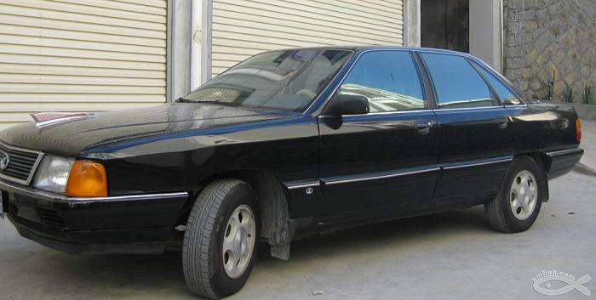
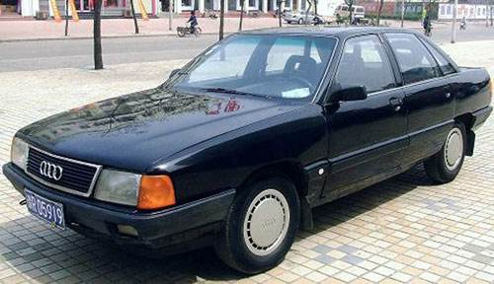

Slide 63
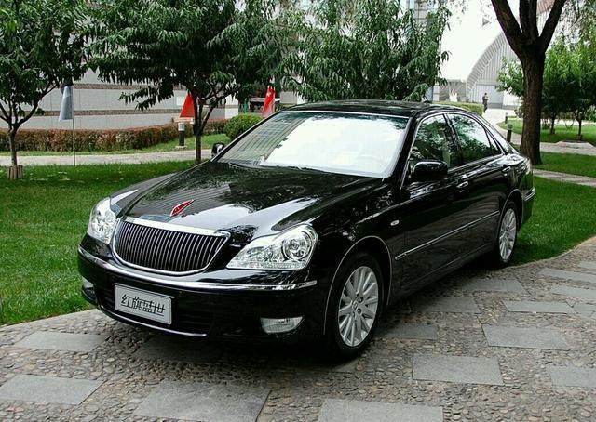
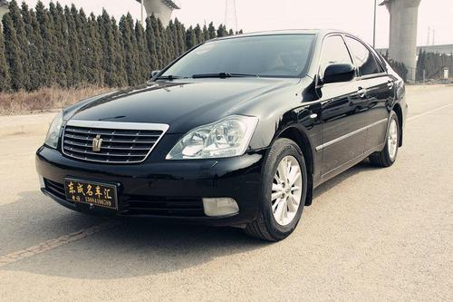

Slide 64
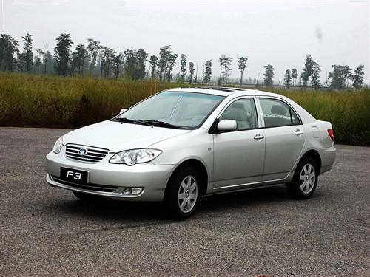
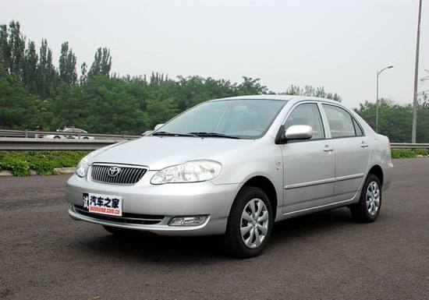

Slide 65
Short-Run & Long-Run Total Cost Curves短期和长期总成本曲线
The firm’s long-run total cost curve consists of the lowest parts of the short-run total cost curves. The long-run total cost curve is the lower envelope包络线 of the short-run total cost curves.

Slide 66
Short-Run & Long-Run Total Cost Curves短期和长期总成本曲线
If input 2 is available in continuous amounts then there is an infinity of short-run total cost curves but the long-run total cost curve is still the lower envelope of all of the short-run total cost curves.在连续的情况下存在无数条短期总成本曲线

Slide 67
$
c_{s}(y;x₂′)
c_{s}(y;x₂′′)
c_{s}(y;x₂′′′)
c(y)
F′′′
F′′
F′
0
y

Slide 68
Short-Run & Long-Run Average Total Cost Curves短期和长期平均成本曲线
For any output level y, the long-run total cost curve always gives the lowest possible total production cost.
Therefore, the long-run av. total cost curve must always give the lowest possible av. total production cost.
The long-run av. total cost curve must be the lower envelope of all of the firm’s short-run av. total cost curves长期平均总成本曲线是短期平均总成本曲线的包络线.

Slide 69
Short-Run & Long-Run Average Total Cost Curves短期和长期平均成本曲线
E.g. suppose again that the firm can be in one of just three short-runs; x₂ = x₂′ or x₂ = x₂′′ (x₂′ < x₂′′ < x₂′′′) or x₂ = x₂′′′ then the firm’s three short-run average total cost curves are ...

Slide 70
$/output unit
AC_{s}(y;x₂′)
AC_{s}(y;x₂′′)
AC_{s}(y;x₂′′′)
y

Slide 71
Short-Run & Long-Run Average Total Cost Curves短期和长期平均成本曲线
The firm’s long-run average total cost curve is the lower envelope of the short-run average total cost curves ...长期平均总成本曲线是短期平均总成本曲线的包络线.

Slide 72
$/output unit
AC_{s}(y;x₂′′′)
AC_{s}(y;x₂′)
AC_{s}(y;x₂′′)
The long-run av. total cost curve is the lower envelope of the short-run av. total cost curves.
AC(y)
y

Slide 73
Short-Run & Long-Run Marginal Cost Curves
Q: Is the long-run marginal cost curve the lower envelope of the firm’s short-run marginal cost curves长期边际成本曲线是短期边际成本曲线的包络线吗?

Slide 74
Short-Run & Long-Run Marginal Cost Curves短期和长期边际成本曲线
Q: Is the long-run marginal cost curve the lower envelope of the firm’s short-run marginal cost curves?
A: No.

Slide 75
Short-Run & Long-Run Marginal Cost Curves短期和长期边际成本曲线
The firm’s three short-run average total cost curves are ...

Slide 76
$/output unit
AC_{s}(y;x₂′′′)
AC_{s}(y;x₂′)
AC_{s}(y;x₂′′)
y

Slide 77
$/output unit
MC_{s}(y;x₂′)
MC_{s}(y;x₂′′)
AC_{s}(y;x₂′′′)
AC_{s}(y;x₂′)
AC_{s}(y;x₂′′)
MC_{s}(y;x₂′′′)
y

Slide 78
$/output unit
MC_{s}(y;x₂′)
MC_{s}(y;x₂′′)
AC_{s}(y;x₂′′′)
AC_{s}(y;x₂′)
AC_{s}(y;x₂′′)
AC(y)
MC_{s}(y;x₂′′′)
y

Slide 79
$/output unit
MC_{s}(y;x₂′)
MC_{s}(y;x₂′′)
AC_{s}(y;x₂′′′)
AC_{s}(y;x₂′)
AC_{s}(y;x₂′′)
AC(y)
MC_{s}(y;x₂′′′)
y

Slide 80
$/output unit
MC_{s}(y;x₂′)
MC_{s}(y;x₂′′)
AC_{s}(y;x₂′′′)
AC_{s}(y;x₂′)
AC_{s}(y;x₂′′)
MC_{s}(y;x₂′′′)
MC(y), the long-run marginal cost curve.
y

Slide 81
Short-Run & Long-Run Marginal Cost Curves短期和长期边际成本曲线
For any output level y > 0, the long-run marginal cost of production is the marginal cost of production for the short-run chosen by the firm.

Slide 82
$/output unit
MC_{s}(y;x₂′)
MC_{s}(y;x₂′′)
AC_{s}(y;x₂′′′)
AC_{s}(y;x₂′)
AC_{s}(y;x₂′′)
MC_{s}(y;x₂′′′)
MC(y), the long-run marginal cost curve.
y

Slide 83
Short-Run & Long-Run Marginal Cost Curves短期和长期边际成本曲线
For any output level y > 0, the long-run marginal cost is the marginal cost for the short-run chosen by the firm.长期边际成本曲线救市短期边际成本曲线的组合。
This is always true, no matter how many and which short-run circumstances exist for the firm.

Slide 84
Short-Run & Long-Run Marginal Cost Curves短期和长期边际成本曲线
For any output level y > 0, the long-run marginal cost is the marginal cost for the short-run chosen by the firm.
So for the continuous case连续情形下, where x₂ can be fixed at any value of zero or more, the relationship between the long-run marginal cost and all of the short-run marginal costs is ...

Slide 85
Short-Run & Long-Run Marginal Cost Curves短期和长期边际成本曲线
$/output unit
SRACs
AC(y)
y

Slide 86
Short-Run & Long-Run Marginal Cost Curves短期和长期边际成本曲线
$/output unit
SRMCs
AC(y)
y

Slide 87
Short-Run & Long-Run Marginal Cost Curve
$/output unit
MC(y)
SRMCs
AC(y)
y
For each y > 0, the long-run MC equals the MC for the short-run chosen by the firm.

Slide 88
Short-Run & Long-Run Marginal Cost Curves短期和长期边际成本曲线
$/output unit
MC(y)
SRMCs
AC(y)
y
For each y > 0, the long-run MC equals the MC for the short-run chosen by the firm.

