Slide 1
Chapter Twenty-Seven
Oligopoly
寡头垄断

Slide 2
Oligopoly
A monopoly is an industry consisting a single firm.
A duopoly is an industry consisting of two firms.
An oligopoly is an industry consisting of a few firms. Particularly, each firm’s own price or output decisions affect its competitors’ profits.

Slide 3
Oligopoly
How do we analyze markets in which the supplying industry is oligopolistic?
Consider the duopolistic case of two firms supplying the same product.

Slide 4
Quantity Competition
Assume that firms compete by choosing output levels.
If firm 1 produces y₁ units and firm 2 produces y₂ units then total quantity supplied is y₁ + y₂. The market price will be p(y₁+ y₂).
The firms’ total cost functions are c₁(y₁) and c₂(y₂).

Slide 5
Quantity Competition
Suppose firm 1 takes firm 2’s output level choice y₂ as given. Then firm 1 sees its profit function as
Given y₂, what output level y₁ maximizes firm 1’s profit?

Slide 6
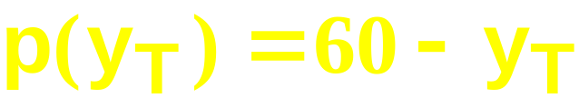
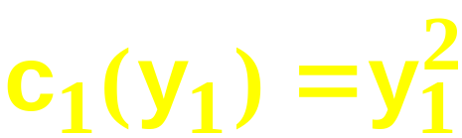
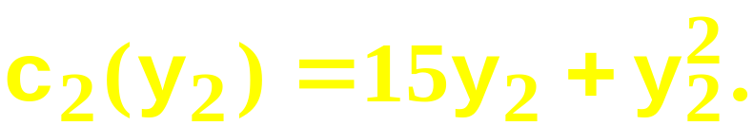
Quantity Competition; An Example
Suppose that the market inverse demand function is
and that the firms’ total cost functions are
and

Slide 7
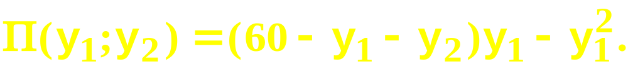
Quantity Competition; An Example
Then, for given y₂, firm 1’s profit function is

Slide 8
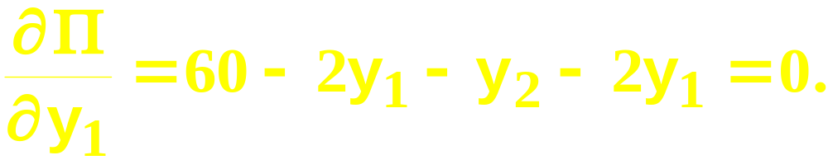
Quantity Competition; An Example
Then, for given y₂, firm 1’s profit function is
So, given y₂, firm 1’s profit-maximizing
output level solves

Slide 9
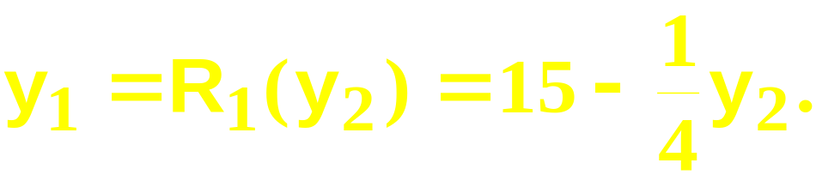
Quantity Competition; An Example
Then, for given y₂, firm 1’s profit function is
So, given y₂, firm 1’s profit-maximizing
output level solves
I.e. firm 1’s best response to y₂ is

Slide 10
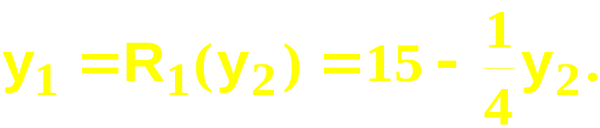
Quantity Competition; An Example
y₂
Firm 1’s “reaction curve”
60
15
y₁

Slide 11
Quantity Competition; An Example
Similarly, given y₁, firm 2’s profit function is

Slide 12
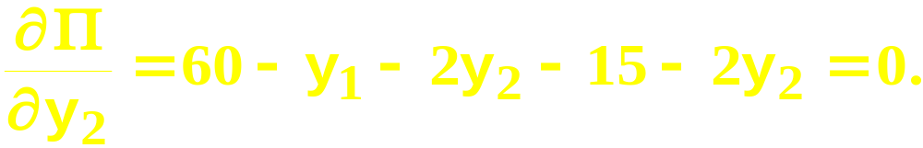
Quantity Competition; An Example
Similarly, given y₁, firm 2’s profit function is
So, given y₁, firm 2’s profit-maximizing
output level solves

Slide 13
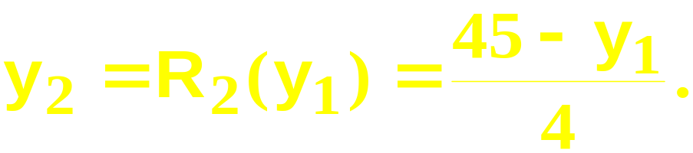
Quantity Competition; An Example
Similarly, given y₁, firm 2’s profit function is
So, given y₁, firm 2’s profit-maximizing
output level solves
I.e. firm 1’s best response to y₂ is

Slide 14
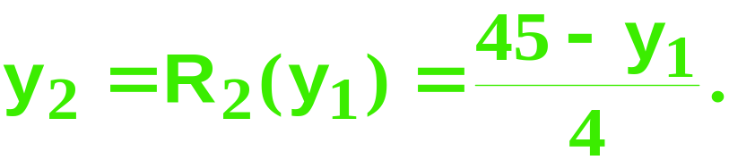
Quantity Competition; An Example
y₂
Firm 2’s “reaction curve”
45/4
45
y₁

Slide 15
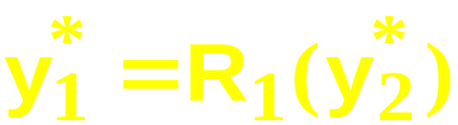
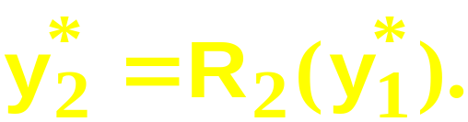
Quantity Competition; An Example
An equilibrium is when each firm’s output level is a best response to the other firm’s output level, for then neither wants to deviate from its output level.
A pair of output levels (y₁*,y₂*) is a Cournot-Nash equilibrium if
and

Slide 16
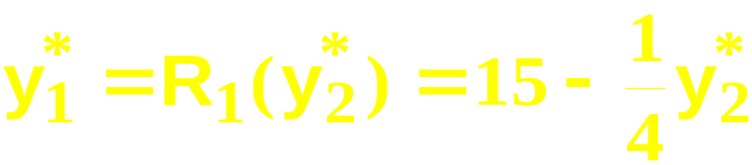
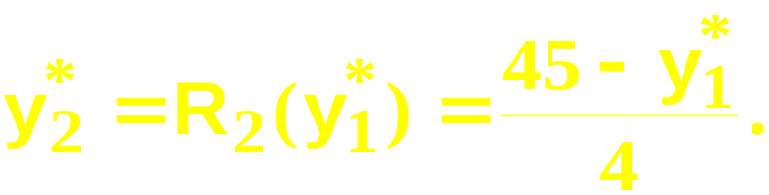
Quantity Competition; An Example
and

Slide 17
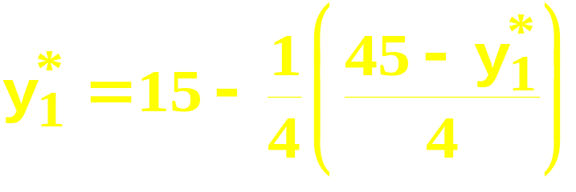
Quantity Competition; An Example
and
Substitute for y₂* to get

Slide 18
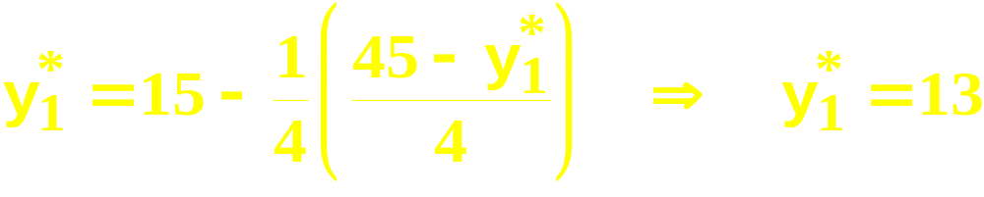
Quantity Competition; An Example
and
Substitute for y₂* to get

Slide 19
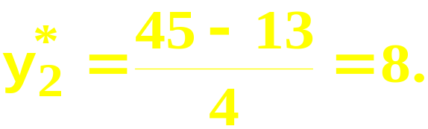
Quantity Competition; An Example
and
Substitute for y₂* to get
Hence

Slide 20
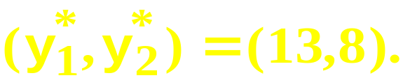
Quantity Competition; An Example
and
Substitute for y₂* to get
Hence
So the Cournot-Nash equilibrium is

Slide 21
Quantity Competition; An Example
y₂
Firm 1’s “reaction curve”
60
Firm 2’s “reaction curve”
45/4
15
45
y₁

Slide 22
Quantity Competition; An Example
y₂
Firm 1’s “reaction curve”
60
Firm 2’s “reaction curve”
Cournot-Nash equilibrium
8
13
48
y₁

Slide 23
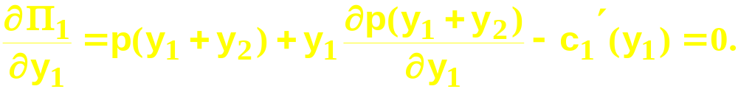
Quantity Competition
Generally, given firm 2’s chosen output
level y₂, firm 1’s profit function is
and the profit-maximizing value of y₁ solves
The solution, y₁ = R₁(y₂), is firm 1’s Cournot-
Nash reaction to y₂.

Slide 24
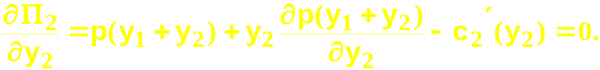
Quantity Competition
Similarly, given firm 1’s chosen output
level y₁, firm 2’s profit function is
and the profit-maximizing value of y₂ solves
The solution, y₂ = R₂(y₁), is firm 2’s Cournot-
Nash reaction to y₁.

Slide 25


Quantity Competition
y₂
Firm 1’s “reaction curve”
Firm 1’s “reaction curve”
Cournot-Nash equilibrium
y₁* = R₁(y₂*) and y₂* = R₂(y₁*)
y₁

Slide 26
Iso-Profit Curves
For firm 1, an iso-profit curve contains all the output pairs (y₁,y₂) giving firm 1 the same profit level Π₁.
What do iso-profit curves look like?

Slide 27

Iso-Profit Curves for Firm 1
y₂
With y₁ fixed, firm 1’s profit
increases as y₂ decreases.
y₁

Slide 28
Iso-Profit Curves for Firm 1
y₂
Increasing profit
for firm 1.
y₁

Slide 29
Iso-Profit Curves for Firm 1
y₂
Q: Firm 2 chooses y₂ = y₂’.
Where along the line y₂ = y₂’
is the output level that
maximizes firm 1’s profit?
y₂’
y₁

Slide 30
Iso-Profit Curves for Firm 1
y₂
Q: Firm 2 chooses y₂ = y₂’.
Where along the line y₂ = y₂’
is the output level that
maximizes firm 1’s profit?
A: The point attaining the
highest iso-profit curve for
firm 1.
y₂’
y₁’
y₁

Slide 31
Iso-Profit Curves for Firm 1
y₂
Q: Firm 2 chooses y₂ = y₂’.
Where along the line y₂ = y₂’
is the output level that
maximizes firm 1’s profit?
A: The point attaining the
highest iso-profit curve for
firm 1. y₁’ is firm 1’s
best response to y₂ = y₂’.
y₂’
y₁’
y₁

Slide 32
Iso-Profit Curves for Firm 1
y₂
Q: Firm 2 chooses y₂ = y₂’.
Where along the line y₂ = y₂’
is the output level that
maximizes firm 1’s profit?
A: The point attaining the
highest iso-profit curve for
firm 1. y₁’ is firm 1’s
best response to y₂ = y₂’.
y₂’
R₁(y₂’)
y₁

Slide 33
Iso-Profit Curves for Firm 1
y₂
y₂”
y₂’
R₁(y₂’)
y₁
R₁(y₂”)

Slide 34
Iso-Profit Curves for Firm 1
y₂
Firm 1’s reaction curve
passes through the “tops”
of firm 1’s iso-profit
curves.
y₂”
y₂’
R₁(y₂’)
y₁
R₁(y₂”)

Slide 35
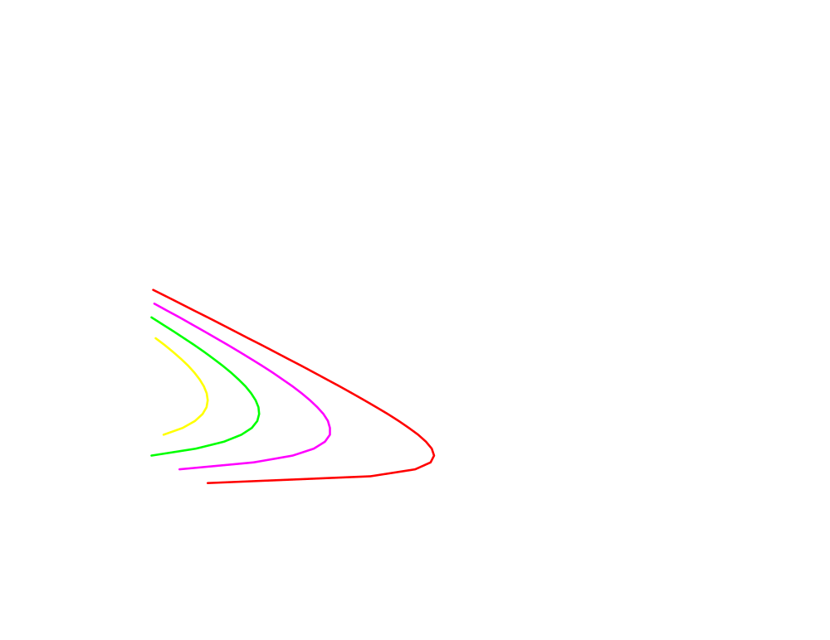
Iso-Profit Curves for Firm 2
y₂
Increasing profit
for firm 2.
y₁

Slide 36
Iso-Profit Curves for Firm 2
y₂
Firm 2’s reaction curve
passes through the “tops”
of firm 2’s iso-profit
curves.
y₂ = R₂(y₁)
y₁

Slide 37
Collusion
Q: Are the Cournot-Nash equilibrium profits the largest that the firms can earn in total?

Slide 38
Collusion
y₂
(y₁*,y₂*) is the Cournot-Nash
equilibrium.
Are there other output level
pairs (y₁,y₂) that give
higher profits to both firms?
y₂*
y₁*
y₁

Slide 39
Collusion
y₂
(y₁*,y₂*) is the Cournot-Nash
equilibrium.
Are there other output level
pairs (y₁,y₂) that give
higher profits to both firms?
y₂*
y₁*
y₁

Slide 40
Collusion
y₂
(y₁*,y₂*) is the Cournot-Nash
equilibrium.
Are there other output level
pairs (y₁,y₂) that give
higher profits to both firms?
y₂*
y₁*
y₁

Slide 41
Collusion
y₂
(y₁*,y₂*) is the Cournot-Nash
equilibrium.
Higher Π₂
Higher Π₁
y₂*
y₁*
y₁

Slide 42
Collusion
y₂
Higher Π₂
y₂*
y₂’
Higher Π₁
y₁*
y₁
y₁’

Slide 43
Collusion
y₂
Higher Π₂
y₂*
y₂’
Higher Π₁
y₁*
y₁
y₁’

Slide 44
Collusion
y₂
(y₁’,y₂’) earns
higher profits for
both firms than
does (y₁*,y₂*).
Higher Π₂
y₂*
y₂’
Higher Π₁
y₁*
y₁
y₁’

Slide 45
Collusion
So there are profit incentives for both firms to “cooperate” by lowering their output levels.
This is collusion.
Firms that collude are said to have formed a cartel.
If firms form a cartel, how should they do it?

Slide 46
Collusion
Suppose the two firms want to maximize their total profit and divide it between them. Their goal is to choose cooperatively output levels y₁ and y₂ that maximize

Slide 47
Collusion
The firms cannot do worse by colluding since they can cooperatively choose their Cournot-Nash equilibrium output levels and so earn their Cournot-Nash equilibrium profits. So collusion must provide profits at least as large as their Cournot-Nash equilibrium profits.

Slide 48
Collusion
y₂
(y₁’,y₂’) earns
higher profits for
both firms than
does (y₁*,y₂*).
Higher Π₂
y₂*
y₂’
Higher Π₁
y₁*
y₁
y₁’

Slide 49
Collusion
y₂
(y₁’,y₂’) earns
higher profits for
both firms than
does (y₁*,y₂*).
Higher Π₂
y₂*
y₂’
Higher Π₁
y₂”
(y₁”,y₂”) earns still
higher profits for
both firms.
y₁”
y₁*
y₁
y₁’

Slide 50
Collusion
y₂
~
~
(y₁,y₂) maximizes firm 1’s profit
while leaving firm 2’s profit at
the Cournot-Nash equilibrium
level.
y₂*
~
y₂
y₁*
y₁
~
y₁

Slide 51
Collusion
y₂
~
~
(y₁,y₂) maximizes firm 1’s profit
while leaving firm 2’s profit at
the Cournot-Nash equilibrium
level.
_
_
_
y₂*
(y₁,y₂) maximizes firm
2’s profit while leaving
firm 1’s profit at the
Cournot-Nash
equilibrium level.
y₂
~
y₂
_
y₂
y₁*
y₁
~
y₁

Slide 52
Collusion
y₂
The path of output pairs that
maximize one firm’s profit
while giving the other firm at
least its CN equilibrium
profit.
_
y₂*
y₂
~
y₂
_
y₂
y₁*
y₁
~
y₁

Slide 53
Collusion
y₂
The path of output pairs that
maximize one firm’s profit
while giving the other firm at
least its CN equilibrium
profit. One of
these output pairs
must maximize the
cartel’s joint profit.
_
y₂*
y₂
~
y₂
_
y₂
y₁*
y₁
~
y₁

Slide 54
Collusion
y₂
(y₁^{m},y₂^{m}) denotes
the output levels
that maximize the
cartel’s total profit.
y₂*
y₂^{m}
y₁^{m}
y₁*
y₁

Slide 55
Collusion
Is such a cartel stable?
Does one firm have an incentive to cheat on the other?
I.e. if firm 1 continues to produce y₁^{m} units, is it profit-maximizing for firm 2 to continue to produce y₂^{m} units?

Slide 56
Collusion
Firm 2’s profit-maximizing response to y₁ = y₁^{m} is y₂ = R₂(y₁^{m}).

Slide 57
Collusion
y₂
y₁ = R₁(y₂), firm 1’s reaction curve
y₂ = R₂(y₁^{m}) is firm 2’s
best response to firm
1 choosing y₁ = y₁^{m}.
R₂(y₁^{m})
y₂^{m}
y₂ = R₂(y₁), firm 2’s
reaction curve
y₁^{m}
y₁

Slide 58
Collusion
Firm 2’s profit-maximizing response to y₁ = y₁^{m} is y₂ = R₂(y₁^{m}) > y₂^{m}.
Firm 2’s profit increases if it cheats on firm 1 by increasing its output level from y₂^{m} to R₂(y₁^{m}).

Slide 59
Collusion
Similarly, firm 1’s profit increases if it cheats on firm 2 by increasing its output level from y₁^{m} to R₁(y₂^{m}).

Slide 60
Collusion
y₂
y₁ = R₁(y₂), firm 1’s reaction curve
y₂ = R₂(y₁^{m}) is firm 2’s
best response to firm
1 choosing y₁ = y₁^{m}.
y₂^{m}
y₂ = R₂(y₁), firm 2’s
reaction curve
y₁^{m}
R₁(y₂^{m})
y₁

Slide 61
Collusion
So a profit-seeking cartel in which firms cooperatively set their output levels is fundamentally unstable.
E.g. OPEC’s broken agreements.

Slide 62
The Order of Play
So far it has been assumed that firms choose their output levels simultaneously.
The competition between the firms is then a simultaneous play game in which the output levels are the strategic variables.

Slide 63
The Order of Play
What if firm 1 chooses its output level first and then firm 2 responds to this choice?
Firm 1 is then a leader. Firm 2 is a follower.
The competition is a sequential game in which the output levels are the strategic variables.

Slide 64
The Order of Play
Such games are von Stackelberg games.
Is it better to be the leader?
Or is it better to be the follower?

Slide 65
Stackelberg Games
Q: What is the best response that follower firm 2 can make to the choice y₁ already made by the leader, firm 1?

Slide 66
Stackelberg Games
Q: What is the best response that follower firm 2 can make to the choice y₁ already made by the leader, firm 1?
A: Choose y₂ = R₂(y₁).

Slide 67
Stackelberg Games
Q: What is the best response that follower firm 2 can make to the choice y₁ already made by the leader, firm 1?
A: Choose y₂ = R₂(y₁).
Firm 1 knows this and so perfectly anticipates firm 2’s reaction to any y₁ chosen by firm 1.

Slide 68
Stackelberg Games
This makes the leader’s profit function

Slide 69
Stackelberg Games
This makes the leader’s profit function
The leader then chooses y₁ to maximize its profit level.

Slide 70
Stackelberg Games
This makes the leader’s profit function
The leader chooses y₁ to maximize its profit.
Q: Will the leader make a profit at least as large as its Cournot-Nash equilibrium profit?

Slide 71
Stackelberg Games
A: Yes. The leader could choose its Cournot-Nash output level, knowing that the follower would then also choose its C-N output level. The leader’s profit would then be its C-N profit. But the leader does not have to do this, so its profit must be at least as large as its C-N profit.

Slide 72
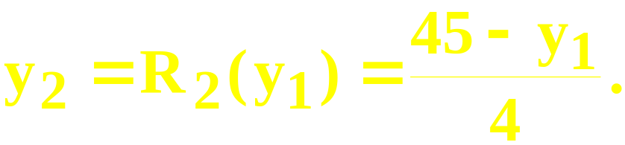
Stackelberg Games; An Example
The market inverse demand function is p = 60 - y_{T}. The firms’ cost functions are c₁(y₁) = y₁² and c₂(y₂) = 15y₂ + y₂².
Firm 2 is the follower. Its reaction function is

Slide 73
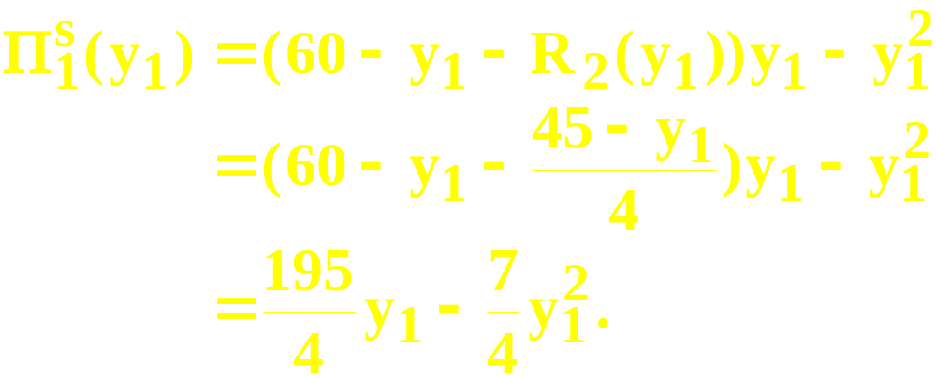
Stackelberg Games; An Example
The leader’s profit function is therefore

Slide 74
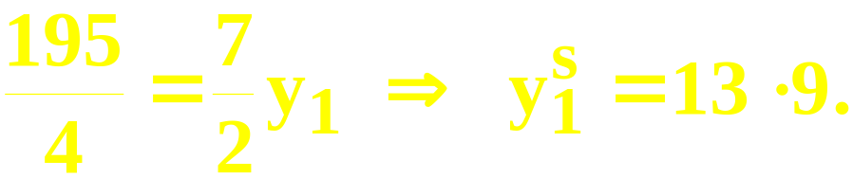
Stackelberg Games; An Example
The leader’s profit function is therefore
For a profit-maximum,

Slide 75
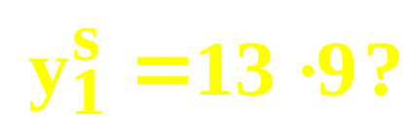
Stackelberg Games; An Example
Q: What is firm 2’s response to the
leader’s choice

Slide 76
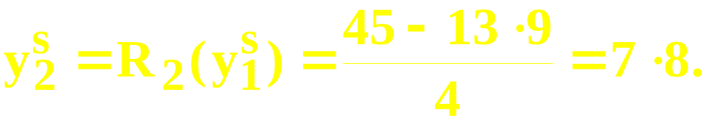
Stackelberg Games; An Example
Q: What is firm 2’s response to the
leader’s choice
A:

Slide 77
Stackelberg Games; An Example
Q: What is firm 2’s response to the
leader’s choice
A:
The C-N output levels are (y₁*,y₂*) = (13,8)
so the leader produces more than its
C-N output and the follower produces less
than its C-N output. This is true generally.

Slide 78
Stackelberg Games
y₂
(y₁*,y₂*) is the Cournot-Nash
equilibrium.
Higher Π₂
Higher Π₁
y₂*
y₁*
y₁

Slide 79
Stackelberg Games
y₂
(y₁*,y₂*) is the Cournot-Nash
equilibrium.
Follower’s
reaction curve
Higher Π₁
y₂*
y₁*
y₁

Slide 80
Stackelberg Games
y₂
(y₁*,y₂*) is the Cournot-Nash
equilibrium. (y₁^{S},y₂^{S}) is the
Stackelberg equilibrium.
Follower’s
reaction curve
y₂*
Higher Π₁
y₂^{S}
y₁*
y₁^{S}
y₁

Slide 81
Stackelberg Games
y₂
(y₁*,y₂*) is the Cournot-Nash
equilibrium. (y₁^{S},y₂^{S}) is the
Stackelberg equilibrium.
Follower’s
reaction curve
y₂*
y₂^{S}
y₁*
y₁^{S}
y₁

Slide 82
Price Competition
What if firms compete using only price-setting strategies, instead of using only quantity-setting strategies?
Games in which firms use only price strategies and play simultaneously are Bertrand games.

Slide 83
Bertrand Games
Each firm’s marginal production cost is constant at c.
All firms set their prices simultaneously.
Q: Is there a Nash equilibrium?

Slide 84
Bertrand Games
Each firm’s marginal production cost is constant at c.
All firms simultaneously set their prices.
Q: Is there a Nash equilibrium?
A: Yes. Exactly one.

Slide 85
Bertrand Games
Each firm’s marginal production cost is constant at c.
All firms simultaneously set their prices.
Q: Is there a Nash equilibrium?
A: Yes. Exactly one. All firms set their prices equal to the marginal cost c. Why?

Slide 86
Bertrand Games
Suppose one firm sets its price higher than another firm’s price.

Slide 87
Bertrand Games
Suppose one firm sets its price higher than another firm’s price.
Then the higher-priced firm would have no customers.

Slide 88
Bertrand Games
Suppose one firm sets its price higher than another firm’s price.
Then the higher-priced firm would have no customers.
Hence, at an equilibrium, all firms must set the same price.

Slide 89
Bertrand Games
Suppose the common price set by all firm is higher than marginal cost c.

Slide 90
Bertrand Games
Suppose the common price set by all firm is higher than marginal cost c.
Then one firm can just slightly lower its price and sell to all the buyers, thereby increasing its profit.

Slide 91
Bertrand Games
Suppose the common price set by all firm is higher than marginal cost c.
Then one firm can just slightly lower its price and sell to all the buyers, thereby increasing its profit.
The only common price which prevents undercutting is c. Hence this is the only Nash equilibrium.

Slide 92
Sequential Price Games
What if, instead of simultaneous play in pricing strategies, one firm decides its price ahead of the others.
This is a sequential game in pricing strategies called a price-leadership game.
The firm which sets its price ahead of the other firms is the price-leader.

Slide 93
Sequential Price Games
Think of one large firm (the leader) and many competitive small firms (the followers).
The small firms are price-takers and so their collective supply reaction to a market price p is their aggregate supply function Y_{f}(p).

Slide 94
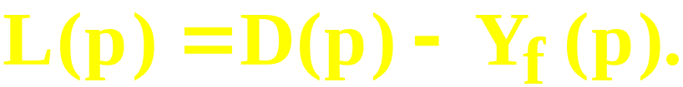
Sequential Price Games
The market demand function is D(p).
So the leader knows that if it sets a price p the quantity demanded from it will be the residual demand
Hence the leader’s profit function is

Slide 95
Sequential Price Games
The leader’s profit function is
so the leader chooses the price level p* for which profit is maximized.
The followers collectively supply Y_{f}(p*) units and the leader supplies the residual quantity D(p*) - Y_{f}(p*).

