Slide 1
ADSTORE.TISTORY.COM
NORTHPOLE
FREE TEMPLATE RELEASED

Slide 2
INDEX
ADSTORE.TISTORY.COM
RETRO
CONEPT
STUDY
-HARD-
디자인
튜토리얼
SELECT
OPTION
LAST
PANG

Slide 3
1. 디자인 튜토리얼

Slide 4

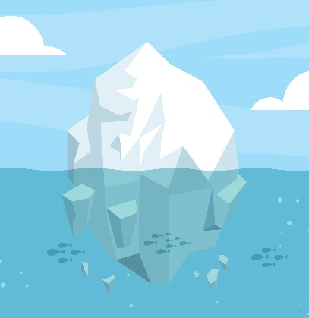
애드스토어 무료배포 템플릿 : NORTH POLE
RETRO의 매력에 한번 빠져보시라
ADSTORE.TISTORY.COM
TUTORIAL
STUDY
산꼭대기에서
바다속까지
SELECT
OPTION

Slide 5
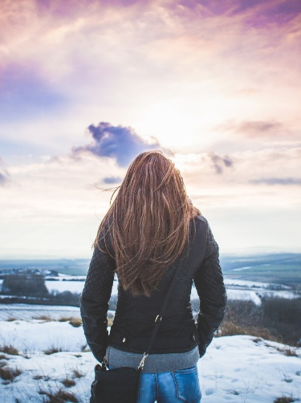
애드스토어 무료배포 템플릿 : NORTH POLE
RETRO의 매력에 한번 빠져보시라
ADSTORE.TISTORY.COM
TUTORIAL
ADSTORE.TISTORY.COM
STUDY
How did it happen that their lips
came together? How does it happen
that birds sing, that snow melts,
that the rose unfolds, that the dawn
whitens behind the stark shapes of trees
on the quivering summit of the hill?
A kiss, and all was said.
SELECT
OPTION

