Slide 1

THE TUBE
WHAT MAKES A TRENDING VIDEO
AN ANALYSIS OF TRENDING YOUTUBE VIDEOS
Zekun Wang Mingli Yang
Ali Yaqoob

Slide 2
5 Billion
500 Hours
51%
INTRODUCTION
MOTIVATION
YouTube is one of the biggest media platforms of the 21st century.
videos are watched daily.
of videos are uploaded every minute.
of users say that they visit the website daily.
This makes YouTube a powerful tool for advertising, business, research and content creators.
Being able to predict if a YouTube video is likely to be trending or not is highly useful if you are:
A content creator who wants to make trending videos.
An advertiser who wants to know the best videos to put advertisements on before they become trending videos.
A researcher trying to derive insight about behavior from YouTube trends.
To do this, you will need to know :
When to upload/look for, a potentially trending YouTube video
How to upload/look for, a potentially trending YouTube video
What to upload/look for, in a potentially trending YouTube video

Slide 3
CONTENT
A Look At Trending Videos
Slide 5
Note: Though this document may be used by advertisers and researchers, it will be structured in a how-to manner to educate the audience with what they need to do in order to create a trending YouTube video.
This is the breakdown of the document
Knowing When To Post A Trending Video
Slide 6
Knowing How To Post A Trending Video
Slide 10
Knowing What Is In A Trending Video
Slide 14
Trending YouTube Video Breakdown
Slide 18

Slide 4
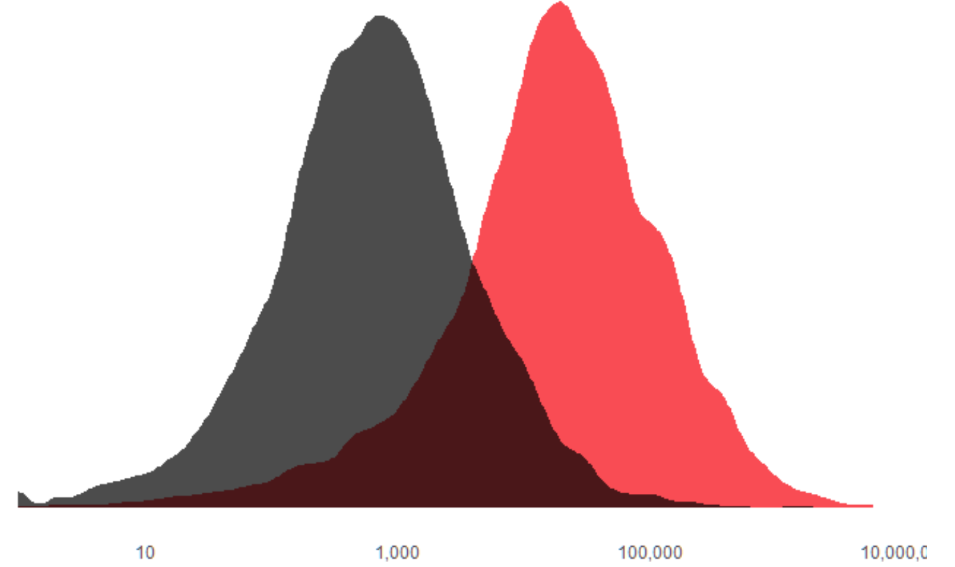
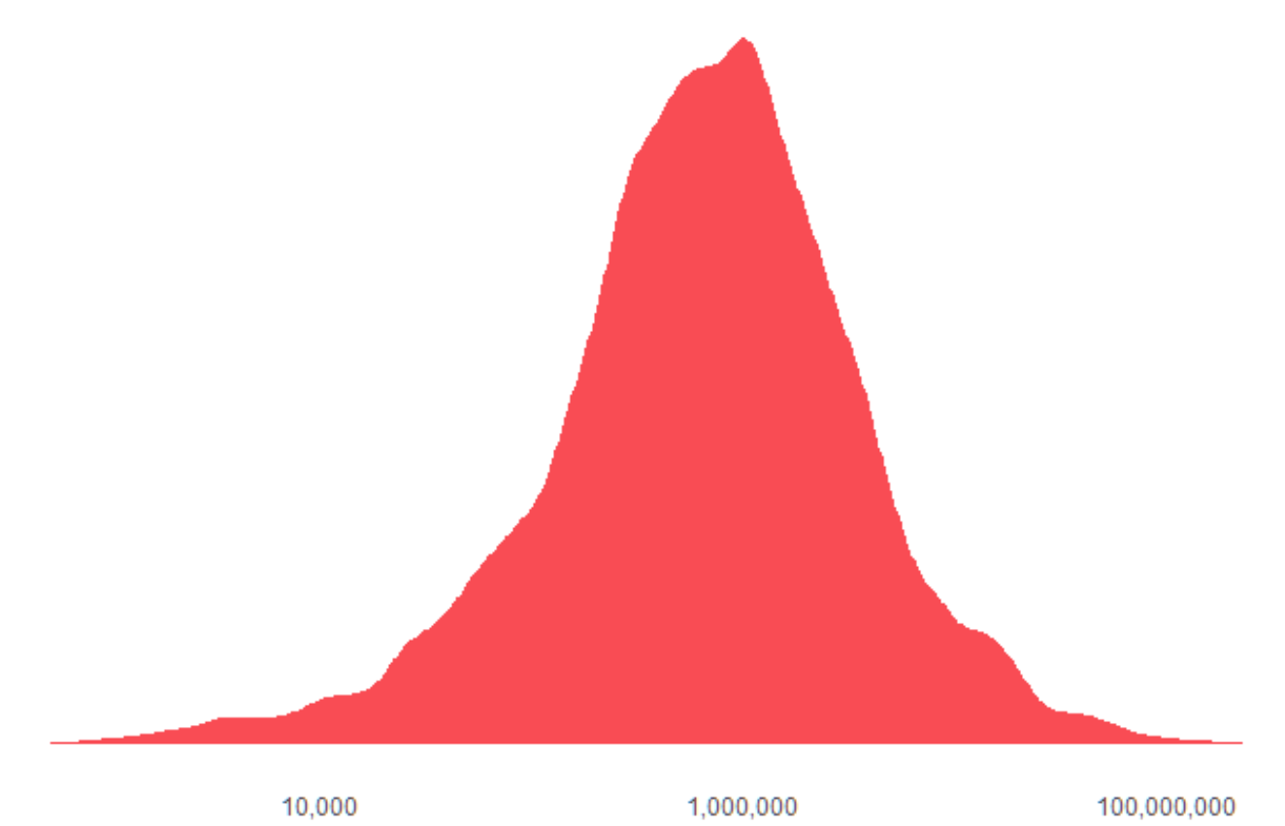
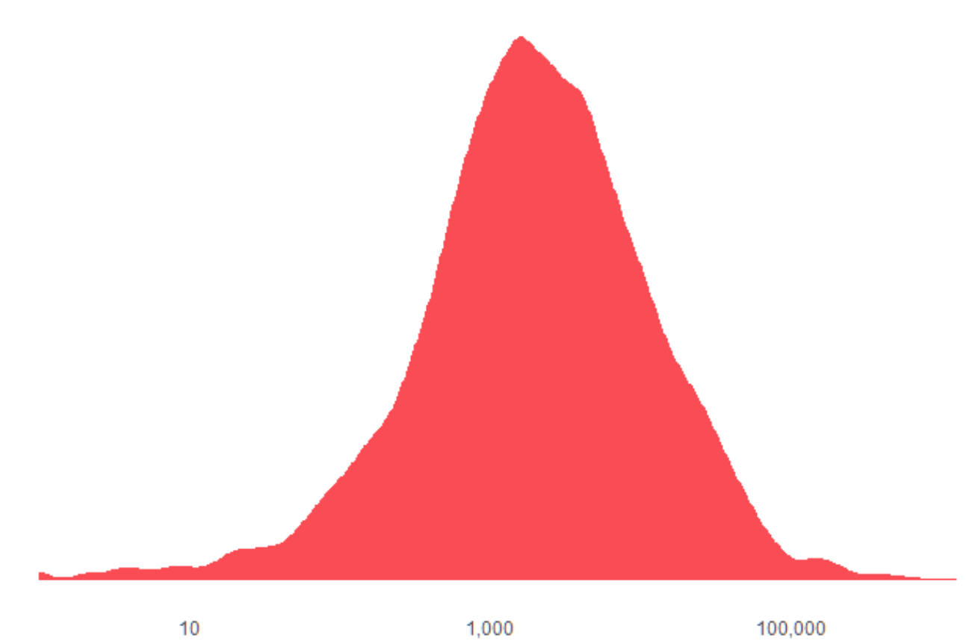
A LOOK AT
THE TRENDING VIDEOS
A trending video can be identified by three major measures:
Number of Likes
Number of Views
Number of Comments
Upon looking at the distribution of likes, dislikes , views and comments of the trending YouTube videos, we can see that, “most of” the trending YouTube videos have a total of:
1,000,000 views
About 1,000 dislikes or 10,000 likes
About 2,000 comments
We will be looking at the number of videos being posted and the number of views being received.
Dislikes & Likes
Views
Comments

Slide 5

WHEN
TO POST A TRENDING VIDEO
MONTH
DAY
TIME
SLIDE 6
SLIDE 7
SLIDE 8

Slide 6

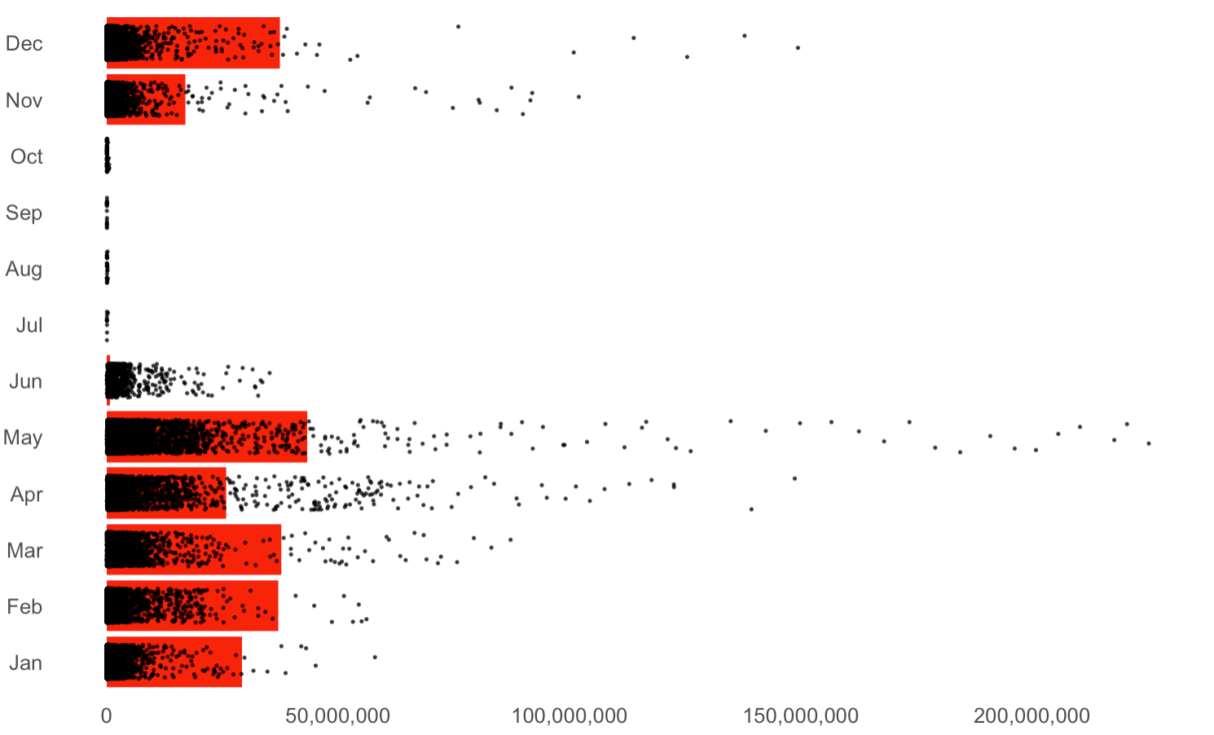
Number of videos
BEST MONTH
Number of views
Lowest number of trending videos are being posted in the months of June to October.
It also shows that the highest number of trending videos are posted in the month of May with highest number of views.
The best time to post a video would be April and May as they show the highest number of views in comparison to the number of videos posted. Months December, March and February also see a high number of trending videos being posted but not as many views.

Slide 7
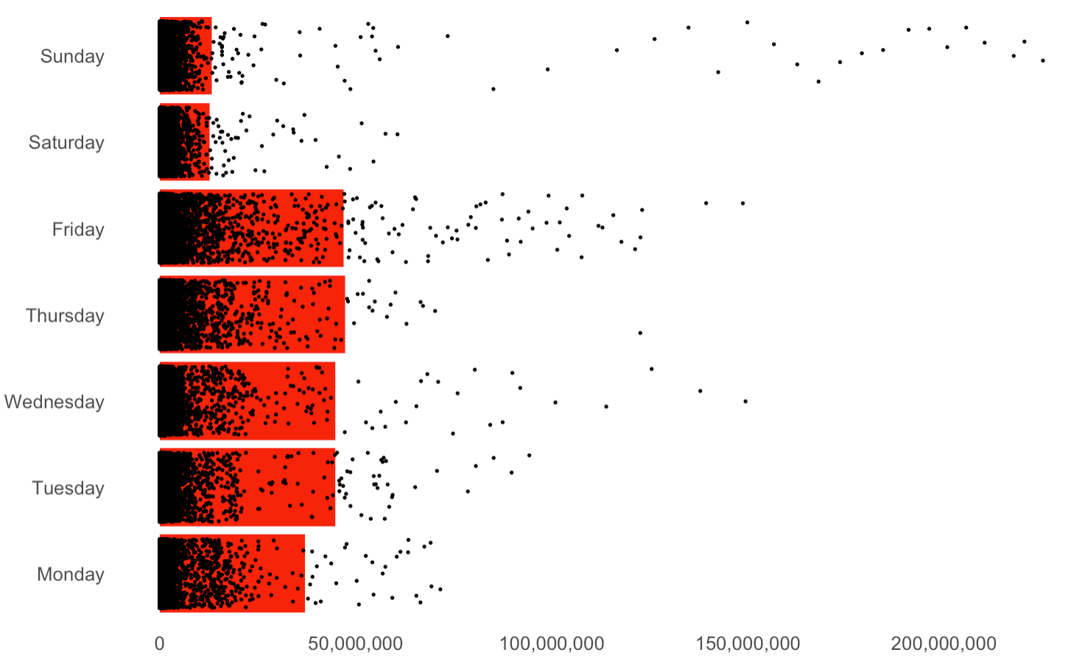
Number of videos
BEST DAY OF THE WEEK
Number of views
Most trending videos are being posted on Tuesdays through Friday. Thursday and Friday see the highest number of trending videos with Friday showing the highest number of views.
Interestingly, Saturday and Sunday are the worst to post videos as there are fewer videos being posted on these and these days see lowest number of views as compared to other days.
However, there might be an extremely small chance that a video that you post on Sunday reaches 200 million views!

Slide 8
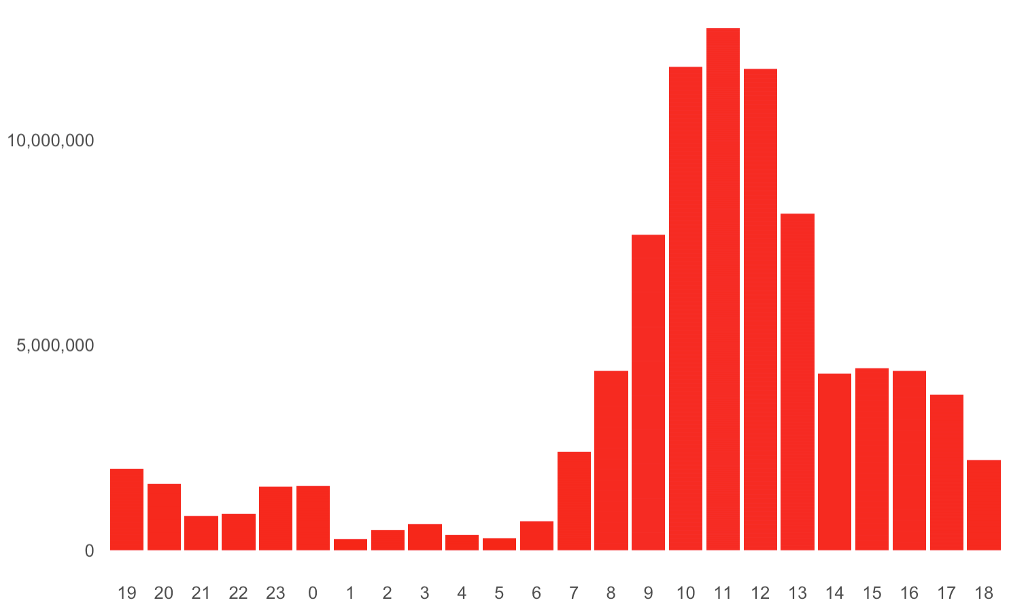
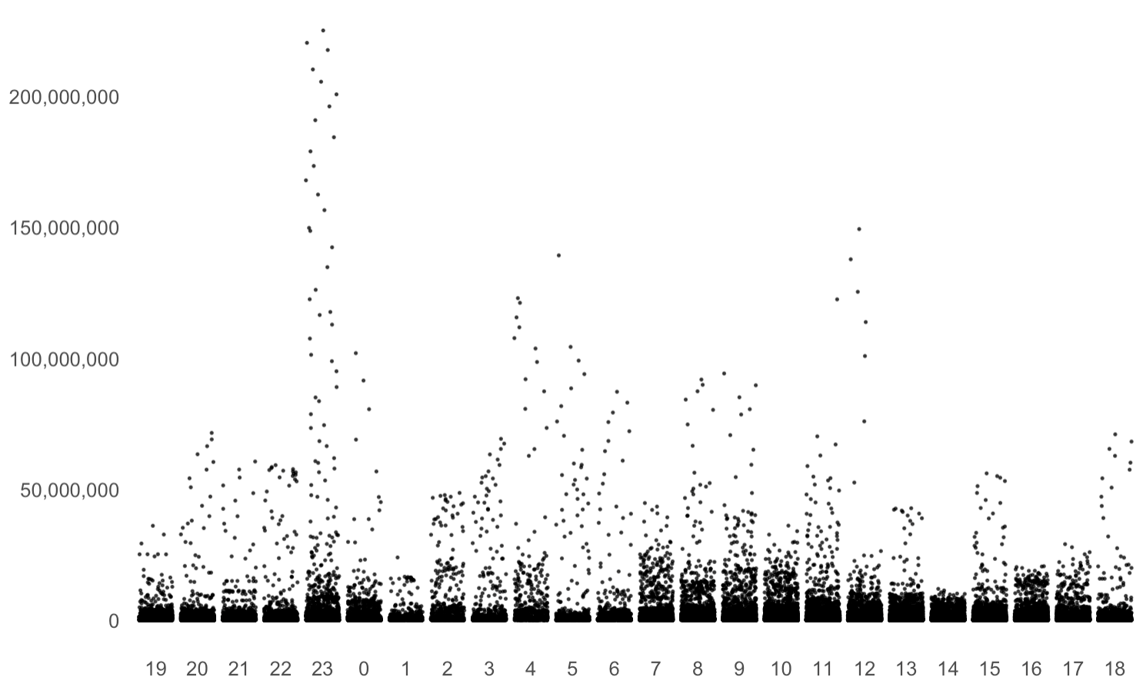
BEST TIME OF DAY
Number of videos
We see the highest number of trending videos being posted around 8AM to 5PM with the peak time from 9AM to 1PM. (CST)
Surprisingly, around 11PM, where few of the the lowest amount of videos are being posted, we see the highest variation in the number of views!
The best time to post a video would be around 8AM to 11AM. However, there is small chance if you post at 11PM, that your video will get the highest number of views, though it might be risky as this is also.
Number of views

Slide 9
HOW
TO POST A TRENDING VIDEO
DESCRIPTION
TAG
TITLE
SLIDE 10
SLIDE 11
SLIDE 12

Slide 10
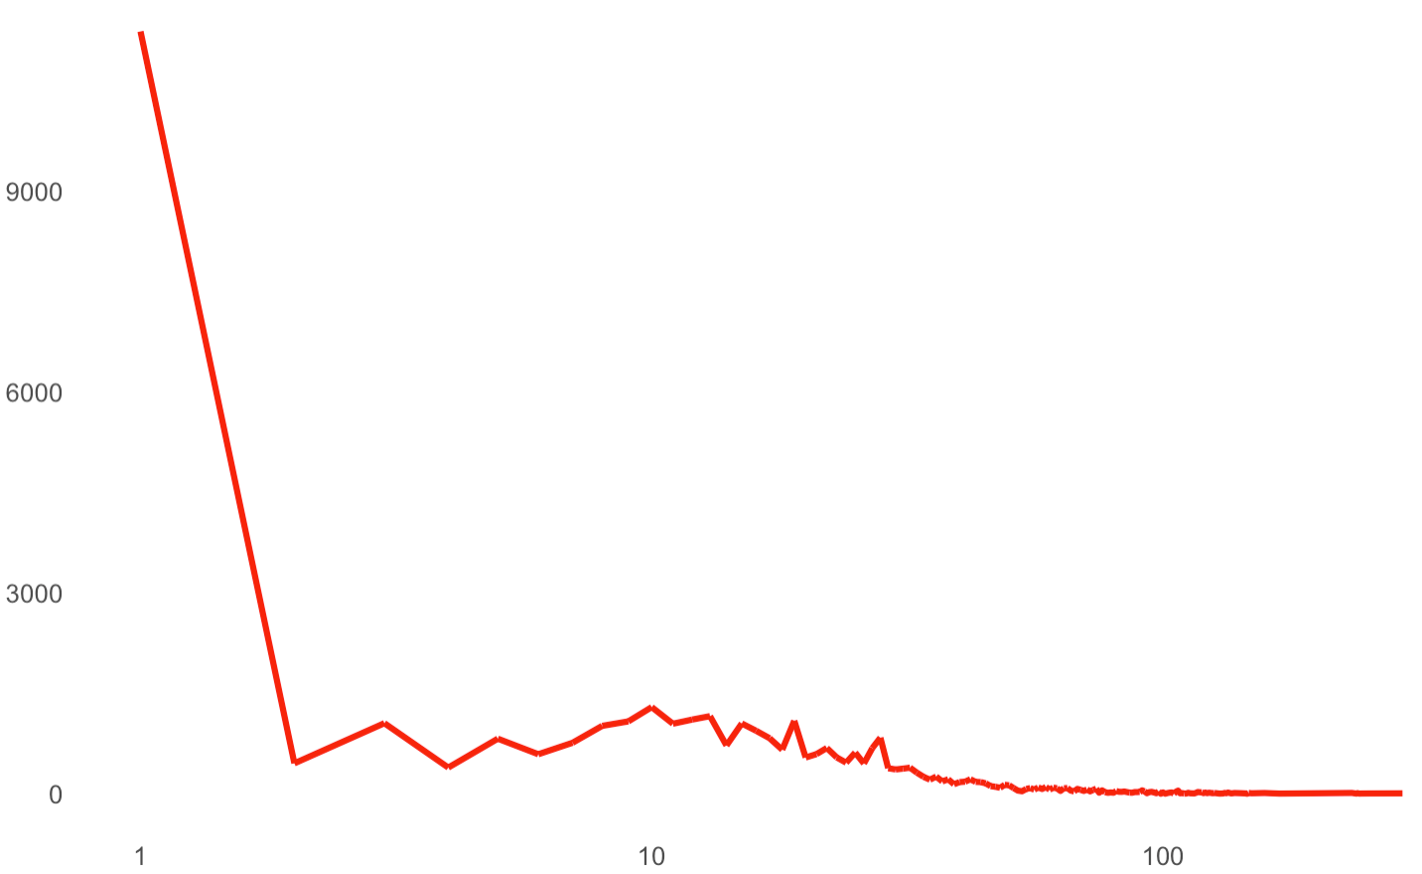
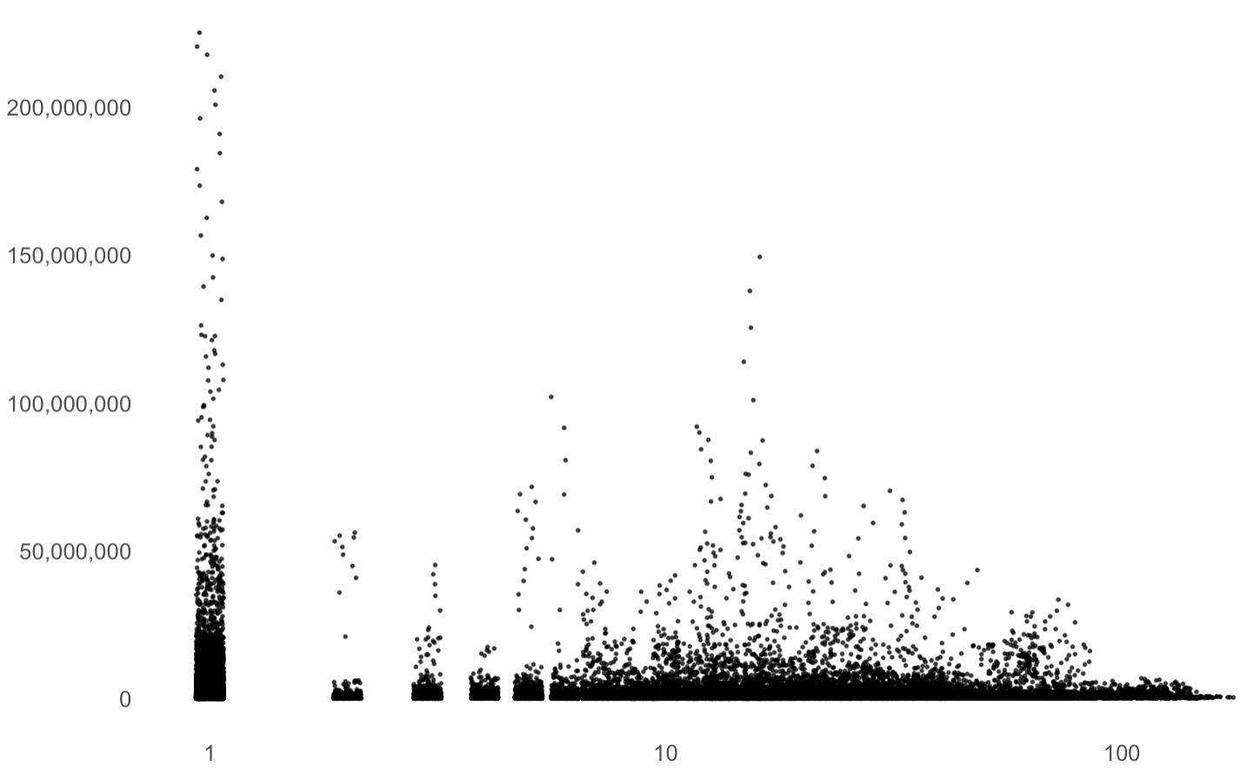
ROWS
OF DESCRIPTION
Number of videos
Number of views
“Rows of description” are defined by the number of rows it takes to give the description of the video.
Most trending YouTube videos have 1 - 3 rows of description only and videos with 1 row of description see the highest number of views. Keeping a simple description of the video may be what attracts or loses a viewer.
However, we see a spike in number of views at around 20 rows of description. These might be videos which required further explanation.

Slide 11
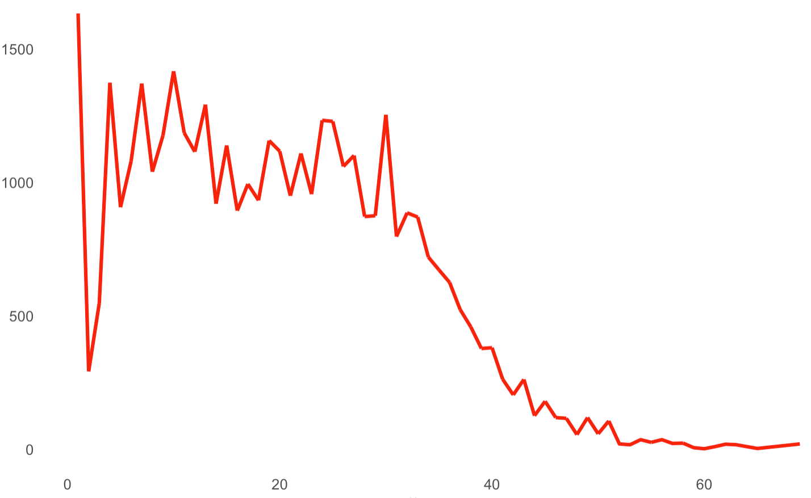
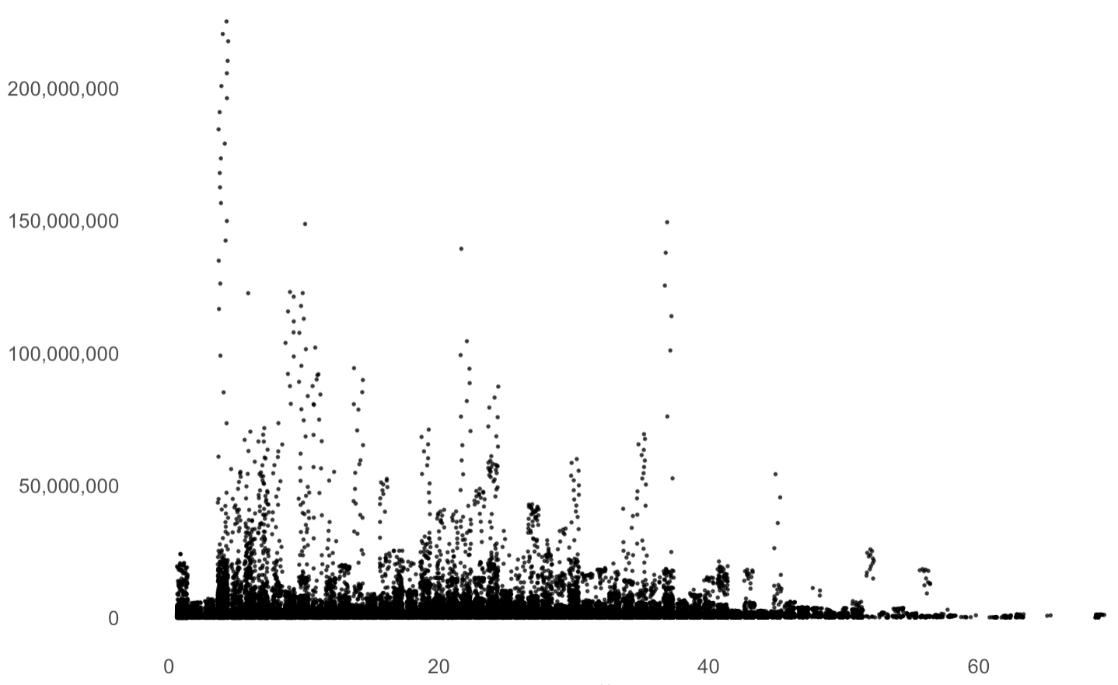
NUMBER OF TAGS
Number of videos
Number of views
There are a large number of trending videos with no tags but they see a lower number of views. Anywhere between 3 to 20 tags see a higher number of views. Most people uploading videos chose to add tags within this range.
We can also see that adding more tags outside of this range resulted in a decline in the number of views. Furthermore, the number of people choosing to add tags greater than this range also declined.

Slide 12
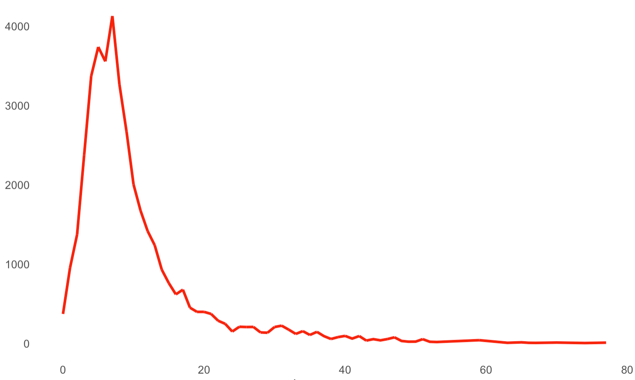
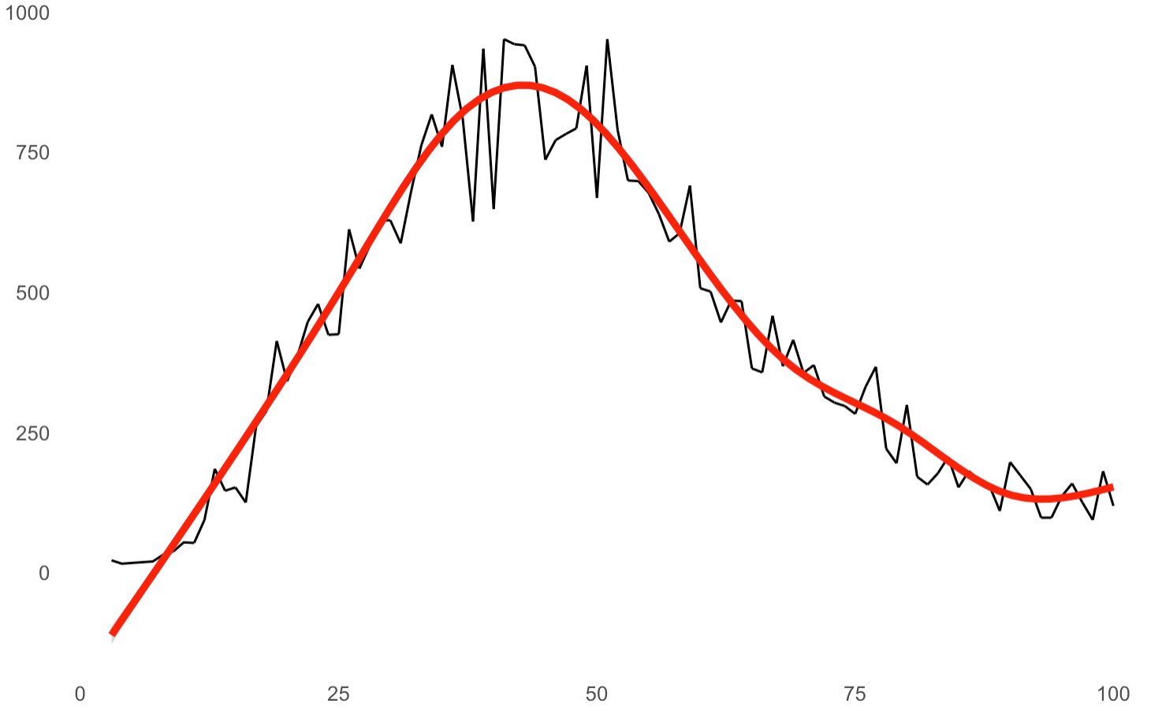
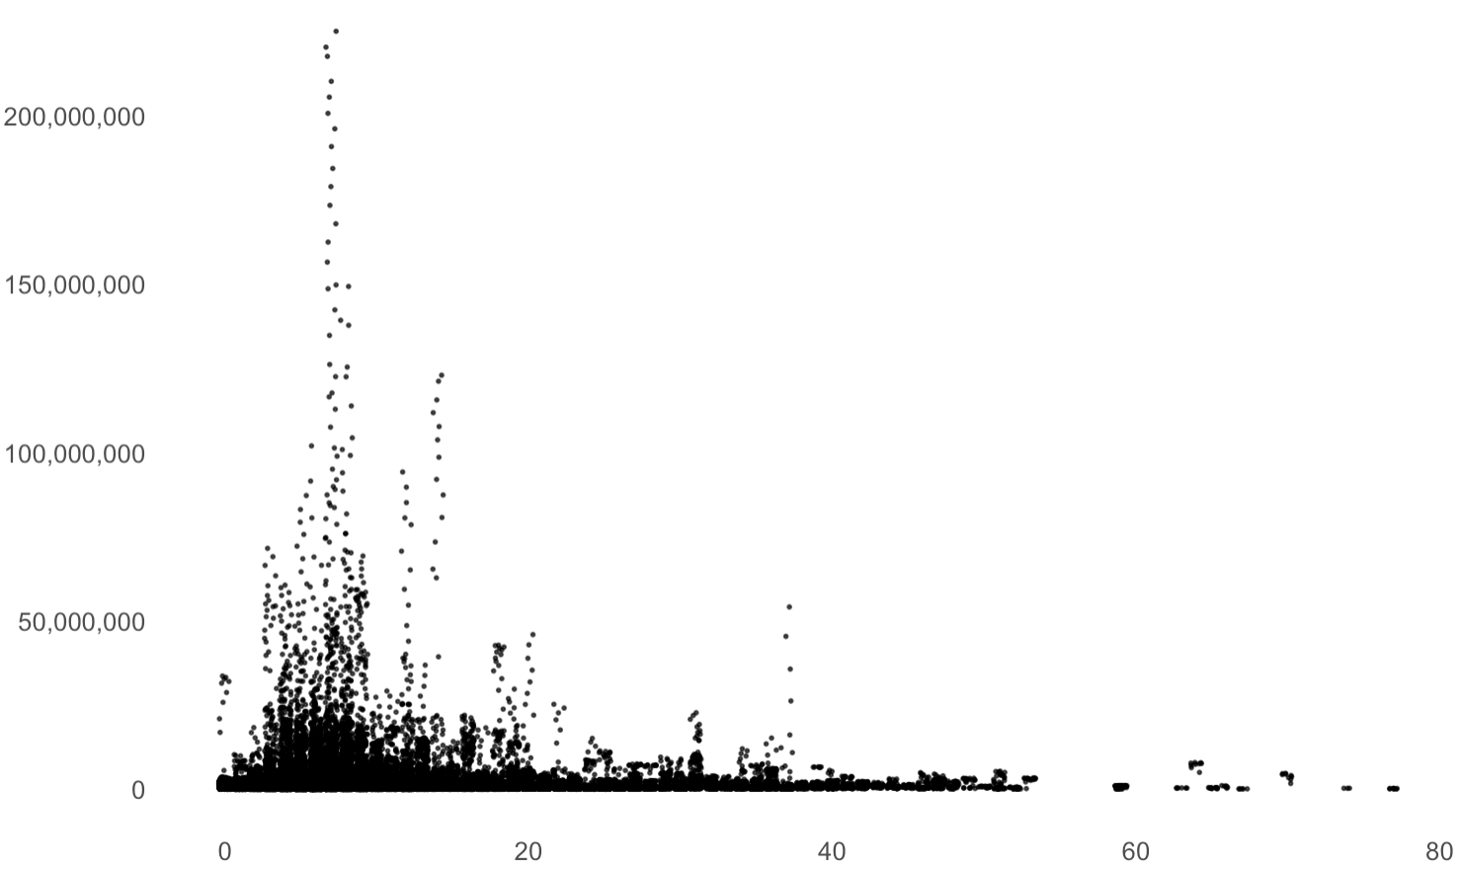
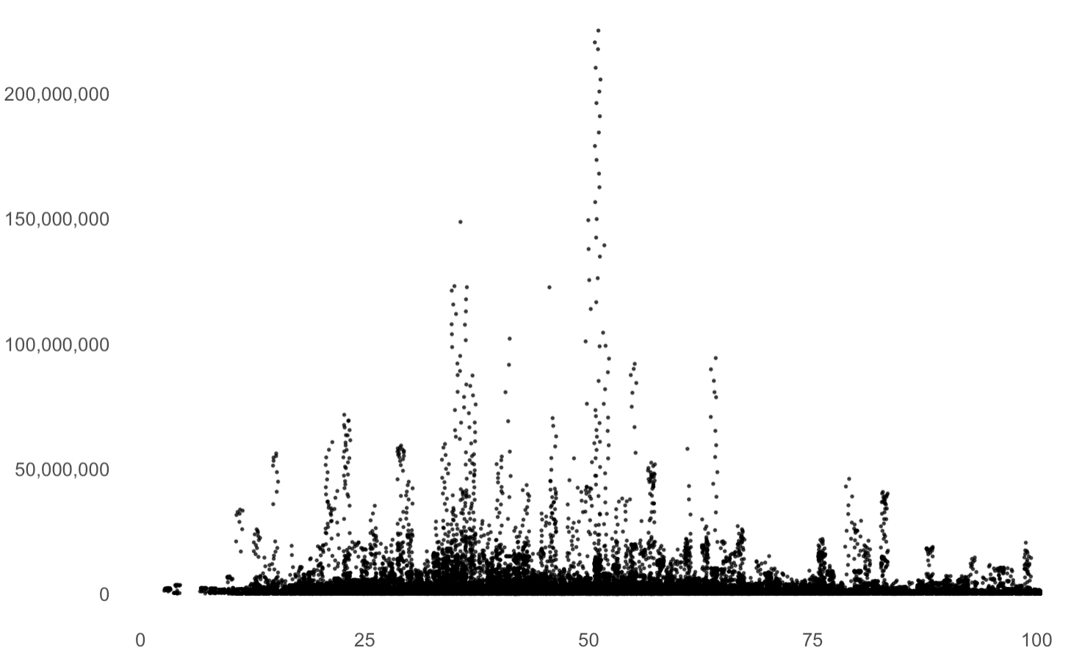
TITLE OF A TRENDING VIDEO
Number of videos
Number of views
Number of Uppercase Letters
the greatest number of views appeared on videos where the title had between 1 to 15 uppercase letters. Most uploaders chose to stay within this range.
the highest
number of views appeared on videos where the title was less than 50 characters long. Uploaders mostly chose titles between 25-50 characters long.
Length of Title

Slide 13
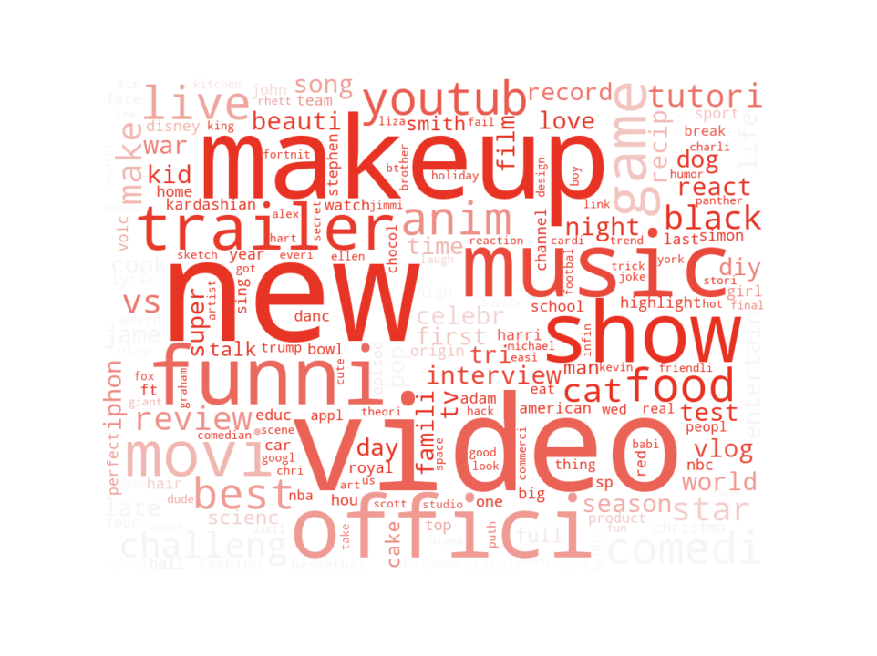
WHAT
IS IN A TRENDING VIDEO
CATEGORICAL
L/D RATIO
SENTIMENT
SLIDE 14
SLIDE 15
SLIDE 16

Slide 14
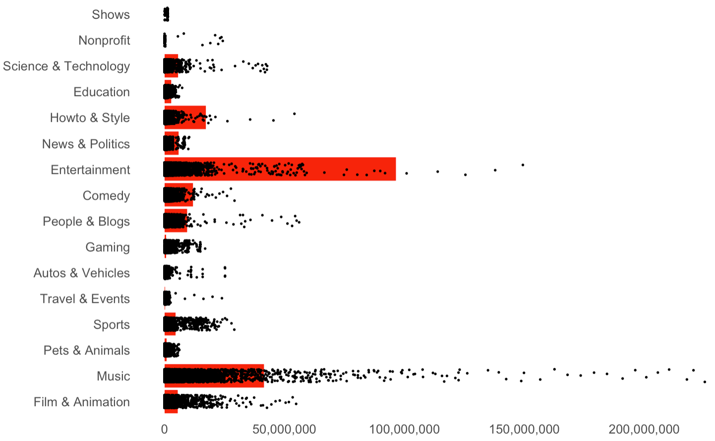
Number of videos
CATEGORICAL ANALYSIS
Number of views
Categories of Entertainment and Music have the highest number of trending videos. However, Music has a higher number of views as compared to Entertainment.
Film and animation has a lower number of trending videos as compared to Entertainment but has comparable views.
If you are a musician or an entertainer, your videos are more likely to be trending as compared to any other type of video.

Slide 15
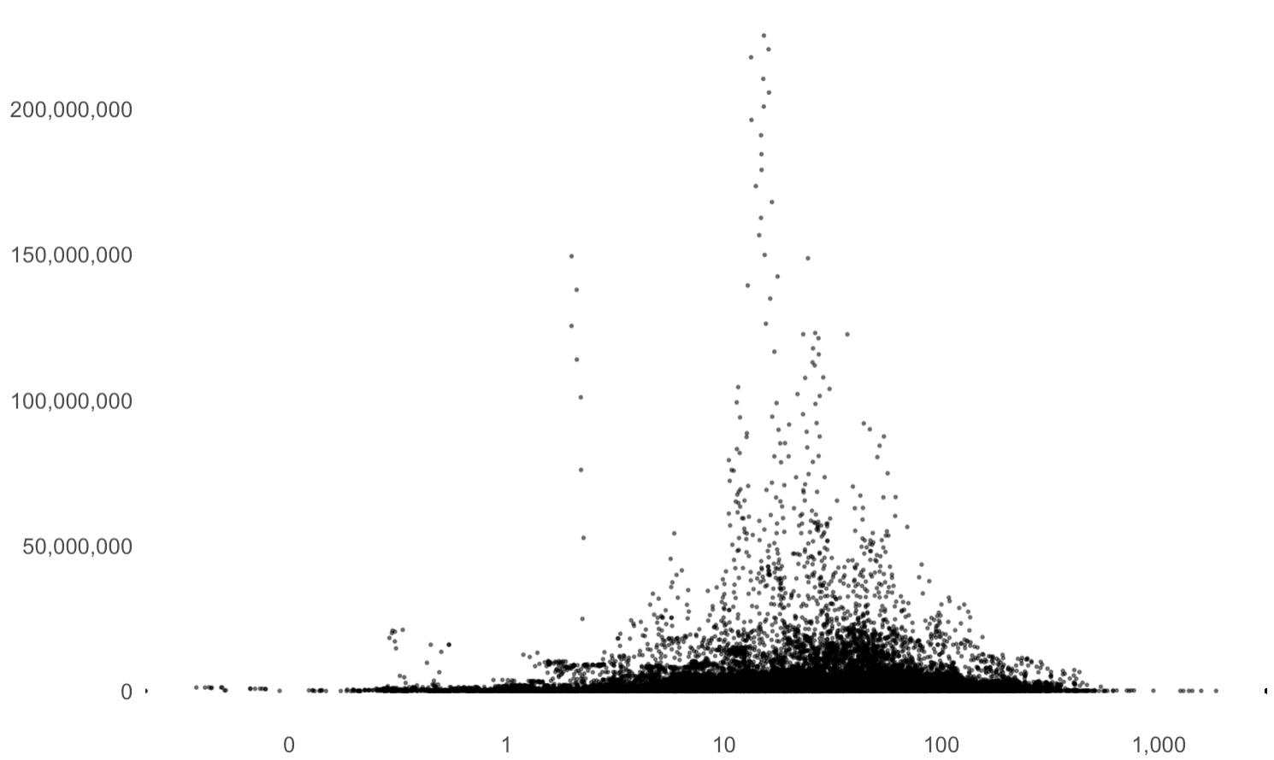
Number of views
LIKES/DISLIKES RATIO
If the L/D ratio is less than 1, more people disliked the video. If greater than 1, more people liked the video. If equal to 1, an equal number of people liked and disliked the video. A video is controversial when the L/D ratio is less than 1 or equal to 1.
If L/D = 10-100 we see the highest views.
If L/D ratio is less than 10, the number of views decline. The more controversial a video is, the less number of views it has.
However, videos with higher L/D ratios (>100) coincided with fewer views. It seems that videos which are slightly controversial may be viewed more than videos which are not controversial at all.

Slide 16
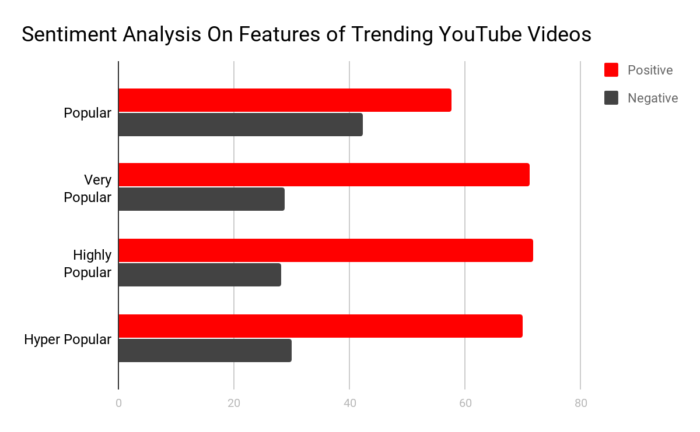
SENTIMENT ANALYSIS I
Understanding how sentiment plays a role in the making of a trending of YouTube video is an interesting area to look at.
To do this sort of analysis we look at the channel title, title tags, and description to see how positive or negative a typical trending video is.
Classification
For this problem we can classify our videos into four distinct categories:
Popular : views < 10,000
Very Popular : 10,000 < views < 100,000
Highly Popular : 100,000 < views < 1 Million
Hyper Popular : views > 1 Million

Slide 17
SENTIMENT ANALYSIS II
From this we can see that the very popular to hyper popular trending videos have positive sentiments in their descriptions, tags and channel title of around 70 %
The least popular videos of these four categories had a positive sentiment of about 57%.
This is consistent with our analysis of Likes/Dislikes ratio. It shows that a video needs to be controversial; however the more negative it tends to be, the less likely it is to be the most trending video.

Slide 18
TIME
CATEGORY
DESCRIPTION
DAY
CONTENT
TAGS
MONTH
TITLE
TRENDING VIDEO BREAKDOWN
Best time: 9AM TO 1PM
Music and Entertainment are the best
Keep it simple. Have 1 - 3 rows of description
Thursdays and Fridays. NOT Saturdays and Sundays
Keep it low on controversy but NOT overly positive
Keep it within 3-20 tags per video
May and April see the highest number of views while May sees the highest number of videos
1 - 15 uppercase characters while 25-50 characters

Slide 19
CONCLUSION
Knowing the components of a Trending YouTube video might be able to provide some insight about what a trending video looks like and how to recognize it but human behavior is unpredictable and there will always be outliers.
In general, your video is much more likely to be trending if you are a musician or an entertainer. This might have to do with the demographic and the reasons why people visit YouTube.
While creating video content, it’s important to keep the idea of controversy in mind. This is based on human psyche: people are attracted to anything that grabs attention, and controversy does just that.
However, it’s important to strike a balance. You will see the most amount of views and have the highest likelihood of a trending video when you hit the sweet spot between challenging a thought and inciting emotion.
As a content creator, you will have to make sure to keep that in mind while trying to enter an online media market that is highly saturated.

Slide 20
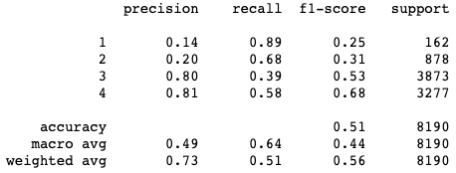
APPENDIX
Motivated by the results from this research, we build a classification model using naive bayes.
The inputs features are title, channel_title, tags, description.
We labeled our dataset into four categories as before:
Popular : 10,000 > views
Very Popular : 10,000 < views < 100,000
Highly Popular : 100,000 < views < 1 Million
Hyper Popular : views > 1 Million
The model has 0.73 weighted average precision, which is a solid result. It further proves the importance of the four features: title, channel_title, tags, description.

Slide 21
REFERENCES
Github Repository https://github.com/waittim/Youtube-trending-videos-analysis
YouTube Data
https://www.kaggle.com/datasnaek/youtube-new
YouTube Statistics
https://youtube.com/yt/press/statistics.html
https://statisticbrain.com/youtube-statistics
https://www.thinkwithgoogle.com

