Slide 1

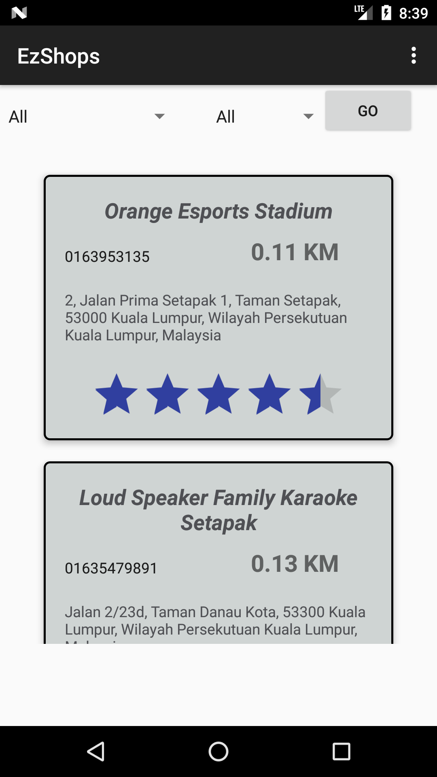
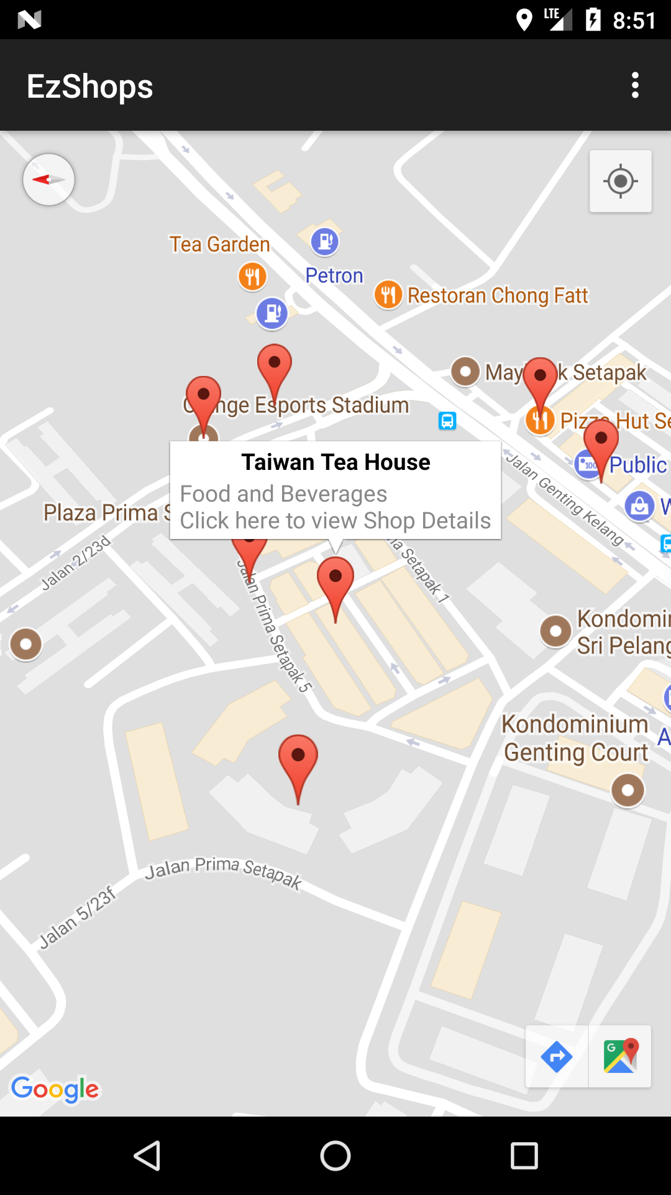
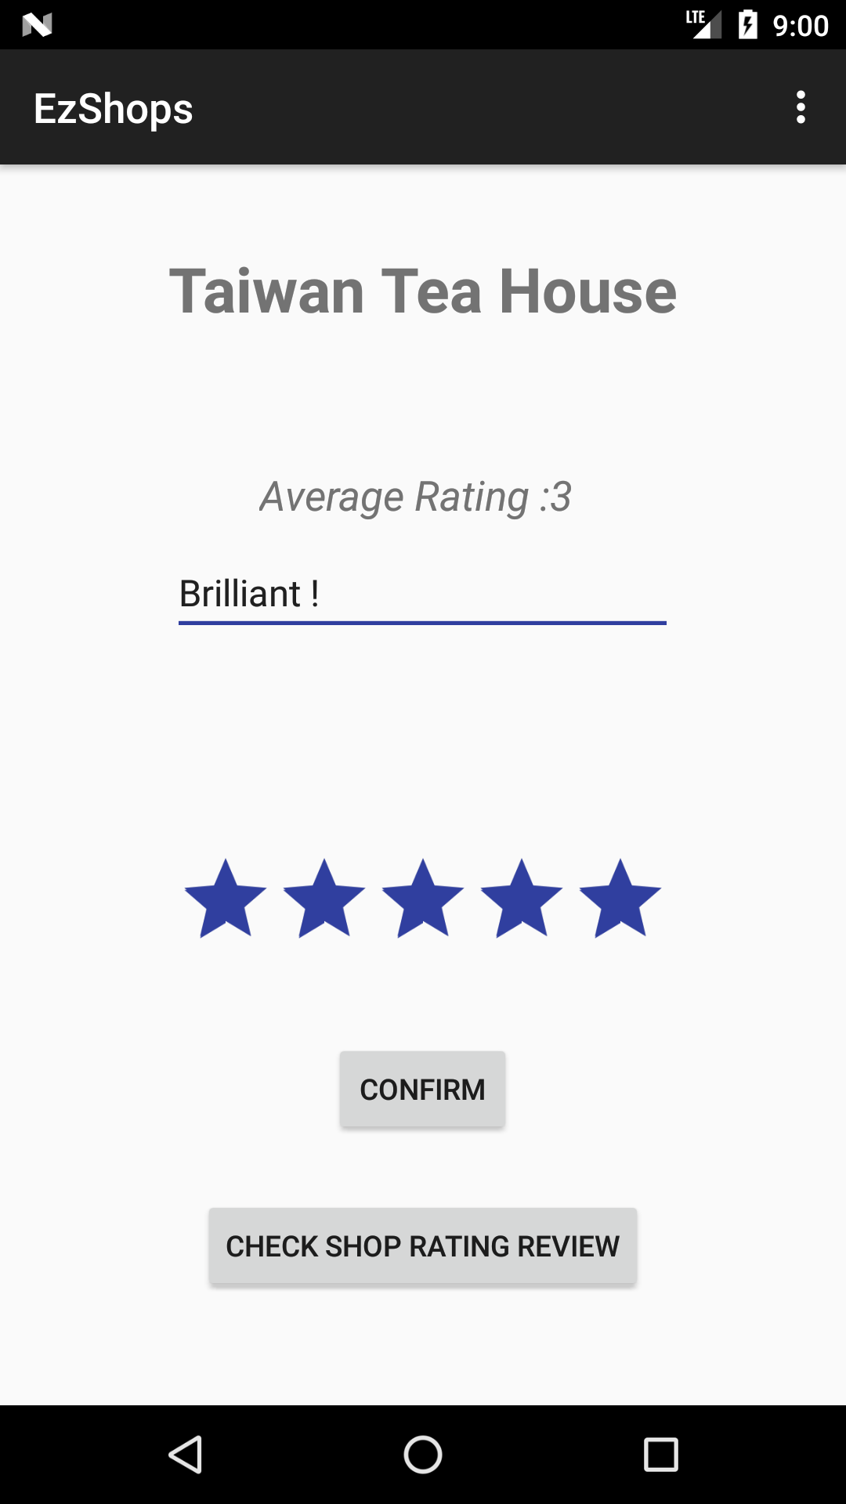
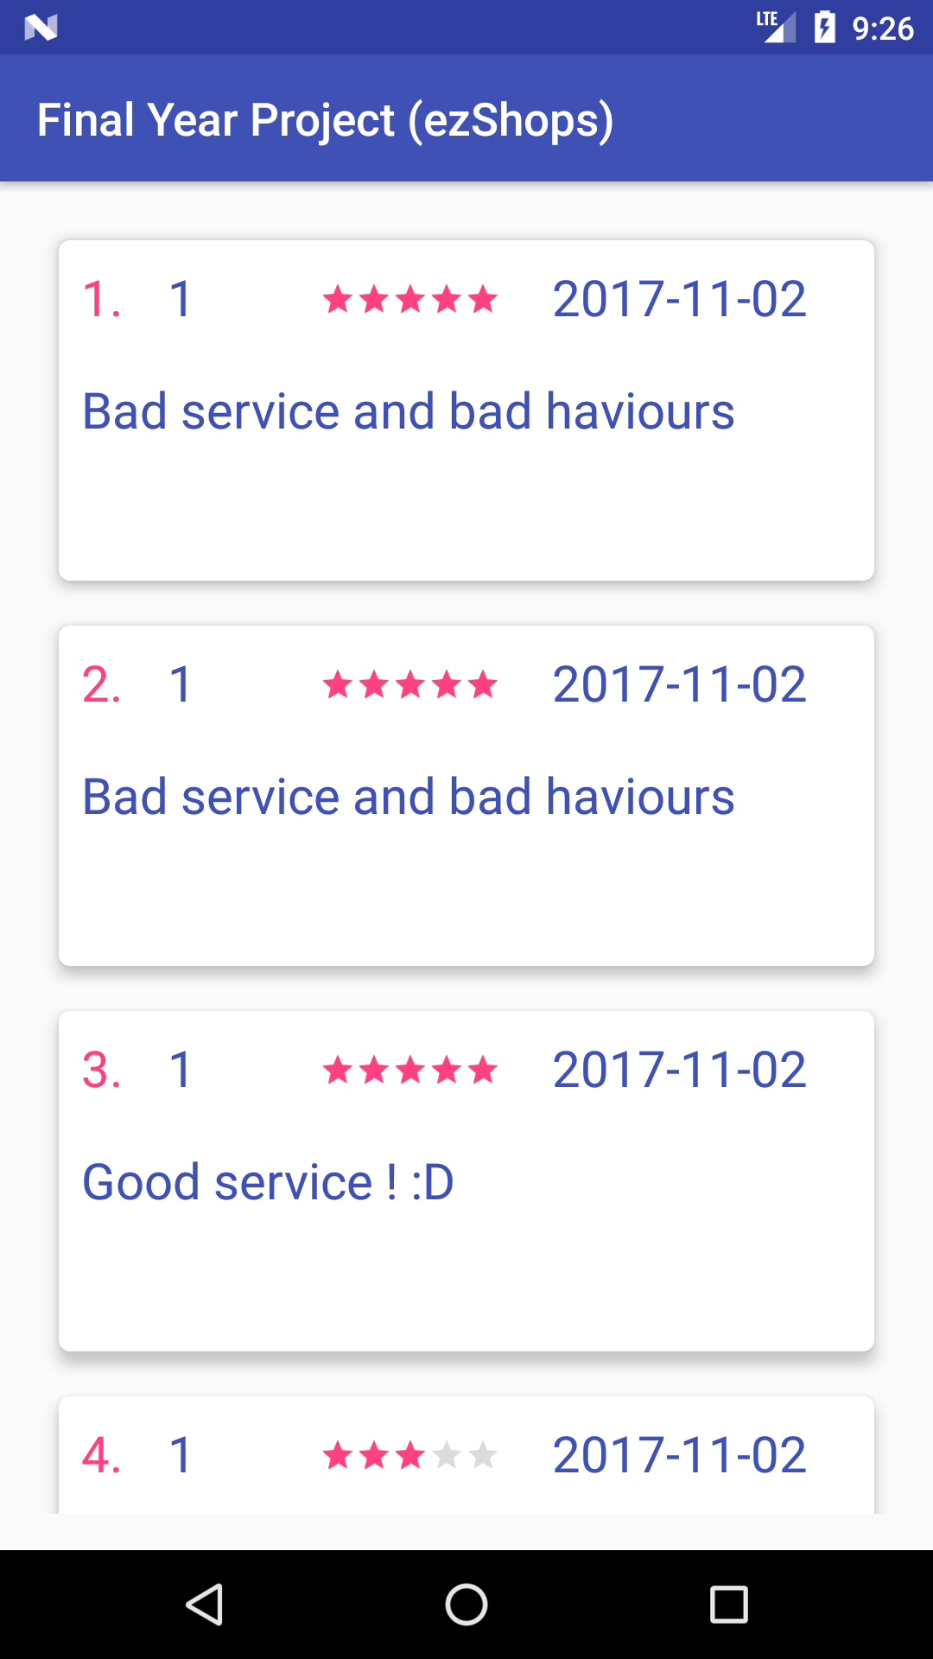
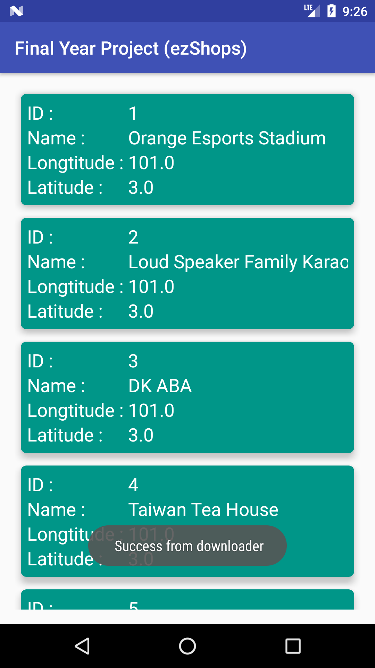
Transforming SME E-Commerce Landscape in Malaysia
Tsang Wai Yong, Wo Choon Ket
Faculty of Computing and Information Technology
Tunku Abdul Rahman University Collage
The overview of this application is to increase the success rate of transitioning from traditional commerce to E-commerce. Most of the commerce nowadays face difficulty to get use with E-commerce platform. We found out a way to solve the problem that we mentioned and promote the local business in the same time, by creating an application to allowed users to access the shops the their mobile devices. This application able to keep track the user location and check the shops within the user location. With this application, we could promote our local commerce and by enable the registered members to rate, review and check the shops nearby.
Abstract
Problem Statement
The technology we used is Android Studio, Google Map API, Java, PHP, JSON and XAMPP for database.
(Picture above showed the nearby shops in map, list and rating & review.)
The problems we faced during the development process are the market and the way of present our information. We solved all those problems through communication, search information through internet and the help of our supervisor.
Our application is an innovative idea, because after doing research toward the market we’re understand the current market status, especially for E-Commerce platform. Most of the E-Commerce currently are self-promoting and more focus toward the products or they provided everyone an opportunity to build an online shops selling second hand items or purchasing items.
What makes us different from the normal E-Commerce platform, the service we provided is for the exist commerce platform that face struggles to convert themselves to E-Commerce world.
We believe a lot of commerce are trustable and worthy enough to deserved something better. This make us different then normal E-Commerce.
1. How to promote local commerce?
2. How to ensure traditional commerce able to survive from E-commerce?
3. How to detect and current location?
4. What makes us different with the normal E-Commerce platform?
5. Who will be our target market?
Results and Discussion
There are few main objectives of this application and we could categories as 2 category. Social benefits and benefit toward the organizations.
Social benefits able to bring tons of benefits to the society, where the people able to shopping with the rating, review and the shop location mentioned in the application. It increase the shopping experience to next level, where the user able to choose online or offline. In the same time, promoting shopping online and offline able to bring benefit toward the organizations. Where organizations able to explore the new market of E-Commerce and maintain their commerce.
Objectives
The way that we constructed our design is by using the software development model which is incremental model. Incremental Module is a software development where the product is designed, implemented and tested incrementally, it will add a little more for each incremental.
Which means after we updated our progress we knew what is task remained, task that required to change and task that need to be complete in the incoming incremental.
As the picture showed at the right
side, where is our first designed
the rate & review and shops nearby.
Where in the later of development
or incremental stage we had improved
the overall designed with the guidance
and advice from our supervisor.
The application is developed in the platform of android. Where android phone played a very important role.
Our target main is everyone that had access to internet easily and own a mobile device (smartphone),
Design and Methodology
In term of commercialization value this application able to bring huge benefit for commerce & E-commerce. Because of promoting local business will be easy by using this application.
In term of social responsibility, this application does the jobs well. Where we able to promote local business, and encourage youngster to join the industry.
Contribution
We had managed to achieved the main requirement that we mentioned in the early stage of development. But during the end of the development process we realize that we could enhance the application even further beyond then we expected. For the highlight of the project, is the project able to show the shop nearby and able to check the rate and review for the specific show selected.
Conclusion

