Slide 1
Discrete Structures
LECTURE 3
Wajahat Akbar
Lecturer
Shaikh Zayed Islamic Centre (SZIC)
University of Peshawar

Slide 2
Previous Lecture Summary
Conditional Propositions.
Negation, Inverse and Converse of the conditional statements.
Contraposition
Bi-conditional statements.
Necessary and Sufficient Conditions.
Conditional statements and their Logical equivalences.

Slide 3
Applications of Logic

Slide 4
LECTURES OUTLINE
BASIC LOGIC GATES
CIRCUITS USING LOGIC GATES
BOOLEAN ALGEBRA
ADDERS
REDUCTIONS OF CIRCUITS

Slide 5
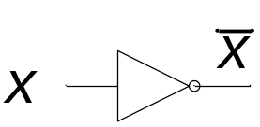
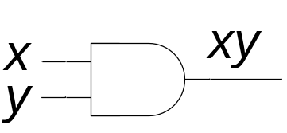
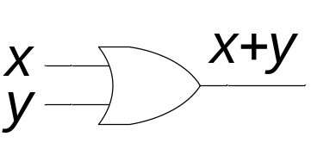
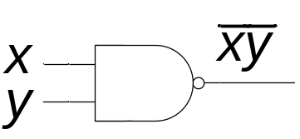
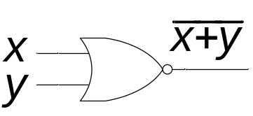
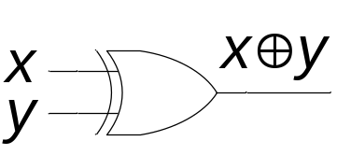
Basic Logic Gates
Not where x = ¬x
And where xy = x ∧ y
Or where x+y = x ∨ y
Nand where ¬(xy)= xy
Nor
Xor

Slide 6
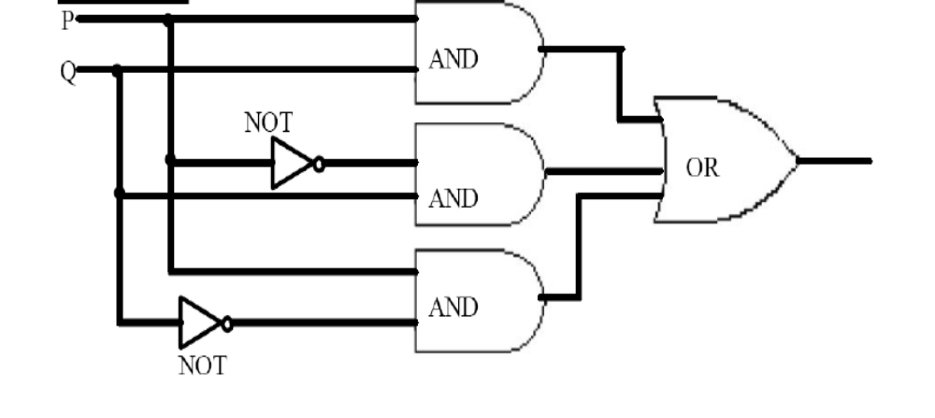
Constructing Circuits
Here is the circuit of the statement
(p ∧ q) ∨ (~p ∧ q) ∨ (p ∧ ~q)

Slide 7
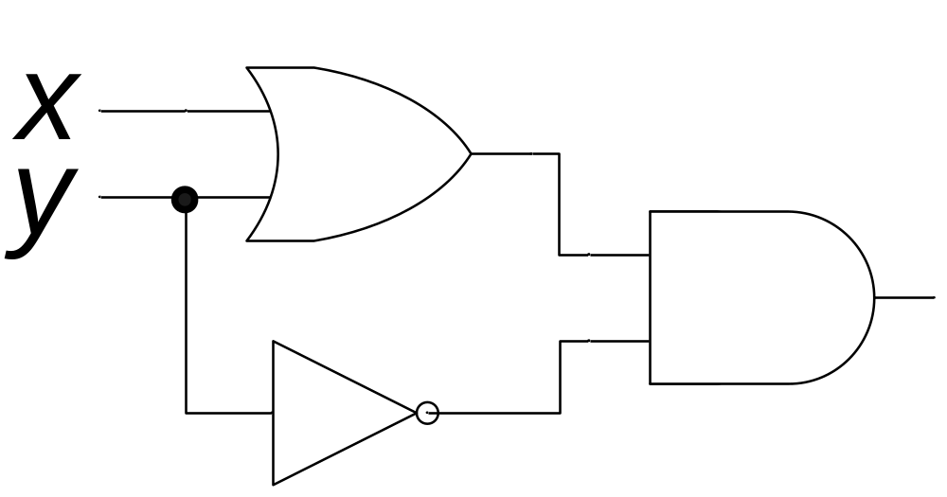
Cont...
Following is the circuit output of the following statement
(x + y) ∧ ¬ y

Slide 8
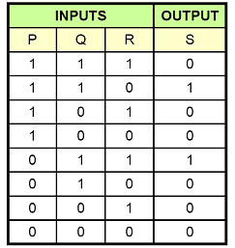
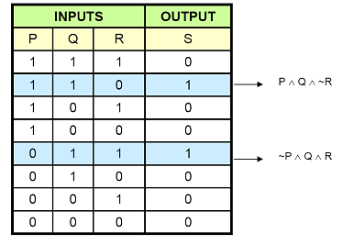
Designing a circuitt for a given input/output
Here is the out put
we can write it as following

Slide 9
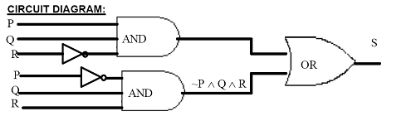
Designing a circuitt for a given input/output
Here is the circuit of the previous input/output

Slide 11
Boolean Algebra
Just like Boolean logic, variables can only be 1 or 0, instead of true/false
Not
  ~0 = 1
  ~1 = 0
Or is used as a plus And is used as a multiplication 0+0 = 0 0 * 0 = 0
0+1=1 0 * 1 = 0
1+0=1 1 * 0 = 0
1+1= ? 1 * 1 = 1

Slide 12
Half Adder
A half adder is a digital circuit that adds two single-bit binary numbers and produces a two-bit output: the sum and the carry. It has two inputs: A and B, representing the two bits to be added, and two outputs: Sum (S) and Carry (C).
The sum (S) output represents the least significant bit (LSB) of the addition result, while the carry (C) output represents the carry-out from the addition.

Slide 13
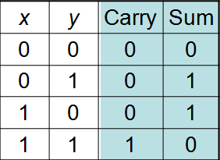
Half Adder
Consider adding two 1-bit binary numbers x and y
  0+0 = 0
  0+1 = 1
  1+0 = 1
  1+1 = 10
Carry is x AND y
Sum is x XOR y
The circuit to compute this is called a half-adder.

Slide 14
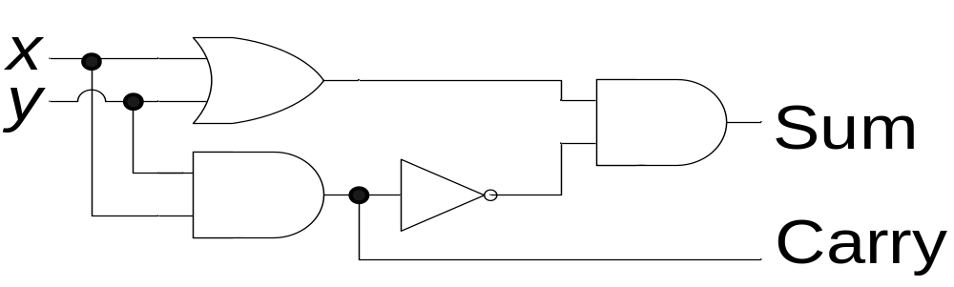
Circuit of Half Adder
Sum = x XOR y
Carry = x AND y

Slide 15
Using Half Adders
We can then use a half-adder to compute the sum of two Boolean numbers
1
0
0
1 1 0 0
+ 1 1 1 0
?
0
1
0

Slide 16
Using Half Adders
We can then use a half-adder to compute the sum of two Boolean numbers
1
0
0
1 1 0 0
+ 1 1 1 0
1
1
0
1
0

Slide 17
The Full Adder
A full adder is a digital circuit that adds three single-bit binary numbers: two inputs (A and B) and a carry-in (Cin), and produces a two-bit output: the sum (S) and the carry-out (Cout). Full adders are used in multi-bit addition, where the carry-out from a lower order addition is fed into the next higher order addition.
The sum (S) output represents the least significant bit (LSB) of the addition result, while the carry-out (Cout) represents the carry that propagates to the next higher order addition.MSB

Slide 18
Most significant bit (MSB):
Definition: The MSB is the leftmost bit in a binary number. It represents the largest value in the number's binary representation.
Least significant bit (LSB):
Definition: The LSB is the rightmost bit in a binary number. It represents the smallest value in the number's binary representation.
E.g in binary number 10
(MSB)Most significant bit Least significant bit (LSB)
1 0
Discrete StructuresDiscrete Structures

Slide 19
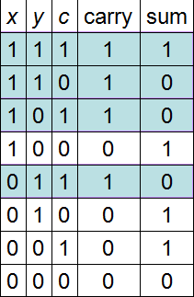
How to fix that
We need to create an adder that can take a carry bit as an additional input
  Inputs: x, y, carry in
  Outputs: sum, carry out
This is called a full adder
  Will add x and y with a half-adder
  Will add the sum of that to the
  carry in
What about the carry out?
  It’s 1 if either (or both):
  x+y = 10
  x+y = 01 and carry in = 1

Slide 20
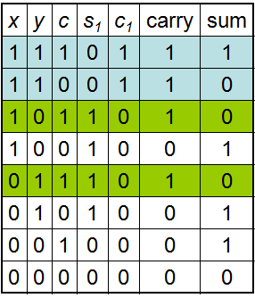
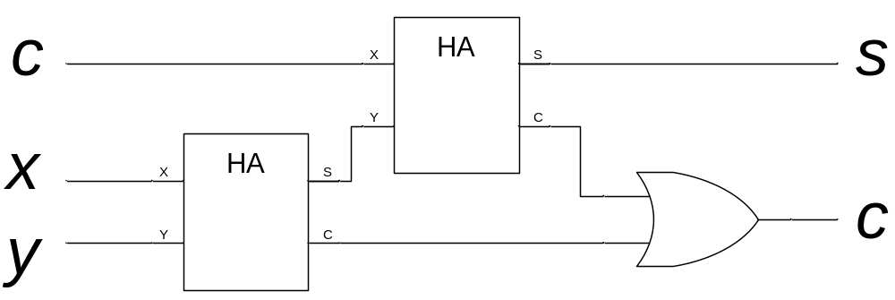
The Full adder
The “HA” boxes are
half-adders

Slide 21
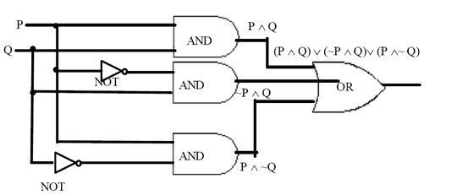
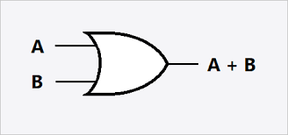
Logical Expression
Following is the circuit representations of the statement

Slide 22
CONT…….
THE ABOVE STATEMENT IS THE LOGICAL EQUIVALENT TO THE STATEMENT (P ∧ Q) ∨ (¬P ∧ Q) ∨ (P ∧ ¬Q) ≡ P ∨ Q
STATEMENT REASONS
(P ∧ Q) ∨ (¬P ∧ Q) ∨ (P ∧ ¬Q)
(P ∨ ¬P) ∧ Q ∨ (P ∧ ¬Q) : DISTRIBUTIVE LAW
t ∧ Q ∨ (P ∧ ¬Q) : NEGATION LAW
Q ∨ (P ∧ ¬Q) : IDENTITY LAW
(Q ∨ P) ∧ (Q ∨ Q¬) : DISTRIBUTIVE LAW
(Q ∨ P) ∧ t : NEGATION LAW
(Q ∨ P) : IDENTITY LAW
P ∨ Q : COMMUTATIVE LAW
THUS
ACCORDINGLY THE TWO CIRCUITS ARE EQUIVALENT

Slide 23
LECTURE SUMMARY
Basic Logic gates
Circuits using logic gates
Circuits corresponding to Logical Expressions
Reductions of circuits

