Slide 1
Functions

Slide 2
RELATIONS AND FUNCTIONS:
A function F from a set X to a set Y is a relation from X to Y that satisfies the following two properties
For every element x in X, there is an element y in Y such that (x,y) ∈F.
In other words every element of X is the first element of some ordered pair of F.
For all elements x in X and y and z in Y, if (x,y) ∈F and (x,z) ∈F, then y = z
In other words no two distinct ordered pairs in F have the same first element.

Slide 3
EXERCISE:
Which of the relations define functions from X = {2,4,5} to Y={1,2,4,6}.
a. R1 = {(2,4), (4,1)}
b. R2 = {(2,4), (4,1), (4,2), (5,6)}
c. R3 = {(2,4), (4,1), (5,6)}

Slide 4
SOLUTION :
R1 is not a function, because 5∈X does not appear as the first element in any ordered pair in R1.
R2 is not a function, because the ordered pairs (4,1) and (4,2) have the same first element but different second elements.
R3 defines a function because it satisfy both the conditions of the function that is every element of X is the first element of some order pair and there is no pair which has the same first order pair but different second order pair.

Slide 5
EXERCISE:
Let A = {4,5,6} and B = {5,6} and define binary relations R and S from A to B as follows:
for all (x,y) ∈A × B, (x,y) ∈ R ⇔ x≥y
for all (x,y) ∈A × B, xSy ⇔ 2|(x-y)
Represent R and S as a set of ordered pairs.
Indicate whether R or S is a function

Slide 6
SOLUTION:
4 cannot be related to any element of B
Since we are given the relation R contains those order pairs of A × B which has their first element greater or equal to the second Hence R contains the order pairs.
R = {(5,5), (6,5), (6,6)}
Similarly S is such a relation which consists of those order pairs for which the difference of first and second elements difference divisible by 2.
Hence S = {(4,6), (5,5), (6,6)}
R is not a function because 4 ∈A is not related to any element of B.
S clearly defines a function since each element of A is related to a unique element of B.

Slide 7
FUNCTION WITHOT RELATION:
A function f from a set X to a set Y is a relationship between elements of X and elements of Y such that each element of X is related to a unique element of Y, and is denoted f : X →Y.
The set X is called the domain of f and Y is called the co-domain of f.
NOTE: The unique element y of Y that is related to x by f is denoted f(x) and is called
f of x, or the value of f at x, or the image of x under f

Slide 8
ARROW DIAGRAM OF A FUNCTION:
The definition of a function implies that the arrow diagram for a function f has the following two properties:
Every element of X has an arrow coming out of it
No two elements of X hava two arrows coming out of it that point to two different elements of Y.

Slide 9
EXAMPLE:
Let X = {a, b, c} and Y={1,2,3,4}.
Define a function f from X to Y by the arrow diagram.
X Y
a .
b
.
c .
. 1
. 2
. 3
. 4

Slide 10
You can easily note that the above diagram satisfy the two conditions of a function hence a graph of the function. Note that f(a) = 2, f(b) = 4,and f(c) = 2. FUNCTIONS AND NONFUNCTIONS: Which of the arrow diagrams define functions from X = {2,4,5}to Y = {1,2,4,6}. X Y X Y
2 .
4 .
5 .
. 1
. 2
. 4
. 6
. 1
. 2
. 4
. 6
2 .
4 .
5 .

Slide 11
The relation given in the diagram (a) is Not a function because there is no arrow coming out of 5∈X to any element of Y. The relation in the diagram (b) is Not a function, because there are two arrows coming out of 4∈X. i.e.,4∈X is not related to a unique element of Y.

Slide 12
RANGE OF A FUNCTION:
Let f: X→Y. The range of f consists of those elements of Y that are image of elements of X.
Symbolically, Range of f = {y ∈Y| y = f(x), for some x ∈X}
NOTE:
The range of a function f is always a subset of the co-domain of f.
The range of f: X →Y is also called the image of X under f.
When y = f(x), then x is called the pre-image of y.
The set of all elements of X, that are related to some y ∈Y is called the inverse image of y.

Slide 13
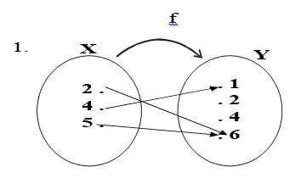
EXERCISE:
Determine the range of the functions f, g, h from X = {2,4,5} to Y = {1,2,4,6} defined as:
2. g = {(2,6), (4,2), (5,1)}
3. h(2) = 4, h (4) = 4, h(5) = 1

Slide 14
SOLUTION:
Range of f = {1, 6}
Range of g = {1, 2, 6}
Range of h = {1, 4}

Slide 15
GRAPH OF A FUNCTION:
Let f be a real-valued function of a real variable. i.e.
f:R →R.
The graph of f is the set of all points (x,y) in the Cartesian coordinate plane with the property that x is in the domain of f and y = f(x).

Slide 16
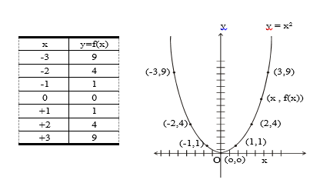
EXAMPLE:
We have to draw the graph of the function f given by the relation y=x² in order to draw the graph of the function we will first take some elements from the domain will see the image of them and then plot then on the graph as follows
Graph of y = x²

Slide 17
VERTICAL LINE TEST FOR THE GRAPH OF A FUNCTION:
For a graph to be the graph of a function, any given vertical line in its domain intersects the graph in at most one point.

Slide 18
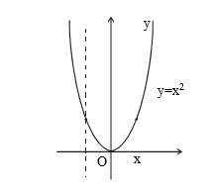
EXAMPLE:
The graph of the relation y = x² on R defines a function by vertical line test.

Slide 19
EXERCISE:
Define a binary relation P from R to R as follows:
for all real numbers x and y (x, y) ∈ P ⇔ x = y² Is P a function? Explain.

Slide 20
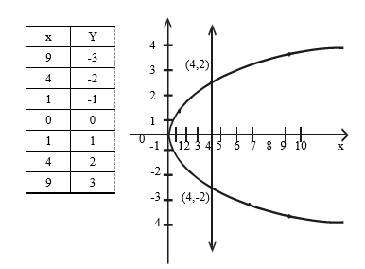
SOLUTION:
The graph of the relation x = y² is shown below. Since a vertical line intersects the graph at two points; the graph does not define a function.

Slide 21
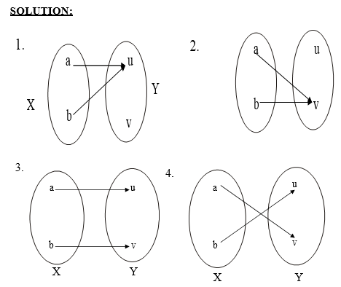
EXERCISE:
Find all functions from X = {a,b} to Y = {u,v}

Slide 22
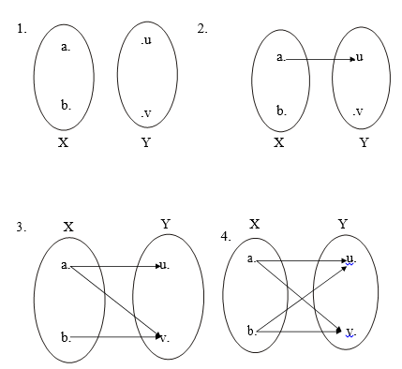
EXERCISE:
Find four binary relations from X = {a,b}to Y = {u,v}that are not functions.
SOLUTION:
The four relations are

Slide 23
EXERCISE:
How many functions are there from a set with three elements to a set with four elements.

Slide 24
SOLUTION:
Let X = {x₁, x₂, x₃} and Y= {y₁, y₂, y₃,y₄}
Then x₁ may be related to any of the four elements y₁, y₂, y₃, y₄ of Y. Hence there are 4 ways to relate x₁ in Y.
Similarly x₂ may also be related to any one of the 4 elements in Y. Thus the total number of different ways to relate x₁ and x₂ to elements of Y
Finally x₃ must also has its image in Y and again any one of the 4 elements y₁, or y₂ or y₃ or y₄ could be its image.
Therefore the total number of functions from X to Y are 4 × 4 × 4 = 4³ = 64.

Slide 25
EXERCISE:
Suppose A is a set with m elements and B is a set with n elements.
How many binary relations are there from A to B?
How many functions are there from A to B?
What fraction of the binary relations from A to B are functions?

Slide 26
SOLUTION:
Number of elements in A × B = m.n
Therefore, number of binary relations from A to B = Number of all subsets of A × B = 2^{mn}
Number of functions from A to B = n.n.n. … .n (m times)
= n ^{m}
Fraction of binary relations that are functions = n ^{m} / 2^{mn}

Slide 27
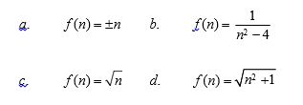
FUNCTIONS NOT WELL DEFINED:
f (n) =
1
n² − 4
Determine whether f is a function from Z to R if

Slide 28
SOLUTION:
f is not well defined since each integer n has two images +n and –n. we know that one element have no two images
f is not well defined since f(2) and f(-2) are not defined. The result not a real number that’s why it is not a function
f is not defined for n < 0 since f then results in imaginary values (not real), for example if we take n=negative number then result will be imaginary number not real number
f is well defined because each integer has unique (one and only one) image in R under f.

Slide 29

EXERCISE:
Student C tries to define a function h : Q → Q by the rule.
for all integers m and n with n ≠ 0
Students D claims that h is not well defined. Justify students D’s claim.

Slide 30

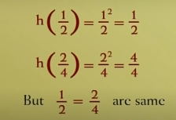
SOLUTION:
The function h is well defined if each rational number has a unique (one and only one image)
Hence an element of Q has more than one images under h. Accordingly h is not well defined.

Slide 31
REMARK:
A function f: X → Y is well defined if
∀ x₁, x₂ ∈X,
if x₁ = x₂ then f(x₁) = f(x₂)

Slide 32
EXERCISE:
Let g: R→R+ be defined by g(x) = x² +1
Show that g is well defined.
Determine the domain, co-domain and range of g.

Slide 33
SOLUTION:
g is well defined:
Let x₁, x₂ ∈R and suppose x₁ = x₂
⇒ x₁² = x₂² (squaring both sides)
⇒ x₁² + 1 = x ² + 1 (adding 1 on both sides)
⇒ g (x₁) = g(x₂) (by definition of g)
Thus if x₁ = x₂ then g (x₁) = g(x₂). According g:R → R+ is well defined.

Slide 34
SOLUTION:
g:R →R⁺ defined by g(x) = x² + 1.
Determine the domain, co-domain and range of g.
Domain of g = R (set of real numbers)
Co-domain of g = R⁺ (set of positive real numbers)
The range of g consists of those elements of R⁺ that appear as image points.
Since x² ≥0 ∀ x ∈R
x² + 1≥ 1 ∀ x ∈R
i.e. g(x) = x² + 1≥ 1 ∀ x ∈R
Hence the range of g is all real number greater than or equal to 1, i.e., the internal [1,∝)

Slide 35
BINARY OPERATIONS:
A binary operation “*” defined on a set A assigns to each ordered pair (a, b) of elements of A, a uniquely determined element a*b of A.
That is, a binary operation takes two elements of A and maps them to a third element of A.

Slide 36
EXAMPLE:
“+” and “.” are binary operations on the set of natural numbers N.
“-” is not a binary operation on N.
“-” is a binary operation on Z, the set of integers.
“÷” is a binary operation on the set of non-zero rational numbers Q-{0}, but not a binary operation on Z.

Slide 37
BINARY OPERATION AS FUNCTION:
A binary operation “*” on a set A is a function from A * A to A.
i.e. *: A ×A →A.
Hence *(a,b) = c, where a, b, c ∈A.
NOTE: *(a,b) is more commonly written as a*b.
I,e
Addition “+” a + b
Multiplication “.” a . b

Slide 38
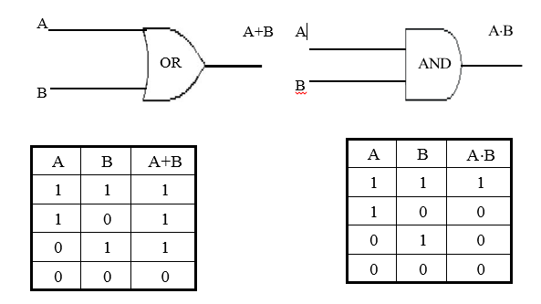
EXAMPLES:
The set operations union ∪, intersection ∩ and set difference -, are binary operators on the power set P(A) of any set A.
The logical connectives ∨, ∧, →, ↔ are binary operations on the set {T, F}
The logic gates OR and AND are binary operations on {0,1}

Slide 39
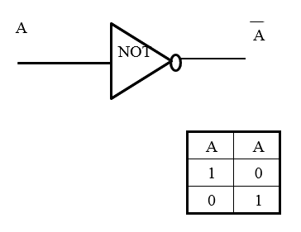
EXAMPLES:
The logic gate NOT is a uniary operation on {0,1}

Slide 40


