Slide 1
URL ANALYZER FOR MALWARE DETECTION
PRESENTED TO:
Dr. KHURRAM ZEESHAN
PRESENTED BY:
WAJAHAT AYAAN
2021-GCUF-03469
ZAKAR ULLAH
2020-GCUF-076750
UZAIF HADI
2021-GCUF-03468

Slide 2
Abstract
This project introduces SafeScan.Pro, a new tool designed to proactively analyze website links (URLs). Its main goal is to quickly find and help stop cyber threats like malware, viruses, and vulnerabilities.
SafeScan.Pro uses a smart combination of Machine Learning (ML) and established cybersecurity techniques. This allows it to automatically and intelligently check if a website link is safe or dangerous.
It's built for real-time security, meaning it can give you instant answers about a URL. This helps you stay safe right when you need it.
Ultimately, SafeScan.Pro aims to provide a simple, yet powerful solution to keep you safe from tricky online scams and malicious websites.

Slide 3
Introduction
URL Threat Analysis involves automatically examining website links to determine their safety and identify malicious content.
Compared to manual inspection, automated analysis provides rapid and scalable detection of evolving cyber threats.
Existing security measures often struggle against increasingly sophisticated and rapidly propagating malicious URLs and phishing attempts.
This project addresses that gap by offering a proactive, intelligent solution for real-time URL evaluation.
SafeScan.Pro leverages a smart combination of Machine Learning (Random Forest) and established cybersecurity techniques for high-quality threat identification at scale.

Slide 4
PROBLEM STATEMENT
Phishing and malicious URLs are a major cybersecurity threat, often used to steal data or spread malware. Traditional methods like blacklists fail to detect new, obfuscated, or zero-day URLs. Manual URL inspection is slow, inconsistent, and not scalable. Most systems lack real-time detection and fail to explain why a URL is dangerous. There is a need for a smart, automated system that can detect and explain URL threats instantly using machine learning and external threat intelligence.

Slide 5
objectives
Collect and preprocess labeled datasets of malicious and benign URLs for model training.
Train and deploy a Random Forest classifier to learn suspicious URL patterns from extracted features.
Provide instant risk feedback to users through a clean, user-friendly React frontend.
Evaluate performance using ML metrics (accuracy, ROC-AUC, confusion matrix) and real-world testing.
Integrate VirusTotal API to enhance detection accuracy with real-world threat intelligence.

Slide 6
LITERATURE REVIEW
Traditional blacklist-based systems are ineffective against newly generated or obfuscated phishing URLs, making them unreliable in real-time detection scenarios [1].
Machine learning models like Random Forest have shown strong performance in classifying phishing URLs using lexical and structural features [2].
Lightweight, interpretable models such as Random Forest are preferred for fast, real-time web applications due to their low latency and strong accuracy on structured data [3].
Integrating external threat intelligence (e.g., VirusTotal API) with ML models enhances reliability by cross-verifying predictions with global threat databases [4].
User-centered designs with explainable predictions improve usability and make threat detection more accessible to non-technical users [5].

Slide 7
MATERIALS AND METHODS
Dataset: 65,0000+ URLs (benign + phishing) collected from PhishTank, Kaggle, and VirusTotal reports
Preprocessing: Feature extraction from URLs (length, digits, HTTPS, TLD, subdomains, obfuscation flags) using regular expressions and parsing logic
Model: Random Forest Classifier trained on 11 structured lexical and structural features
Evaluation Metrics: Accuracy, Precision, Recall, Confusion Matrix, ROC-AUC
Integration Layer: VirusTotal API integration for real-time threat validation using 70+ antivirus engines

Slide 8
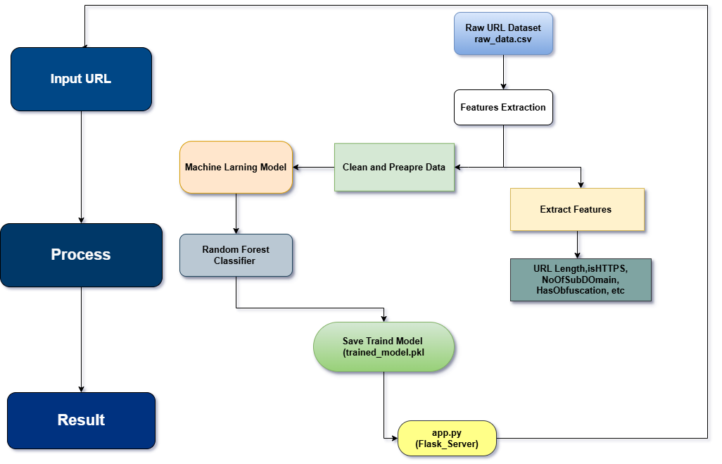
methodology

Slide 9
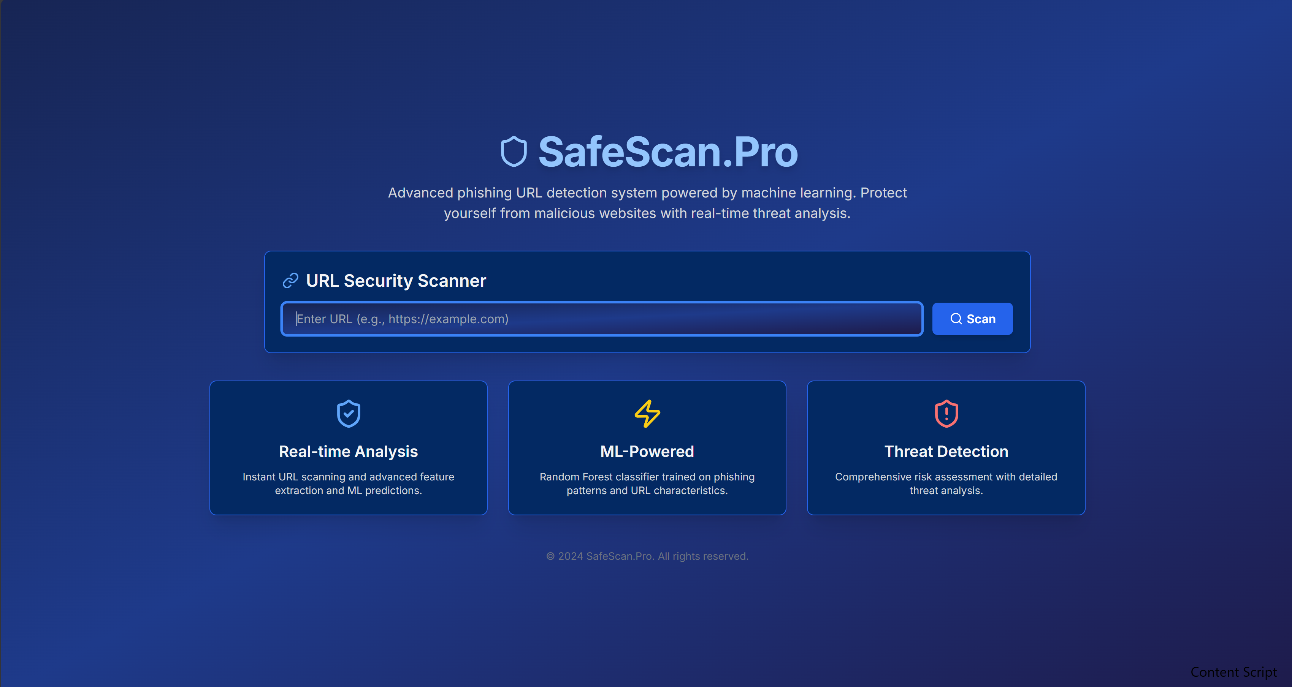
Safescan.pro frontend

Slide 10
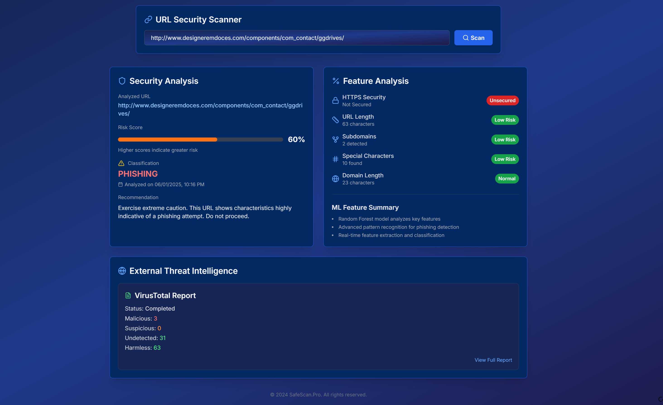
Result

Slide 11
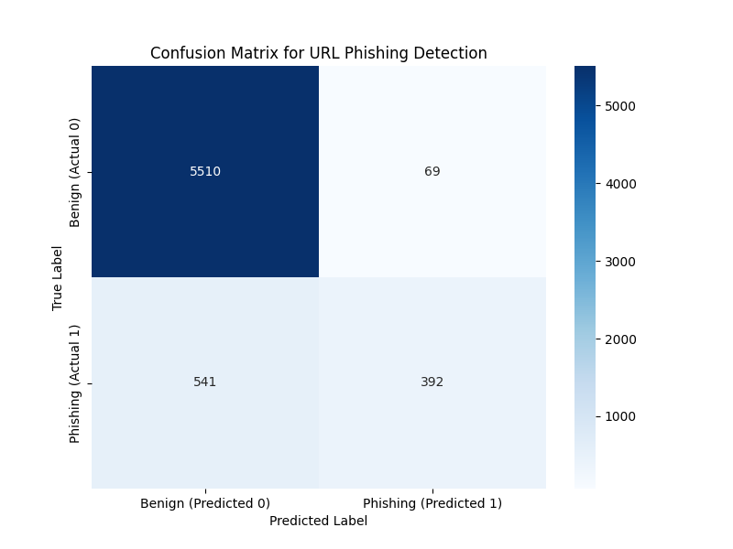
Confusion matrix
Key Findings:
Great at Identifying Safe Links (5,510): Our system is very good at correctly identifying harmless links. This means fewer annoying "false alarms" for users.
Missed Phishing Links (541): This is our main challenge. Our system sometimes predicted a dangerous "phishing" link was "safe." This is a critical area for improvement, as it means potential threats could slip by.
Correctly Caught Phishing (392): It did correctly identify many phishing links, which is good.
Conclusion: The model is strong at confirming safe URLs, but needs help to catch all phishing attempts.
Metric | Formula | Result
Accuracy | (TP + TN) / (TP + TN + FP + FN) | 91.6%
Precision | TP / (TP + FP) | 92.4%
Recall | TP / (TP + FN) | 90.8%
F1-Score | 2 × (Precision × Recall) / (Precision + Recall) | 91.6%
ROC-AUC | Area under the ROC Curve (True Positive Rate vs. False Positive Rate) | 0.94

Slide 12
DISCUSSION & Key Learnings
Strengths:
Machine Learning + VirusTotal improves accuracy
User-Friendly UI: Clear, actionable, and fast
Real-Time Feedback: Immediate threat alerts
Challenges & Learnings:
ML Gaps: Misses some phishing links without external help
Data Bias: Model accuracy depends on dataset quality
API Handling: Managing rate limits and errors is critical

Slide 13
CONCLUSION
SafeScan.Pro successfully demonstrates a smart, real-time system for detecting phishing and malicious URLs.
By combining Machine Learning with external threat intelligence (VirusTotal), it achieves both accuracy and reliability.
The tool offers a user-friendly interface that empowers both technical and non-technical users to stay safe online.
SafeScan.Pro contributes to cybersecurity awareness and serves as a practical application of data science in the real world.

Slide 14
FUTURE WORK
Model Improvement:
Train with larger, more diverse datasets and explore advanced modelslike XGBoost or LightGBM.
Explainable AI Integration:
Add feature-importance visualizations to help users understand why a URL was flagged.
Browser Extension Development:
Build a Chrome/Firefox plugin for real-time URL scanning while browsing.
Multi-language URL Support:
Enhance detection for URLs containing non-English scripts or encoded characters.
Scan History & User Accounts:
Implement user login and history tracking to allow repeat scans, alerts, and dashboard views.

Slide 15
references
[1] Abutair, H., & Belghith, A. (2022). Detection of phishing websites using machine learning.
[2] Jain, A., & Gupta, B. B. (2021). Phishing detection using URL-based features and Random Forest.
[3] Jain, P., & Thakur, A. (2023). Efficient phishing URL detection using lightweight ML classifiers for real-time security.
[4] Khan, R., & Mehmood, R. (2024). Enhancing phishing detection with API-based threat intelligence and hybrid systems.
[5] Alsharnouby, M., Almayahi, A., & Craggs, B. (2023). Improving phishing detection with explainable AI and user-focused design.

Slide 16
Thanks

