Slide 1
The 10 Essential Public Health Services
An Overview
Office for State, Tribal, Local and Territorial Support
Centers for Disease Control and Prevention
March 2014
Centers for Disease Control and Prevention
Office for State, Tribal, Local and Territorial Support

Slide 2
Objectives
Describe the 10 Essential Public Health Services
Review the history of the development of the 10 Essential Public Health Services
Explain the use of the 10 Essential Public Health Services as a framework for public health initiatives

Slide 3
Core Functions of Public Health Steering Committee:
”Public Health in America”
Core Functions of Public Health
  Assessment
  Policy development
  Assurance
Purpose of Public Health
  Prevent epidemics and spread of disease
  Protect against environmental hazards
  Prevent injuries
  Promote and encourage healthy behaviors
  Respond to disasters and assist communities in recovery
  Assure the quality and accessibility of services
http://iom.edu/Reports/1988/The-Future-of-Public-Health.aspx
http://www.health.gov/phfunctions/public.htm
Notes:
First, a little history. Many of you may be familiar with the core functions, which were outlined in the 1988 Institute of Medicine report “The Future of Public Health.” As stated in the IOM report, the three core functions of public health are assessment, policy development, and assurance. This is a good start to describing public health, but in 1994, when the country was exploring issues related to healthcare reform, the public health sector felt that a better definition and description of public health was needed. A “Core Functions of Public Health Steering Committee” was convened to address this need. This Steering Committee involved representatives from Public Health Service Agencies (CDC, HRSA, Office of Disease Prevention and Health Promotion, etc.) and key national public health organizations. The committee produced a statement called “Public Health in America.”
Public Health in America – Vision and Mission
The Public Health In America statement provides a vision and mission for public health as well as the context of what public health should be prepared to do and how public health service is delivered. The vision for public health is broad: “Healthy People in Healthy Communities.” The mission identified is to “Promote Physical and Mental Health and Prevent Disease, Injury, and Disability.”

Slide 4
The 10 Essential Public Health Services
Monitor health status to identify and solve community health problems
Diagnose and investigate health problems and health hazards in the community
Inform, educate, and empower people about health issues
Mobilize community partnerships to identify and solve health problems
Develop policies and plans that support individual and community health efforts
Notes:
The last part of the Public Health in America statement defines the “Essential Services of Public Health.” The 10 essential services are shown here on the screen and include
Monitor health status to identify and solve community health problems
Diagnose and investigate health problems and health hazards in the community
Inform, educate, and empower people about health issues
Mobilize community partnerships to identify and solve health problems
Develop policies and plans that support individual and community health efforts

Slide 5
The 10 Essential Public Health Services
Enforce laws and regulations that protect health and ensure safety
Link people to needed personal health services and assure the provision of health care when otherwise unavailable
Assure a competent public and personal health care workforce
Evaluate effectiveness, accessibility, and quality of personal and population-based health services
Research for new insights and innovative solutions to health problems
Notes:
6. Enforce laws and regulations that protect health and ensure safety
7. Link people to needed personal health services and assure the provision of health care when otherwise unavailable
8. Assure a competent public and personal health care workforce
9. Evaluate effectiveness, accessibility, and quality of personal and population-based health services
10. Research for new insights and innovative solutions to health problems
Basically, any public health activity can fit into one of these 10 categories. So, for example, Essential Service #1 includes activities such as data collection, community health assessments, and the maintenance of population health registries. As another example, Essential Service #7 includes personal healthcare services as well as transportation and other enabling services and assuring the availability of culturally appropriate personnel and materials. Since the release of the 10 Essential Services, numerous initiatives have explored the utility and feasibility of these services and have found them to be a good descriptor of public health.

Slide 6
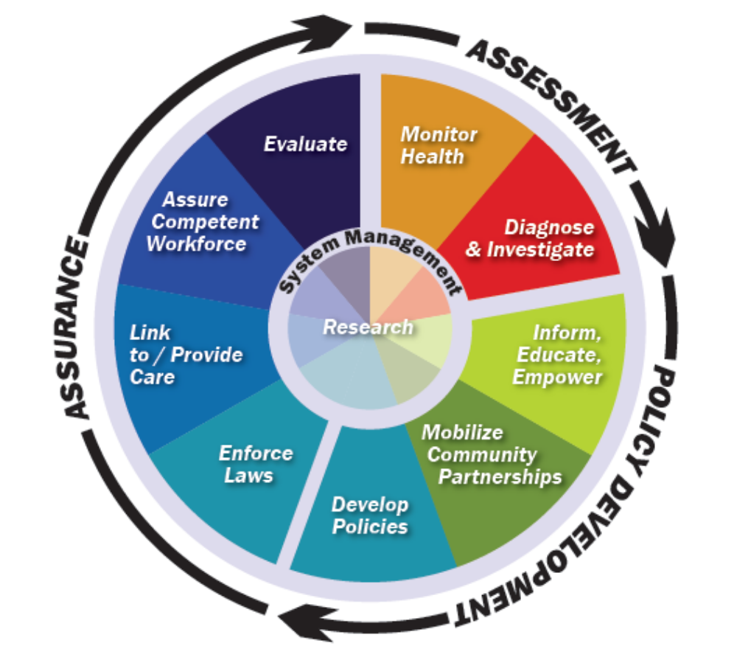
Essential Public Health Services
Notes:
The Public Health Wheel shows the three core functions (assessment, policy development, and assurance) in black around the “wheel” of essential services. In essence, the essential services can be grouped under the three core functions.
Essential services 1 and 2 fit under the core function of assessment. Essential services 3, 4, and 5 fit under policy development while essential services 6, 7, 8, and 9 fit under assurance. Research (essential service 10) and system management form the center of the wheel since these activities are included within all three core functions.
Adopted: Fall 1994, Source: Public Health Functions Steering Committee, Members (July 1995):
American Public Health Association·Association of Schools of Public Health·Association of State and Territorial Health Officials·Environmental Council of the States·National Association of County and City Health Officials·National Association of State Alcohol and Drug Abuse Directors·National Association of State Mental Health Program Directors·Public Health Foundation·U.S. Public Health Service --Agency for Health Care Policy and Research·Centers for Disease Control and Prevention·Food and Drug Administration·Health Resources and Services Administration·Indian Health Service·National Institutes of Health·Office of the Assistant Secretary for Health·Substance Abuse and Mental Health Services Administration

Slide 7
The 10 Essential Services as a Framework
Provide a foundation for any public health activity
Describe public health at the state, tribal, local, and territorial levels
Used as a foundation for the National Public Health Performance Standards (NPHPS)
  NPHPS provides a description of the essential service at an optimal level that public health systems can use to assess their performance
Provided structure for national voluntary public health accreditation
http://www.cdc.gov/nphpsp/
http://www.phaboard.org/accreditation-overview/what-is-accreditation/

Slide 8

Essential Service (ES) 1 – Monitor Health to Identify and Solve Community Health Problems
Accurate, periodic assessment of the community’s health status
  Identification of health risks
  Attention to vital statistics and disparities
  Identification of assets and resources
Use of methods and technology (e.g., mapping technology) to interpret and communicate data
Maintenance of population health registries
Notes:
ES 1 answers these questions:
What’s going on in our state/community?
Do we know how healthy we are?
Accurate, periodic assessment of the community’s health status, including
Identification of health risks, determinants of health, and determination of health service needs
Attention to the vital statistics and health status indicators of groups that are at higher risk than the total population
Identification of community assets that support the local public health system (LPHS) in promoting health and improving quality of life
Use of appropriate methods and technology, such as geographic information systems (GIS), to interpret and communicate data to diverse audiences
Collaboration among all LPHS components, including private providers and health benefit plans, to establish and use population health registries, such as disease or immunization registries

Slide 9

ES 2 – Diagnose and Investigate Health Problems and Hazards in the Community
Timely identification and investigation of health threats
Availability of diagnostic services, including laboratory capacity
Response plans to address major health threats
Notes:
ES 2 answers these questions:
Are we ready to respond to health problems or threats?
How quickly do we find out about problems?
How effective is our response?
Epidemiologic investigations of disease outbreaks, patterns of infections, chronic diseases, injuries, environmental hazards, and other public health threats and emergencies.
Active infectious disease epidemiology programs.
Access to a public health laboratory capable of conducting rapid screening and high-volume testing.

Slide 10

ES 3 – Inform, Educate, and Empower People About Health Issues
Initiatives using health education and communication sciences to
  Build knowledge and shape attitudes
  Inform decision-making choices
  Develop skills and behaviors for healthy living
Health education and health promotion partnerships within the community to support healthy living
Media advocacy and social marketing
Notes:
ES 3 answers this question:
How well do we keep all segments of our state/community informed about health issues?
Health information, health education, and health promotion activities designed to reduce health risk and promote improved health.
Health communication plans and activities such as media advocacy and social marketing.
Accessible health information and educational resources.
Health education and health promotion program partnerships with schools, faith-based communities, work sites, personal care providers, and others to implement and reinforce health promotion programs and messages.

Slide 11
ES 4 – Mobilize Community Partnerships to Identify and Solve Health Problems
Constituency development
Identification of system partners and stakeholders
Coalition development
Formal and informal partnerships to promote health improvement
Notes:
ES 4 answers this question:
How well do we truly engage people in state/community health issues?
Identifying potential stakeholders who contribute to or benefit from public health and increasing their awareness of the value of public health.
Building coalitions, partnerships, and strategic alliances to draw upon the full range of potential human and material resources to improve community health.
Convening and facilitating partnerships and strategic alliances among groups and associations (including those not typically considered to be health-related) in undertaking defined health improvement projects, including preventive, screening, rehabilitation, and support programs.

Slide 12

ES 5 – Develop Policies and Plans That Support Individual and Community Health Efforts
Policy development to protect health and guide public health practice
Community and state improvement planning
Emergency response planning
Alignment of resources to assure successful planning
Notes:
ES 5 answers these questions:
What policies in both the government and private sector promote health in our state/community?
How well are we setting health policies?
Effective local public health governance.
Development of policy, codes, regulations, and legislation to protect the health of the public and to guide the practice of public health.
Systematic LPHPS and state-level planning for health improvement in all jurisdictions.
Alignment of LPHS resources and strategies with community health improvement plans.

Slide 13

ES 6 – Enforce Laws and Regulations That Protect Health and Ensure Safety
Review, evaluation, and revision of legal authority, laws, and regulations
Education about laws and regulations
Advocating for regulations needed to protect and promote health
Support of compliance efforts and enforcement as needed
Notes:
ES 6 answers this question:
When we enforce health regulations are we technically competent, fair. and effective?
Assurance of due process and recognition of individuals’ civil rights in all procedures, enforcement of laws and regulations, and public health emergency actions taken under the board of health or other governing body’s authority.
Review, evaluation and revision of laws and regulations designed to protect health and safety, reflect current scientific knowledge, and utilize best practice for achieving compliance.
Education of persons and entities obligated to obey and agencies obligated to enforce laws and regulations to encourage compliance.
Enforcement activities in a wide variety of areas of public health concern under authority granted by local, state, and federal rule or law including, but not limited to: abatement of nuisances, animal control, childhood immunizations and other vaccinations, food safety, housing code, local sanitary code, on site wastewater disposal (septic systems), protection of drinking water, school environment, solid waste disposal, swimming pool and bathing area safety and water quality, tobacco control, enforcement activities during emergency situations, and vector control.

Slide 14
ES 7 – Link People to Needed Personal Health Services and Assure the Provision of Health Care When Otherwise Unavailable
Identification of populations with barriers to care
Effective entry into a coordinated system of clinical care
Ongoing care management
Culturally appropriate and targeted health information for at risk population groups
Transportation and other enabling services
Notes:
ES 7 answers this question:
Are people in my state/community receiving the health services they need?
Assuring the identification of populations with barriers to personal health services.
Assuring identification of personal health service needs of populations with limited access to a coordinated system of clinical care.
Assuring the linkage of people to appropriate personal health services through coordination of provider services and development of interventions that address barriers to care (e.g., culturally and linguistically appropriate staff and materials, transportation services).

Slide 15

ES 8 – Assure a Competent Public and Personal Healthcare Workforce
Assessing the public health and personal health workforce
Maintaining public health workforce standards
  Efficient processes for licensing /credentialing requirements
  Use of public health competencies
Continuing education and life-long learning
  Leadership development
  Cultural competence
Notes:
ES 8 answers these questions:
Do we have a competent public health staff?
How can we be sure that our staff stays current?
Education, training, and assessment of personnel (including volunteers and other lay community health workers) to meet community needs for public and personal health services.
Efficient processes for licensure of professionals.
Adoption of continuous quality improvement and life-long learning programs that include determinants of health.
Active partnerships and strategic alliances with professional training programs to assure community-relevant learning experiences for all students.
Continuing education in management and leadership development programs for those charged with administrative/executive roles.

Slide 16

ES 9 – Evaluate Effectiveness, Accessibility, and Quality of Personal and Population-Based Health Services
Evaluation must be ongoing and should examine:
  Personal health services
  Population based services
  The public health system
Quality Improvement
Performance Management
Notes:
ES 9 answers these questions:
Are we meeting the needs of the population we serve?
Are we doing things right?
Are we doing the right things?
Assurance of ongoing evaluation and critical review of health program effectiveness, based on analysis of health status and service utilization data.
Assurance of the provision of information necessary for allocating resources and reshaping programs.

Slide 17

ES 10 – Research for New Insights and Innovative Solutions to Health Problems
Identification and monitoring of innovative solutions and cutting-edge research to advance public health
Linkages between public health practice and academic/research settings
Epidemiological studies, health policy analyses and public health systems research
Notes:
ES 10 answers this question:
Are we discovering and using new ways to get the job done?
Public health research activities:
initiating research,
participating in research by others,
reporting results, and
Implementing policy based on these results.

Slide 18
For More Information
10 Essential Public Health Services and the Public Health in America Statement www.health.gov/phfunctions/public.htm
Mobilizing for Action through Planning and Partnerships
www.naccho.org/topics/infrastructure/mapp/index.cfm
National Public Health Performance Standards www.cdc.gov/nphpsp
Public Health Accreditation Board
www.phaboard.org

Slide 19
Centers for Disease Control and Prevention
Office for State, Tribal, Local and Territorial Support

