Slide 1
Product Vision & Strategy
Introduction
  Purpose:
    Communicate vision, strategy and roadmap for a product in one location including product partners, product options, and the product roadmap
    Support the Project Funding process
  Ownership:
    The Business is the owner of the Product Strategy
    The person designated to fulfill the role of Product Manager is accountable for creating and maintaining the Product Strategy in collaboration with the relevant Product Owners
  Maintenance Guidelines:
    Create the draft of the document prior to the Iteration 0 Workshop and complete with the team during the workshop
    Review and revise as required at each Iteration 0 Workshop, Release Planning or as needed during the project to keep in alignment with the plan

Slide 2
Product Vision & Strategy
Instructions
  Create a copy of this template to serve as your Product Strategy document
  Delete the first two slides (Introduction, Instructions)
  Replace the [bracketed] items on each page with information for your project
  Include your document version number in the footer
  Additional instructions and guidance can be found in the Notes section of the individual slides. (Optionally, the notes may be deleted to make room for talking points specific to your project)
Notes:
For more information regarding the funding process please refer to Project Place https://spteam.aa.com/sites/ITS/PAD
For guidance on IT Vendor Management (ITVM) and support when engaging vendors please refer to ITVM at https://department.jetnet.aa.com/itstechsourcing/index.shtml;
specifically note the links to all of vendor management’s processes on the left under Technology Sourcing
For assistance with this or to schedule an Iteration 0 workshop, please contact the IT Project Performance Team or Agile Coach.

Slide 3
[Product Name]
Product Strategy Document
Revision [Major.Minor]
[Date]
[ProdMgr Name], Product Manager

Slide 4
Understanding Customers to Create Product Vision

Slide 5
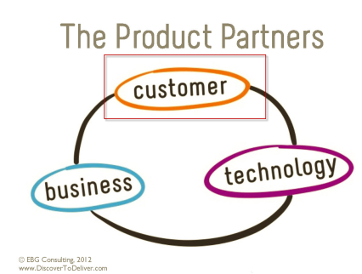
Product Partners
Who are our Customer Partners for this Product?
Customer Partner | Motivations | Value Considerations
Notes:
Who are our Customer Partners? They can be made up of various groups of people. For each product, we must identify who makes up our customer base.

Slide 6
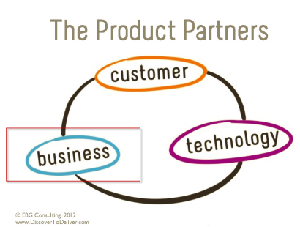
Product Partners
Who are our Business Partners for this Product?
Business Partner | Motivations | Value Considerations
Notes:
Who are our Business Partners? They can be various people or groups of people or vendors who work for our company. For each product, we must identify who makes up our Business base.

Slide 7
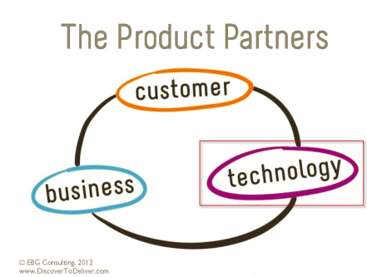
Product Partners
Who are our Technology Partners for this Product?
Technology Partner | Motivations | Value Considerations
Notes:
Who are our Technology Partners? They can be various people or groups of people or vendors who work for our company. For each product, we must identify who makes up our Technology base.

Slide 8

Personas
Which Personas are we targeting with this Product?
Persona | Characteristics | Needs
Notes:
Personas are a valuable tool in product management. They invite us to view the product from the user’s perspective. They help us design a product that truly benefits it users and allow us to explore if a feature would actually benefit one of the personas.

Slide 9
Product Channels
Through which Channels do our Customers want to be reached? How are we reaching them now?
Customer Partner / Persona | Product Channel | Direct / Indirect | Internal / External
Notes:
Channels – Value is delivered to customers through communication, distribution, and sales channels. Channels serve several functions including:
Raising awareness among customers about a company’s products and services
Helping customers evaluate a company’s Value Proposition
Allowing customers to purchase specific products and services
Delivering a Value Proposition to customers
Providing post-purchase customer support

Slide 10
Product Channels
Which channels work best? Which ones are most cost-efficient? How are we integrating them with customer routines?
Channel Phases
Awareness - How do we raise awareness about our company’s products and services?
Evaluation - How do we help customers evaluate our organization’s Value Proposition?
Purchase - How do we allow customers to purchase specific products and services?
Delivery - How do we deliver a Value Proposition to customers?
After Sales - How do we provide post-purchase customer support?
Product Channel | Awareness | Evaluation | Purchase | Delivery | After Sales
Notes:
Channels – Value is delivered to customers through communication, distribution, and sales channels. Channels serve several functions including:
Raising awareness among customers about a company’s products and services
Helping customers evaluate a company’s Value Proposition
Allowing customers to purchase specific products and services
Delivering a Value Proposition to customers
Providing post-purchase customer support

Slide 11
Product Vision
For [target user]
Who [needs]
The [product name] is a [category]
That [benefit provided]
Unlike [competition or alternative]
Our Product [differentiation]

Slide 12
Product Vision Board
Vision Statement [Brief Summary of the vision for the product]
Target Group
[Which market segment does this product address?]
[Who are the target users & customers?]
Needs
[Which needs does the product fulfill?]
[How does it create value for its users?]
[Which emotions will it evoke?]
Product
[What are the 3-5 top features?]
[What are its unique selling points?]
Value
[How is the product going to benefit the company?]
[Will it increase revenue, enter a new market, develop the brand, reduce cost, create valuable knowledge?]
*adapted from http://www.romanpichler.com/blog/agile-product-innovation/the-product-vision-board/

Slide 13
Strategy to Create Product Roadmap

Slide 14
Key Product Lifecycle Activities
What Key Activities are required to support the Product throughout the product lifecycle?
Key Activities:
Production Activities – those related to designing, making and delivering a product
Problem Solving Activities – those related to solving customer problems
Platform / Network Activities – those related to platform mgmt, service provisioning, and platform promotion
Product Introduction | Product Growth | Product Maturity | Product Decline
Notes:
Key Activities – Key activities needs to be performed in order to provide value to our customers. These are the most important actions a company must take to operate successfully.

Slide 15
Product Needs & Options
What are the Product Options for meeting the needs of our Customer Partners, Business Partners, and Technology Partners?
Needs | Partner / Persona | Product Option
[need] [need] |  | [Opt A]
[need] [need] |  | [Opt B]
[need] [need] |  | [Opt C]

Slide 16
Product Options & Channels
Which Product Channels are associated with each of the Product Options?
Product Option | Product Channels
[Opt A] | [channel] [channel]
[Opt B] | [channel] [channel]
[Opt C] | [channel] [channel]

Slide 17
Revenue Streams
How are our customers really willing to pay for the various options in their respective channels?
Example Types of Revenue Streams:
Product sale, Usage fee, Subscription fees, Advertising
Partner / Persona | Product Option | Channel | Revenue Stream
Notes:
Revenue Stream – Revenue streams result from value propositions successfully offered to customers.

Slide 18
Key Resources
What Key Resources are required for the Product?
Types of resources:
Physical, Intellectual (brand patents, copyrights, data), Human, Financial
Resource | Contact | Owner
Notes:
Key Resources – Key resources are the assets required to offer and deliver value to customers.

Slide 19
Minimum Marketable Product
What does our minimum marketable Product consist of?
Customer Segment | Product Option / Feature | Channel

Slide 20
Product Roadmap
Notes:
Insert your product roadmap here. This is typically displayed in some sort of timeline.

Slide 21
Authors
Collaborative Team
  [Name of Product Manager]
  [Name of Product Owner(s)]
  [Name of Architect]

Slide 22
Review History
Date | Activity | Comments
[date] | Document created | [comments]
[date] | [name of activity] | [comments]

Slide 23
Revision History
Date | Version | Comments
[date] | 1.0 | [comments]
[date] | [x.y] | [comments]

