Slide 1
Laser Surface Texturing of Aluminium Alloy for Bearing application

Slide 2

A Project Presentation by
Sumeera Jan (17206145020)
Ibtisam jan (17206145035)
Sameer Showkat (17206145042)
Adnan Bashir (17206145053)
Suraya jan (17206145055)
Under the guidance of Dr. Farooq Ahmad Najar & Dr. Summera Banday
Department Of Mechanical Engineering
Institute of Technology, University Of Kashmir
Zakura Campus - 190006

Slide 3
Introduction
Laser texturing is a process that alters a material's surface properties by modifying its texture and roughness.
Laser surface texturing can be used to improve properties like adherence, wettability, electrical and thermal conductivity, and friction.

Slide 4
Why Laser Surface Texturing?
Non-contact processing, zero tool wear, fast processing speed and ease for automation.
Cost - efficient as reduces in labor and production time.
Less environmental impact of the process in comparison to other methods.
A significant reduction in waste , as well as the lack of need for any chemical reagents.

Slide 5
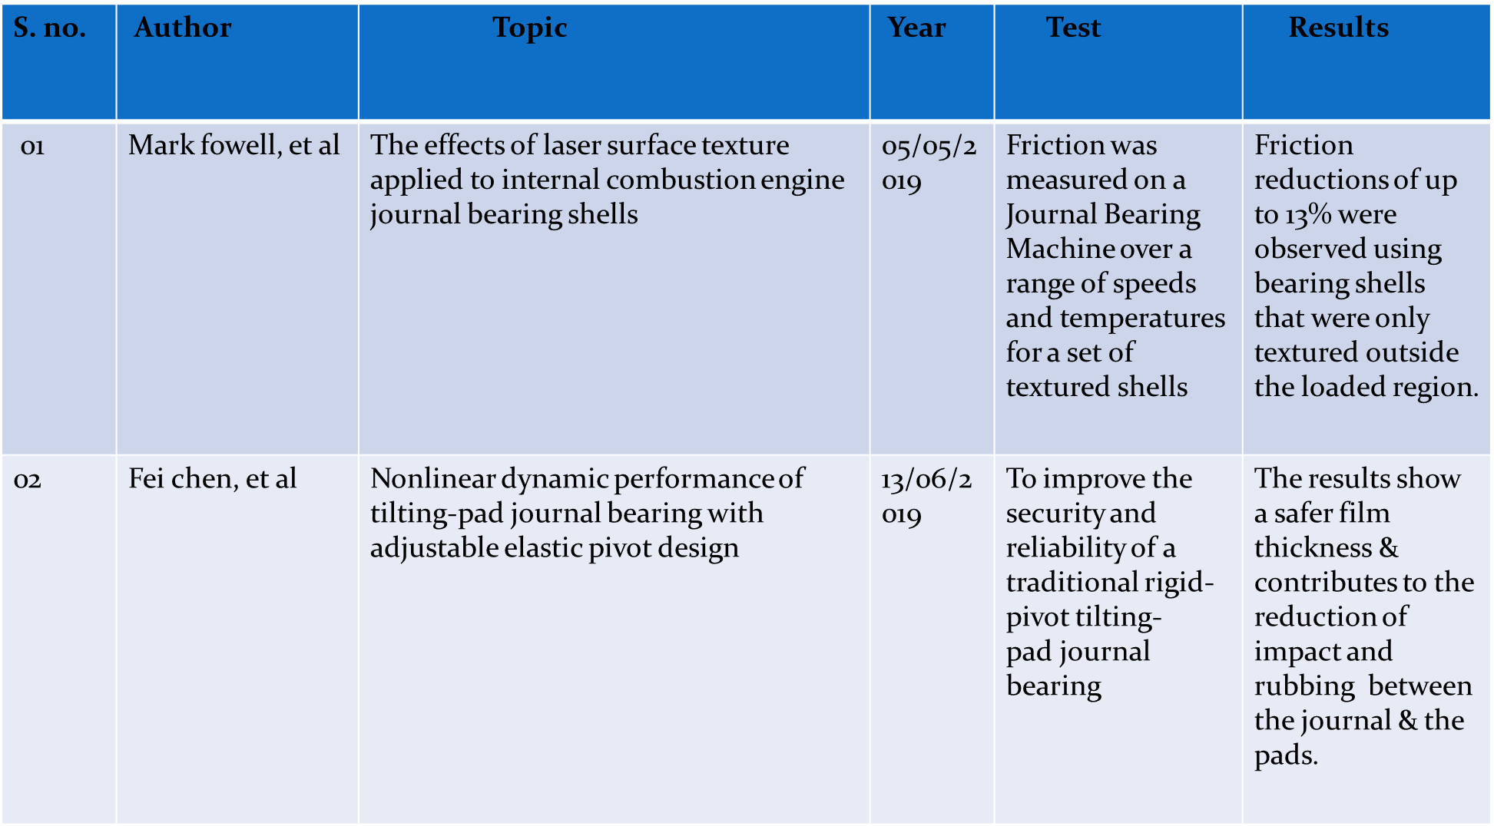
Literature Survey.

Slide 6
Research Gap
It is evident from the literature review that a few literature is available to study the tribological behavior laser textured Al alloy for bearing application.
The growing emphasis on development of high performance , low cost readily available of material for engineering application.
Therefore, it is of interest to study the effect of texturing on friction and wear behavior of Al alloy.

Slide 7
Objective
Material used Aluminum Silicon (Al-Si) alloy.
Laser texturing of two shapes (circular & square).
Tribological test under Lubrication condition.
Validation.

Slide 8
Methodology

Slide 9
Procurement and Cutting
Al-Si alloy and Steel ball were used for every test performed.
Al-Si alloy and Steel ball materials procured from Nano Shells
Al-Si alloy procured inside the shape of rod of 30mm diameter.
Rod is then cut into discs of size 30mm x 8mm.

Slide 10
Moulding
Moulding is the process of manufacturing by shaping liquid or pliable raw material using a rigid frame called a mold or matrix. Moduling done in our case is shown in table below.
S. NO. | SAMPLES | TEMPERATURE | HEATING TIME (min) | MATERIAL USED (scoops)
1 | SAMPLE 1 | 168°C | 10 | 1
2 | SAMPLE 2 | 168°C | 10 | 1
3 | SAMPLE 3 | 160°C | 10 | 1
4 | SAMPLE 4 | 160° C | 10 | 1

Slide 11
Polishing
Finishing was done with the aid of Manual and Machine grinder by using different grit sizes. After initial flattening using coarsest diamond grades further polishing was done using diamond paste (1µm & 0.25µm). Finally samples are wiped in digital ultrasonic purifier with acetone solution.
SAMPLES | GRIT SIZE (µm) | LUBRICANT | TIME (mins /sample)
1 | 400 | Water | 15
2 | 800 | water | 10
3 | 1000 | Water | 15
4 | 2000 | Water | 20

Slide 12
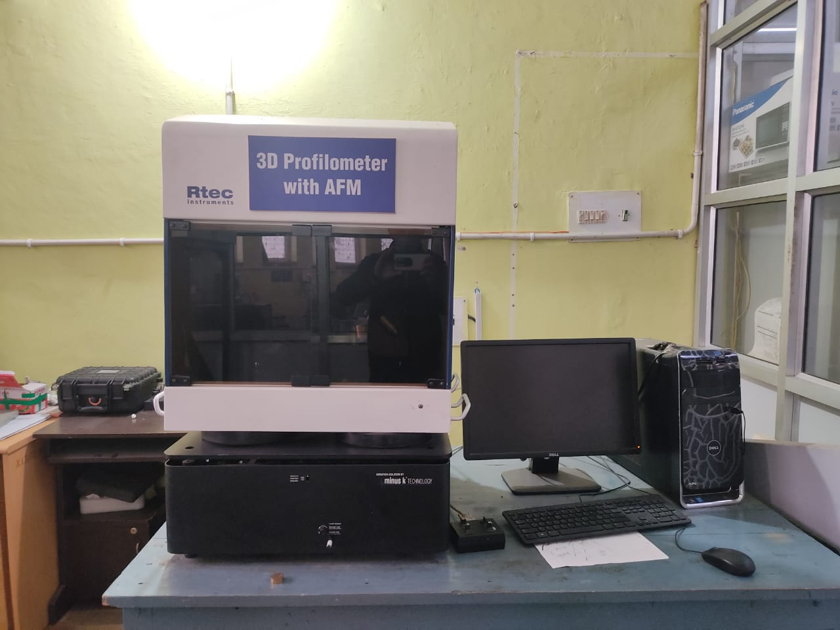
3-D Profilometer
3-D Optical profilometry utilizes light rather than a physical test. The significant thing segment to this methodology is coordinating the mellow in a way that it can unearth the surface in 3-D. Models incorporate optical obstructions, the use of a confocal gap, awareness and the fragment recognition, and anticipating an example onto the optical picture.

Slide 13
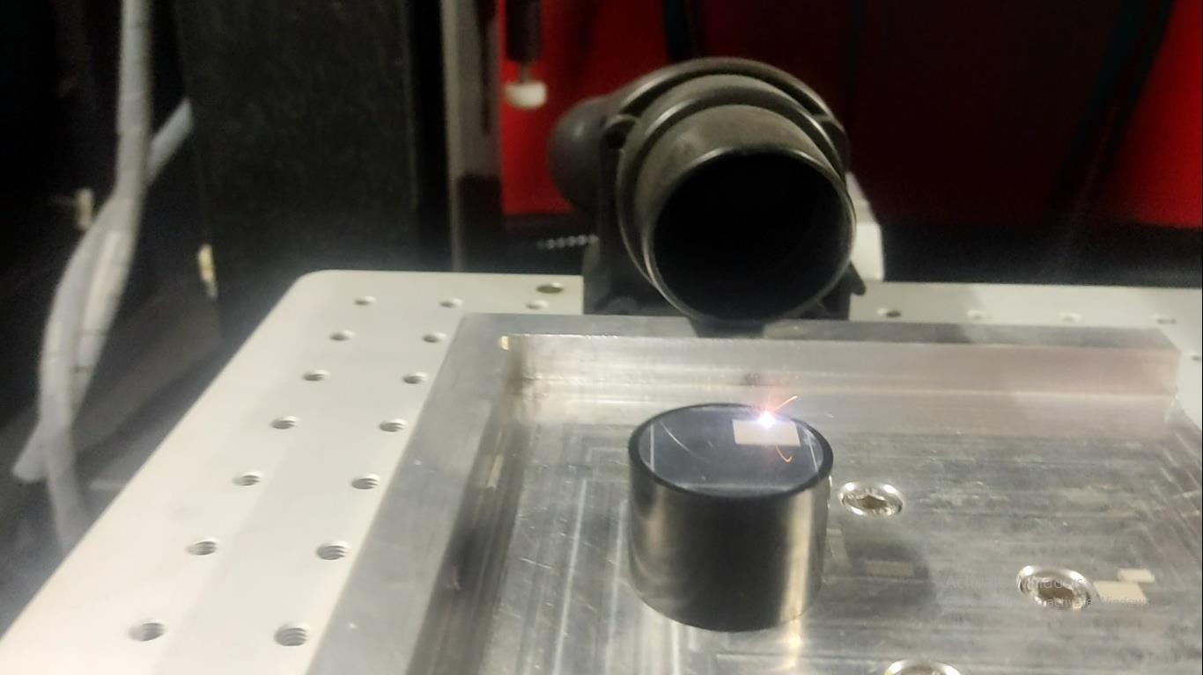
Laser Surface Texturing
LST was accomplished on the surface of Al-Si using a double frequency laser beam of 532µm wavelength. The Laser operation was done in the pulse mode using a pulse width of 2.5µs & at 25KHz frequency. Laser beam uses an objective lens to focus the sample surface and a set of deflection mirrors to scan over the surface of the sample. Dimples were generated by the laser on the polished sample surface.

Slide 14
Results

Slide 15
Surface Roughness
Surface roughness, often shortened to roughness, is a component of surface texture It is quantified by the deviations in the direction of the normal vector of a real surface from its ideal form. If these deviations are large, the surface is rough; if they are small, the surface is smooth. Fig 1 shows the 3D roughness image of the Al-Si alloy after polishing.

Slide 16
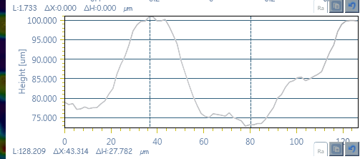
Laser Texturing (Square)

Slide 17
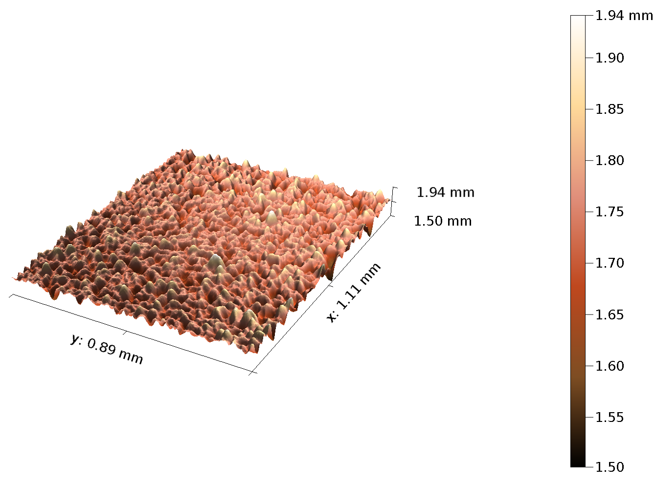
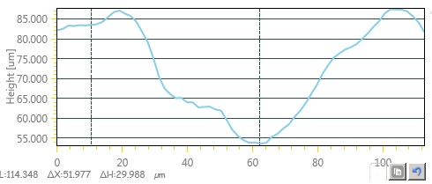
Laser Texturing (Circular)

Slide 18
Tribological Tests

Slide 19
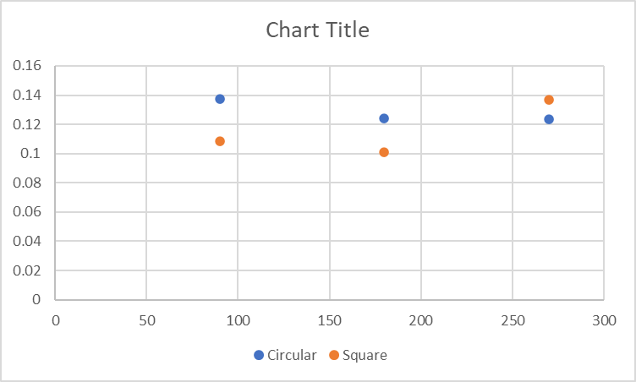
Coefficient of Friction
Coefficient of friction is the ratio of the frictional force resisting the motion of two surfaces in contact to the normal force pressing the two surfaces together. It is usually symbolized by the Greek letter mu (μ). Mathematically, μ = F/N, where F is the frictional force and N is the normal force.

Slide 20
Mathematical Analysis of Wear Rate (Circular)
Wear Volume
S₂ 90 = 2.251374 x 10⁻¹ mm³
S₂ 180 = 2.161120 x 10⁻¹ mm³
S₂ 270 = 1.959747 x 10⁻¹ mm³
Wear Rate
S₂ 90 = 2.251374 x 10⁻¹ mm³/ 5 x 90 = 5.003 x 10⁻⁴ mm³/Nm
S₂ 180 = 2.161120 x 10⁻¹ mm³/5 x 180 = 2.401 x 10⁻⁴ mm ³/ Nm
S₂ 270 = 1.959747 x 10⁻¹ mm³/ 5 x 270 = 0.132 x 10⁻⁴ mm ³/ Nm

Slide 21
Mathematical Analysis of Wear Rate (Square)
Wear Volume
S₁ 90 = 2.363765 x 10⁻¹ mm³
S₁ 180 = 2.332437 x 10⁻¹ mm³
S₁ 270 = 2.266151 x 10⁻¹ mm³
Wear Rate
S₁ 90 = 2.363765 x 10⁻¹ mm³/ 5 x 90 = 5.253 x 10⁻⁴ mm³/Nm
S₁ 180 = 2.332437 x 10⁻¹ mm³/5 x 180 = 2.592 x 10⁻⁴ mm ³/ Nm
S₁ 270 = 2.266151 x 10⁻¹ mm³/ 5 x 270 = 1.679 x 10⁻⁴ mm ³/ Nm

Slide 22
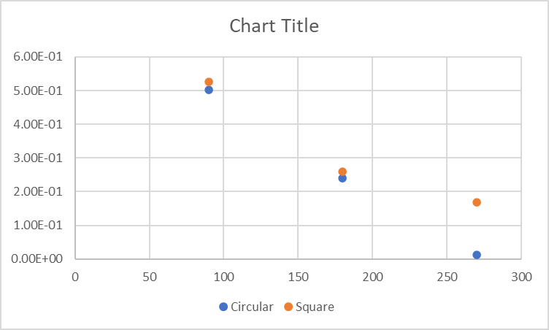
Wear Rate

Slide 23
Results Tribology Testing (Square)
Figure 11: 2D view of wear scar
Figure 12: 3D view of wear scar

Slide 24
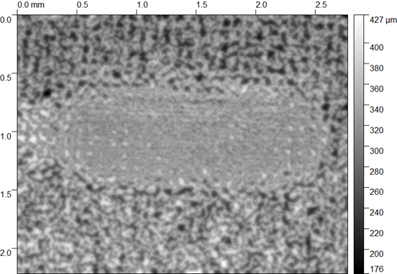
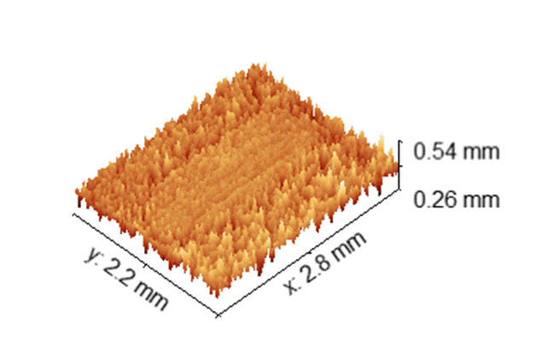
Results Tribology Testing (Circular)
Figure 11: 2D view of wear scar
Figure 12: 3D view of wear scar

Slide 25
Conclusion
It has been seen that the properties of Al-Si alloy improves after texturing the surface.
The coefficient of friction in sample having square pits is first decreasing then abruptly increasing and in sample having circular pits it is decreasing.
While performing the tribological tests, we observed that the wear rate in both the samples is decreasing, whereas, is decreasing more in sample having circular pits.

Slide 26
References
Kittel, C., McEuen, P., &McEuen, P. (1996). Introduction to solid state physics (Vol. 8, pp. 105-130). New York: Wiley.
Yeo, C. Y., Tam, S. C., Jana, S., & Lau, M. W. (1994). A technical review of the laser drilling of aerospace materials. Journal of materials processing technology, 42(1), 15-49.
Semaltianos, N. G., Perrie, W., French, P., Sharp, M., Dearden, G., Logothetidis, S., & Watkins, K. G. (2009). Femtosecond laser ablation characteristics of aluminium. Applied Physics A, 94(4), 999-1009.
Jee, Y., Becker, M. F., & Walser, R. M. (1988). Laser-induced damage on single-crystal metal surfaces. JOSA B, 5(3), 648-659.
R. Sehgal, Experimental measurement of oil film temperatures of elliptical journal bearing profile using different grade oils, Tribology online 5 (6) (2010) 291–299.
A. Chauhan, R. Sehgal, An experimental determination of temperature profile in an offset-halves journal bearing with different oils, Tribology Online 2 (3) (2007) 83–88.
A. Chauhan, R. Sehgal, R.K. Sharma, Investigations on the thermal effects in non-circular journal bearings, Tribol. Int. 44 (12) (2011) 1765–1773.

Slide 27

Thank You

