Slide 1


A GPU Algorithm for Detecting
Strongly Connected Components
Ghadeer Alabandi^{TXST}, William Sands^{UTA},
George Biros^{UTA}, and Martin Burtscher^{TXST}

Slide 2
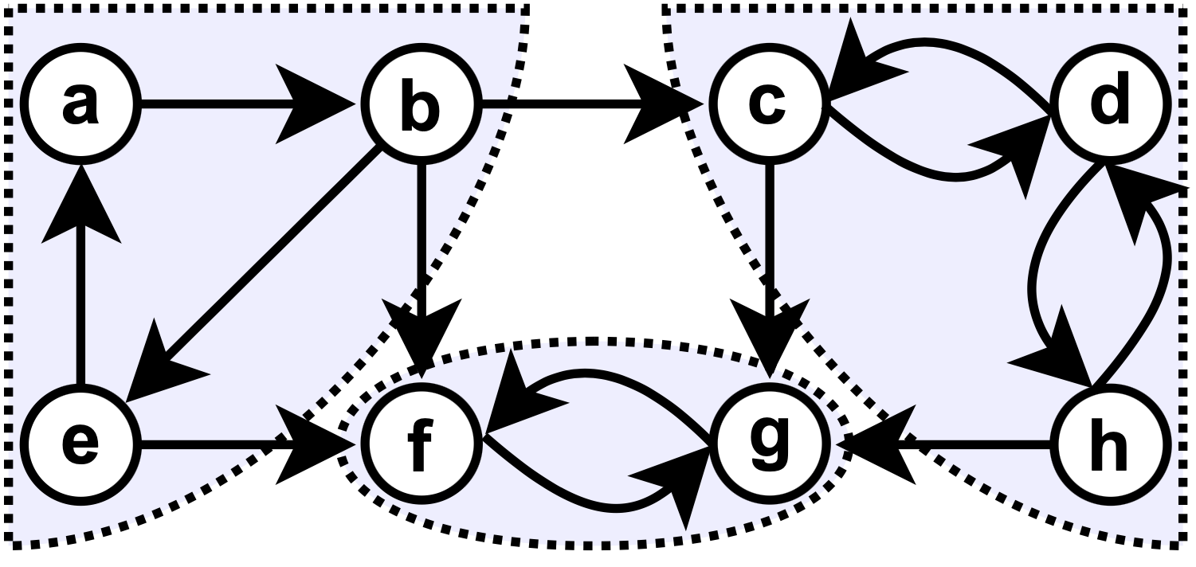
Strongly Connected Components (SCC)
SCC of directed graph 𝐺 = (𝑉, 𝐸)
  Maximal subset 𝑆 of vertices
  that can reach each other
General SCC properties
  Every vertex belongs to exactly one SCC
  Contracting each SCC into a single vertex
  turns 𝐺 into a Directed Acyclic Graph (DAG)
Finding SCCs is key building block in many apps
Obtained form wikipedia

Slide 3
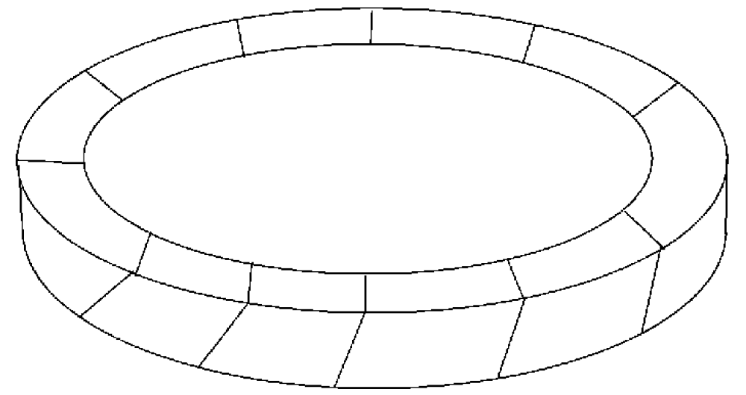
SCC Detection in Sweep-based Solvers
Sweep solvers for thermal radiation transfer
  Sweep over domain in multiple directions Ω
  Each direction induces a directed graph
Cycles in induced graphs
  Can lead to accuracy and livelock issues
SCC identification
  Critical first step in some sweeping algorithms
  Needs to be performed for each sweep direction
Ω
Plimpton et al. 2005

Slide 4

Highlights of our ECL-SCC Algorithm
Parallelism and GPU friendly
New algorithm based on innovative techniques
  Maximum vertex-ID propagation
  Edge removal
ECL-SCC running on an A100 GPU
  Outperforms fastest GPU code by 6.5× on mesh graphs
  Outperforms fastest GPU code on power-law graphs
  Outperforms fastest serial and parallel CPU code

Slide 5
Prior Algorithms

Slide 6

Tarjan’s Serial Algorithm
Well-known sequential approach for detecting SCCs
Runs in linear time in the number of edges and vertices of 𝐺
  Very fast in practice
Based on depth-first search
  Prevents efficient parallelization

Slide 7
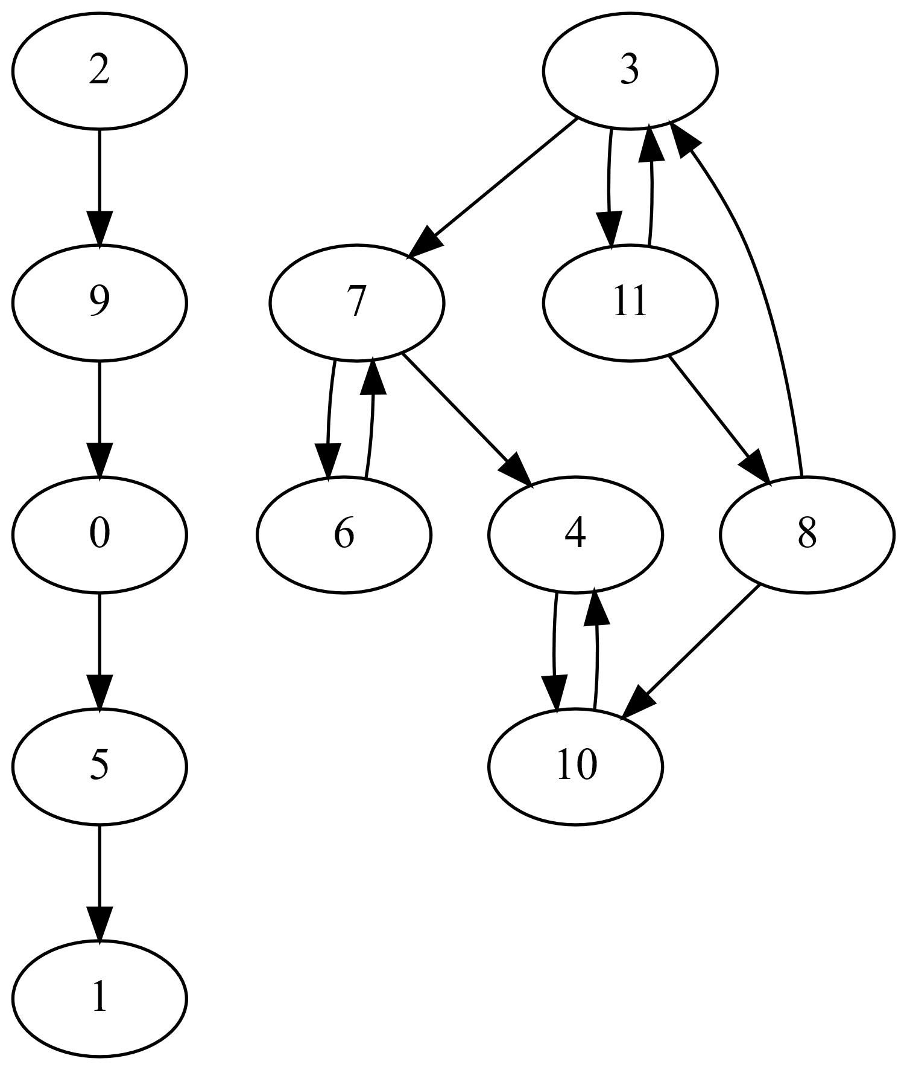
Parallel Forward-Backward Algorithm
Leading parallel SCC algorithms are based on
Forward-Backward (FB) approach
  Randomly select a pivot vertex
  Perform parallel forward BFS
  Perform parallel backward BFS
  Result partitions graph into 4 subgraphs
    Vertices reached by both BFSs (green)
    Vertices only reached by fwd BFS (blue)
    Vertices only reached by bwd BFS (yellow)
    Vertices not reached by BFS (unshaded)
  First set (green) is done (SCC of pivot)
  Recurse on latter three sets
    Independent, can be done in parallel

Slide 8
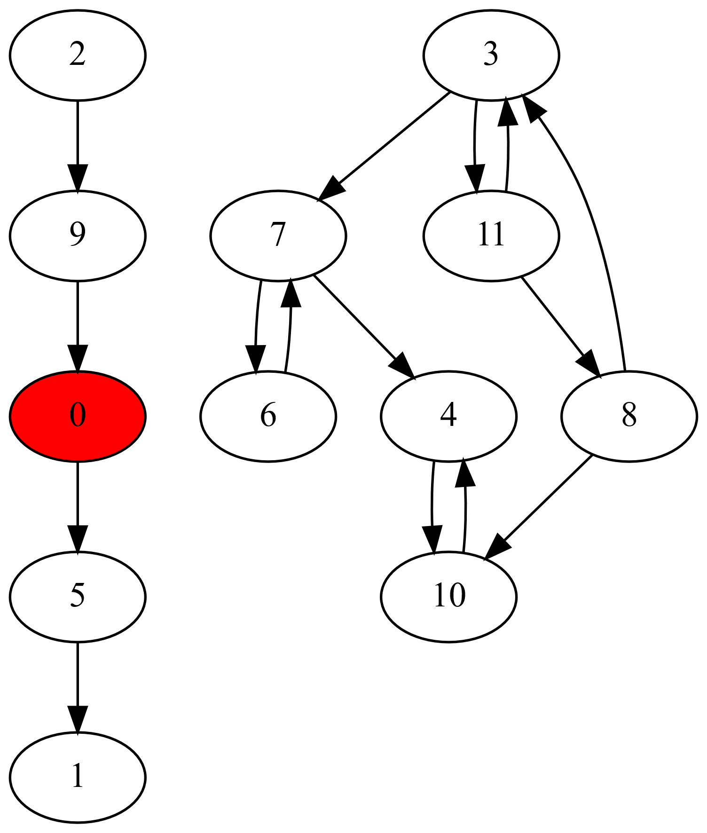
Parallel Forward-Backward Algorithm
Leading parallel SCC algorithms are based on
Forward-Backward (FB) approach
  Randomly select a pivot vertex
  Perform parallel forward BFS
  Perform parallel backward BFS
  Result partitions graph into 4 subgraphs
    Vertices reached by both BFSs (green)
    Vertices only reached by fwd BFS (blue)
    Vertices only reached by bwd BFS (yellow)
    Vertices not reached by BFS (unshaded)
  First set (green) is done (SCC of pivot)
  Recurse on latter three sets
    Independent, can be done in parallel

Slide 9
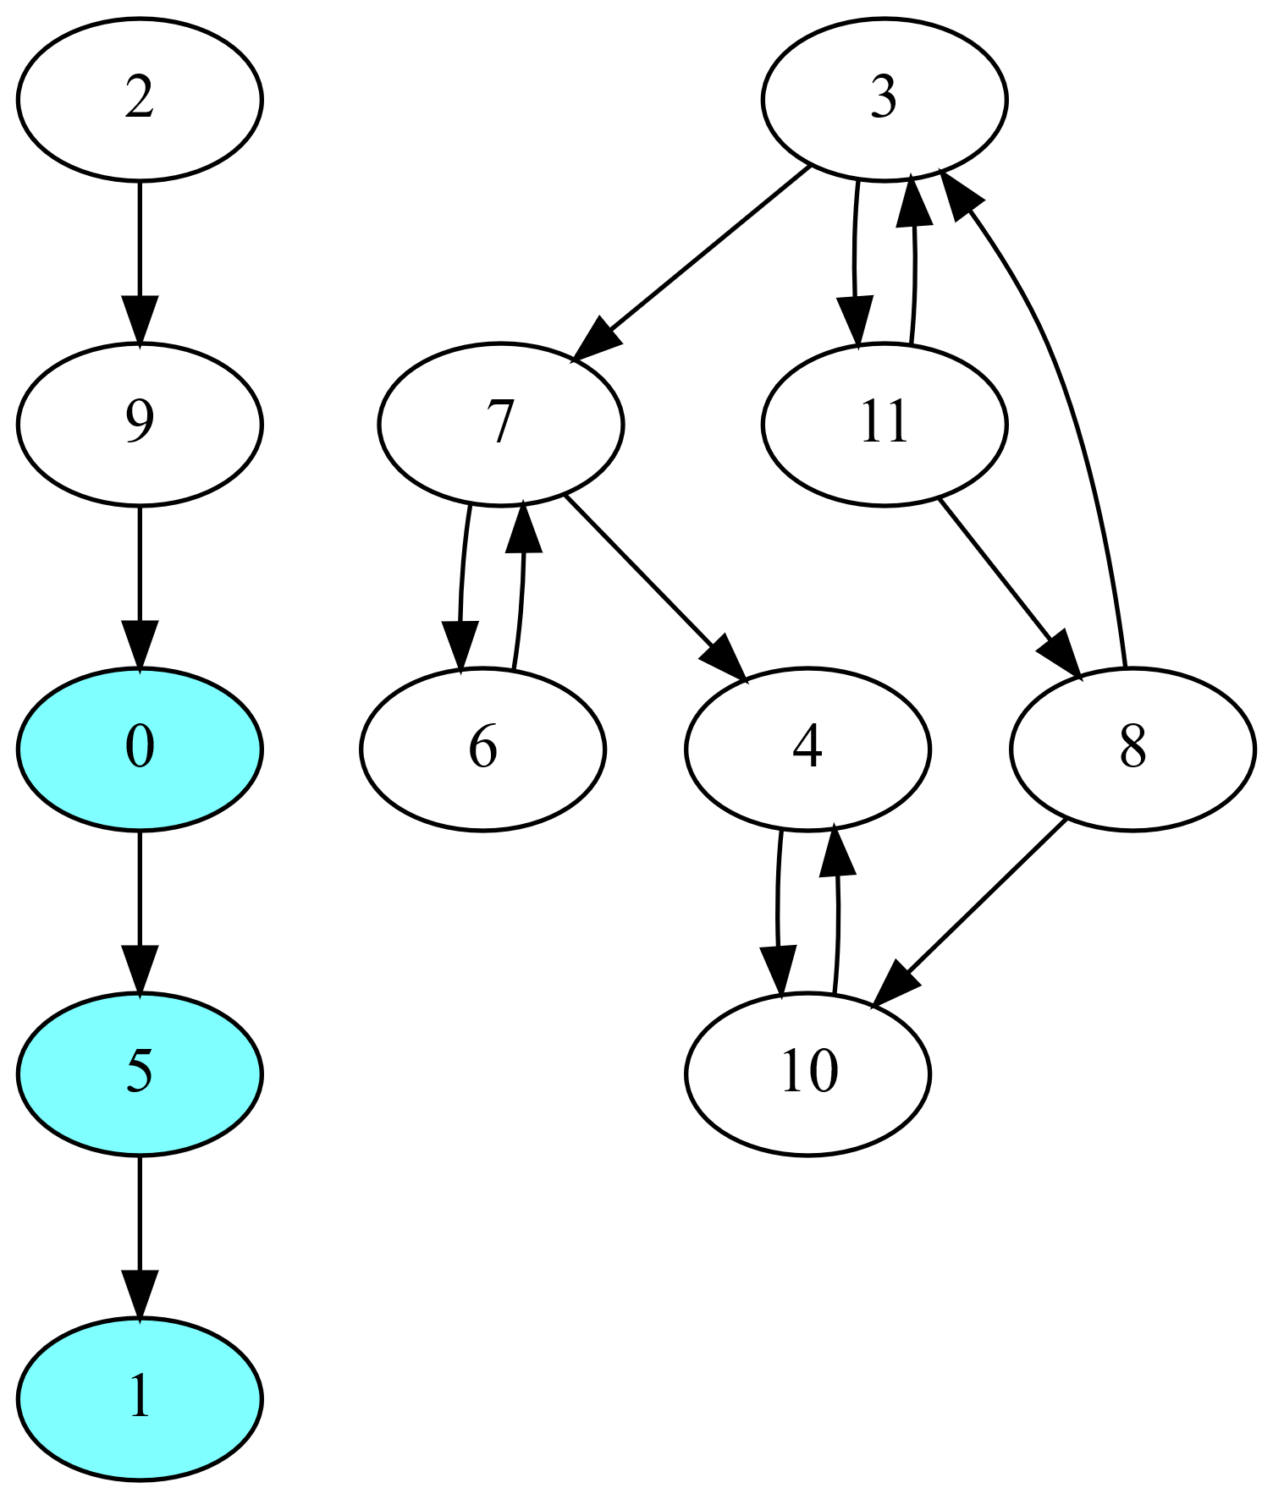
Parallel Forward-Backward Algorithm
Leading parallel SCC algorithms are based on
Forward-Backward (FB) approach
  Randomly select a pivot vertex
  Perform parallel forward BFS
  Perform parallel backward BFS
  Result partitions graph into 4 subgraphs
    Vertices reached by both BFSs (green)
    Vertices only reached by fwd BFS (blue)
    Vertices only reached by bwd BFS (yellow)
    Vertices not reached by BFS (unshaded)
  First set (green) is done (SCC of pivot)
  Recurse on latter three sets
    Independent, can be done in parallel

Slide 10
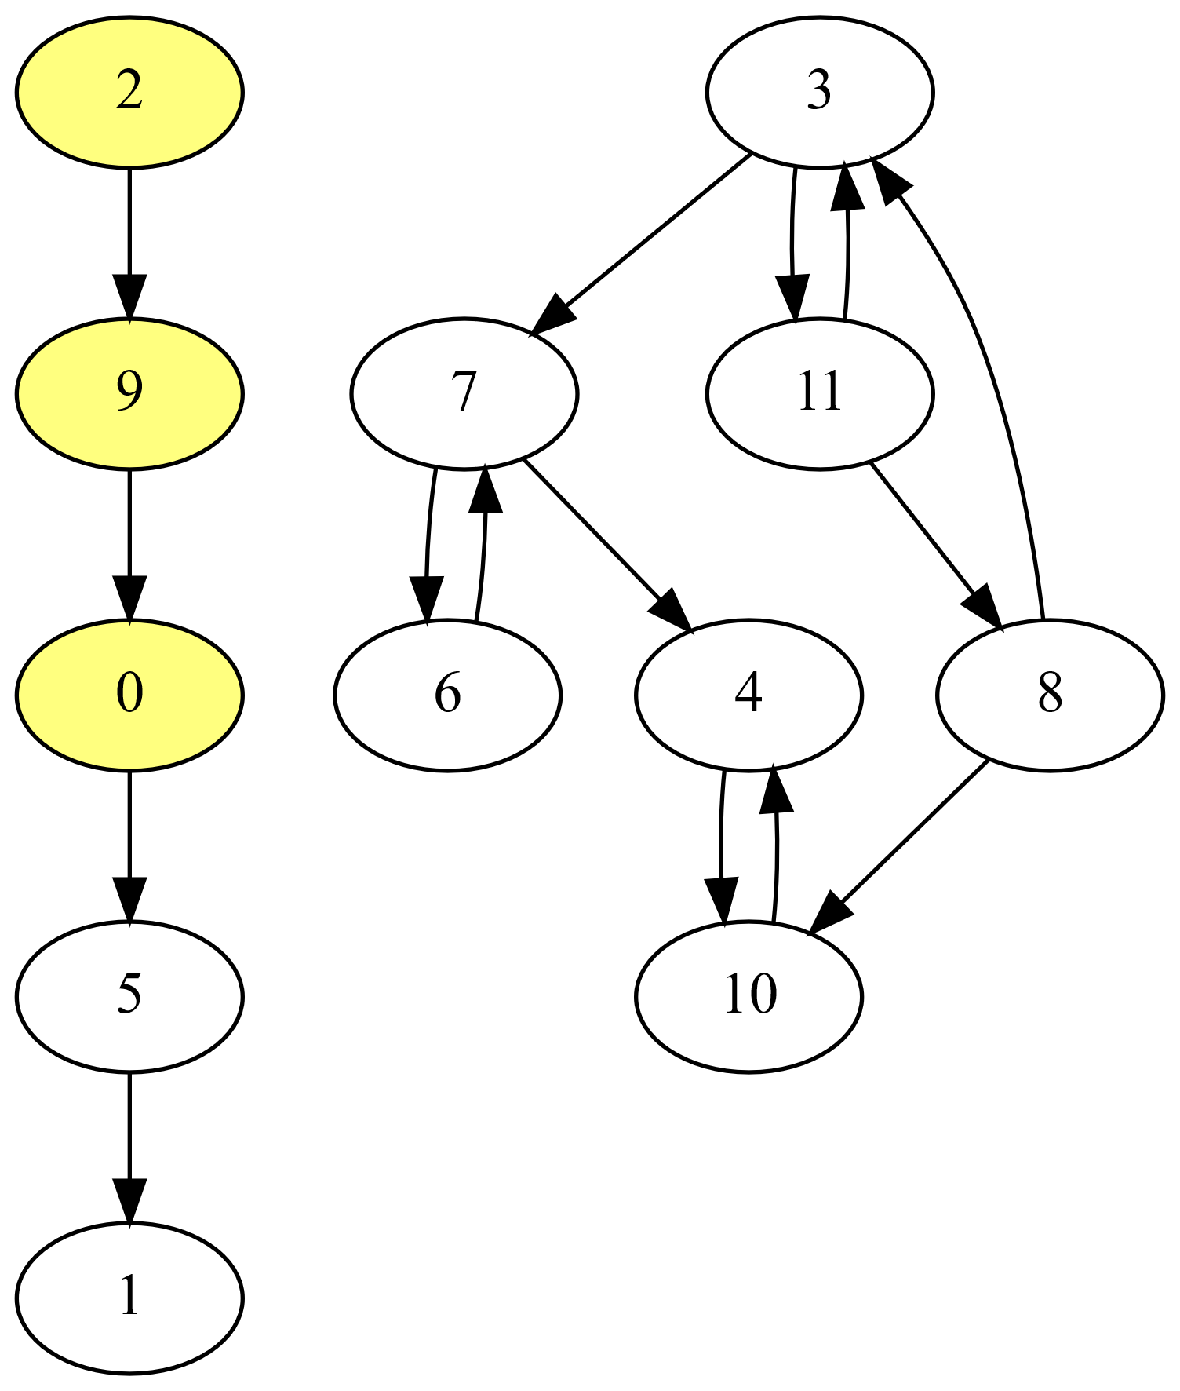
Parallel Forward-Backward Algorithm
Leading parallel SCC algorithms are based on
Forward-Backward (FB) approach
  Randomly select a pivot vertex
  Perform parallel forward BFS
  Perform parallel backward BFS
  Result partitions graph into 4 subgraphs
    Vertices reached by both BFSs (green)
    Vertices only reached by fwd BFS (blue)
    Vertices only reached by bwd BFS (yellow)
    Vertices not reached by BFS (unshaded)
  First set (green) is done (SCC of pivot)
  Recurse on latter three sets
    Independent, can be done in parallel

Slide 11
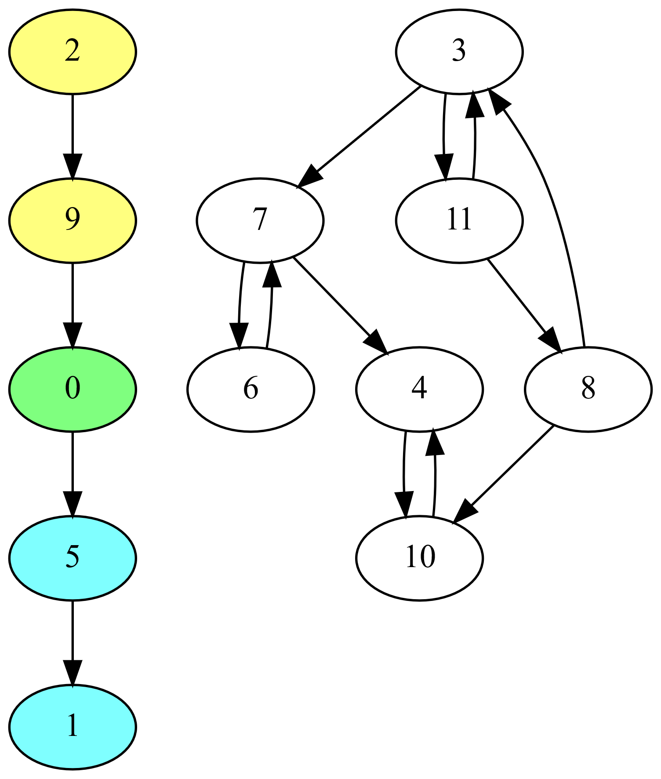
Parallel Forward-Backward Algorithm
Leading parallel SCC algorithms are based on
Forward-Backward (FB) approach
  Randomly select a pivot vertex
  Perform parallel forward BFS
  Perform parallel backward BFS
  Result partitions graph into 4 subgraphs
    Vertices reached by both BFSs (green)
    Vertices only reached by fwd BFS (blue)
    Vertices only reached by bwd BFS (yellow)
    Vertices not reached by BFS (unshaded)
  First set (green) is done (SCC of pivot)
  Recurse on latter three sets
    Independent, can be done in parallel

Slide 12
Parallel Forward-Backward Algorithm
Leading parallel SCC algorithms are based on
Forward-Backward (FB) approach
  Randomly select a pivot vertex
  Perform parallel forward BFS
  Perform parallel backward BFS
  Result partitions graph into 4 subgraphs
    Vertices reached by both BFSs (green)
    Vertices only reached by fwd BFS (blue)
    Vertices only reached by bwd BFS (yellow)
    Vertices not reached by BFS (unshaded)
  First set (green) is done (SCC of pivot)
  Recurse on latter three sets
    Independent, can be done in parallel

Slide 13
Parallel Forward-Backward Algorithm
Leading parallel SCC algorithms are based on
Forward-Backward (FB) approach
  Randomly select a pivot vertex
  Perform parallel forward BFS
  Perform parallel backward BFS
  Result partitions graph into 4 subgraphs
    Vertices reached by both BFSs (green)
    Vertices only reached by fwd BFS (blue)
    Vertices only reached by bwd BFS (yellow)
    Vertices not reached by BFS (unshaded)
  First set (green) is done (SCC of pivot)
  Recurse on latter three sets
    Independent, can be done in parallel

Slide 14
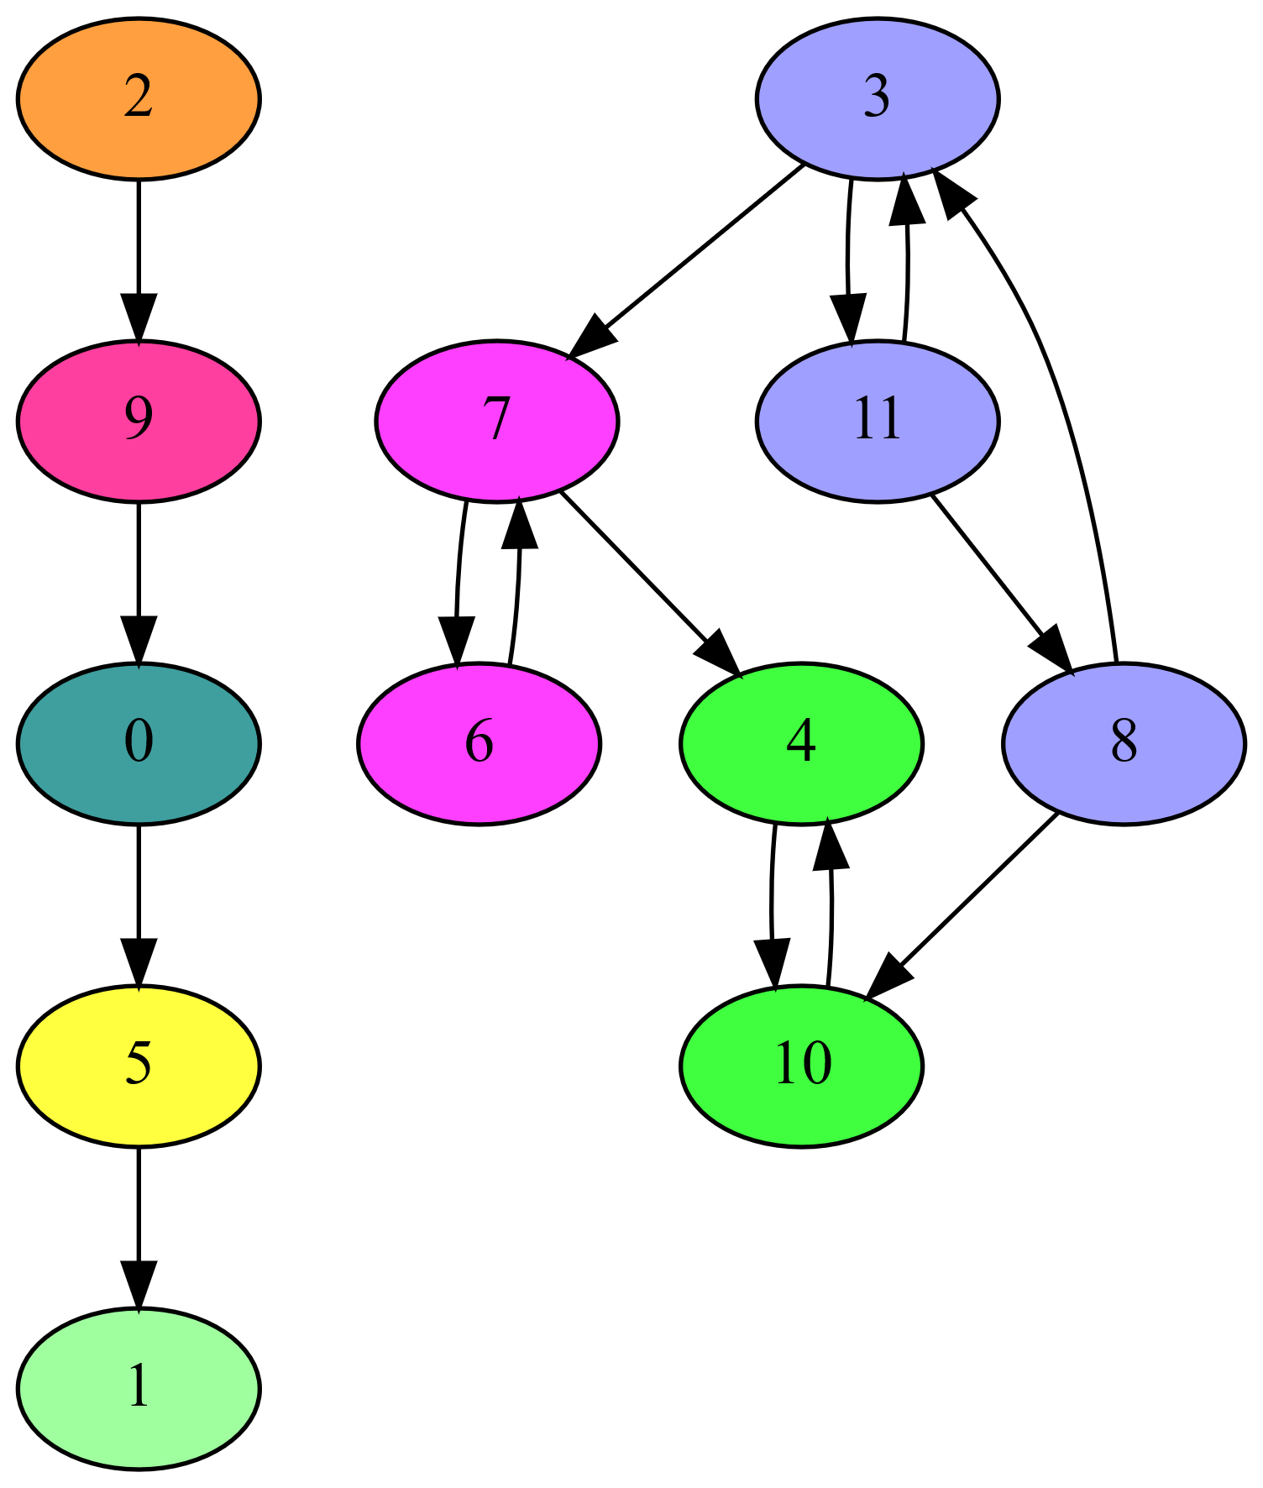
Parallel Forward-Backward Algorithm
Leading parallel SCC algorithms are based on
Forward-Backward (FB) approach
  Randomly select a pivot vertex
  Perform parallel forward BFS
  Perform parallel backward BFS
  Result partitions graph into 4 subgraphs
    Vertices reached by both BFSs (green)
    Vertices only reached by fwd BFS (blue)
    Vertices only reached by bwd BFS (yellow)
    Vertices not reached by BFS (unshaded)
  First set (green) is done (SCC of pivot)
  Recurse on latter three sets
    Independent, can be done in parallel

Slide 15
FB with Trim Optimizations
FB can be slow in presence of many small SCCs
Trim optimizations can help
Trim-1: detects some 1-vertex SCCs
  Vertex with no in- or no out-edges
Trim-2: detects some 2-vertex SCCs
  Any cyclically connected vertex pair
  with otherwise no in- or no out-edges
Trim-3: detects some 3-vertex SCCs
  Any cyclically connected vertex triple
  with otherwise no in- or no out-edges
  Detected based on a set of patterns
Trim steps may be iterated

Slide 16
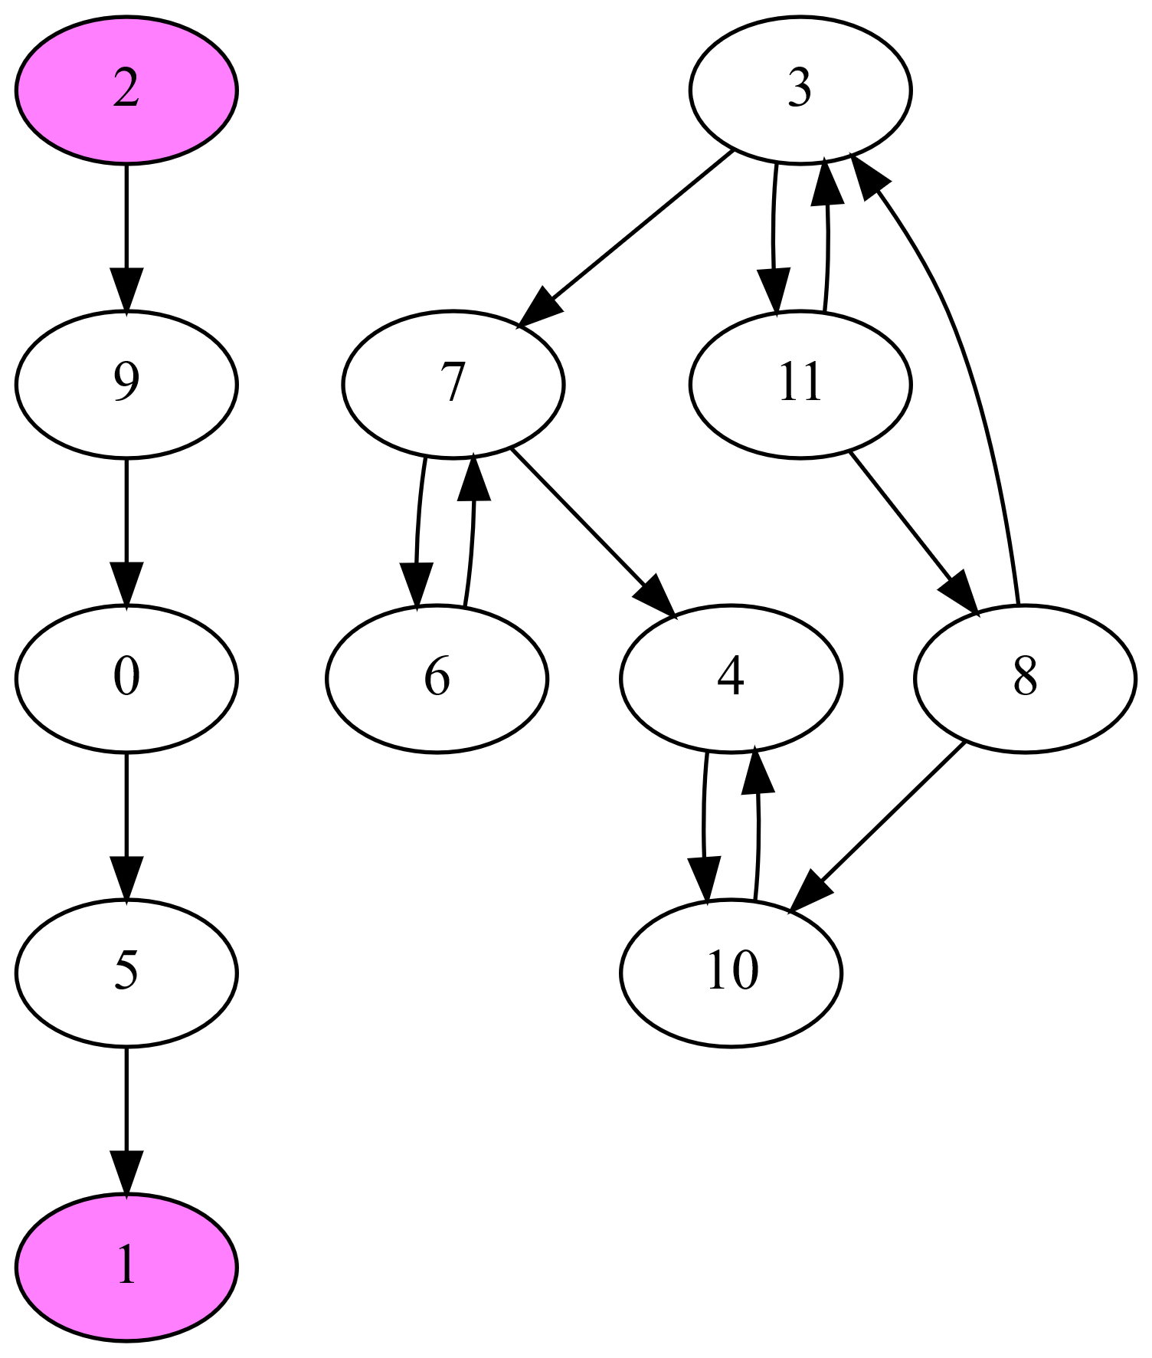
FB with Trim Optimizations
FB can be slow in presence of many small SCCs
Trim optimizations can help
Trim-1: detects some 1-vertex SCCs
  Vertex with no in- or no out-edges
Trim-2: detects some 2-vertex SCCs
  Any cyclically connected vertex pair
  with otherwise no in- or no out-edges
Trim-3: detects some 3-vertex SCCs
  Any cyclically connected vertex triple
  with otherwise no in- or no out-edges
  Detected based on a set of patterns
Trim steps may be iterated

Slide 17
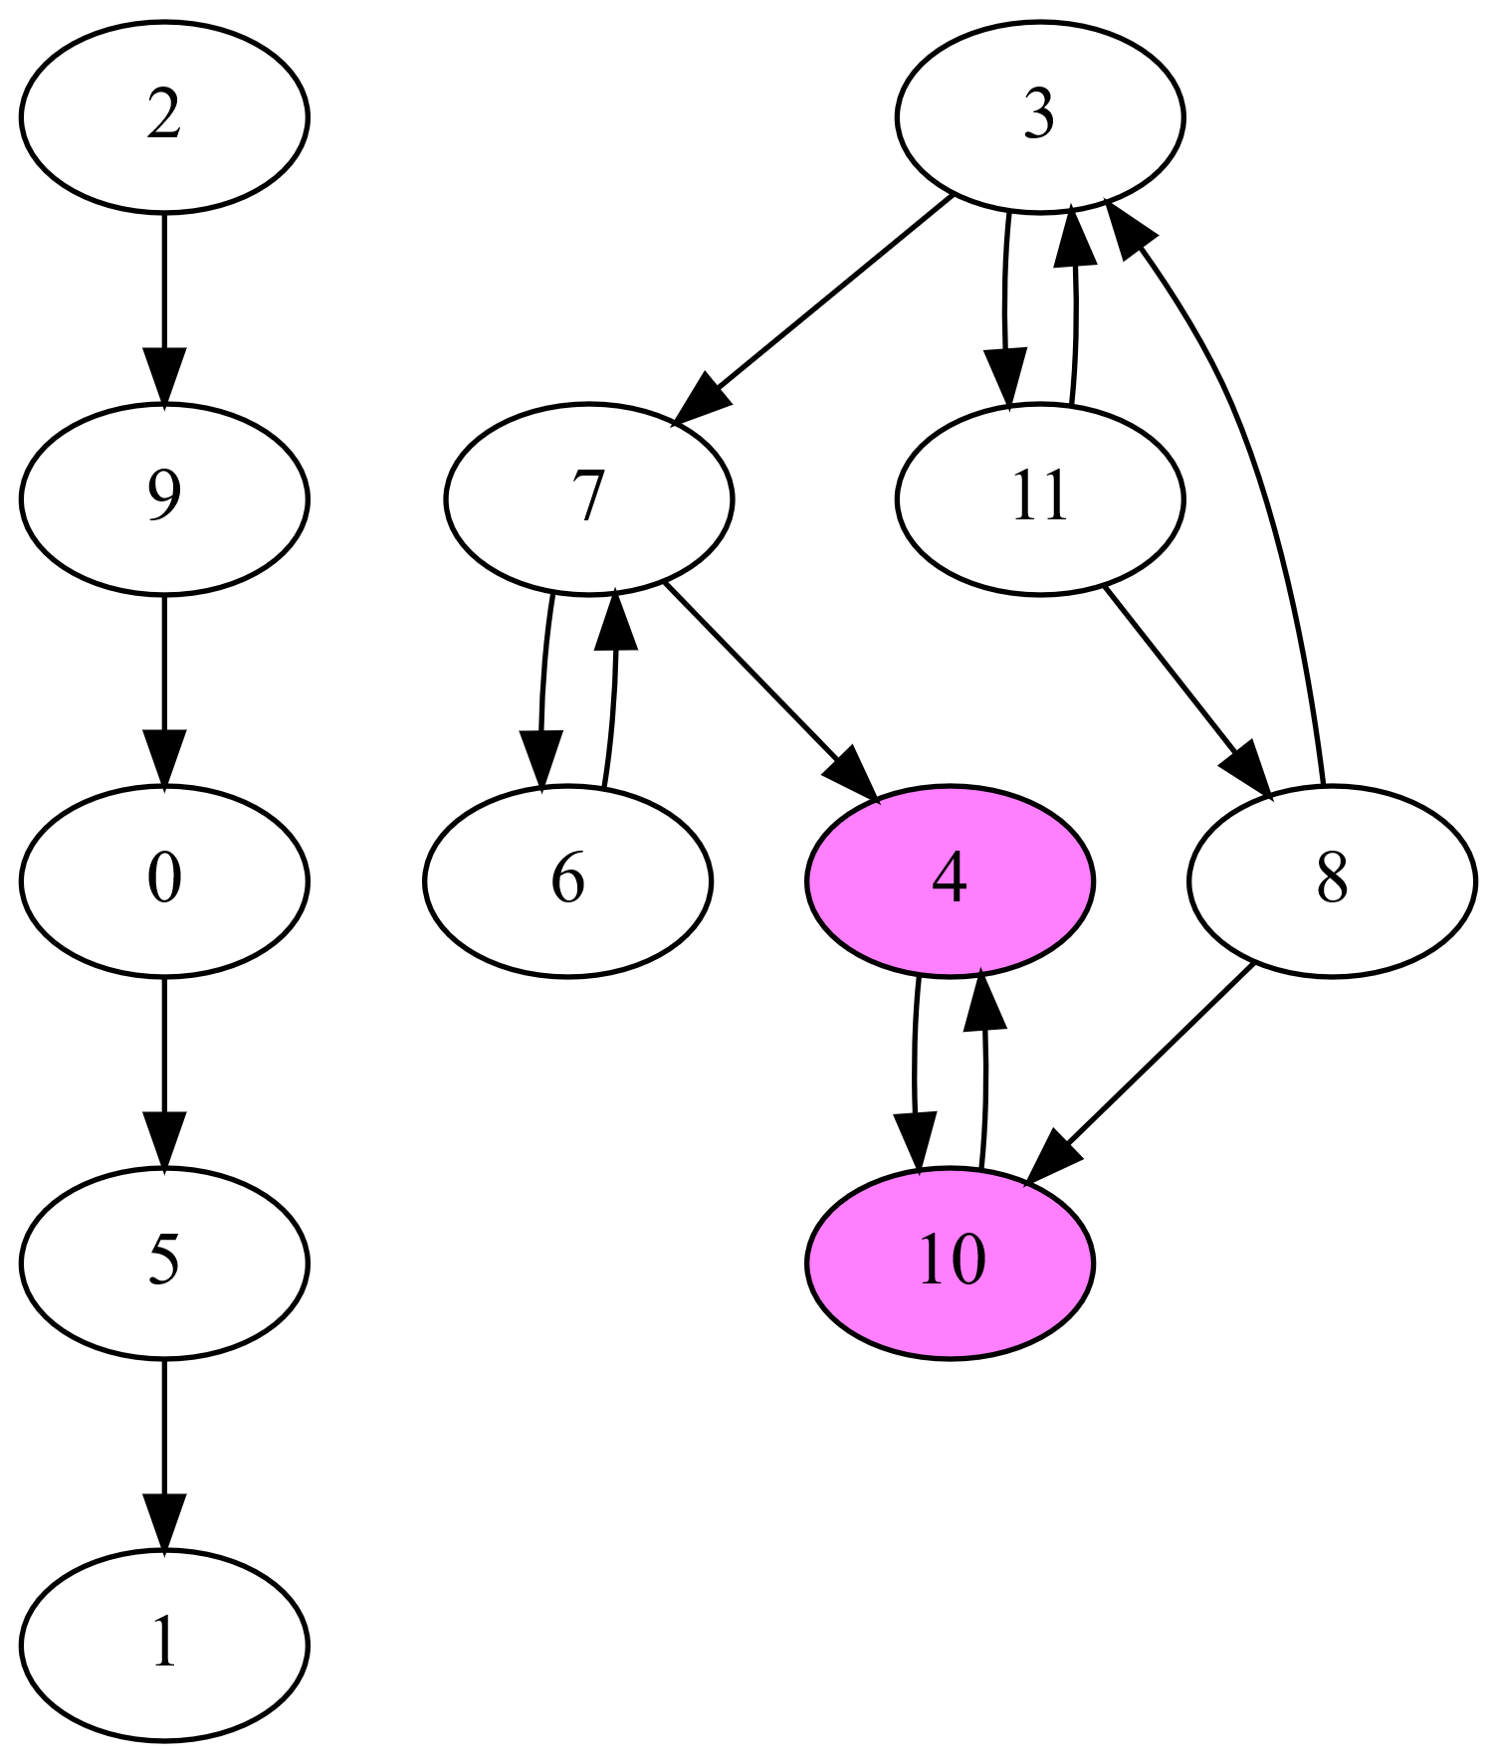
FB with Trim Optimizations
FB can be slow in presence of many small SCCs
Trim optimizations can help
Trim-1: detects some 1-vertex SCCs
  Vertex with no in- or no out-edges
Trim-2: detects some 2-vertex SCCs
  Any cyclically connected vertex pair
  with otherwise no in- or no out-edges
Trim-3: detects some 3-vertex SCCs
  Any cyclically connected vertex triple
  with otherwise no in- or no out-edges
  Detected based on a set of patterns
Trim steps may be iterated

Slide 18
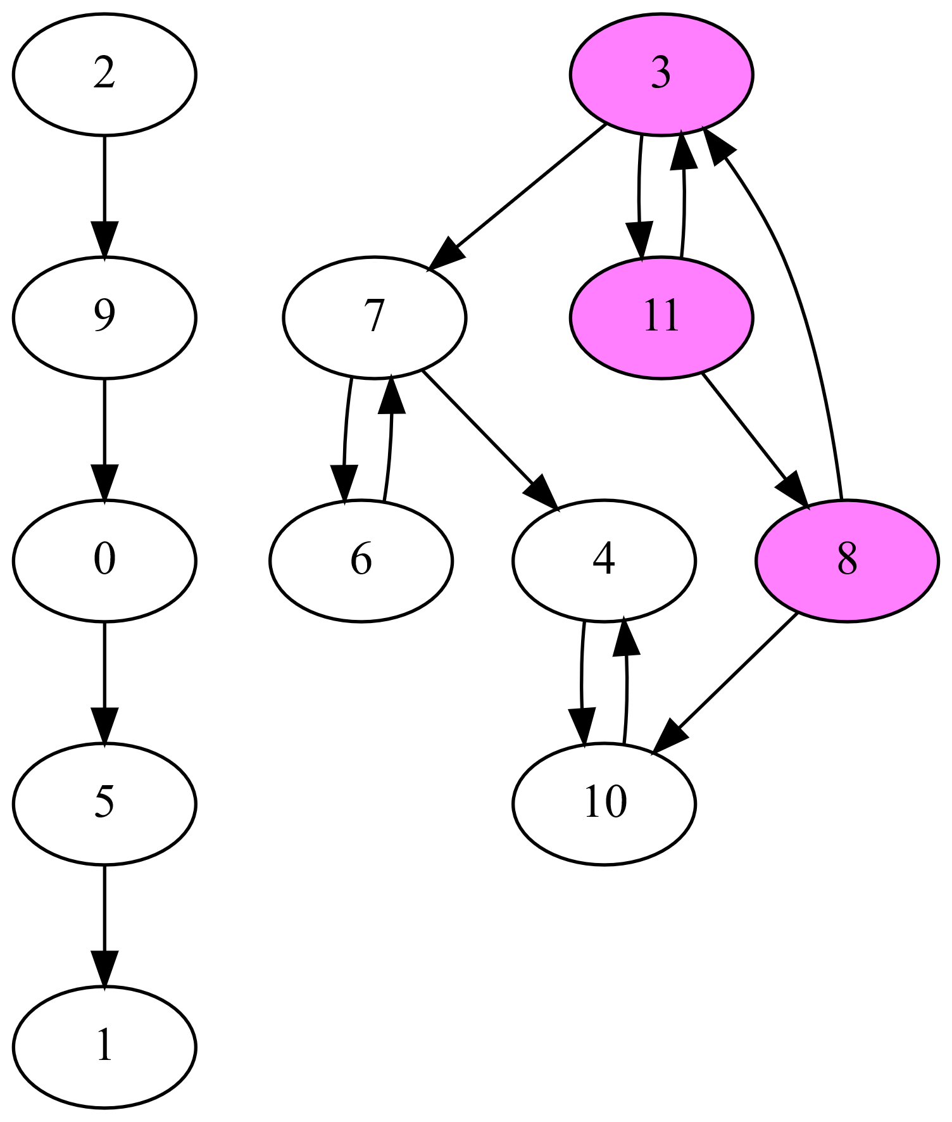
FB with Trim Optimizations
FB can be slow in presence of many small SCCs
Trim optimizations can help
Trim-1: detects some 1-vertex SCCs
  Vertex with no in- or no out-edges
Trim-2: detects some 2-vertex SCCs
  Any cyclically connected vertex pair
  with otherwise no in- or no out-edges
Trim-3: detects some 3-vertex SCCs
  Any cyclically connected vertex triple
  with otherwise no in- or no out-edges
  Detected based on a set of patterns
Trim steps may be iterated

Slide 19
FB with Trim Optimizations
FB can be slow in presence of many small SCCs
Trim optimizations can help
Trim-1: detects some 1-vertex SCCs
  Vertex with no in- or no out-edges
Trim-2: detects some 2-vertex SCCs
  Any cyclically connected vertex pair
  with otherwise no in- or no out-edges
Trim-3: detects some 3-vertex SCCs
  Any cyclically connected vertex triple
  with otherwise no in- or no out-edges
  Detected based on a set of patterns
Trim steps may be iterated

Slide 20

Problem
Many parallel SCC codes target power-law graphs
  Often have a few high-degree vertices
  Tend to have one large SCC and several small SCCs
  Have shallow DAG when collapsing the SCCs
Mesh graphs from thermal radiative transfer sims
  Have low-degree vertices
  Have variable numbers and sizes of SCCs
  Often have a deeper DAG when collapsing the SCCs
Prior parallel SCC codes are ineffective on meshes
  Often slower than serial code

Slide 21
Our ECL-SCC Algorithm

Slide 22
Our Parallel ECL-SCC Algorithm
Computes two signature values for each vertex
  𝑣_{𝑖𝑛}: max reachable vertex ID on incoming paths
  𝑣_{𝑜𝑢𝑡}: max reachable vertex ID on outgoing paths
Step 1: signature initialization
  Initializes signature values to vertex ID
Step 2: maximum-value propagation
  Updates signatures until fixed-point reached
    𝑣_{𝑖𝑛} = max of itself and 𝑣_{𝑖𝑛} of in-neighbors
    𝑣_{𝑜𝑢𝑡} = max of itself and 𝑣_{𝑜𝑢𝑡} of out-neighbors
Step 3: edge removal
  Delete edges between differing signatures
Repeat above steps until every vertex satisfies 𝑣_{𝑖𝑛} = 𝑣_{out}

Slide 23
Our Parallel ECL-SCC Algorithm
Computes two signature values for each vertex
  𝑣_{𝑖𝑛}: max reachable vertex ID on incoming paths
  𝑣_{𝑜𝑢𝑡}: max reachable vertex ID on outgoing paths
Step 1: signature initialization
  Initializes signature values to vertex ID
Step 2: maximum-value propagation
  Updates signatures until fixed-point reached
    𝑣_{𝑖𝑛} = max of itself and 𝑣_{𝑖𝑛} of in-neighbors
    𝑣_{𝑜𝑢𝑡} = max of itself and 𝑣_{𝑜𝑢𝑡} of out-neighbors
Step 3: edge removal
  Delete edges between differing signatures
Repeat above steps until every vertex satisfies 𝑣_{𝑖𝑛} = 𝑣_{out}

Slide 24
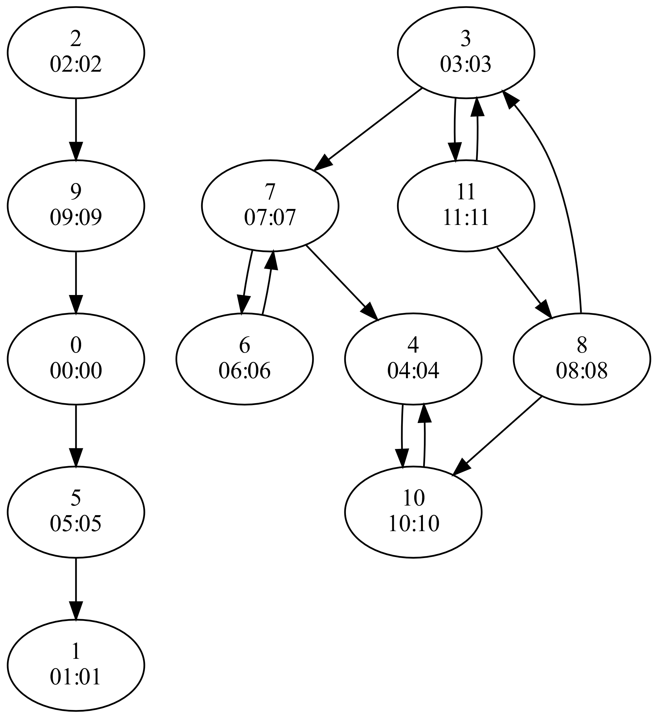
Our Parallel ECL-SCC Algorithm
Computes two signature values for each vertex
  𝑣_{𝑖𝑛}: max reachable vertex ID on incoming paths
  𝑣_{𝑜𝑢𝑡}: max reachable vertex ID on outgoing paths
Step 1: signature initialization
  Initializes signature values to vertex ID
Step 2: maximum-value propagation
  Updates signatures until fixed-point reached
    𝑣_{𝑖𝑛} = max of itself and 𝑣_{𝑖𝑛} of in-neighbors
    𝑣_{𝑜𝑢𝑡} = max of itself and 𝑣_{𝑜𝑢𝑡} of out-neighbors
Step 3: edge removal
  Delete edges between differing signatures
Repeat above steps until every vertex satisfies 𝑣_{𝑖𝑛} = 𝑣_{out}

Slide 25
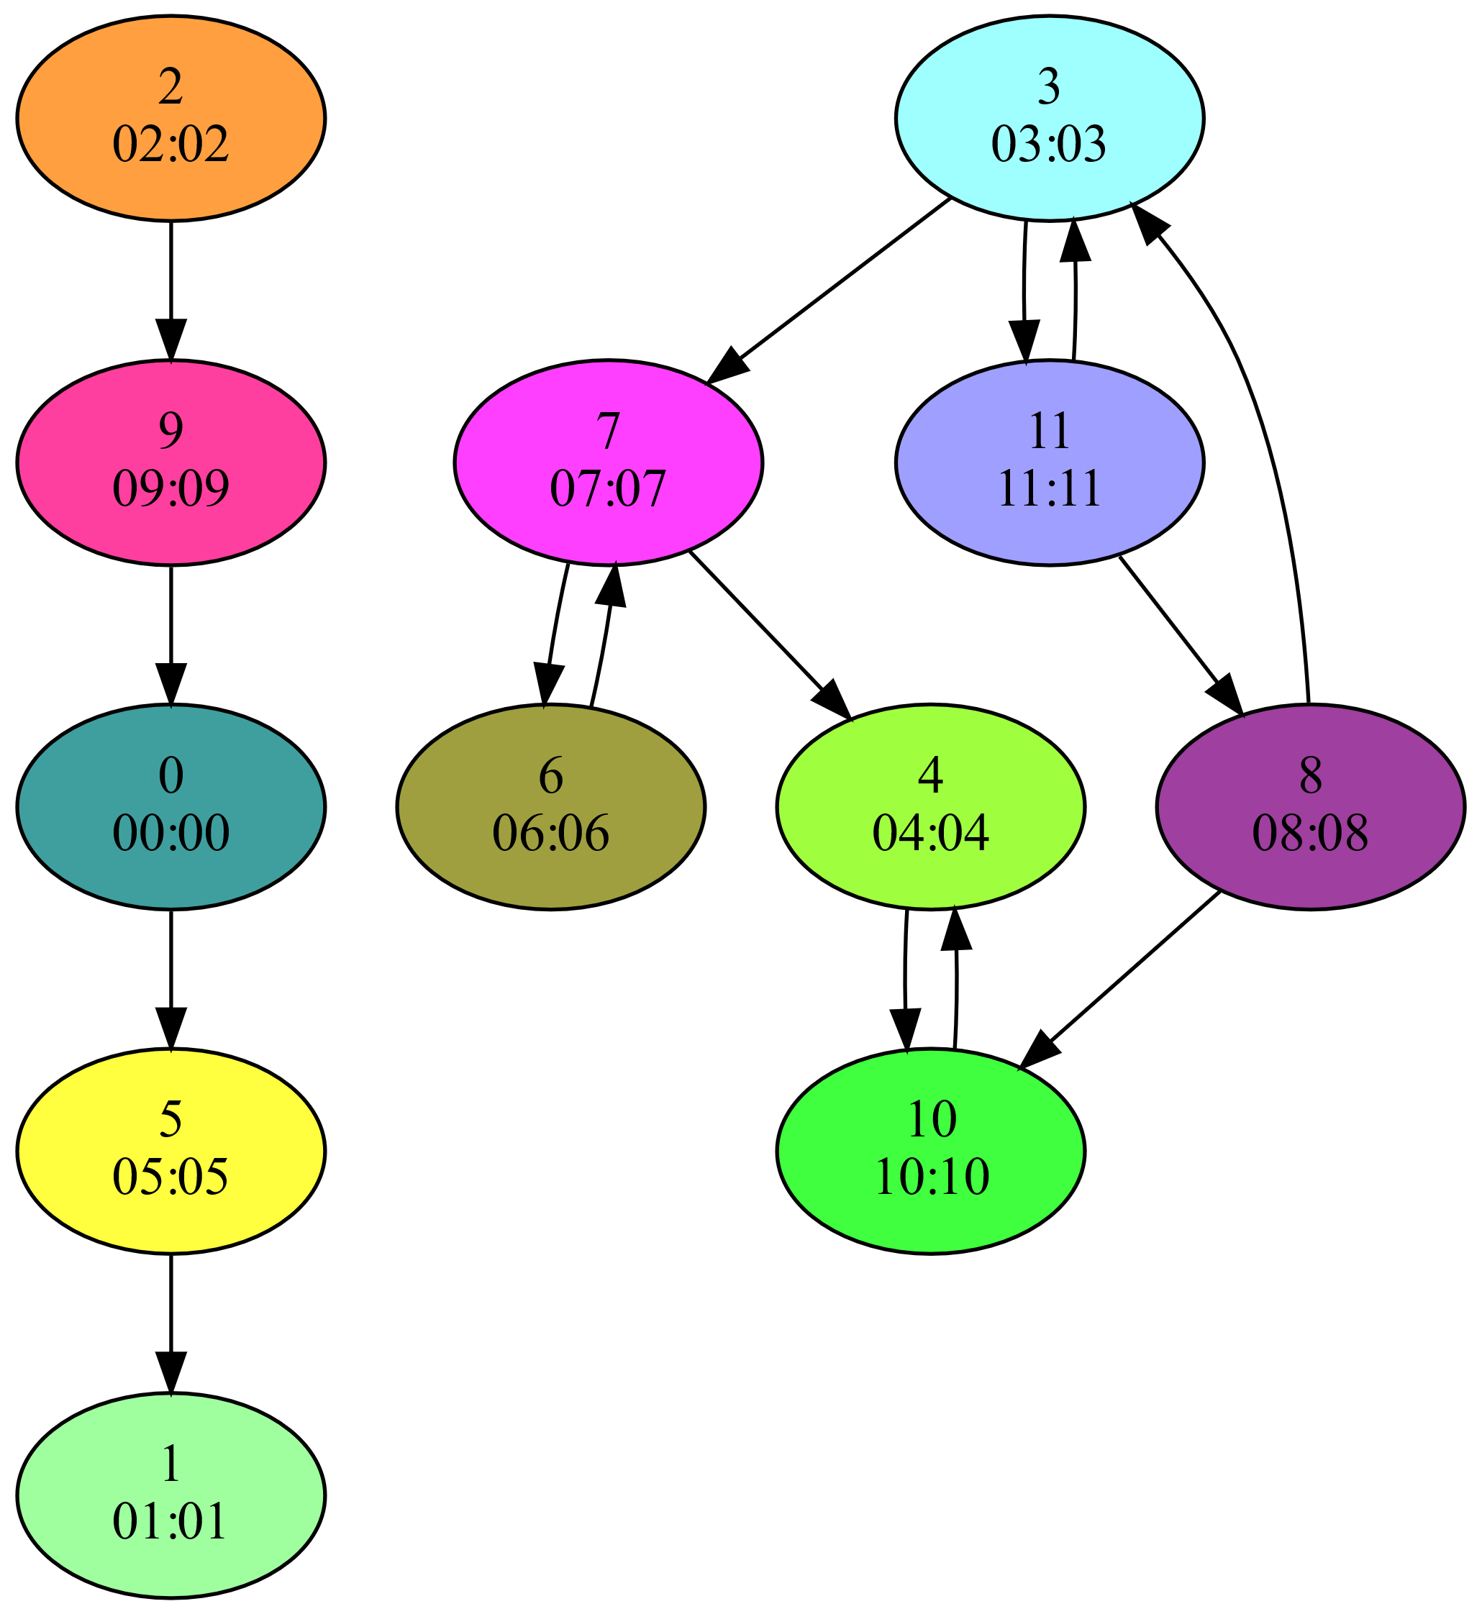
Our Parallel ECL-SCC Algorithm
Computes two signature values for each vertex
  𝑣_{𝑖𝑛}: max reachable vertex ID on incoming paths
  𝑣_{𝑜𝑢𝑡}: max reachable vertex ID on outgoing paths
Step 1: signature initialization
  Initializes signature values to vertex ID
Step 2: maximum-value propagation
  Updates signatures until fixed-point reached
    𝑣_{𝑖𝑛} = max of itself and 𝑣_{𝑖𝑛} of in-neighbors
    𝑣_{𝑜𝑢𝑡} = max of itself and 𝑣_{𝑜𝑢𝑡} of out-neighbors
Step 3: edge removal
  Delete edges between differing signatures
Repeat above steps until every vertex satisfies 𝑣_{𝑖𝑛} = 𝑣_{out}

Slide 26
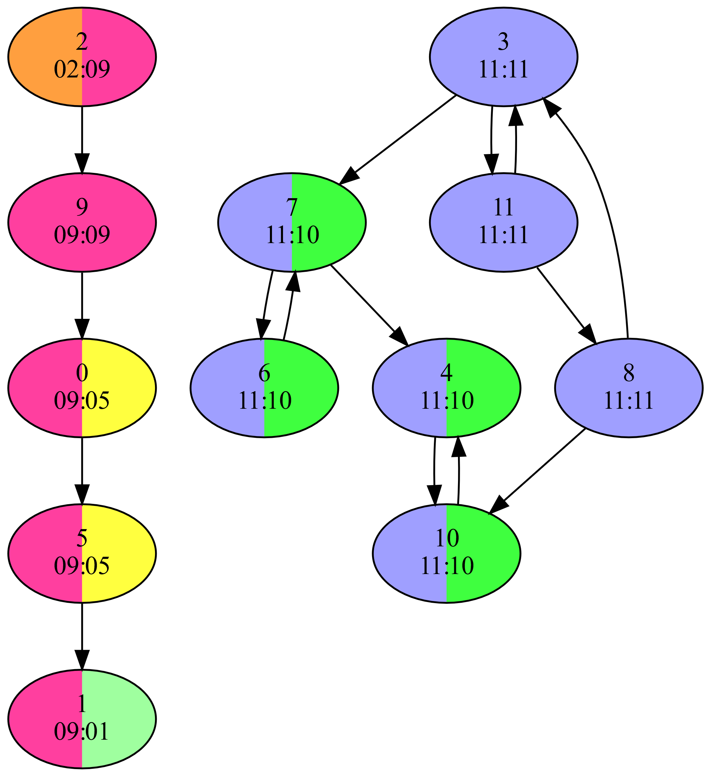
Our Parallel ECL-SCC Algorithm
Computes two signature values for each vertex
  𝑣_{𝑖𝑛}: max reachable vertex ID on incoming paths
  𝑣_{𝑜𝑢𝑡}: max reachable vertex ID on outgoing paths
Step 1: signature initialization
  Initializes signature values to vertex ID
Step 2: maximum-value propagation
  Updates signatures until fixed-point reached
    𝑣_{𝑖𝑛} = max of itself and 𝑣_{𝑖𝑛} of in-neighbors
    𝑣_{𝑜𝑢𝑡} = max of itself and 𝑣_{𝑜𝑢𝑡} of out-neighbors
Step 3: edge removal
  Delete edges between differing signatures
Repeat above steps until every vertex satisfies 𝑣_{𝑖𝑛} = 𝑣_{out}

Slide 27
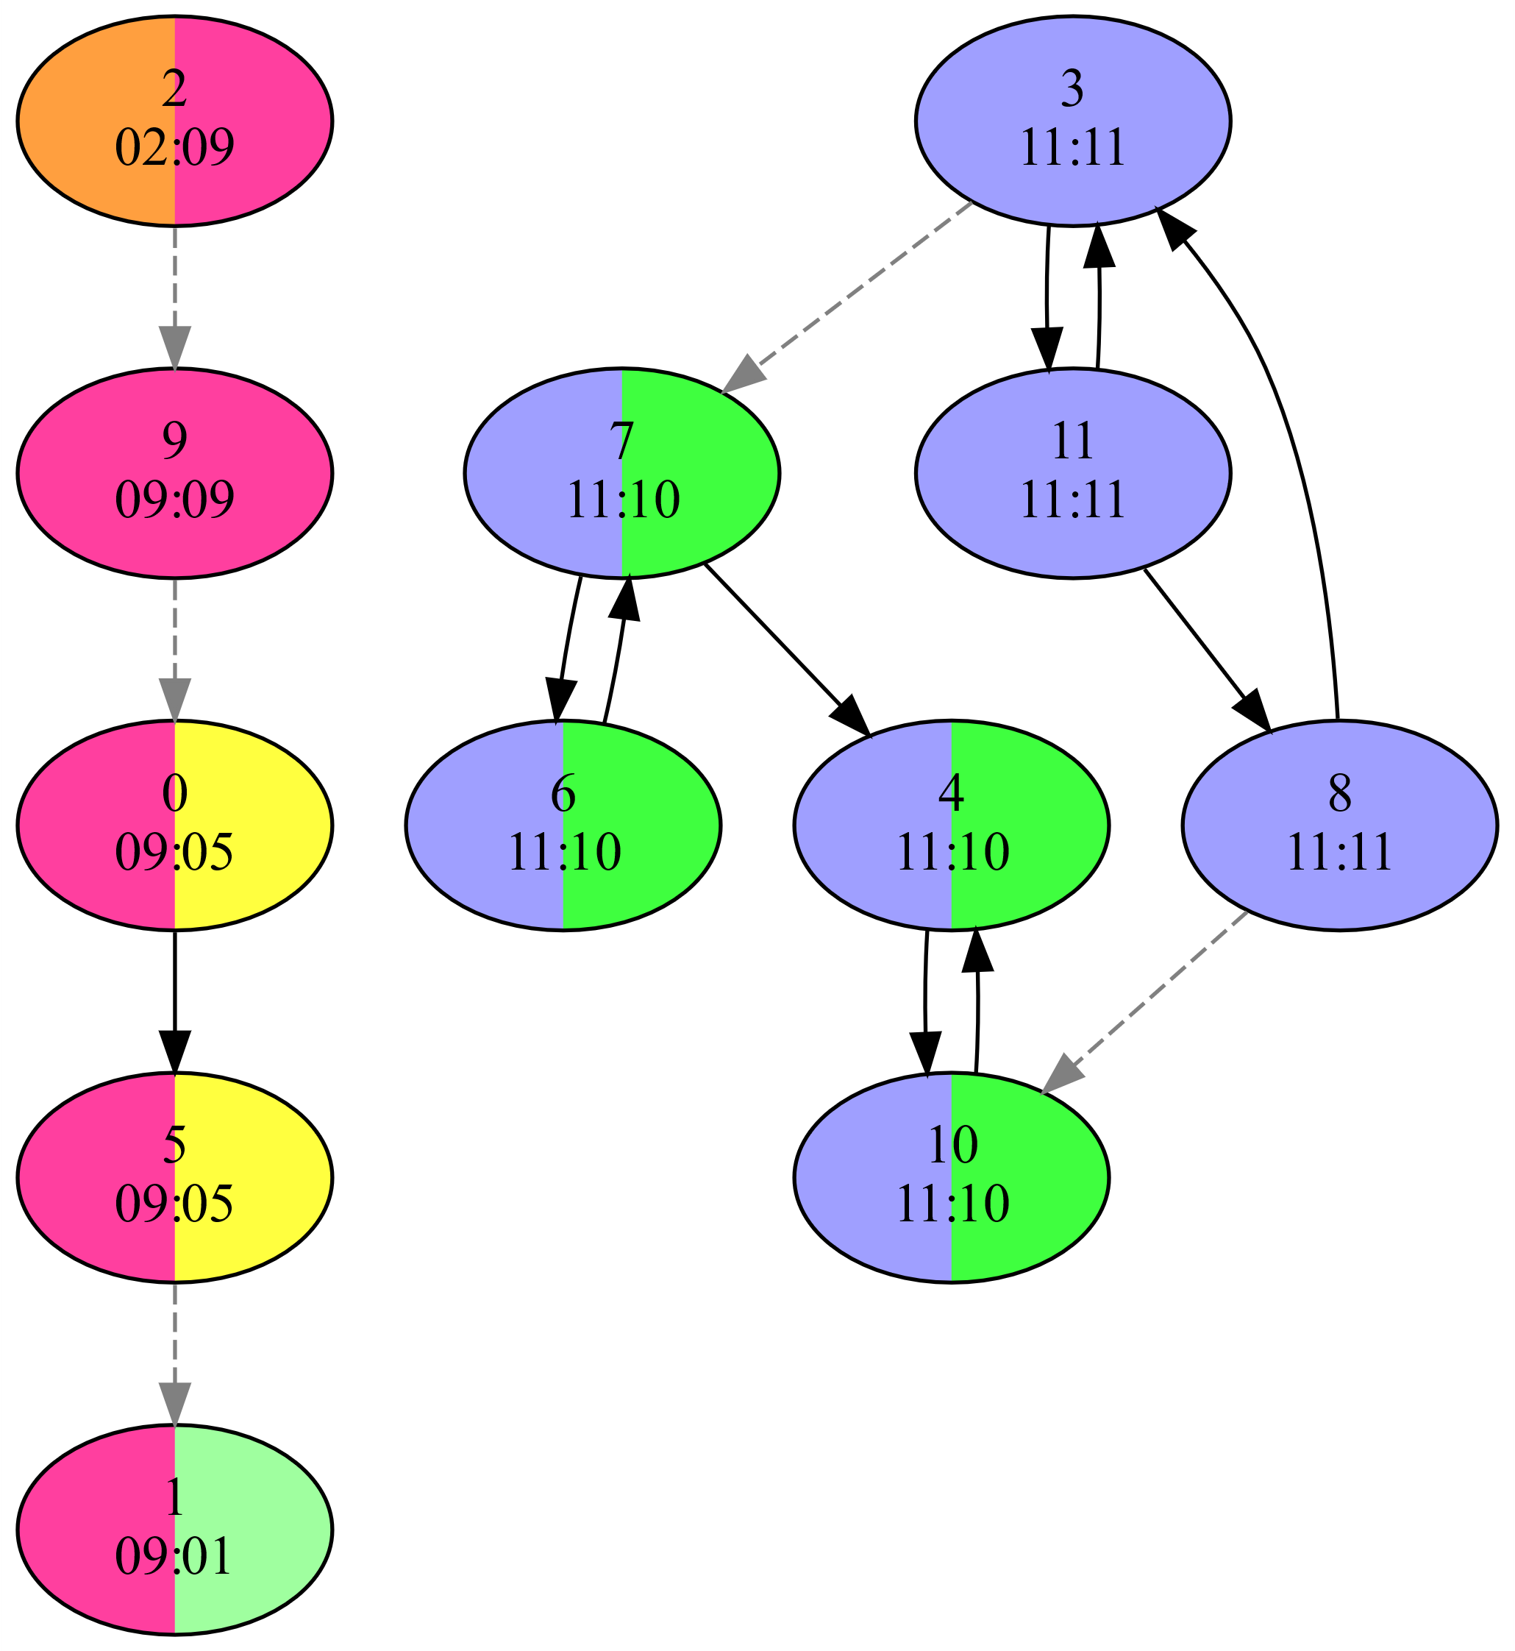
Our Parallel ECL-SCC Algorithm
Computes two signature values for each vertex
  𝑣_{𝑖𝑛}: max reachable vertex ID on incoming paths
  𝑣_{𝑜𝑢𝑡}: max reachable vertex ID on outgoing paths
Step 1: signature initialization
  Initializes signature values to vertex ID
Step 2: maximum-value propagation
  Updates signatures until fixed-point reached
    𝑣_{𝑖𝑛} = max of itself and 𝑣_{𝑖𝑛} of in-neighbors
    𝑣_{𝑜𝑢𝑡} = max of itself and 𝑣_{𝑜𝑢𝑡} of out-neighbors
Step 3: edge removal
  Delete edges between differing signatures
Repeat above steps until every vertex satisfies 𝑣_{𝑖𝑛} = 𝑣_{out}

Slide 28
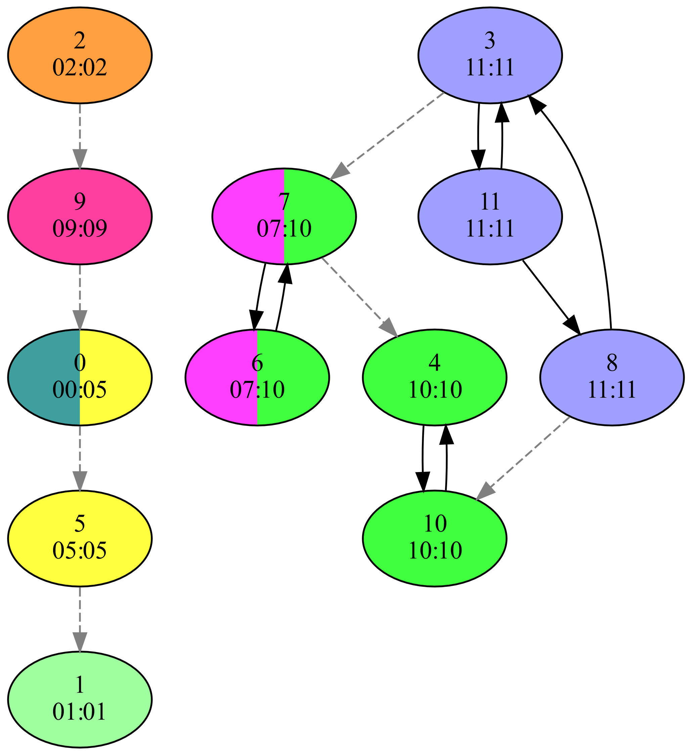
Our Parallel ECL-SCC Algorithm
Computes two signature values for each vertex
  𝑣_{𝑖𝑛}: max reachable vertex ID on incoming paths
  𝑣_{𝑜𝑢𝑡}: max reachable vertex ID on outgoing paths
Step 1: signature initialization
  Initializes signature values to vertex ID
Step 2: maximum-value propagation
  Updates signatures until fixed-point reached
    𝑣_{𝑖𝑛} = max of itself and 𝑣_{𝑖𝑛} of in-neighbors
    𝑣_{𝑜𝑢𝑡} = max of itself and 𝑣_{𝑜𝑢𝑡} of out-neighbors
Step 3: edge removal
  Delete edges between differing signatures
Repeat above steps until every vertex satisfies 𝑣_{𝑖𝑛} = 𝑣_{out}

Slide 29
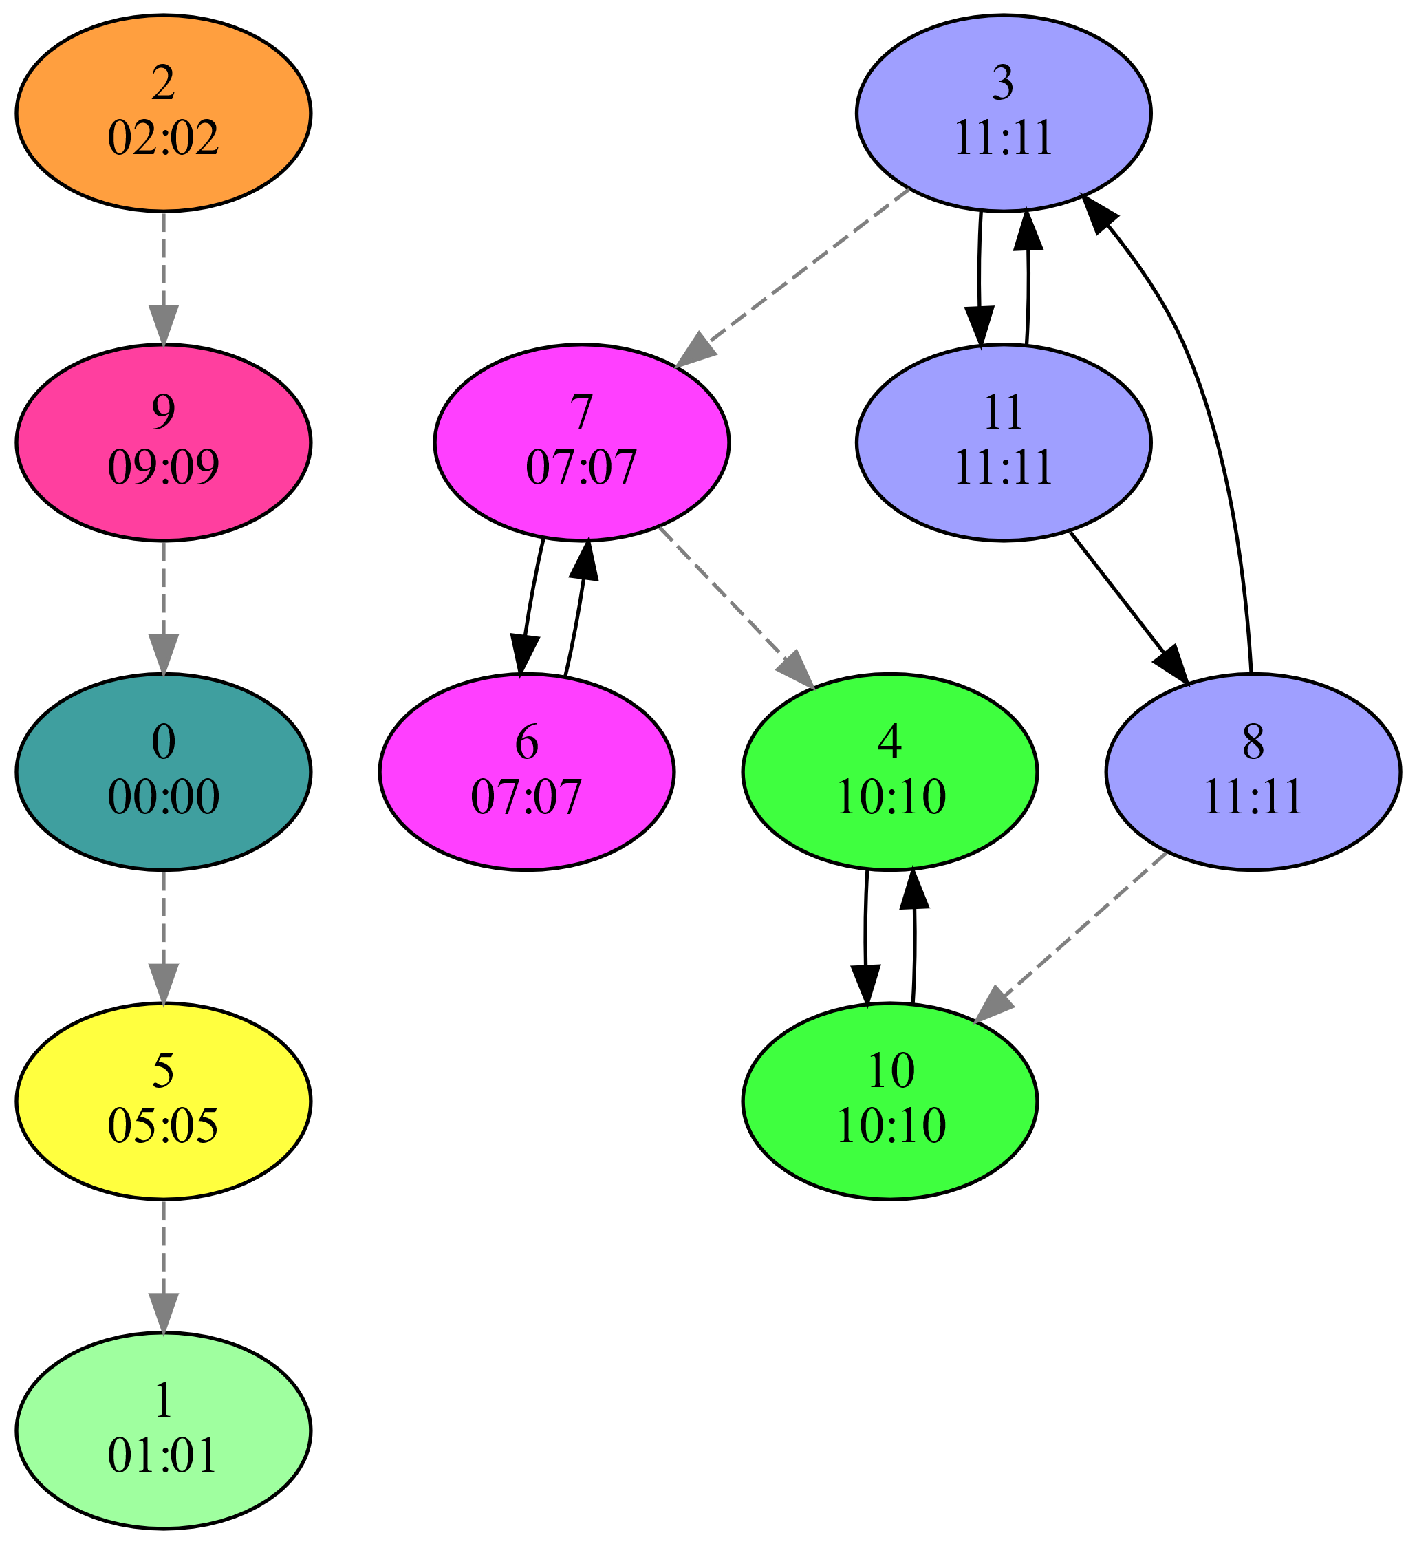
Our Parallel ECL-SCC Algorithm
Computes two signature values for each vertex
  𝑣_{𝑖𝑛}: max reachable vertex ID on incoming paths
  𝑣_{𝑜𝑢𝑡}: max reachable vertex ID on outgoing paths
Step 1: signature initialization
  Initializes signature values to vertex ID
Step 2: maximum-value propagation
  Updates signatures until fixed-point reached
    𝑣_{𝑖𝑛} = max of itself and 𝑣_{𝑖𝑛} of in-neighbors
    𝑣_{𝑜𝑢𝑡} = max of itself and 𝑣_{𝑜𝑢𝑡} of out-neighbors
Step 3: edge removal
  Delete edges between differing signatures
Repeat above steps until every vertex satisfies 𝑣_{𝑖𝑛} = 𝑣_{out}

Slide 30
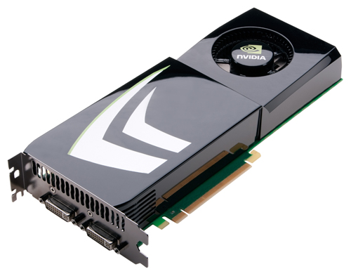
ECL-SCC Parallelization
Algorithm designed to be parallelism friendly
  No depth- or breadth-first search
  Starts out with high degree of parallelism
  Uses every vertex simultaneously as a “pivot”
GPU friendly
  No recursion, little or no explicit synchronization
    Initialization is embarrassingly parallel
    Vertex-ID propagation is atomic-free
    Edge removal uses atomic operations

Slide 31

ECL-SCC Performance Optimization
Vertex-ID propagation
  Employs “path compression” idea from union-find
    Enables faster label propagation
  Uses asynchronous persistent-thread approach
    Reduces kernel launch overhead if many iterations
Edge removal
  ECL-SCC uses worklist (WL) to hold edges
    Edge removal deletes edges from WL, not from graph
  Also removes edges within detected SCCs from WL
    Eliminates unnecessary work and reduces iterations

Slide 32
Complexity Analysis
Memory
  Signatures: 𝑂(|𝑉|) and worklist: 𝑂(|𝐸|)
Work
  Phase 1: 𝑂(|𝑉|), Phase 2: 𝑂(𝑐|𝐸|), Phase 3: 𝑂(|𝐸|),
  c = longest cycle length
  Phases iterate up to 𝑑 times, d = depth of DAG
  Worst case: 𝑂(𝑑𝑐|𝐸| + 𝑑|𝑉|))
  Expected work: 𝑂(𝑙𝑜𝑔(𝑑) 𝑙𝑜𝑔(𝑐) |𝐸| + 𝑙𝑜𝑔(𝑑) |𝑉|)
    Process cycles in 𝑙𝑜𝑔(𝑐) steps using “path compression”
    Halve DAG depth in each iteration (if vertex IDs are random)

Slide 33
Results

Slide 34
Experimental Methodology
Two CPU systems
  16-core 3.5 GHz Ryzen Threadripper 2950X (32 threads)
  Dual 16-core 2.9 GHz Xeon Gold 6226R (64 threads)
Two GPUs
  Volta-based Titan V: 5120 PEs, 80 SMs, 12 GB memory
  Ampere-based A100: 6912 PEs, 108 SMs, 40 GB memory
OS and compilers
  Fedora 37 operating system
  nvcc 12.0 with “-O3 -arch=sm_80” for A100
  gcc/g++ 12.2.1 using -O3 -fopenmp”

Slide 35
Experimental Methodology
Performance comparison
  SCC-GPU, fastest GPU code
  iSpan, fastest parallel CPU code
  Tarjan, fastest serial CPU code
Metrics
  SCC computation time
    Excluding reading in graph, writing result, and verification
    Median of 9 runs (except for some slow iSpan runs)
  Throughput = #graph vertices / computation time
Verification
  Compared solution of ECL-SCC to Tarjan’s algorithm

Slide 36
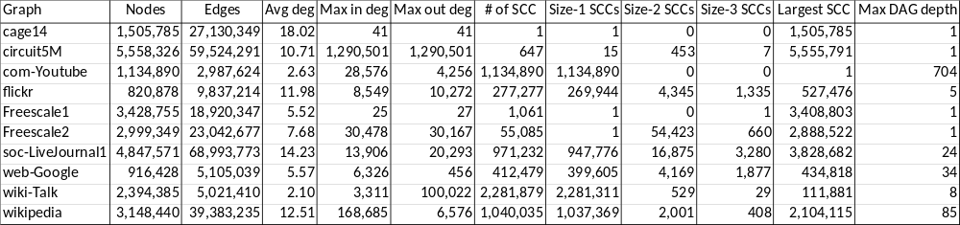
Power-law Graphs
10 graphs from SuiteSparse Matrix Collection
  Also used in related work
Most have shallow DAG when collapsing SCCs
Most have some high-degree vertices
Most have one very large SCC

Slide 37
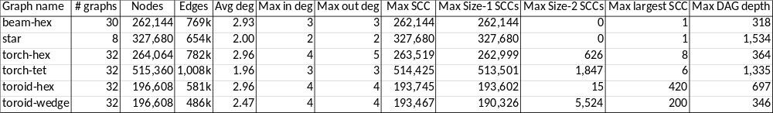
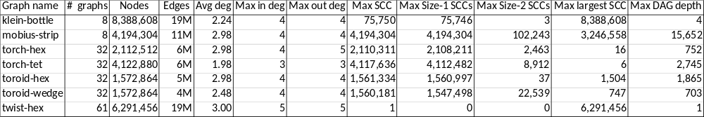
Small & Large Mesh Graphs
166 small and 205 large meshes
  Constructed using MFEM
  Low-order tet. & hex. elements
  Curved high-order elements
Relatively deep DAGs when collapsing SCCs
None have high-degree vertices
SCC sizes vary greatly
Present averages over all ordinates

Slide 38
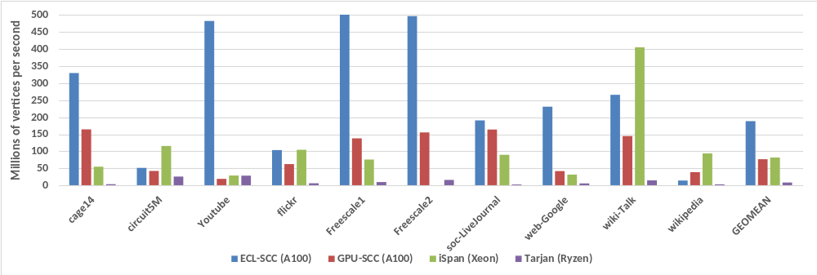
Throughput on Power-law Graphs
Our ECL-SCC code is fastest on 6 of 10 graphs
Geometric mean speedup is >2× over GPU-SCC and iSpan and >20× over Tarjan
iSpan (CPU) code is fastest on 4 graphs
GPU-SCC code is faster on 1 graph

Slide 39
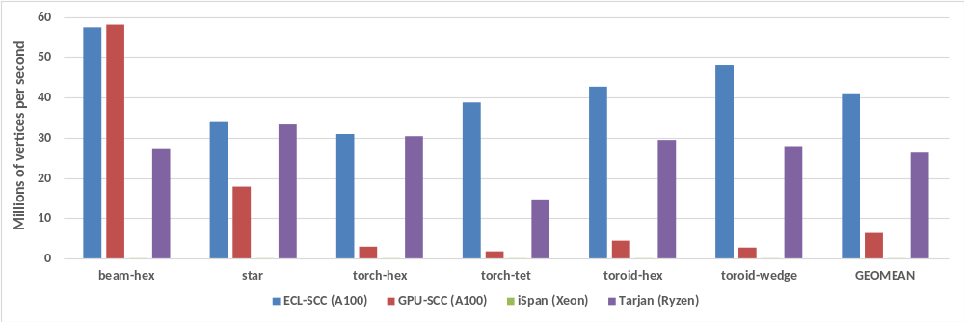
Throughput on Small Mesh Graphs
Our ECL-SCC code is fastest on all small mesh groups except for beam-hex group
Serial Tarjan is second fastest, >4× faster than GPU-SCC and >2800× faster than iSpan
Beam-hex has only SCCs of size 1, GPU-SCC only uses Trim-1 phase on these inputs
Geometric mean speedup is 6.5× over GPU-SCC, 4400× over iSpan, 1.6× over Tarjan
Tarjan’s throughput is higher on meshes; other codes’ through-puts are lower on meshes

Slide 40
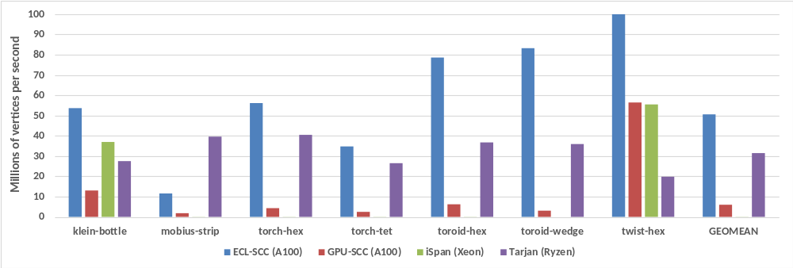
Throughput on Large Mesh Graphs
Serial Tarjan is again second fastest, outperforming prior parallel CPU and GPU codes
Our ECL-SCC code is fastest on all large mesh groups except for mobius-strip group
The klein-bottle and twist-hex graphs have one large SCC and a shallow DAG
Geometric mean speedup is 8.4× over GPU-SCC, 1100× over iSpan, 1.6× over Tarjan
Mobius-strip has both one very large SCC and the deepest DAG

Slide 41


Summary
ECL-SCC
  New GPU algorithm to detect SCCs
    Uses maximum vertex-ID propagation and edge removal
    Particularly effective on graphs with smaller SCCs and medium DAG depth (e.g., mesh graphs)
      Tarjan faster on graphs with large SCC and high DAG depth
      iSpan faster on graphs with large SCC and low DAG depth
Our CUDA implementation on mesh graphs
  6.5× faster that the fastest GPU code
  Only studied code that is faster than serial Tarjan

Slide 42

Thank you!
Acknowledgments
  DOE, NSF, NVIDIA
Contact information
  burtscher@txstate.edu
Web and github pages (paper and code)
  https://cs.txstate.edu/~burtscher/research/ECL-SCC/
  https://github.com/burtscher/ECL-SCC

Slide 44
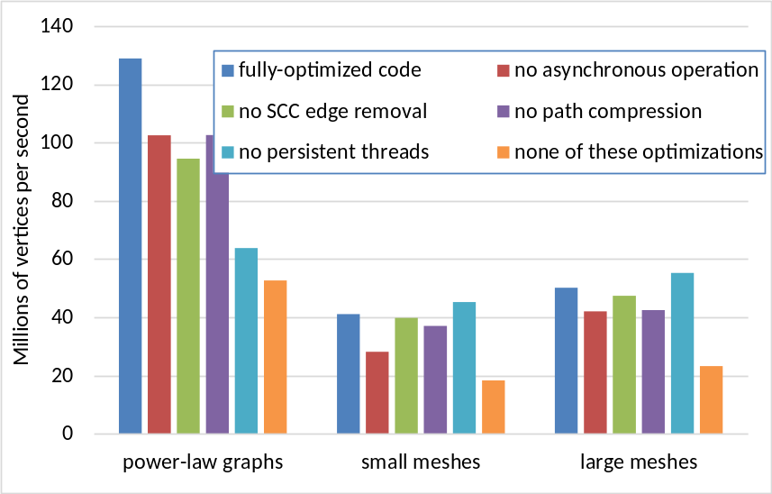
Optimization Evaluation
Path compression and asynchronous operation help on all three types of input graph
Persistent threads boost the performance on the power-law graphs but hurt on the mesh graphs
These optimizations together more than double the throughput of ECL-SCC

Slide 45
Propagation Step Guarantees
Signature
  All vertices in an SCC must end up with same signature since there is a cycle
    Proof by contradiction
Convergence
  Guaranteed to terminate as max is monotonic and vertex IDs are finite
    Can only increase or stay the same in each iteration
    Capped by highest ID in graph

Slide 46
Correctness & Convergence
Initially, SCCs are clustered together
One SCC in each cluster must contain highest ID vertex of the cluster (due to uniqueness of IDs)
  Ancestor SCCs cannot have this ID in in_{max} values
  Descendant SCCs cannot have it in out_{max} values
  Therefore, at least this SCC will be separated out
    Remaining SCCs will be separated out in same or later iterations
After some iterations, all SCCs are separated out
  Final signature is maxID : maxID, unique to each SCC

Slide 47
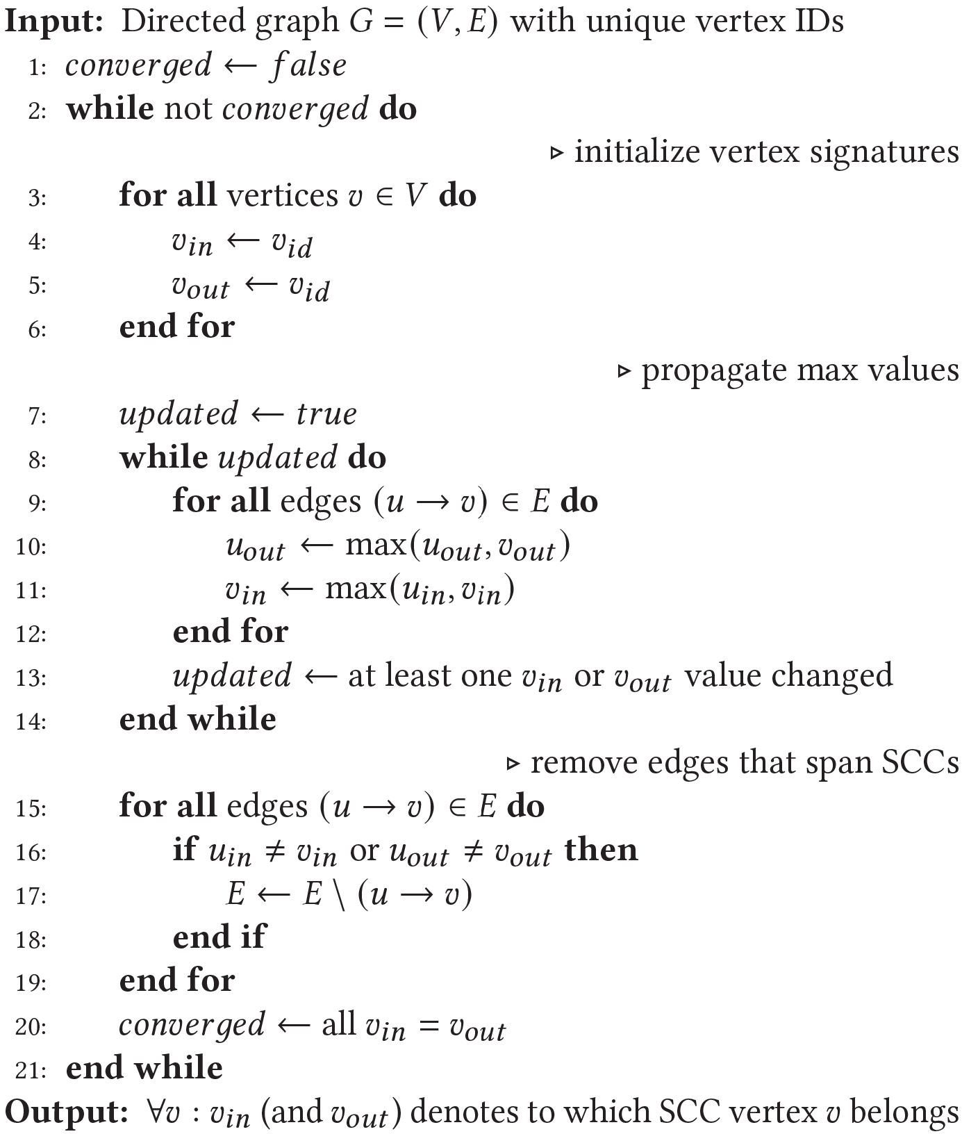
ECL-SCC Algorithm

