Slide 1
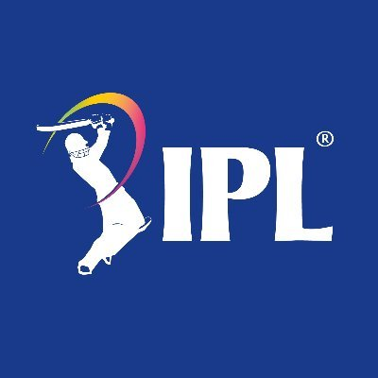

CASE STUDY ON
PIE-IN-THE-SKY
IPL MATCH BIDDING APP
Members:
Adhi Priyanka. A V
Aditya Singh
Mir Abrar Ali
Garimella V S Alekhya
Sonu Thalia
Wajid Sharieff. A

Slide 2

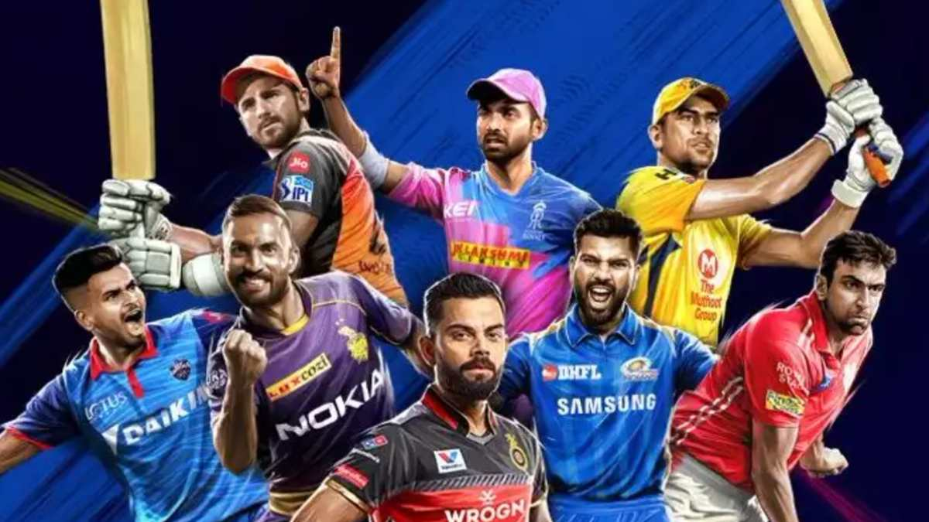
Objective
The problem statement is to use the SQL queries to find the various insight from the Pie-in-the-Sky IPL Match Bidding App data.
TRIVIA
The earliest clearly defined proof of the game existence , first appeared in 1597

Slide 3
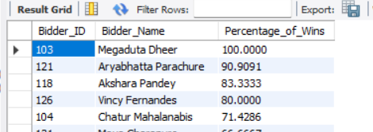
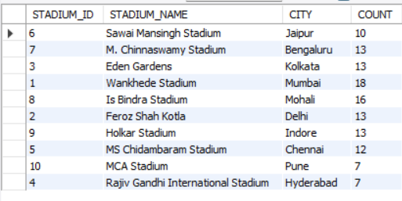
Insights from ‘Percentage of wins of each bidder and Number of matches conducted at each stadium’
Mr.Megaduta Dheer - won all the 5 bids.
Mr.Megaduta Dheer - bid on Sunrisers Hyderabad twice out of 5 bids
The best supporting reasons:
Sunil naraine was an allrounder.
On considering Sunil’s past match performance
Mumbai's Wankhede Stadium - Highest number of matches(18).
Followed by Mohali's Is Bindra stadium - with 16 matches in total.
The best supporting reasons:
Wankhede stadium is one of the largest stadium in India with the seating capacity of 45000.
Mumbai is a happening city and most of the international matches are held here.

Slide 4
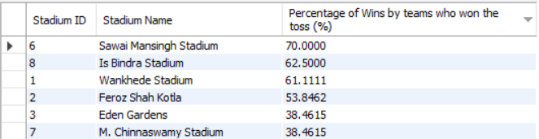
Insights from ‘Percentage of wins by a team which has won the toss’
1. Sawai Mansingh stadium has got more percentage of wins by team who won the toss around 70%.
2. Rajiv Gandhi international stadium has least percentage of wins by team who won the toss around 14%
The best supporting reasons:
1. Jaipur has hot semi-arid climate. Dry pitch helps spinners. So the teams who won the toss must have chosen to bowl to win the match.

Slide 5
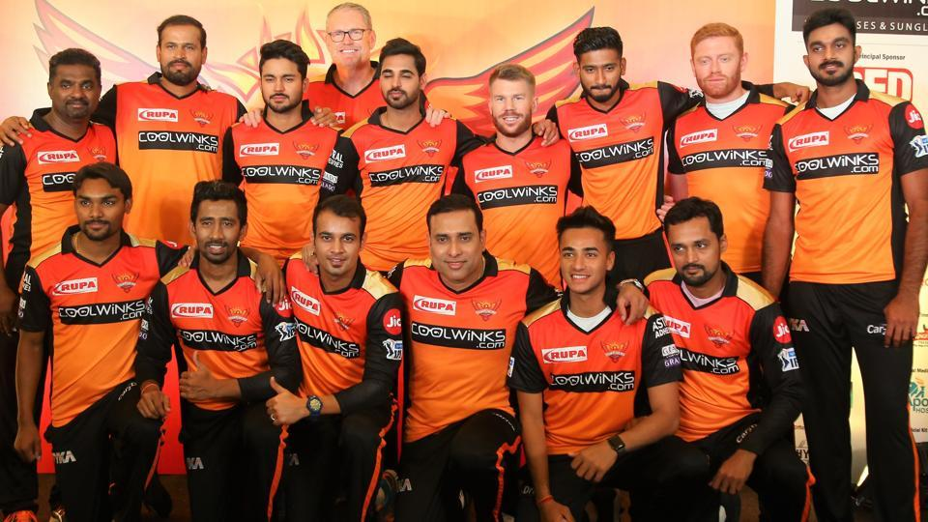
Insights from ‘Total bids along with the bid team and Team name’
1. Sunrisers Hyderabad has more number of bids of 32 followed by Rajasthan Royals with a total of 27 and so on.
The best supporting reasons:
1. The bidders choose to bid on the teams with more number of all-rounder players.
TRIVIA
The first cricket ball was made of wool

Slide 6
Insights from ‘Team id who won the match as per the win details’
Teams won at least once Teams did not win at least once
TEAM ID | TEAM NAME | NO. OF MATCHES WON
1 | Chennai Super Kings | 18
3 | Kings XI Punjab | 15
4 | Kolkata Knight Riders | 12
7 | Royal Challengers Bangalore | 12
8 | Sunrisers Hyderabad | 18
TEAM ID | TEAM NAME | NO. OF MATCHES WON
2 | Delhi Daredevils | 0
5 | Mumbai Indians | 0
6 | Rajasthan Royals | 0
TRIVIA:
Warne lifted the diamond studded IPL 2008 trophy

Slide 7
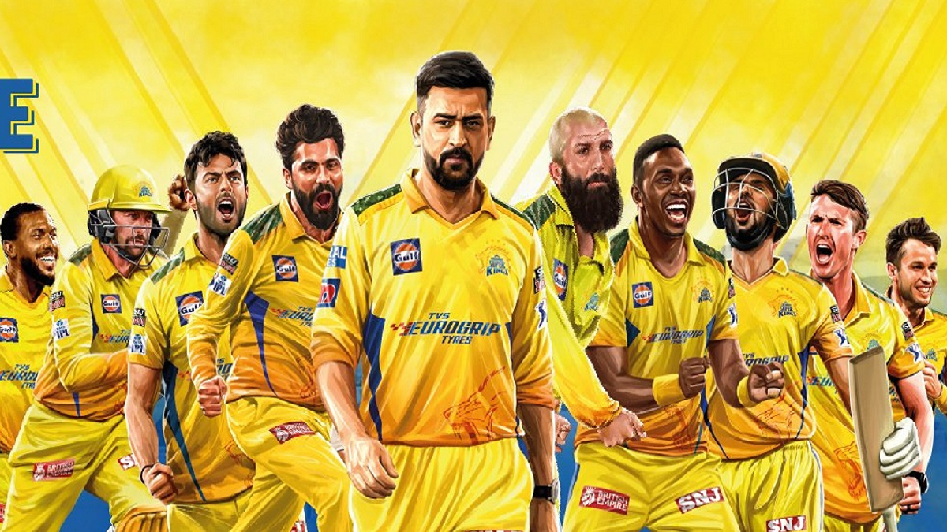
Insights from ‘Total matches played, total matches won and total matches lost’
1. Chennai Super kings won the most number of matches
2. Royal Challengers Bangalore has won least number of matches
The best supporting reasons:
1. Presence of experienced team captain, MS Dhoni
A. Well experienced players.
B. Retaining core players.
C. Non interference of owners
2. Presence of individual superstars in RCB.

Slide 8
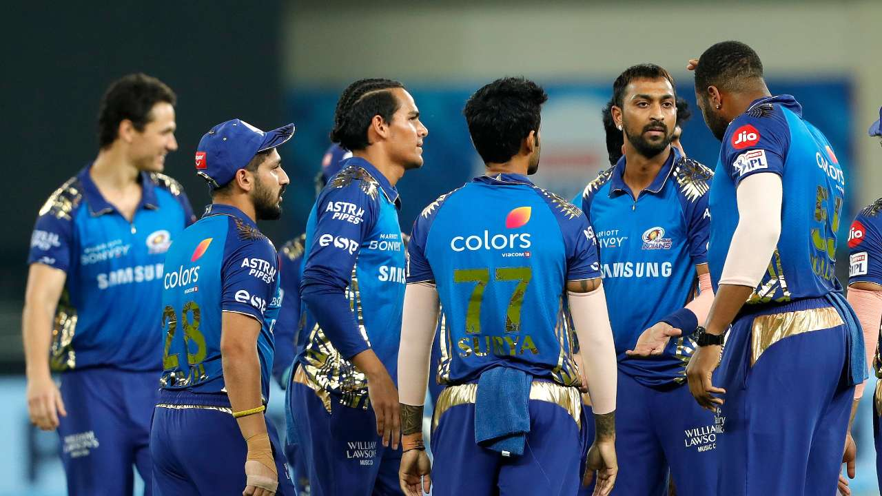
Insights on ‘Bowlers of the Mumbai Indians team’
Team - Mumbai Indians
1. Majority of the bowlers in the team have more than 200 points pertaining to a strong structure with respect to bowling.
2. However the team has unbalanced structure with single batsman only.
S.NO. | Player role | No of players
1 | Bowlers | 9
2 | All-rounder | 4
3 | Batsman | 1

Slide 9

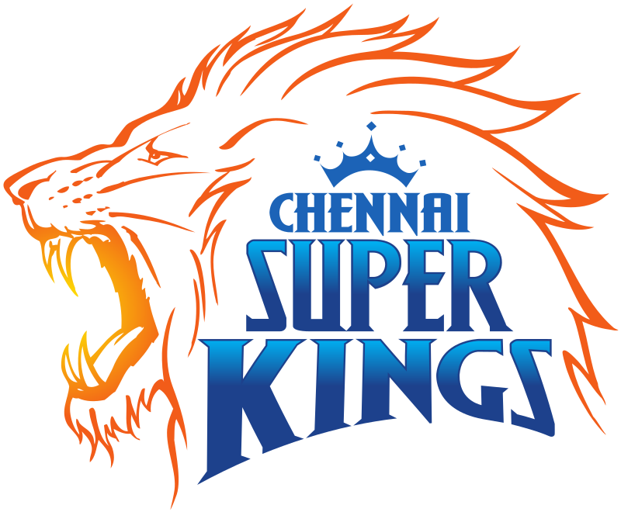
Insights on ‘All-rounders in each team and status of those bidders - who bid on CSK when it won the match in M. Chinnaswamy Stadium’
Delhi Daredevils and Kings XI Punjab are lacking batting and bowling experts.
The best supporting reasons:
Lost maximum number of matches
next to RCB.
CSK contains maximum number of batsman.
The best supporting reasons:
The best batting pitch at M. Chinnaswamy Stadium when compared to all the stadiums in India also known as ‘batting paradise’.
The roar of the crowd due to the proximity from their home ground.

Slide 10
Insights on ‘Bowlers, All Rounders, wickets and IPL season which has min duration and max duration’
Order | Player_id | Player name | Player role | Wickets
1 | 16 | Umesh Yadav | Bowler | 20
2 | 8 | Hardik Pandya | All-rounder | 18
3 | 43 | Mitchell McClenaghan | All-rounder | 14
4 | 53 | Ankit Rajpoot | Bowler | 11
5 | 51 | Shreyas Gopal | Bowler | 11
6 | 36 | Ravindra Jadeja | Bowler | 11
No. of matches_played | Season | Duration_days
8 | 2009 | 36(minimum)
9 | 2013 | 53(maximum)
The best supporting factors:
1. Seasons of April and May(intervals between two matches is high due to extreme temperature).
2. Number of teams
3.Physical form of the players/miscellaneous
TRIVIA
In 1939, South Africa and England played the longest Test match in the history of the game.

Slide 11
Insights on ‘total points month-wise for the 2017 bid year’
1. Aryabhatta Parachure – Highest total bid points(April-210 and May-140).
The best supporting reasons:
1. His analysis on
A. Nationality of the player(7/11 should be Indians)
B. First team and back up player,
C. International player’s commitments
D. Structure of the squad(No too much of one strong category)
E. valuation of under-rated player
TRIVIA
111 is widely considered to be an unlucky score LITTLE WEIRD RIGHT

Slide 12
Insights on top 3 and bottom 3 bidders based on the total bidding points for the 2018 bidding year
1. The top three bidders are well experienced in both analytical and logical thinking about the match.
2. The bottom three need more experience and analytical thinking before bidding.
The best supporting reasons:
1. The bottom three did not analyse the internal and external factors logically.
THANK YOU!

