Slide 1

PITCH DECK
VIDEO PRESENTATION

Slide 2

WRITE YOUR TOPIC OR IDEA
ADD A MAIN POINT
Briefly elaborate on what you want to discuss.
ADD A MAIN POINT
Briefly elaborate on what you want to discuss.
ADD A MAIN POINT
Briefly elaborate on what you want to discuss.

Slide 3

PROBLEMS
PROBLEM 1
Businesses Struggle with Outdated Methods
PROBLEM 2
Inefficient Processes Hinder Growth and Profitability
PROBLEM 3
Lack of access to affordable products

Slide 4



2010
2020
2030
Finalizing branding guidelines and developing marketing strategy.
Launching the first product and reaching 1 million customers.
Participated in major industry conference and hosted exclusive product launch event.

Slide 5
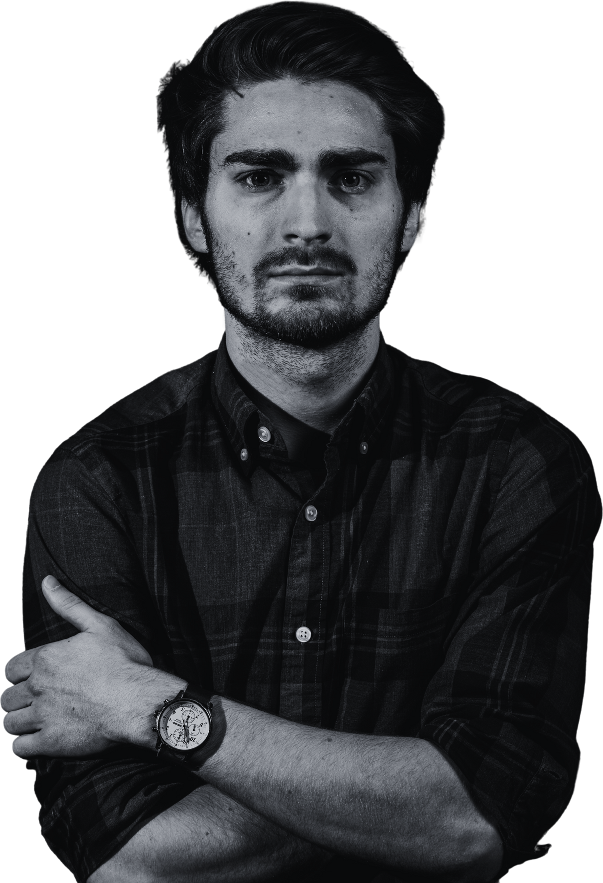

TEAM MEMBERS
Our team consists of Aaron Loeb who is our CEO and has over 20 years of experience in the industry, and Francois Mercer who leads our development team and has a PhD in Computer Science
Aaron Loeb - CEO
Sarah Mercer - CMO

