Slide 1
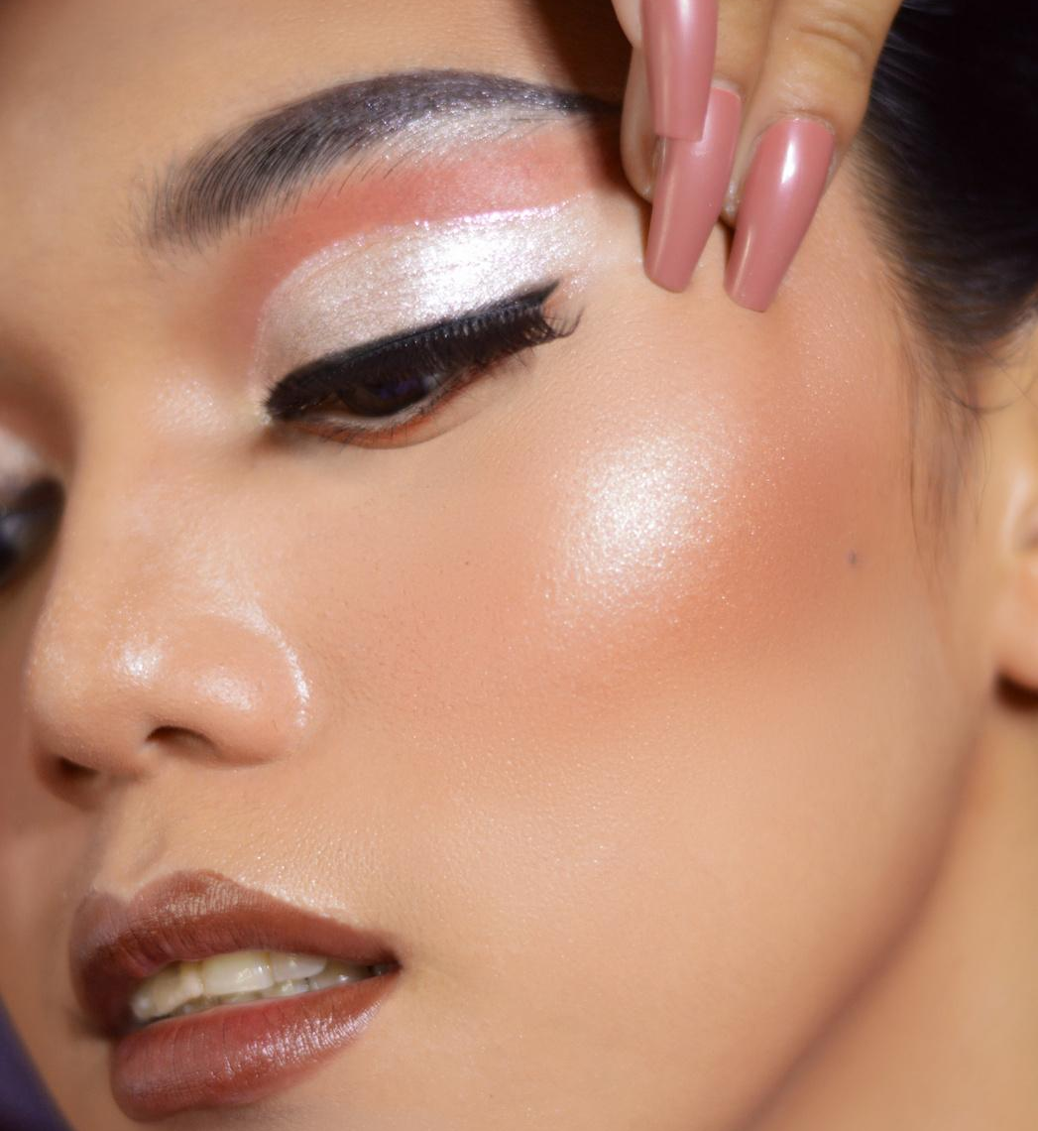
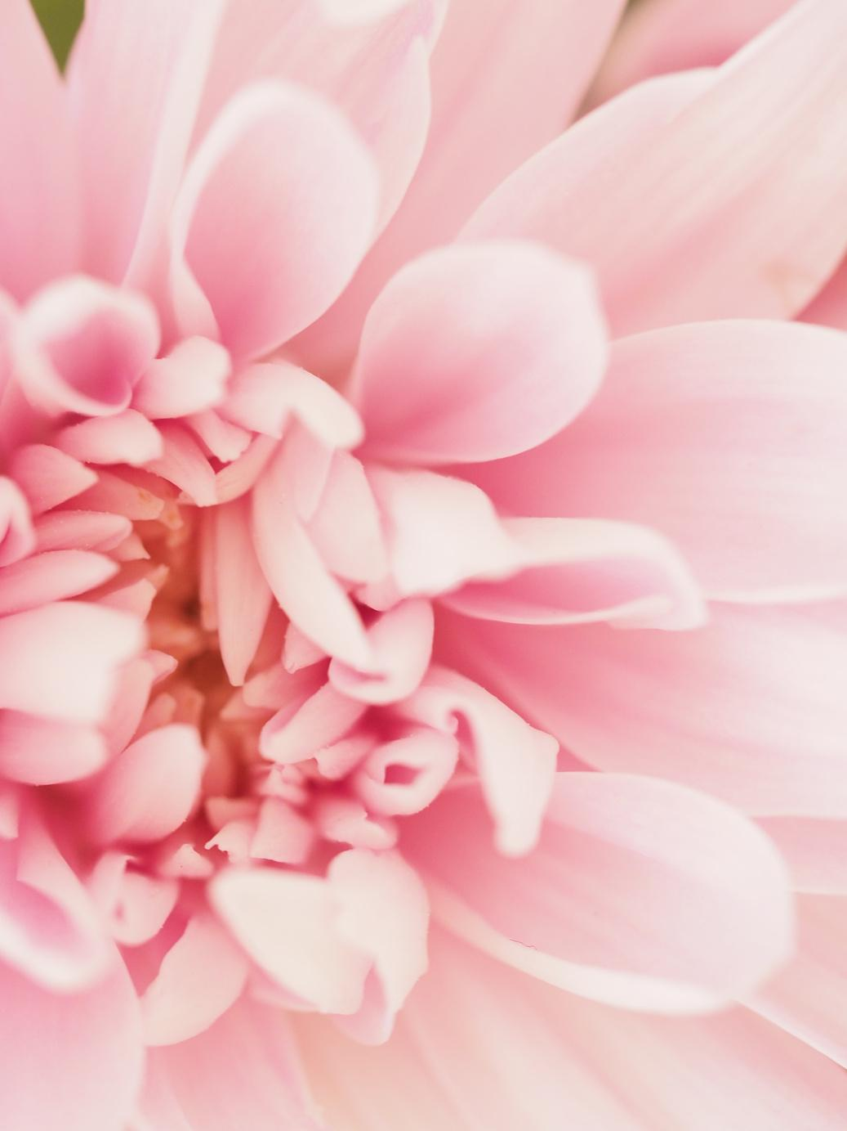
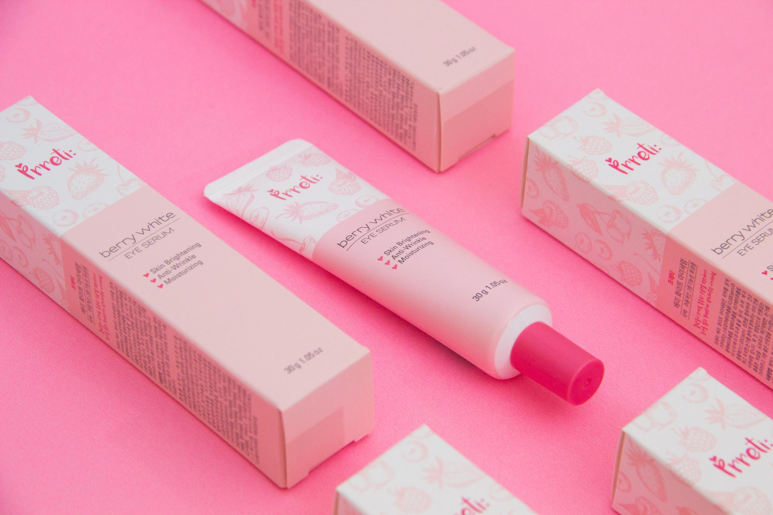
CV
beauty vlogger

Slide 2
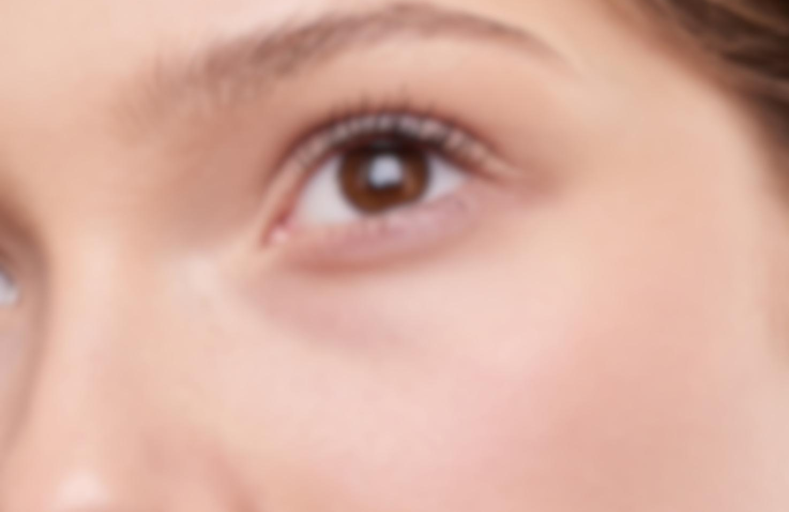
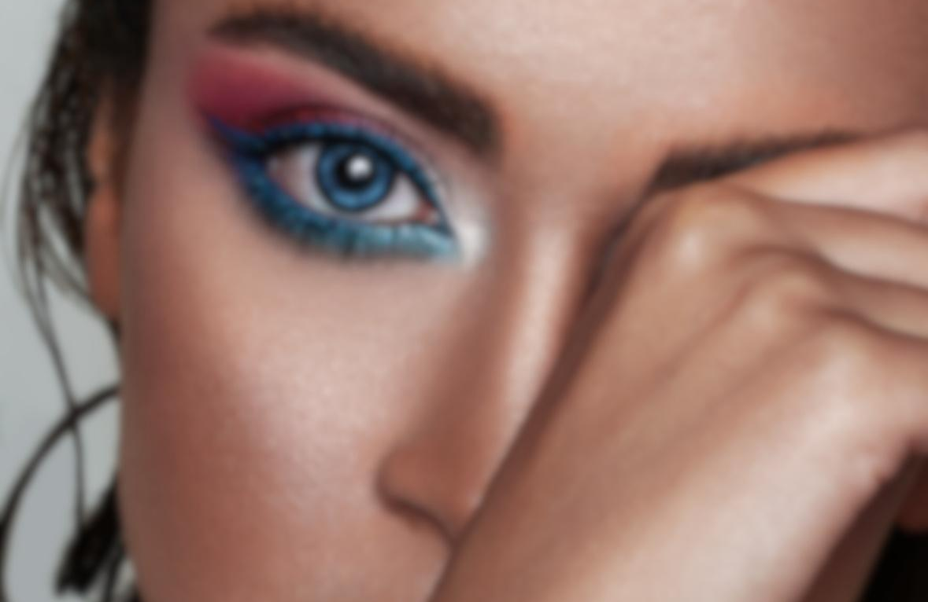
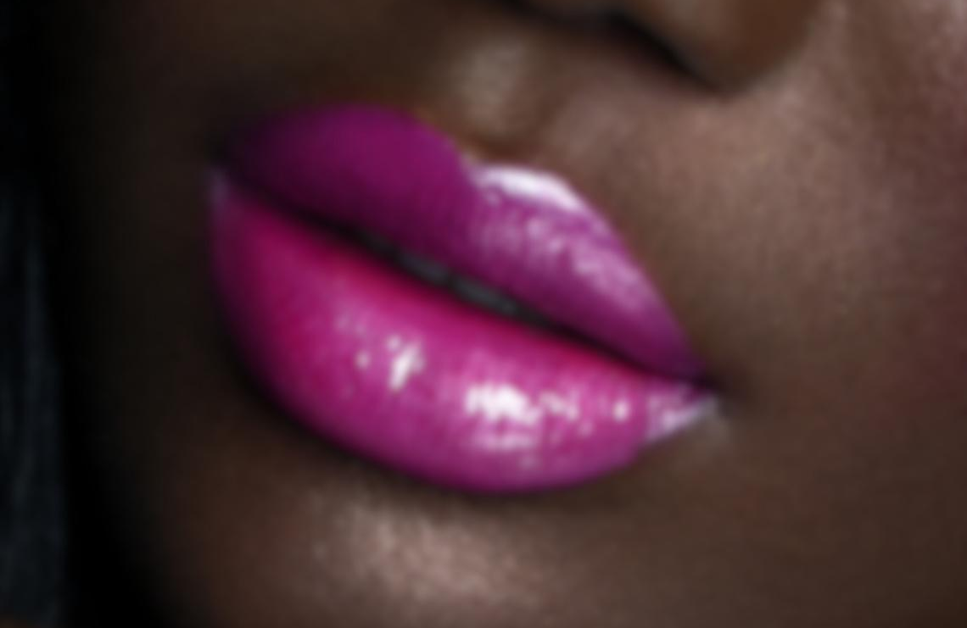
current trends.
Au Naturale
Glitter Everywhere
Neon Lips
The 'no-makeup' makeup trend is here to stay for 2030! This trend is all about enhancing your natural beauty with a few subtle touches. Think sheer lip tints, light coverage foundation, and a touch of bronzer for a sun-kissed glow.
Glitter is no longer just for special occasions – it's for every day! From glittery eyeshadow to sparkly highlighter, this trend is all about adding some sparkle to your look. Don't be afraid to shine!
Neon lips are taking over for 2030! This trend is all about bright, bold colors that pop. Whether you prefer hot pinks or electric oranges, there's a neon shade for everyone.

Slide 3
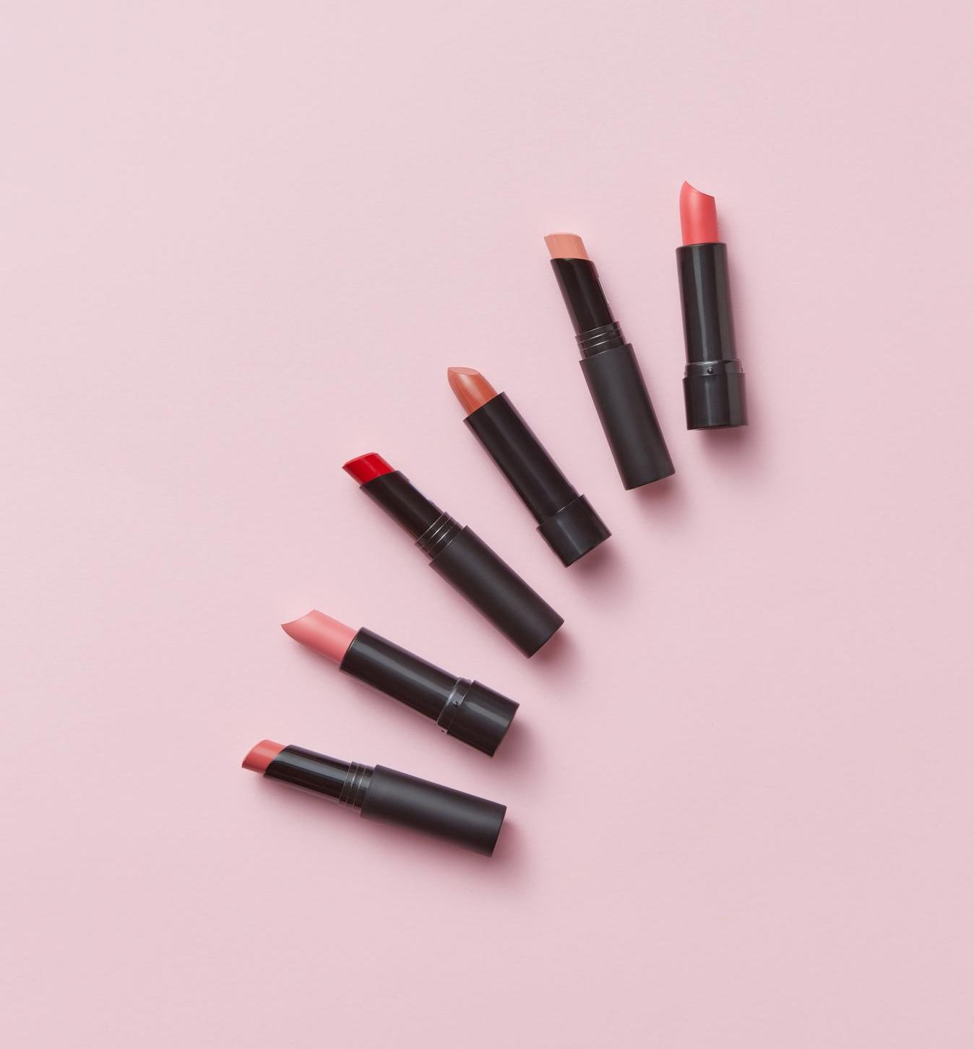
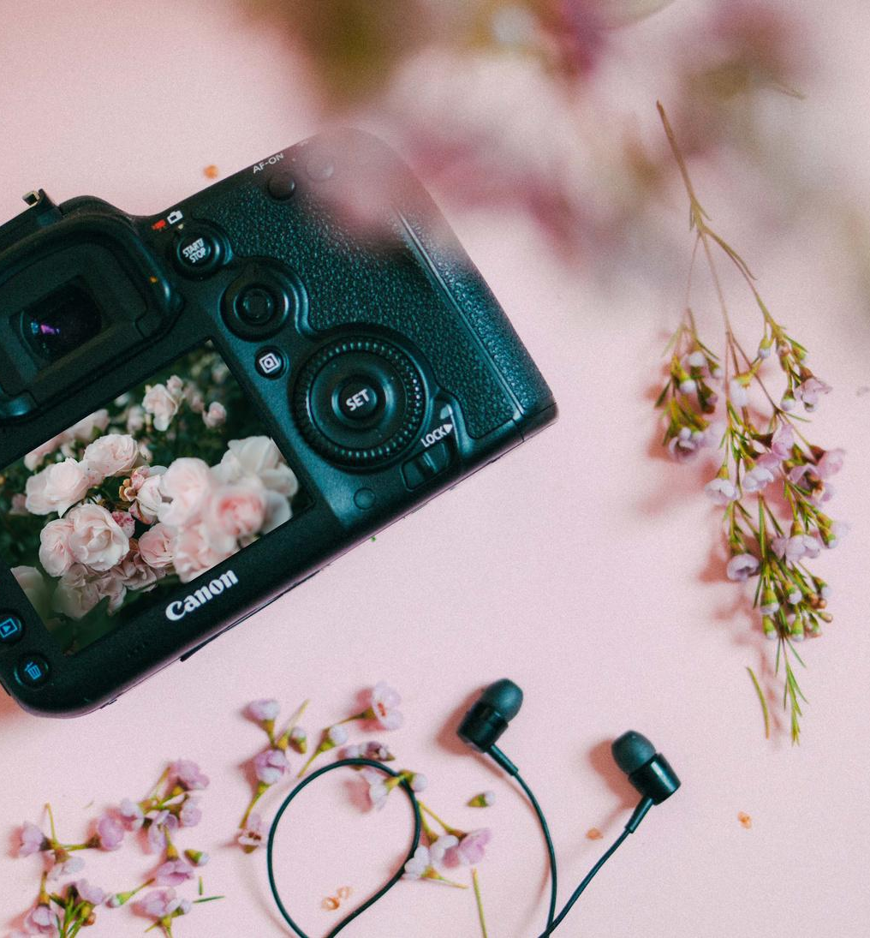
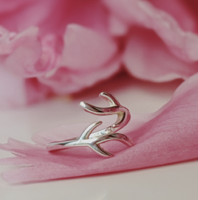
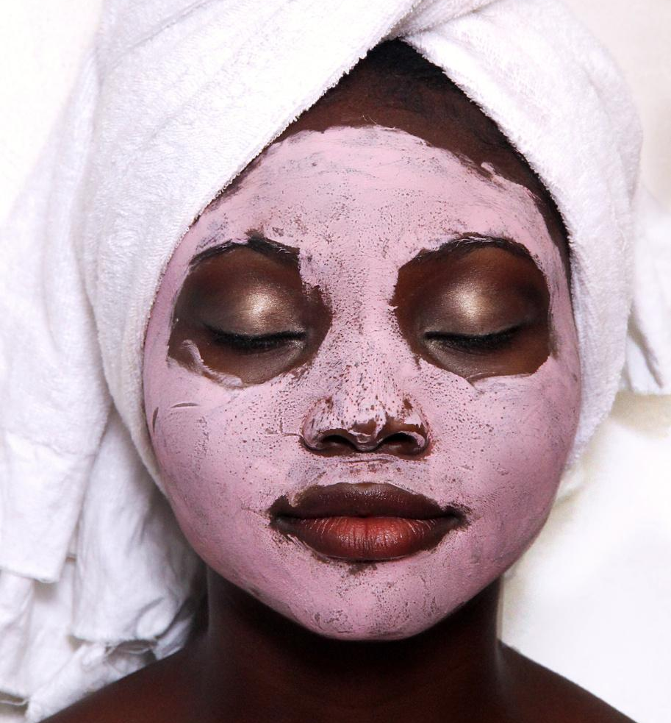
skills.
01.
02.
Content Creation
Photography
Elaborate on what you want to discuss.
Elaborate on what you want to discuss.
03.
04.
SMM
Skincare
Elaborate on what you want to discuss.
Elaborate on what you want to discuss.

Slide 4
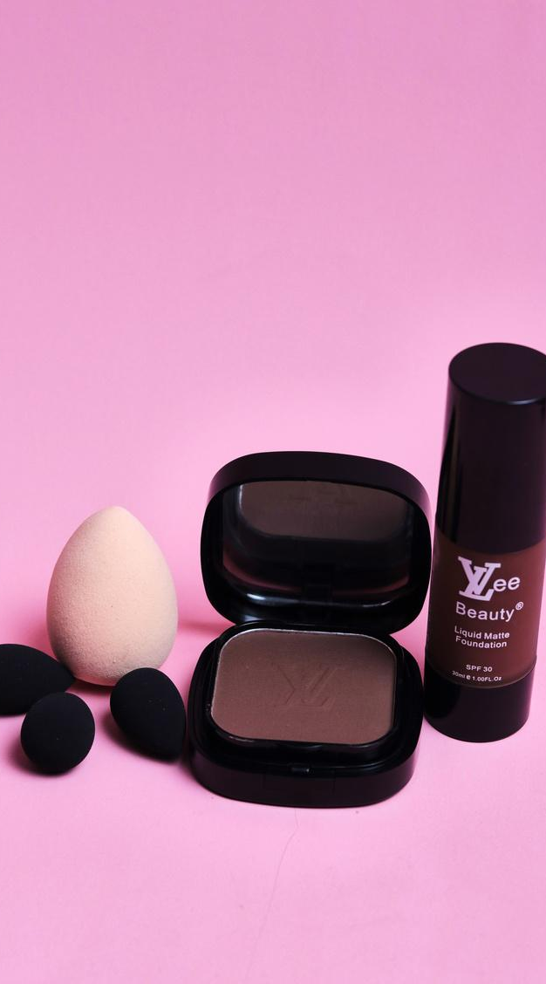
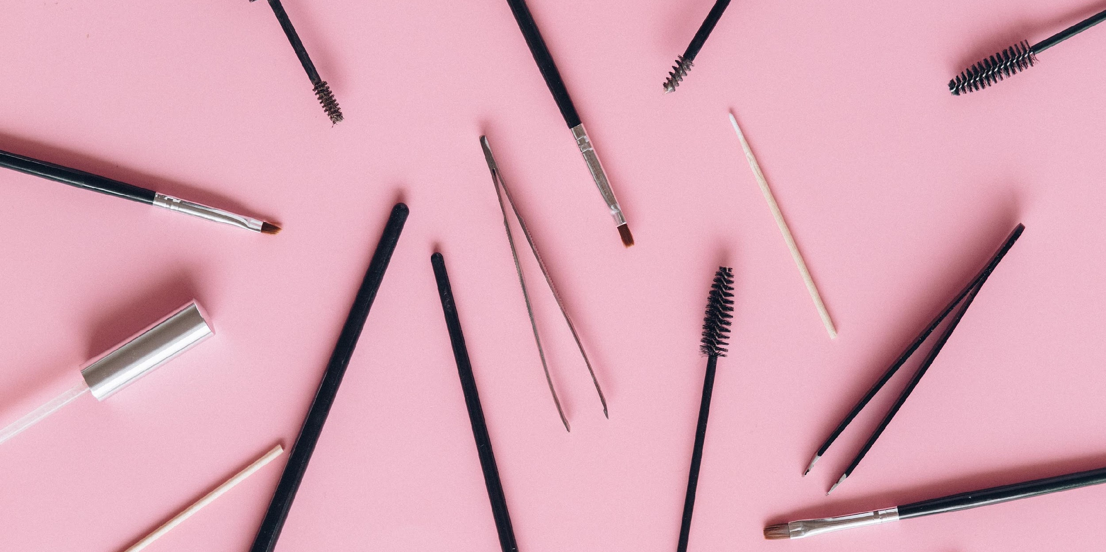
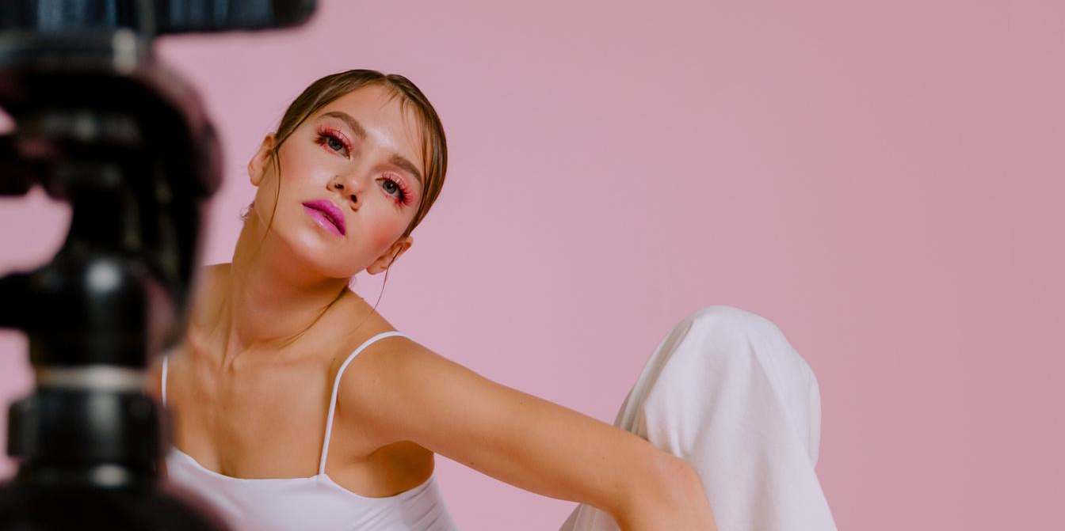
experience.
2025-2027
Borcelle,
Social Media Manager
2027-2028
Giggling Platypus Co., Brand Ambassador
2028-present
Thynk Unlimited,
Beauty Vlogger

Slide 5
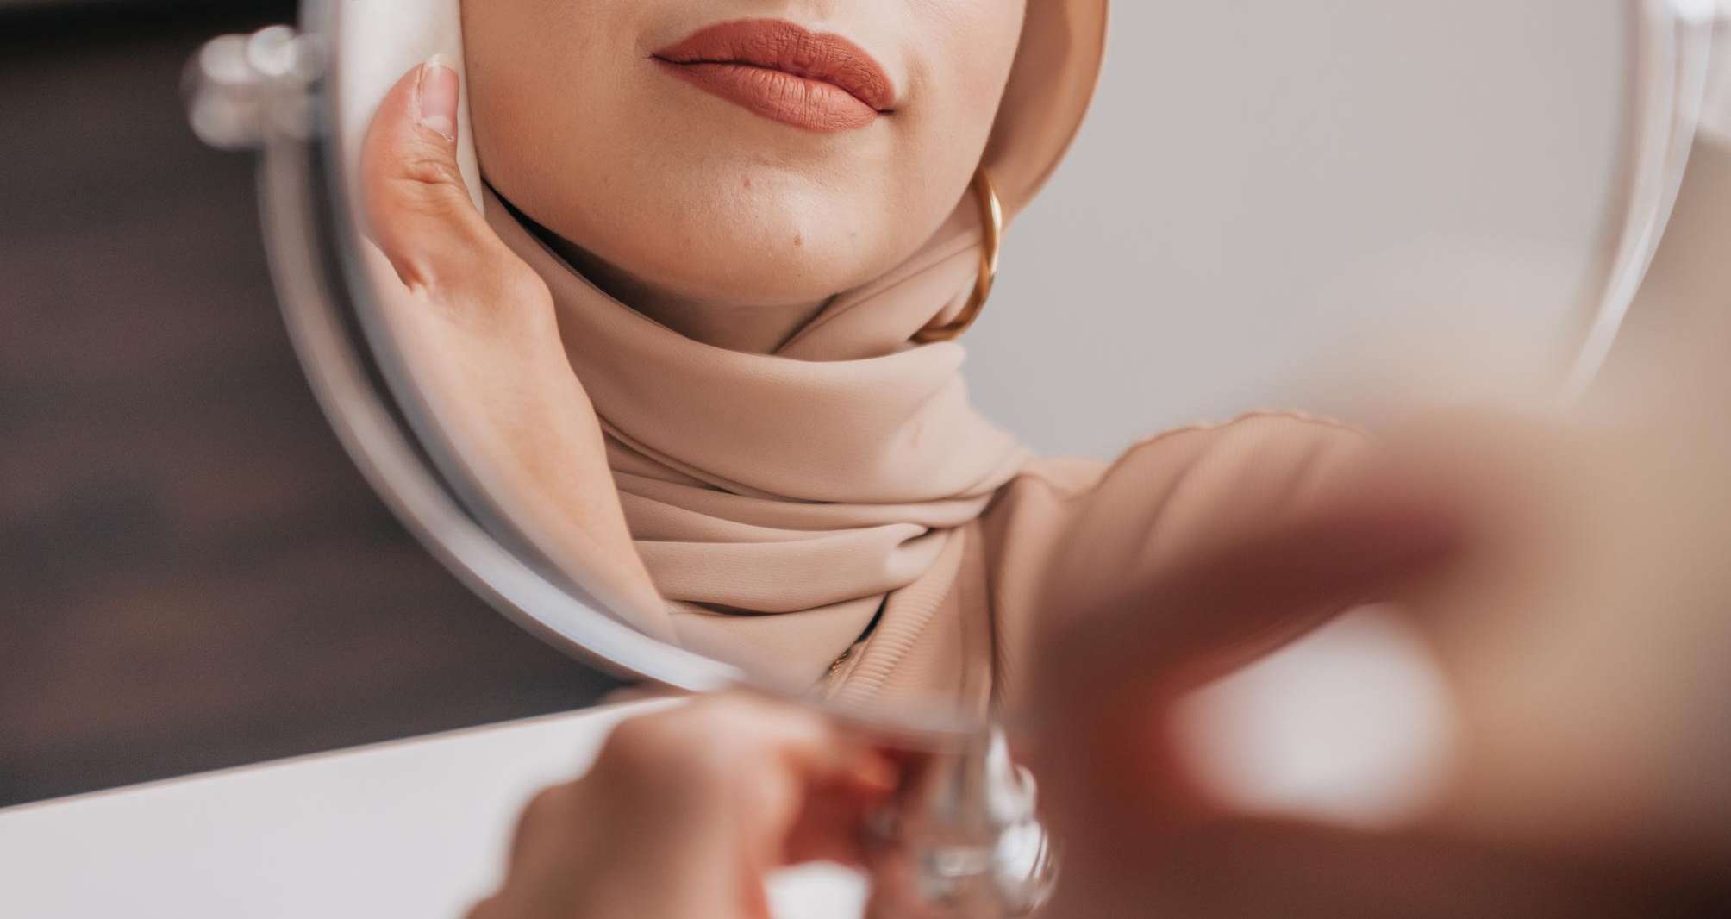
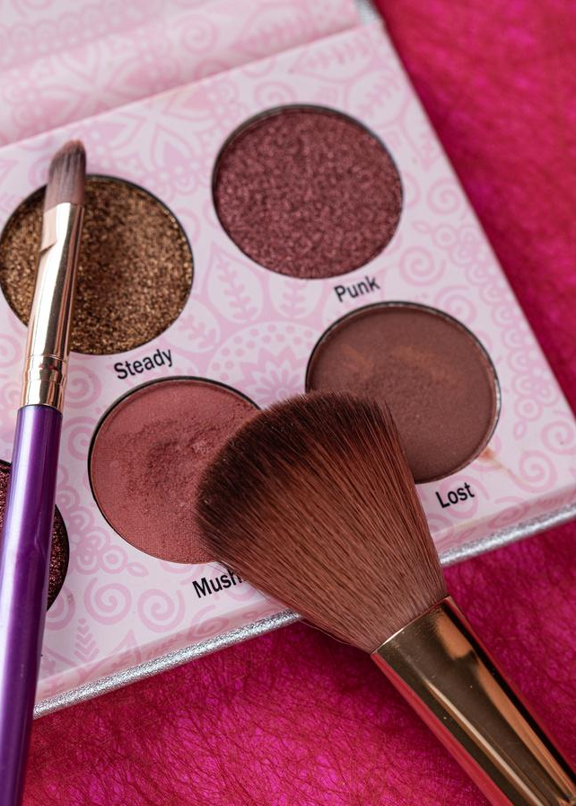
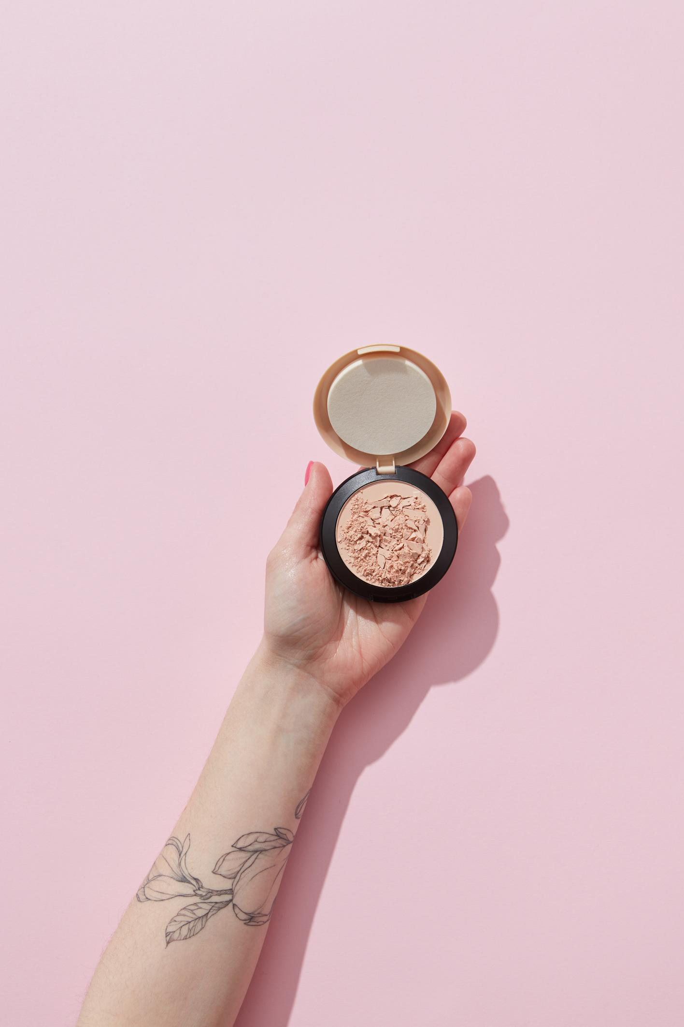
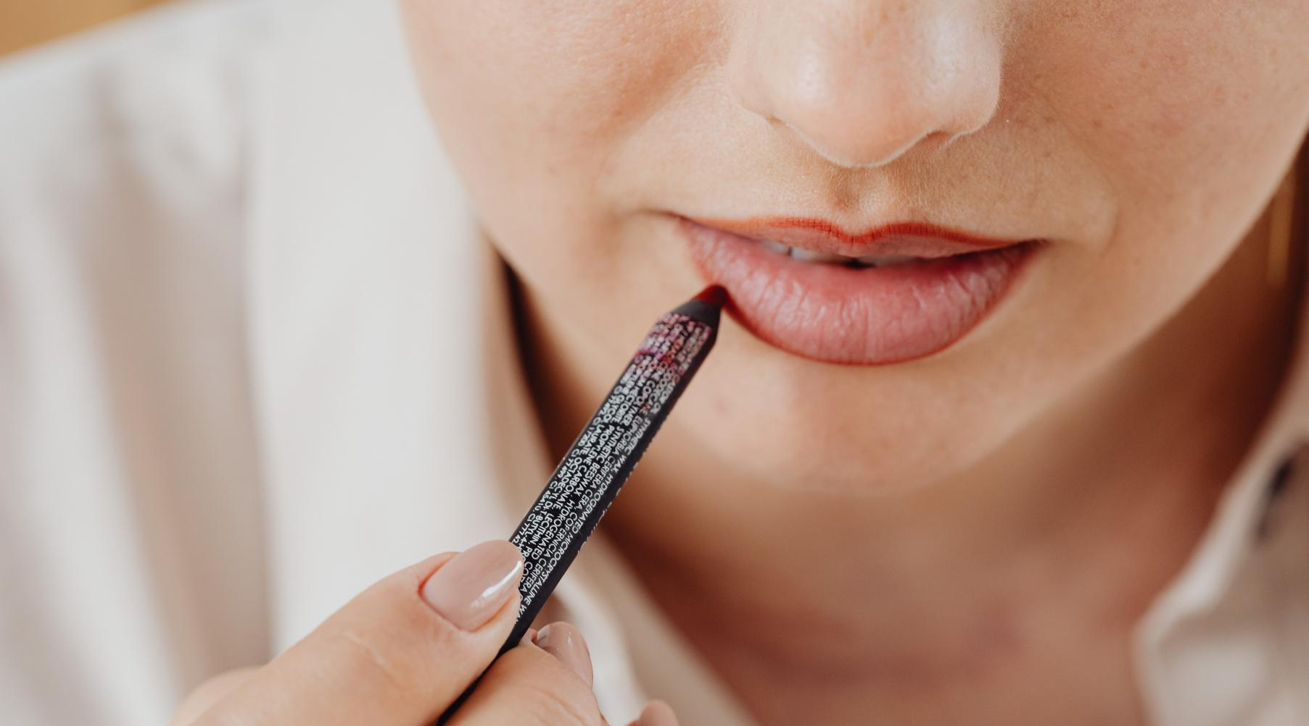
gallery image.
What can you say about your projects? Share it here!

