Slide 1
HISTORY OF
GRAPHIC DESIGN

Slide 2
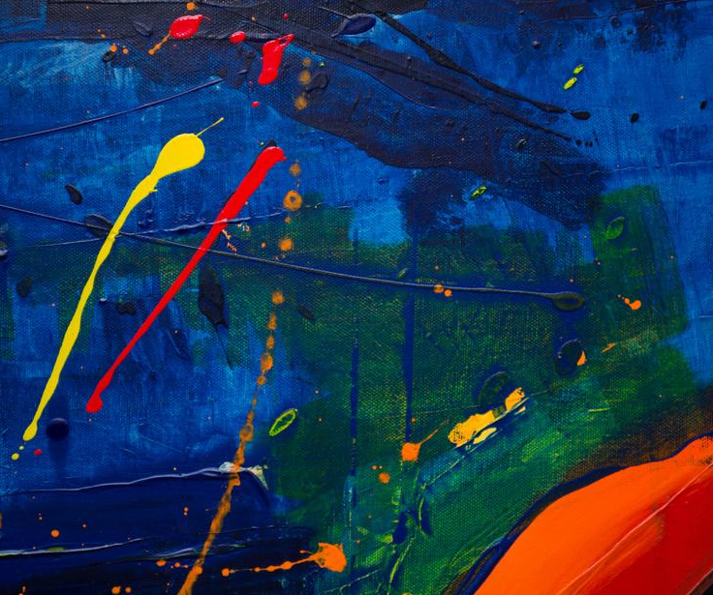
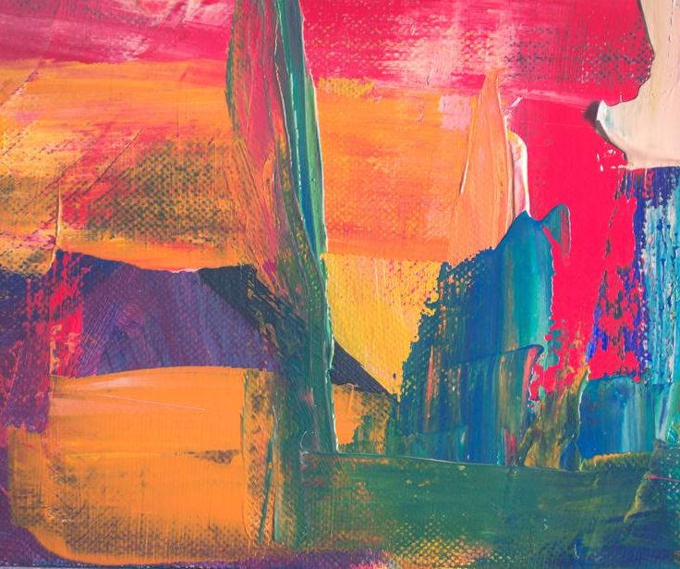
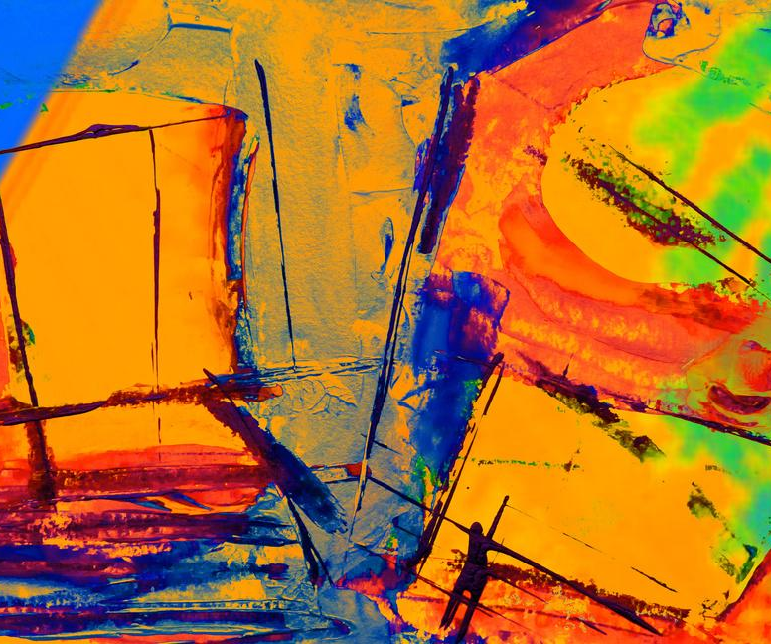
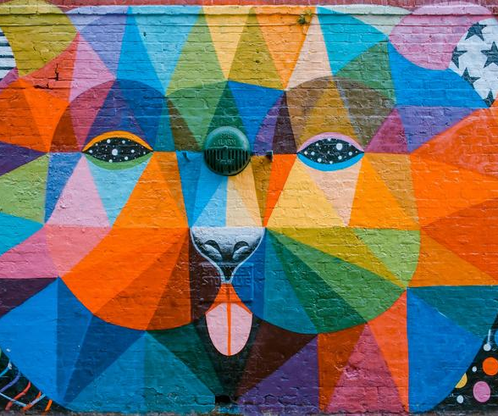
RENAISSANCE DESIGN:
ART MEETS SCIENCE
ADD A MAIN POINT
ADD A MAIN POINT
ADD A MAIN POINT
ADD A MAIN POINT
Briefly elaborate on what you want to discuss.
Briefly elaborate on what you want to discuss.
Briefly elaborate on what you want to discuss.
Briefly elaborate on what you want to discuss.
introduction
modernism
contemporary
conclusion
contact

Slide 3

MODERN GRAPHIC DESIGN
INDUSTRIAL REVOLUTION AND MODERNISM
Elaborate on what you want to discuss.
ART NOUVEAU
Elaborate on what you want to discuss.
CONSTRUCTIVISM
Elaborate on what you want to discuss.
DE STIJL AND MONDRIAN’S INFLUENCE
Elaborate on what you want to discuss.
introduction
modernism
contemporary
conclusion
contact

Slide 4


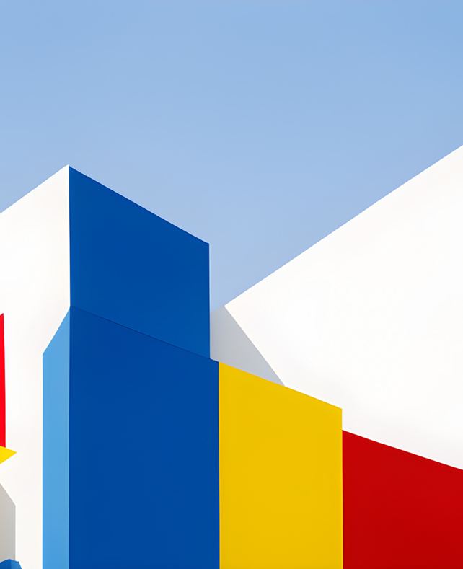

GALLERY IMAGE
What can you say about your projects? Share it here!
introduction
modernism
contemporary
conclusion
contact

Slide 5
TIMELINE
1990s
2000s
2020s
ADD A MAIN POINT
ADD A MAIN POINT
ADD A MAIN POINT
Presentation are communication tools that can be used as demonstrations, lectures, reports, and more.
Presentation are communication tools that can be used as demonstrations, lectures, reports, and more.
Presentation are communication tools that can be used as demonstrations, lectures, reports, and more.
introduction
modernism
contemporary
conclusion
contact

