Slide 1
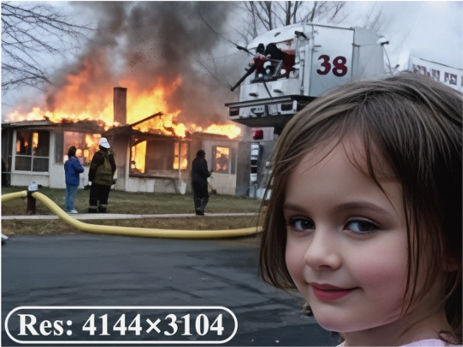
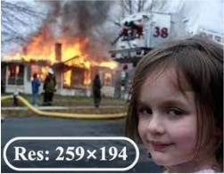
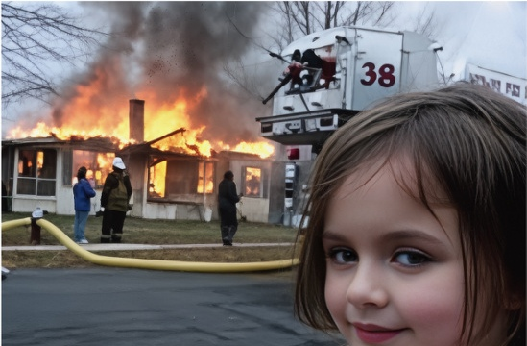

?
Profile Module
P
Perception Agent
R
Restoration Agent
4K
Task 1
Face
Stage 1: Image Analyzer
Execution
Rollback
VLM
Quality scores
if low quality
P
Preference
Profile
Reflection
Re-Plan
Stage 2: Degradation Reasoning & Task Planning
if SR
Face Restoration
A
Description
Task 2
Restoration Plan
⋮
Task K
Stage 1
Task 1 Super-Resolution
Task 2 Denoising
Task 3 Super-Resolution
Stage 1
CLIPIQA+:
0.6344
TOPIQ:
0.5907
Task 1 Super-Resolution
MUSIQ:
62.9828
Face Crop
Expert IQA
NIQE:
3.5966
Quality Scores
Execution
Q–MoE
Face Restoration
Stage 2
A
Description
Experience
Tool 1
Tool 2
Tool N
Tool 1
Tool 2
Tool N
"A young girl with long brown hair, … firefighting efforts."
…
…
VLM
Agenda
VLM
["DN", "SR", "SR"]
Distortion
["Noise", "LR", "LR"]
A
Description
Score-based Select for face
Quality Scores
"Noise"
+ "LR"×2
Distortions
Reflection
Score-base Select
Face Q–MoE
Upscaling Setting for 4K
High quality ?
Paste
Best Face from Tool 1
No
(0.927,
)
Restoration Plan
Rollback
Output
Tool 4
Super-Resolution
Denoising
Super-Resolution

Slide 2
