Slide 1
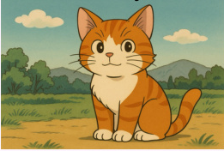
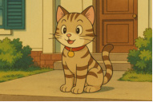
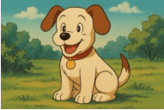

(A) Overall Pipeline
(C) Overall Training Process
Query
Candidate 1
Candidate 2
Candidate K
Stage 1: Self-Alignment for Pretraining ICM
Relationship Prompt Template:
LLM
...
According to <rel>, describe the
similarity, difference and any
potential relationship between the
pair in detail.
CE
Loss
T
q
...
...
...
...
...
T
c
Find an image with
a different animal
but the same style.
T
c1
T
c2
T
cK
ICM
Content Prompt Template:
CE
Loss
Information Compression Module (ICM)
Describe the content of <c> in detail.
t
con
t
rel
...
t
c1
t
c1
t
c2
t
c2
...
t
cK
t
cK
T
con
rel
con
rel
con
rel
Stage 2: SFT with Synthetic Dataset for Activation
q
Large Language Model
LLM
· (1): Retrieval result speculation
· (2): Quick verification for negative samples
(3): Refined verification for positive samples
(4): Retrieval result generation
SFT
<think> ... <inspection-index-start>2<inspection-index-end>
T
c2
... <inspection-
index-start>K<inspection-index-end>
T
... </think> <answer>2</answer>
Annotation
MLLM
cK
Synthetic
CoT Dataset
Stage 3: RL with Curriculum Reward for Enhancement
(B) Information Compression Module (ICM)
LLM
o
Reward Calculation
r
e
...
...
...
1
1
con
T
c
T
c
T
q
o
Format
Result
Efficiency
r
GRPO
2
2
...
...
ATT 1
ATT 2
...
ATT 1
o
G
r
G
t
con
R
q,c
e
con
t
rel
Rollout
Optimize
Reward

Slide 2
