Slide 1
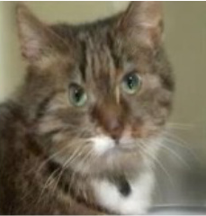
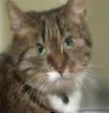
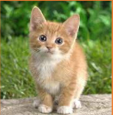
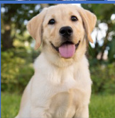
Rematching
Inference
g
Initial Matching
Param.
Pool P
t̂s
Classifier
g
Testing sample
ω
•••
θ
g
Pretrained hₚₜₘ
MLP
Rematching
Class ŷ
Direct
Task
ID t̂f
Task ID t̂s
Selected p
Yes
t̂f ≠ t̂s
No
Pretrained
h
ptm
pₜ̂s
pₜ̂f
Task-t training data
Classifier
g
Confidence-based
θ
g
d
T₁
T₂
T₃
Tₜ₋₁
Direct
Training
...
...
•••
Distribution d̃
W₁
W₂
Wₖ
top-K
Confidence E
{T₁, T₃, T₄ ... Tⱼ}
Old feature space
L
E < τ
CLMR
CTIRD
Yes
Param.
Pool P
t̂s=argmax E(x; pᵢ)
i ∈ Γ
•••
Wₜ
New feature space

Slide 2
