Slide 1
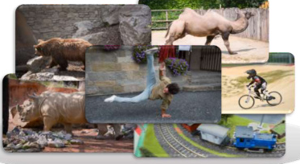






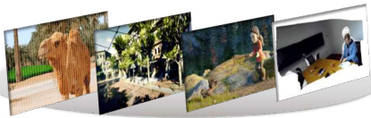



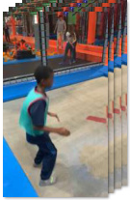
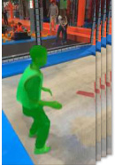
Stage 1 : Generating Metric-scale Camera, Video Depth, Object Category, Object Mask and Size
Raw Data Collection
Powerful Foundation Models
Data Filter Strategy
Dynamic Bundle Adjustment
1
Proximal Depth Verification
Dynamic Masking
2
Dynamic Object Coverage
UniDepth-V2
SegAnyMo
3
Focal-Length Stability
Coarse Camera Initialization
4
Random
forest
Video Blur Degree
Raw 2D video datasets with GT
instance mask & semantic label
5
Camera Motion Smoothness
Static Area
Bundle Adjustment
UniMatch
CoTracker-V3
6
VLM Judgement
Moving Object Recovery
Non-Rigid
Bundle Adjustment
SAM2 & Variants
VGGT
1
VLM-based object recognition
2
Semantic-based Segmentation
Sliding Window
Global Refinement
Raw dynamic 3D datasets
with GT camera & depth
3
Physical-aware Size Extraction
Epipolar Errors
Language Models
Stage 2 : Generating Fine-grained Captions For Moving Objects, Cameras and Dynamic Scenes
Moving Object Caption
S
Dynamic Scene Caption
S
Camera Motion Caption
Prompt: Given the <raw video> ▣, <moving instance mask> ▨ and
<instance label> T. Provide a description of the moving instance.
Focus on its action and attributes (e.g., color, shape, material).
Prompt: Given the <raw video> ▣, <moving instance masks> ▨, <instance label> T
and <moving instance caption> ▤. Provide a description of the dynamic scene.
Focus on the scene type, instance-scene interaction, instance's motion pattern, etc.
Prompt: Given the <raw video> ▣,
<instance label> T, <moving instance
caption> ▤, and <dynamic scene
caption> ▤. Provide a description of
the camera motion.
Response (object-level)
S
Response (scene-level)
<think> Alright, let's break down the attributes step by
step: First, observe the boy's action: stand, crouch, ... .
Then, see the boy's attire: light green shirt, ... . Next,
note the shape and movement: agile, ... . Then, consider
the material of the clothing: lightweight, ... . Finally,
take into account the setting and the boy's engagement:
indoor trampoline park, ... . </think>. <answer> {...}</answer>
S
<think> Alright, let's break down the attributes step by step:
First, identify the scene type: an indoor trampoline park, ... .
Then, note the primary interactive entities: a young boy, ... .
Next, observe the instance's motion patterns: jumps, spins, ...
Then consider the static background components: Padded
Walls, ... . Finally, take into account the spatial relationships and
interactions among different moving instances and the scene: the
boy actively interacts on the trampoline by jumping and
performing various acrobatic actions. </think>. <answer> {...}</answer>
Response
S
Raw Videos
<answer> {
The camera smoothly
pans right, tracking the
subject from the side with
minimal shaking.
} </answer>
LLM-rephrased
<answer> {
A young boy in a vibrant green vest with red
trim and dark pants performs a dynamic sequence.
Beginning in profile, they turn, extending arms and
balancing on ready legs. Fluidly shifting from
standing to a focused crouch, their movements
display agility and control. The energetic sequence
concludes with them seated, relaxed yet purposeful,
embodying athleticism and grace throughout the
transitions.
} </answer>
LLM-rephrased
<answer> {
Inside a vibrant indoor trampoline park, a young boy in a
turquoise shirt dynamically jumps, spins, and flips. Brightly lit,
the park features multiple trampolines with blue padding and
colorful play structures like orange and red climbing frames.
Other children in white and pink shirts enjoy the lively,
energetic atmosphere as the boy's joyful acrobatics highlight
the scene's playful activity and vibrant setting.
} </answer>
LLM-aligned
<answer> {
The camera smoothly pans
right, tracking the young boy
in the indoor trampoline
park with minimal shaking.
} </answer>
Instance Masks
“A Young Boy”
T
Instance Label

Slide 2
