Slide 1



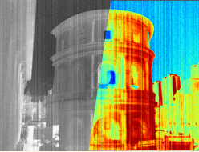


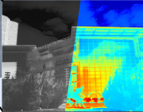


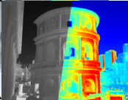






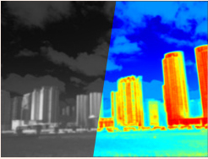


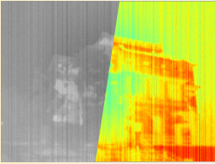


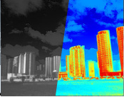


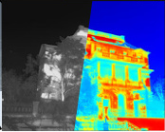






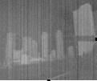
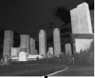
(a) Infrared Degradation Processing
Low Contrast
Noise
Contrast Degradation
Gaussian
Standard
Random
Blur
Mixture
k = 3
k = 5
k = 7
Gaussian Blur
Sequential Blending
(b) Dual Prompt Processing
(c) IR Multi-Degradation Restoration Network
(d) SPT
Degradation Descriptor
TP
S
0
0
0
0
0
1
Iter.1
Nθ
≪
N
Type/Degradation-specific
Prompts
H
0
0
0
0
1
0
Nθ
B
Update
⋮
Degraded
Inf. Image
Restored
Inf. Image
Nθ
C
1×1×64
Prompt Fusion
Iterative
Iter.2
γ
β
N
Iter.3
B
0
0
0
0
0
1
IR Block
Iter.n
Nθ
N
C
0
0
0
0
1
0
⋮
Nθ
B
Update
Nθ
≪
C
DSP
Selective Progressive Training(SPT)
S
Single Degraded
H
Hybrid Degraded
N
Noise
B
Blur
C
Contrast
DSP:
Degradation-specific Prompts
TP:
Type Prompt
FP
BP
Parameter update

Slide 2
