Slide 1

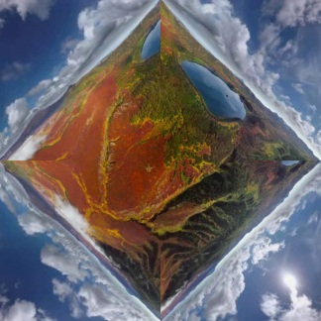







CubeMap
project
F
r
→
r*
project
U
L
F
U
F
B
D
R
F
D
L
B
F
√2 a
a
U
R
B
U
Equirectangular Map
remap
ViewPoint Map
add noise
Pano Attention
Perspective Attention
Input
L
concat
L
Attn
Block
F
Attn
Block
F
B
R
B
Projected Input Perspective Video
R
× N
Output
Mask
Prompt

Slide 2
