Slide 1
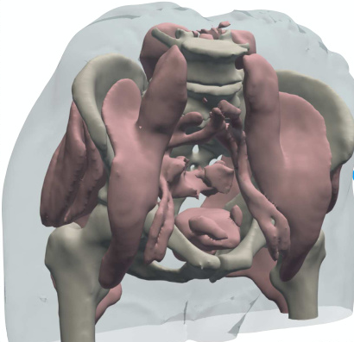
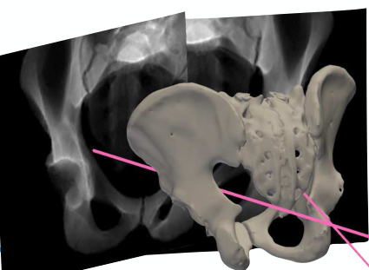
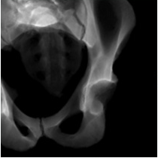
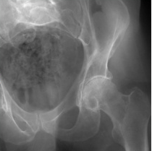
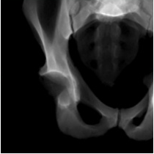
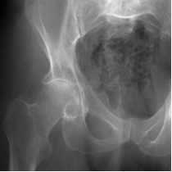
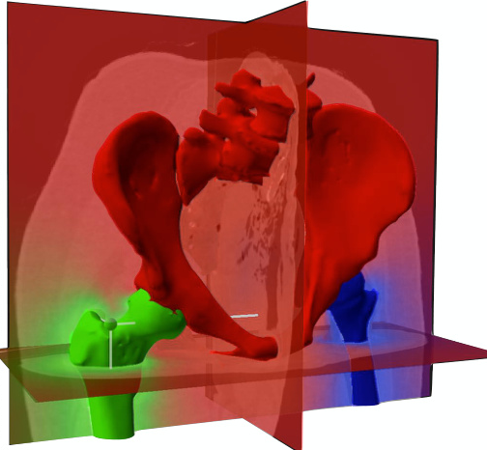
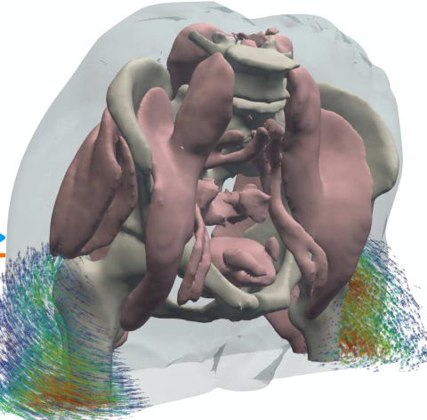
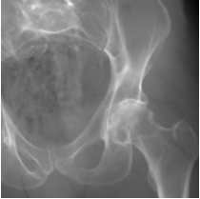
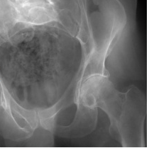
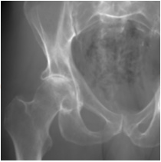
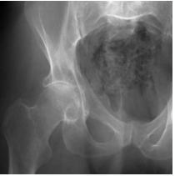
(A) Stage 1: Estimate the pose (Π̂) of each X-ray image
Operation flow
Gradient flow
Rendered X-ray
Real X-ray
𝒫(Π̂₁)
ℒ
Diff. X-ray
renderer
Eq. (3)
𝒫(Π̂₂)
ℒ
Diff. X-ray
Extract structure
renderer
Eq. (3)
S_{anchor} ⊙ V
Π̂₂
Preoperative CT (V)
Π̂₁
(B) Stage 2: Optimize structure-specific poses
(
)
to estimate the polyrigid deformation field (Φ)
𝒫
Projection operator
ξ̂
Articulated poses
ℒ
Image loss function
Π
Camera matrix
ξ̂
Rendered X-ray
Real X-ray
log(ξ̂₁)
log(ξ̂₂)
𝒫(Π̂₁)
ℒ
log(ξ̂₃)
Diff. X-ray
renderer
Eq. (7)
Eq. (3)
exp(Wξ̂)
𝒫(Π̂₂)
ℒ
0.24
Diff. X-ray
renderer
Eq. (7)
0.75
Eq. (3)
0.01
Precompute weight field W
W(x)
Sample deformation field Φ and warp V
Eq. (6)
Eq. (4)

Slide 2
