Slide 1
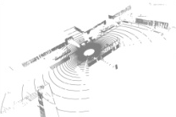
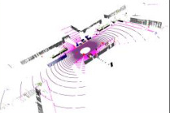
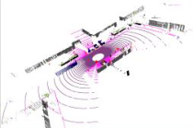
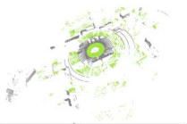
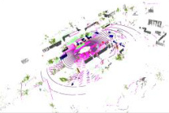


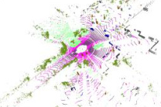

Source Domain
Additional Structural Priors
ℰ
𝒟
L^{s}
1
2
3
1
2
3
L_{permutation}
stu
stu
4
5
6
4
5
6
Permutation
Invariance Prior
x^{s}
f_{stu}(x^{s})
y^{s}
7
8
9
7
8
9
Shared
Shared
Hilbert curves
Z-order curves
Mixed Domain
1
2
4
3
5
7
6
8
9
1
4
7
2
5
8
3
6
9
z
y
1
2
3
L_{local}
1
2
3
ℰ
𝒟
L_{mix}
4
5
6
x
4
5
6
stu
stu
Local
Consistency Prior
7
8
9
7
8
9
y
x^{mix}
Feature F
f_{stu}(x^{mix})
y^{mix}
Rectangular Partition
z
x
EMA
update
EMA
update
Cylindrical Partition
1
2
3
4
5
6
7
8
9
5
4
2
6
8
1
3
9
7
Target Domain
1
2
3
1
2
L_{geometric}
ℰ
𝒟
L^{t}
4
5
6
5
6
Geometric
Consistency Prior
tea
tea
τ
7
8
9
7
9
High Density
Low Density
Input
x^{t}
Prediction
f_{tea}(x^{t})
(Pseudo) Label
ŷ^{t}
1
2
3
4
5
6
7
8
9
1
2
5
6
7
9

Slide 2
