Slide 1
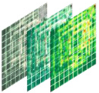









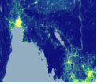
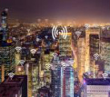
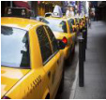
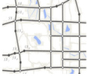
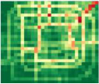
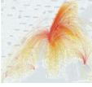





Output
Frequency pattern
Reshape
Temporal pattern
ST
Data
⋮
Spatial pattern
Data
memory
Data-driven prompt
Urban Diffusion Transformer
Different
data types
Sequential
format
Concat
Attention
Mask
Task
memory
Spatio-temporal
patching
Embedding
layer
Task-specific prompt
(d) Unified Prompt Learning
Noisy
ST data
Timestep
Multiple Domains
Multiple Cities
t
(a) Datasets
(b) Urban Diffusion Transformer
(c) Masking Strategies

Slide 2
