Slide 1
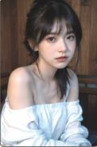
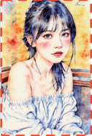









In-context Editing Framework based on T2I DiT
Edit by
In-context
Generation
LoRA-MoE Module
T2I Diffusion Transformer
+
Inversion × N
Inverted Noise
Base Layer
Decoder
••
Source Image
Feature
Injection
Denoising × N
N×
…
+
+
concat
T2I Diffusion Transformer
×
Expert 1
Expert 2
Expert 3
Expert N
Out Projection
✓
Inverted
Noise
Random
Noise
TopK=1
×
×
crop
×
MLP
MM Attention
“ A diptych with two side-by-side images of the same scene.
Route
On the right, the scene is the same as on the left, but
Generated
Target Image
{make the man grab a basketball}. ”
Norm & Mod
In-context Editing Framework based on Inpainting DiT
+
concat
: Trainable Parameter
Text Encoder
Image Encoder
: Frozen Parameter
mask
Inpainting DiT
••
concat
crop
Image
Mask
Noise
: Standard LoRA Tuning
Noise
“ A diptych with ...
but {what if it
looks like water
color painting?}”
: LoRA-MoE Tuning
Image with Mask
: LoRA Adapter
Source Image
“A diptych with ... ... but
Target
Image
{make her hold a red can}. ”
(a) Training-free Structure of ICEdit
(b) Finetuning Strategy for ICEdit

Slide 2
