Slide 1
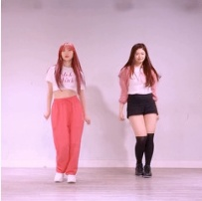
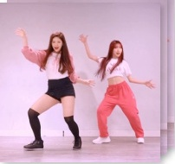
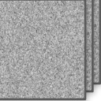
ReferenceNet
Pose
Enc
Spatial-Attn
Cross-Attn
Temporal-Attn
Ref Pose
VAE
Enc
Intermediate Feature
Gradient from C⁽ˡ⁾
IMG Construction
(Training only)
CLIP
Ref Img
Selected for MSM
DenoisingNet
Pose
Enc
VAE
Dec
Tgt Pose
Noise
Gen Frames
Mask
C⁽¹⁾
C⁽ᴺ⁾
xT
xT

Slide 2
