Slide 1
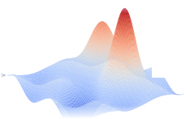
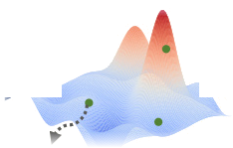
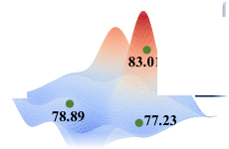
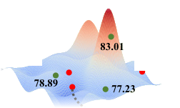
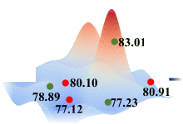
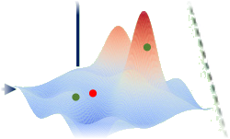
(a) The whole process of evolutionary multi-view classification
1
Initialize
population
2
Fitness
evaluation
3
Offspring
generation
Crossover
4
Fitness
evaluation
5
Selection
Fusion operator set
Mutation
View set
Search space
Individual
Pₜ
New individual
New population Pₜ₊₁
(b) Unbiased fitness evaluation
❄ Parameter freeze
Distillation loss
Evolutionary navigator
of the view⁽ᵛ⁾
View⁽¹⁾
FC
FC
Corresponding
category
Lₜ⁽¹⁾
Pre-training process
Evolutionary
navigator set
LENL⁽¹⁾
FC
Cross-category
Lwd⁽¹⁾
View⁽ᵛ⁾
FC
Search
View⁽¹⁾
FC
FC
Fusion
operator
Cross-entropy loss
Feature
vector
LCE
LWDOLF
FC
Softmax
LCE
Softmax
Evolutionary
navigators of
individual
Label
Guide
View⁽²⁾
FC
FC
Corresponding
category
Evolutionary navigator
Lₜ⁽²⁾
FC
Dimensions of fused views
Decode
LENL⁽²⁾
View⁽²⁾
FC
FC
Cross-category
FC
Dimensions of the number of
category
Individual
Encode
Lwd⁽²⁾
❄ Parameter freeze
Distillation loss

Slide 2
