Slide 1
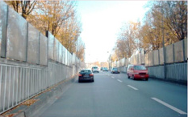
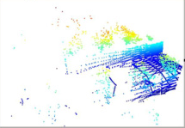
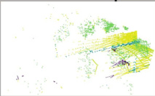
(a) Construction of Object Agent Queries
(b) Dual-queries Consistency Scheme
Pre-trained
Encoder
Add Noise
...
Object Agent Queries
t
Diffusion
Model
❄
SVD
k
k
k
k
}
}
}
}
❄
Latent z₀
t′
r
r
r
r
Source Image
c
Aggregating Instance Semantic
c
c
c
c
...
Quantized Object Agent Queries
...
Learnable Queries
...
...
...
2D Object Agent Queries
...
ℒconsist
...
2D Auxiliary Object Agent Queries
Dual-queries
Design
qᵢₙₛ
q′ᵢₙₛ
MLP
3D Object Agent Queries
Principal Component Extraction
qᵢₙₛ_ₚc
q′ᵢₙₛ_ₚc
Paired
...
Cross-modal Semantic Alignment
Linear
Linear
q̂₃ᴅ
q₃ᴅ
...
×
S
×
MLP
...
Aggregating Instance Semantic
Feature
Refinement
...
Feature
Refinement
Conv
ℒseg
Layer 1
Layer L
Decoder
...
Share
Weight
ℒ¹ₛᵤₚ
Share
Weight
ℒˢₛᵤₚ
Label
Backbone
Feature
Refinement
Feature
Refinement
Source Point Cloud
(c) Cross-modal Semantic Enhancement

Slide 2
