Slide 1



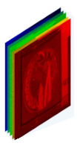
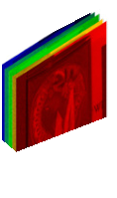
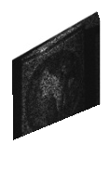
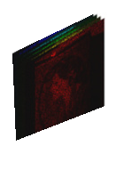
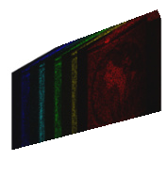
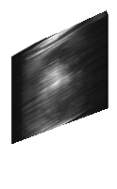




(a)
y
y
y
C
Concatenate
ℰ(·)
ℰ(·)
ℰ(·)
·
Element-wise multiplication
w⁽1⁾
w⁽2⁾
w⁽K⁾
Initialization
Σ⁽1⁾
Σ⁽2⁾
Σ⁽K⁾
proj(·)
proxᴿ(·)
proj(·)
proxᴿ(·)
proj(·)
proxᴿ(·)
Matrix multiplication
· · ·
z⁽1⁾
z⁽2⁾
z⁽K⁾
Σ
Weighted-Sum
y
·
H
(y, H)
(y, H)
(y, H)
Down- sample
Down
(c)
(b)
C
M′
X′
X″
Y
Up- sample
C×H×W
C×H×W
Up
Conv3x3
Conv3x3
Dispersion
Imaging
LayerNorm
LN
C×H×W
C×H×W
Spa-LWSA
C
Fusion
Spec-TKSA
Chromaticity
Mask
Modulated HSI
Dispersed HSI
Measurement
Convolution 1×1
1x1
C×H×W
C×H×W
Down
C×H×W
Up
(d)
2C×H⁄2×W⁄2
2C×H⁄2×W⁄2
C×HW
C×C
Spa-LWSA
C
Fusion
Spec-TKSA
1x1
Q
2C×H⁄2×W⁄2
Mask
Softmax
Down
2C×H⁄2×W⁄2
Up
LN
1x1
K
C×HW
· · ·
C×H×W
4C×H⁄4×W⁄4
4C×H⁄4×W⁄4
C×HW
Spa-LWSA
1x1
V
Σ
1x1
C×H×W

Slide 2
