Slide 1
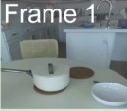
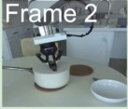
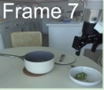
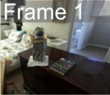
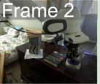
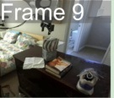
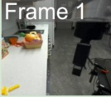
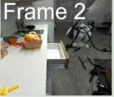
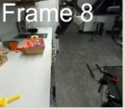
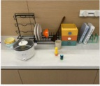
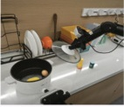
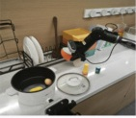
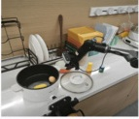
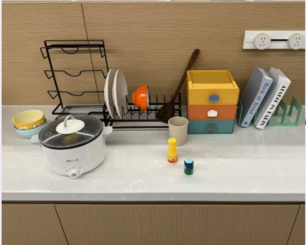
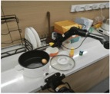
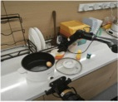
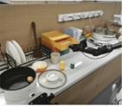
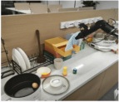
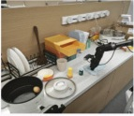
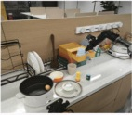
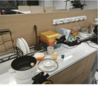
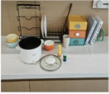
(a) Keyframe Extraction
(b) Atomic Domain Generation
(c) Domain Fusion
Frame 1
Frame 2
Frame 7
Domain Construction
& Revision
Unified Domain
…
:predicates (…)
:actions …
Atomic
Domain
Atomic
Domain
…
Atomic
Domain
Atomic
Domain
:precondition (…)
:effect (…)
DROID
Dataset
Frame 1
Frame 2
Frame 9
Learning
…
Solvability
Check
Meta
Domain
Meta
Domain
Feedback
Closed-Loop
Refinement
…
⋮
Frame 1
Frame 2
Frame 8
Solution
Verification
Feedback
:predicates (…)
…
:actions …
Meta
Domain
:precondition (…)
:effect (…)
Move the corn from the pot
into the orange bowl, wipe the
table with the towel in the
drawer and put it back to the
closed drawer.
(d) Problem Generation
(e) Planning
(f) Execution
Meta
Domain
Predicate
Grouping
PDDL
Solver
Planning
remove_lid
Predicate
& Operator Filtering
(lid)
pick_from_rack
(bowl)
place_on_table
(bowl)
…
wipe_table
Problem
Generation
(towel)
:objects (…)
place_in_drawer
(towel)
:init …
:goal (…)
close_drawer
(drawer)

Slide 2
