Slide 1

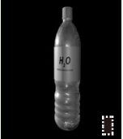


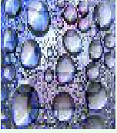
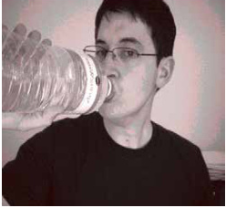


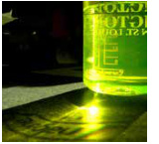


Sample Selection
Explore the effect of triggers on sample selection
via the enhancement of attack success rate and stealthiness.
Component A
attack success rate
Component B
stealthiness
highlight
enhancement
enhancement
large trigger scale
Category Diversity (ours)
Trigger ▮ can be
concealed in the
black background.
Cancel trigger
Find the appropriate combination
our method
features on
based on the scale of trigger features 🦠.
images by
Trigger 😺 can be
similarity
Forgetting Events (traditional)
concealed in the
calculation.
small trigger scale
complexly texture
highlight
background.
attack success rate
the scale of triggers
trigger features
stealthiness
enhancement
ensurement
Triggers
Explore the effect of sample selection on triggers.
Component C
Stealthiness ensurement via avoid selecting single-color dominated samples.
G
Distinct sensitivity of human visual system on RGB
Enhance the trigger feature
mild distortion
severe distortion
subtle distortion
Special samples
R
Green
Blue
on the Blue color channel.
dominated
dominated
low sensitivity
distinct-color
poisoning
B
R
G
B

Slide 2
