Slide 1
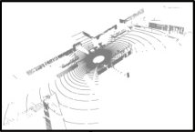
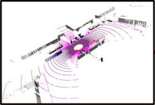
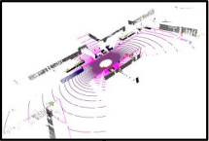
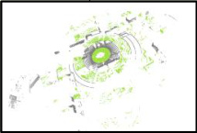
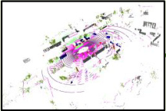
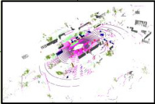
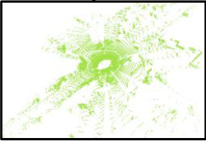
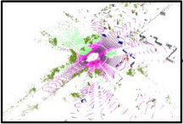
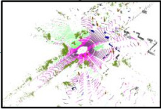
Source Domain
Additional Structural Priors
L_s
1
2
3
1
2
3
Eₛₜᵤ
Dₛₜᵤ
L_permutation
4
5
6
4
5
6
7
8
Permutation
9
7
8
9
xˢ
Invariance Prior
fₛₜᵤ(xˢ)
yˢ
Shared
Shared
Hilbert curves
Z-order curves
Mixed Domain
1
2
4
3
5
7
6
8
9
1
4
7
2
5
8
3
6
9
y
1
2
3
1
2
3
L_local
L_mix
4
5
6
4
5
6
Eₛₜᵤ
Dₛₜᵤ
Local
7
8
9
7
8
9
Consistency Prior
xᵐⁱˣ
fₛₜᵤ(xᵐⁱˣ)
yᵐⁱˣ
Rectangular Partition
x
EMA
EMA
Cylindrical Partition
1
2
3
4
5
6
7
8
9
5
z
update
update
4
2
6
8
1
3
9
7
Target Domain
1
2
3
1
2
4
5
6
L_geometric
5
6
L_t
Eₜₑₐ
Dₜₑₐ
tau
7
8
9
Geometric
7
9
Consistency Prior
Input xᵗ
High Density
Low Density
Prediction
(Pseudo) Label
1
2
3
4
5
6
7
8
9
1
2
5
6
7
9
fₜₑₐ(xᵗ)
ŷᵗ

Slide 2
